Slide 1
Toward Workload Aware State Management in Streaming Systems
Showan Esmail Asyabi

Slide 2
State Managers in Streaming Systems
The long-running nature of streaming computations often requires maintaining larger-than-memory state.
Our preliminary results indicate that streaming operators often access the state multiple times per incoming event.
State managers play a vital role in determining the performance of streaming systems.
2

Slide 3
Research Problem
Current streaming systems use out-of-the-box stores such RocksDB
It has been shown that out-of-the-box stores notably hampers the performance of streaming systems
Current benchmarks such as YSCB cannot faithfully represent the characteristics of state workload
System designers have to integrate alternative KV stores with the streaming engine
System designers might have to instrument the streaming system to characterize the state workload
3

Slide 4
Our methodology
We Conduct a comprehensive analysis to characterize streaming workloads
We Design and build a system to accurately and quickly evaluate existing and novel stores for streaming systems
We Design and Build a KV store tailored for streamings systems requirements
4

Slide 5
State workload Characterization
Read&Write Ratio
Temporal locality
Key popularity
Key space and Working set size
Event Amplification
Operation Sequence
Google Borg Cluster Traces
Characteristics
Tumbling Windows
Sliding Windows
Join windows
Session windows
Continuous Join
Continuous Aggregation
Applications
KV Store
5

Slide 6
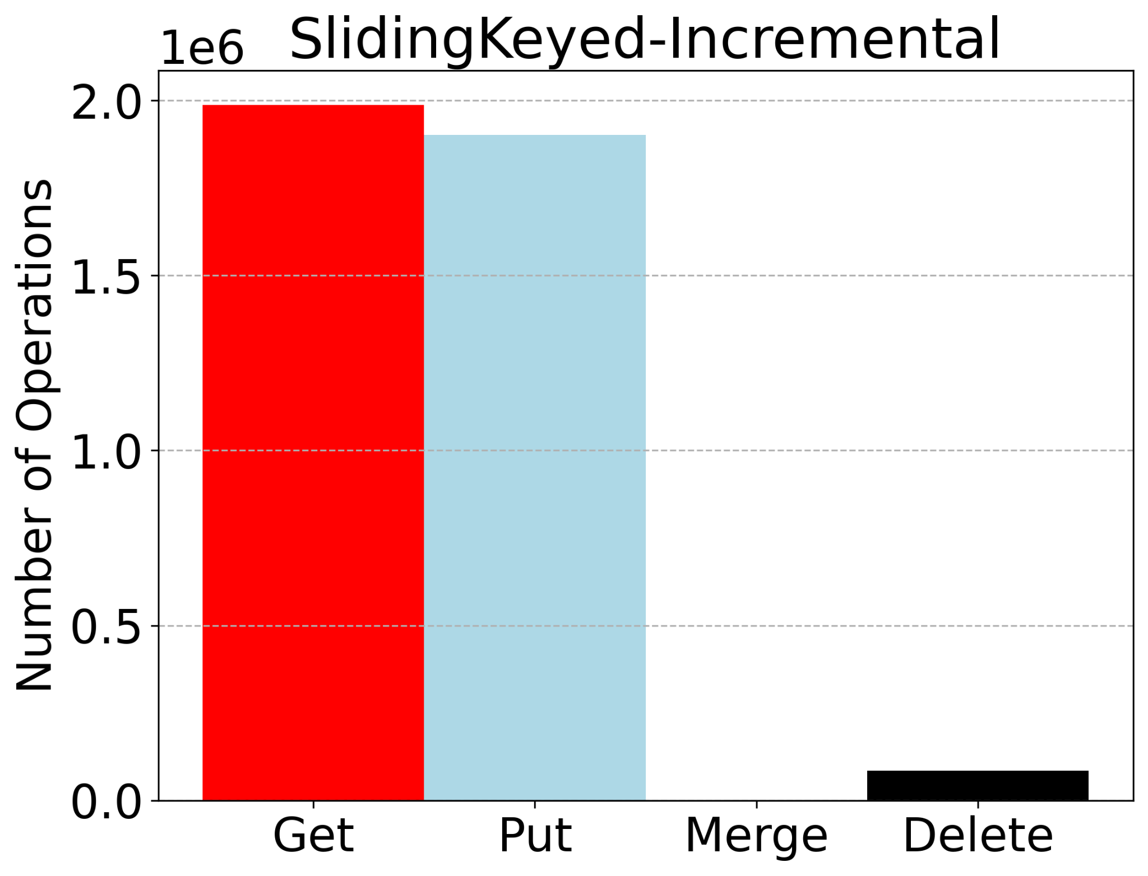
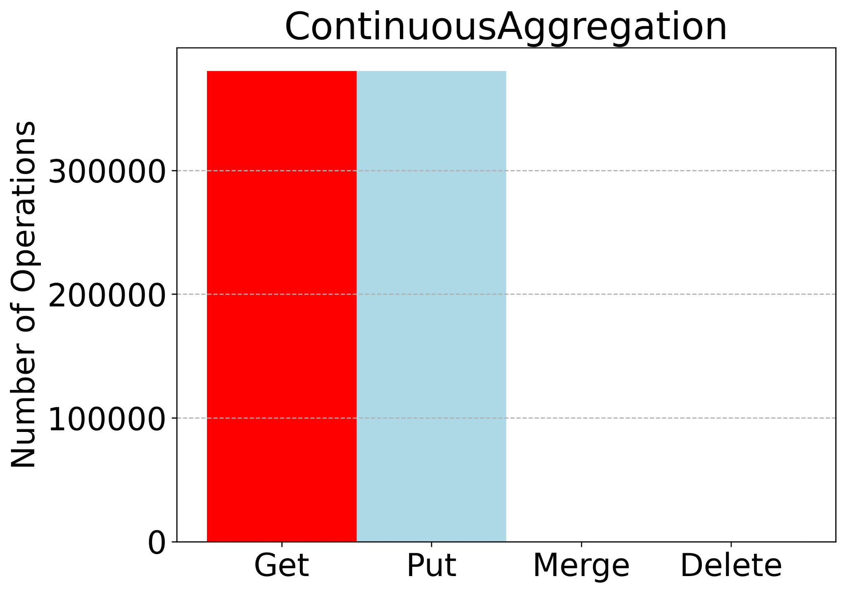
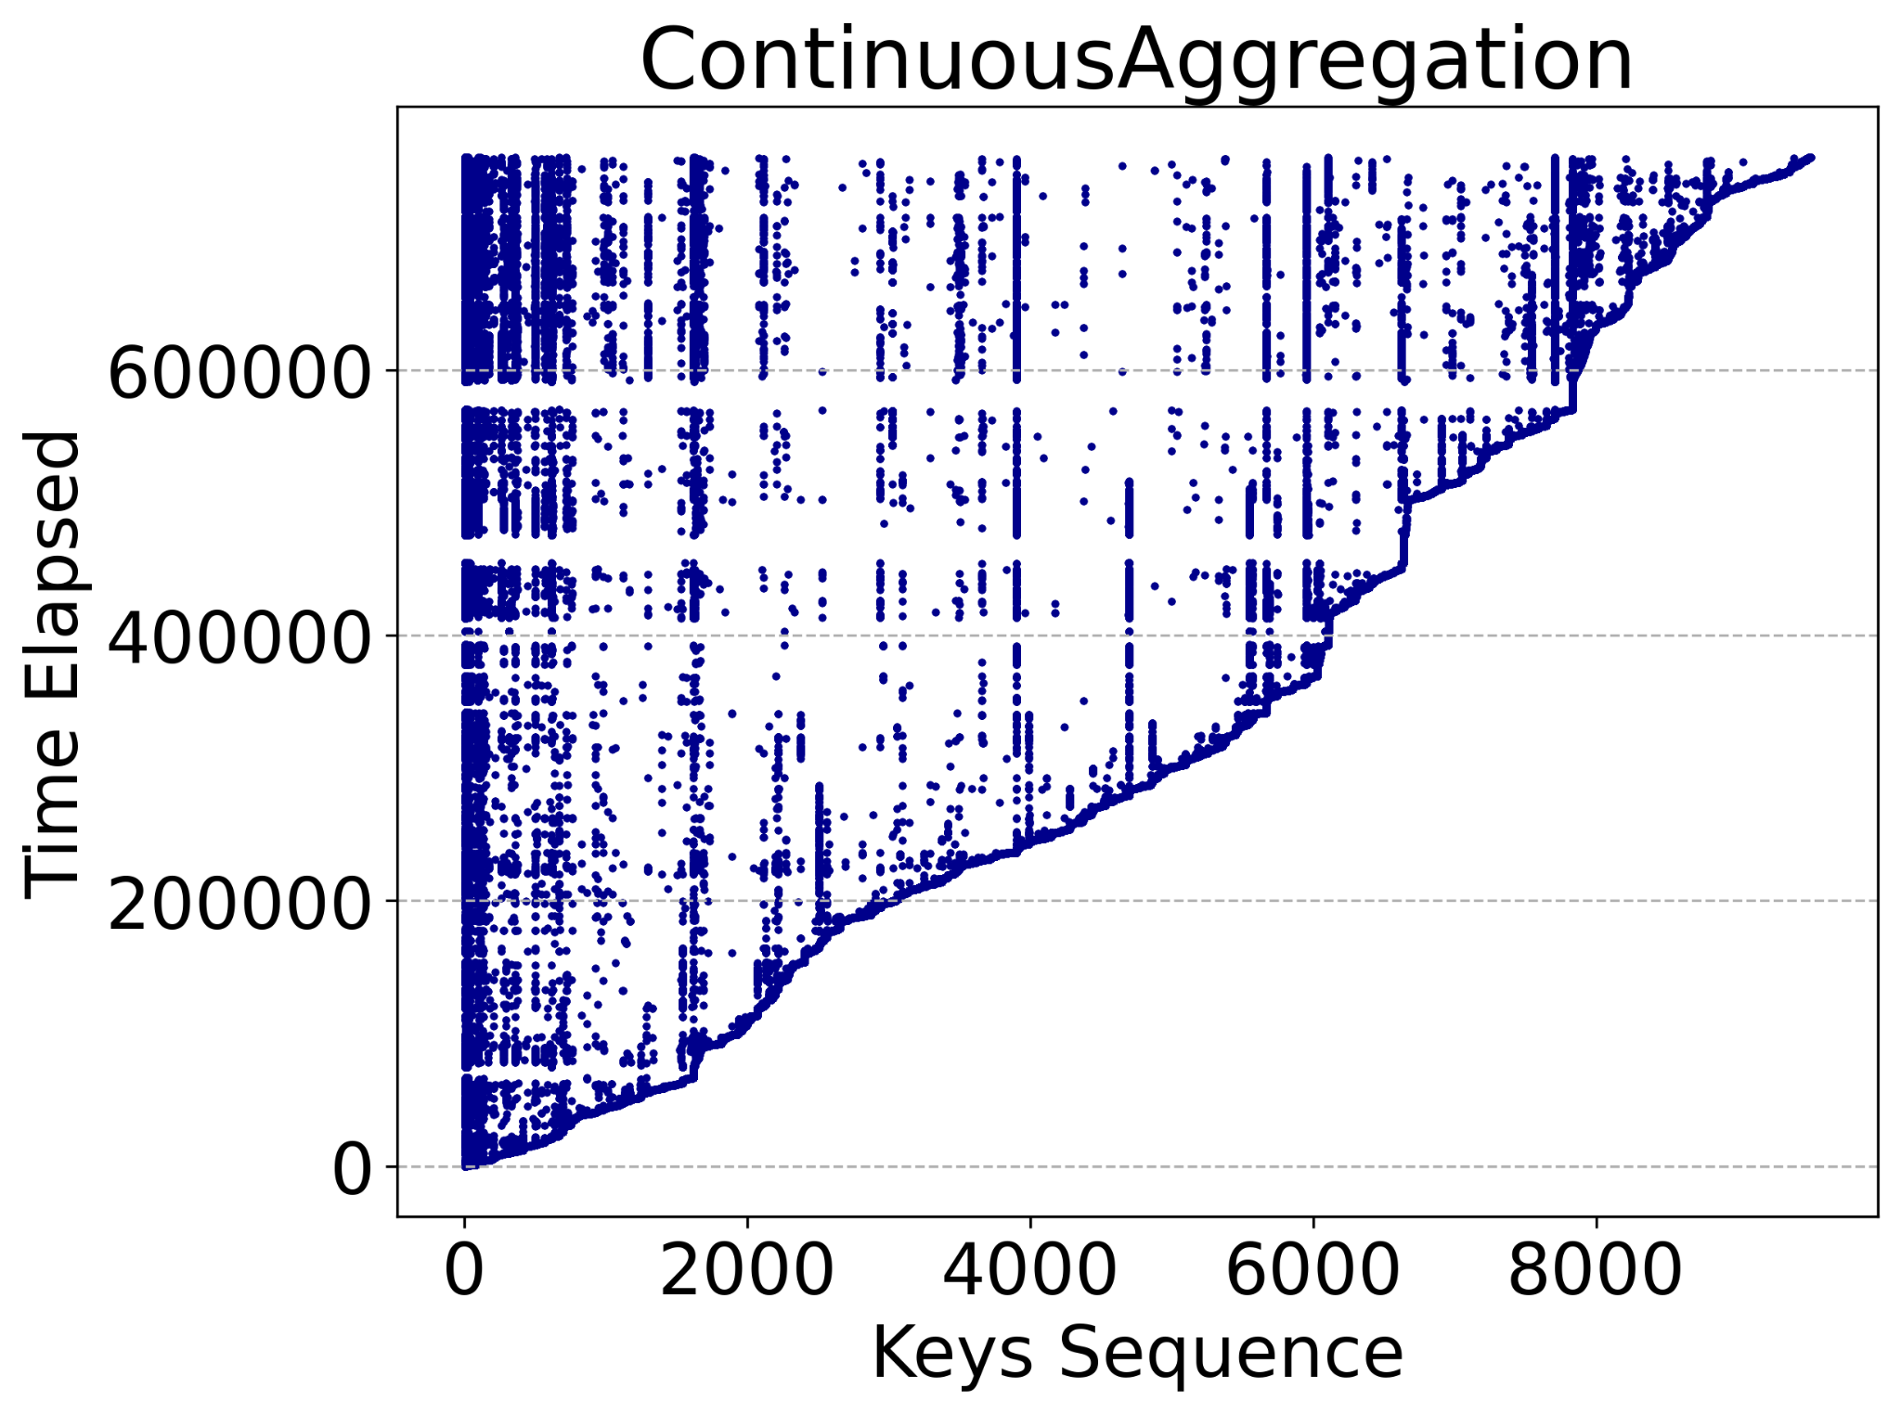
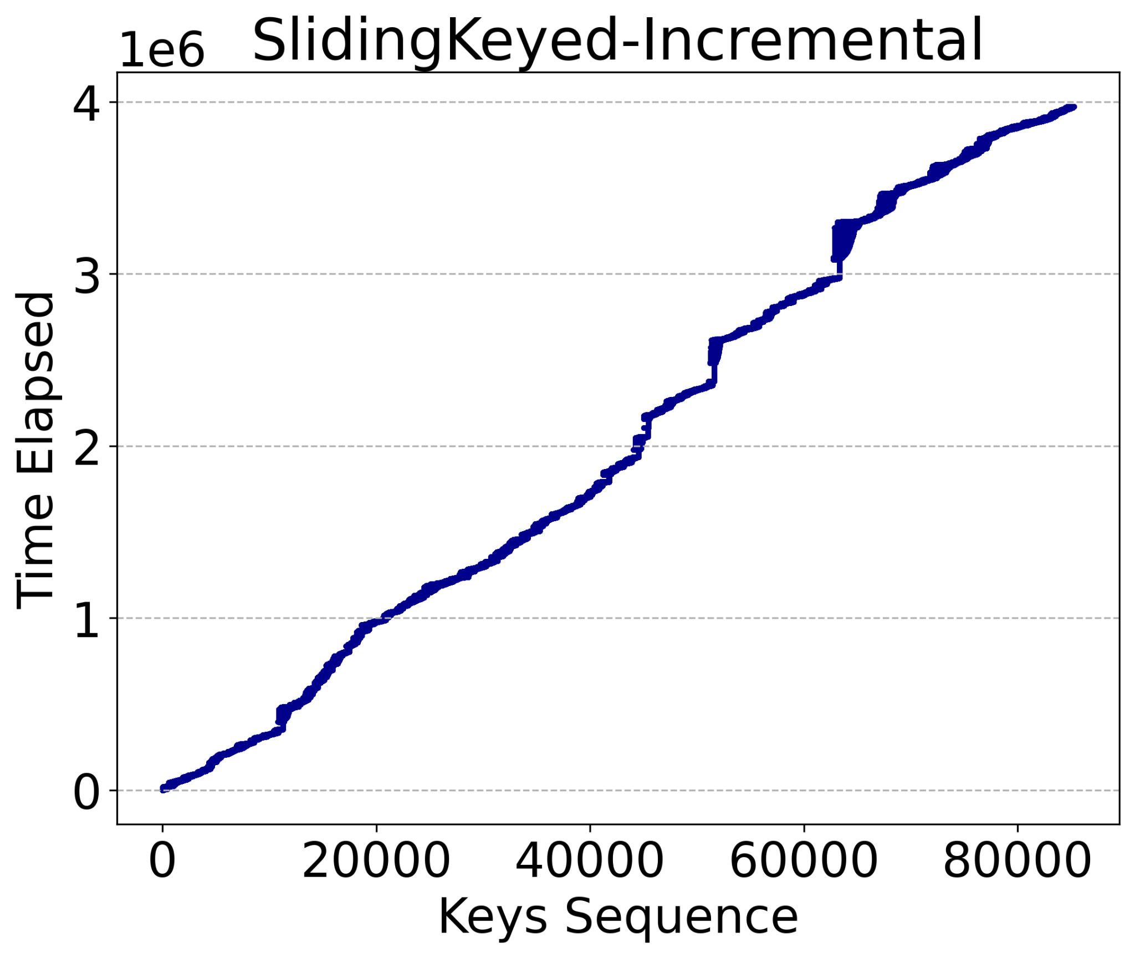
Read&Write Ratio
Temporal Locality
State workload Characterization
High Temporal locality
Key space and Working set size
Event Amplification
Operation Sequence
YCSB is not able to generate state access workloads
6
Notes:
hi

Slide 7
Gadget : A benchmarking system for accurate and fast evaluation of state managers in streaming systems
Gadget Driver
Event Generator
Window assigner
State access generator
Evaluator
7

Slide 8
Gadget - Event Generator
Events: Each events has four properties: Event Time, Arrival Time, Key and Type
Key (Zipf- ECDF- Uniform ...)
Out of order events
Arrival Time
ƛ
Arrival Rate
3.6
2.3
1.5
0.5
2.4
1.4
0.6
0.4
2.4
1.4
0.6
0.4
ƛ
Event Rate
3
2
1
Evaluator
State Access Generator
Event Time
Window Management
2.4
1.4
0.6
0.4
3
2
1
Out of order events
8

Slide 9
Gadget - Window Manager
Gadget Window Types:Tumbling windows, Sliding window, Session windows ...
Gadget Window Properties: Start Time- Finish Time, Window Key, Window Length, Sliding Length , and Session Gap
WindowKey: wKey1
windowKey: wKey2
WindowKey: wKey3
0
5
10
Window Start Time = Floor (EventTime/ Window Length ) * Window Length
Window Finish Time= Window Finish Time + window StartTime
Event Generator
Evaluator
Time 1
State Access Generator
Key1
Time 2
Key3
Expiring Window Dictionary
Active Window Dictionary
.
.
.
.
.
..
.
..
Time n
Key n
9

Slide 10
Gadget - Sate Access Generator
Gadget state machines generates corresponding state access of each event
Gadget Compuaton Types: Incremental and Holistic
K
Get
Put
Get
Del
State machine for incremental computation
Event Generator
Evaluator
Window Manager
K
Merge
Get
Del
State machine for Holistic computation
10

Slide 11
K
Get
Put
Get
Del

Slide 12
Gadget Architecture
Gadget Driver
operation
Push Operations
events
Operate state Machine
Set State
Do Experiment
Expiring Windows
Active Windows
Event Generator
State Access Generator
Evaluator
RocksDB
Window management
3.6
2.3
1.5
0.5
K
Keys
Faster
Val
2.4
1.4
0.6
0.4
.
.
Opr
.
..
K
BerkeleyDB
K
LetheDB
.
.
.
..
11

Slide 13
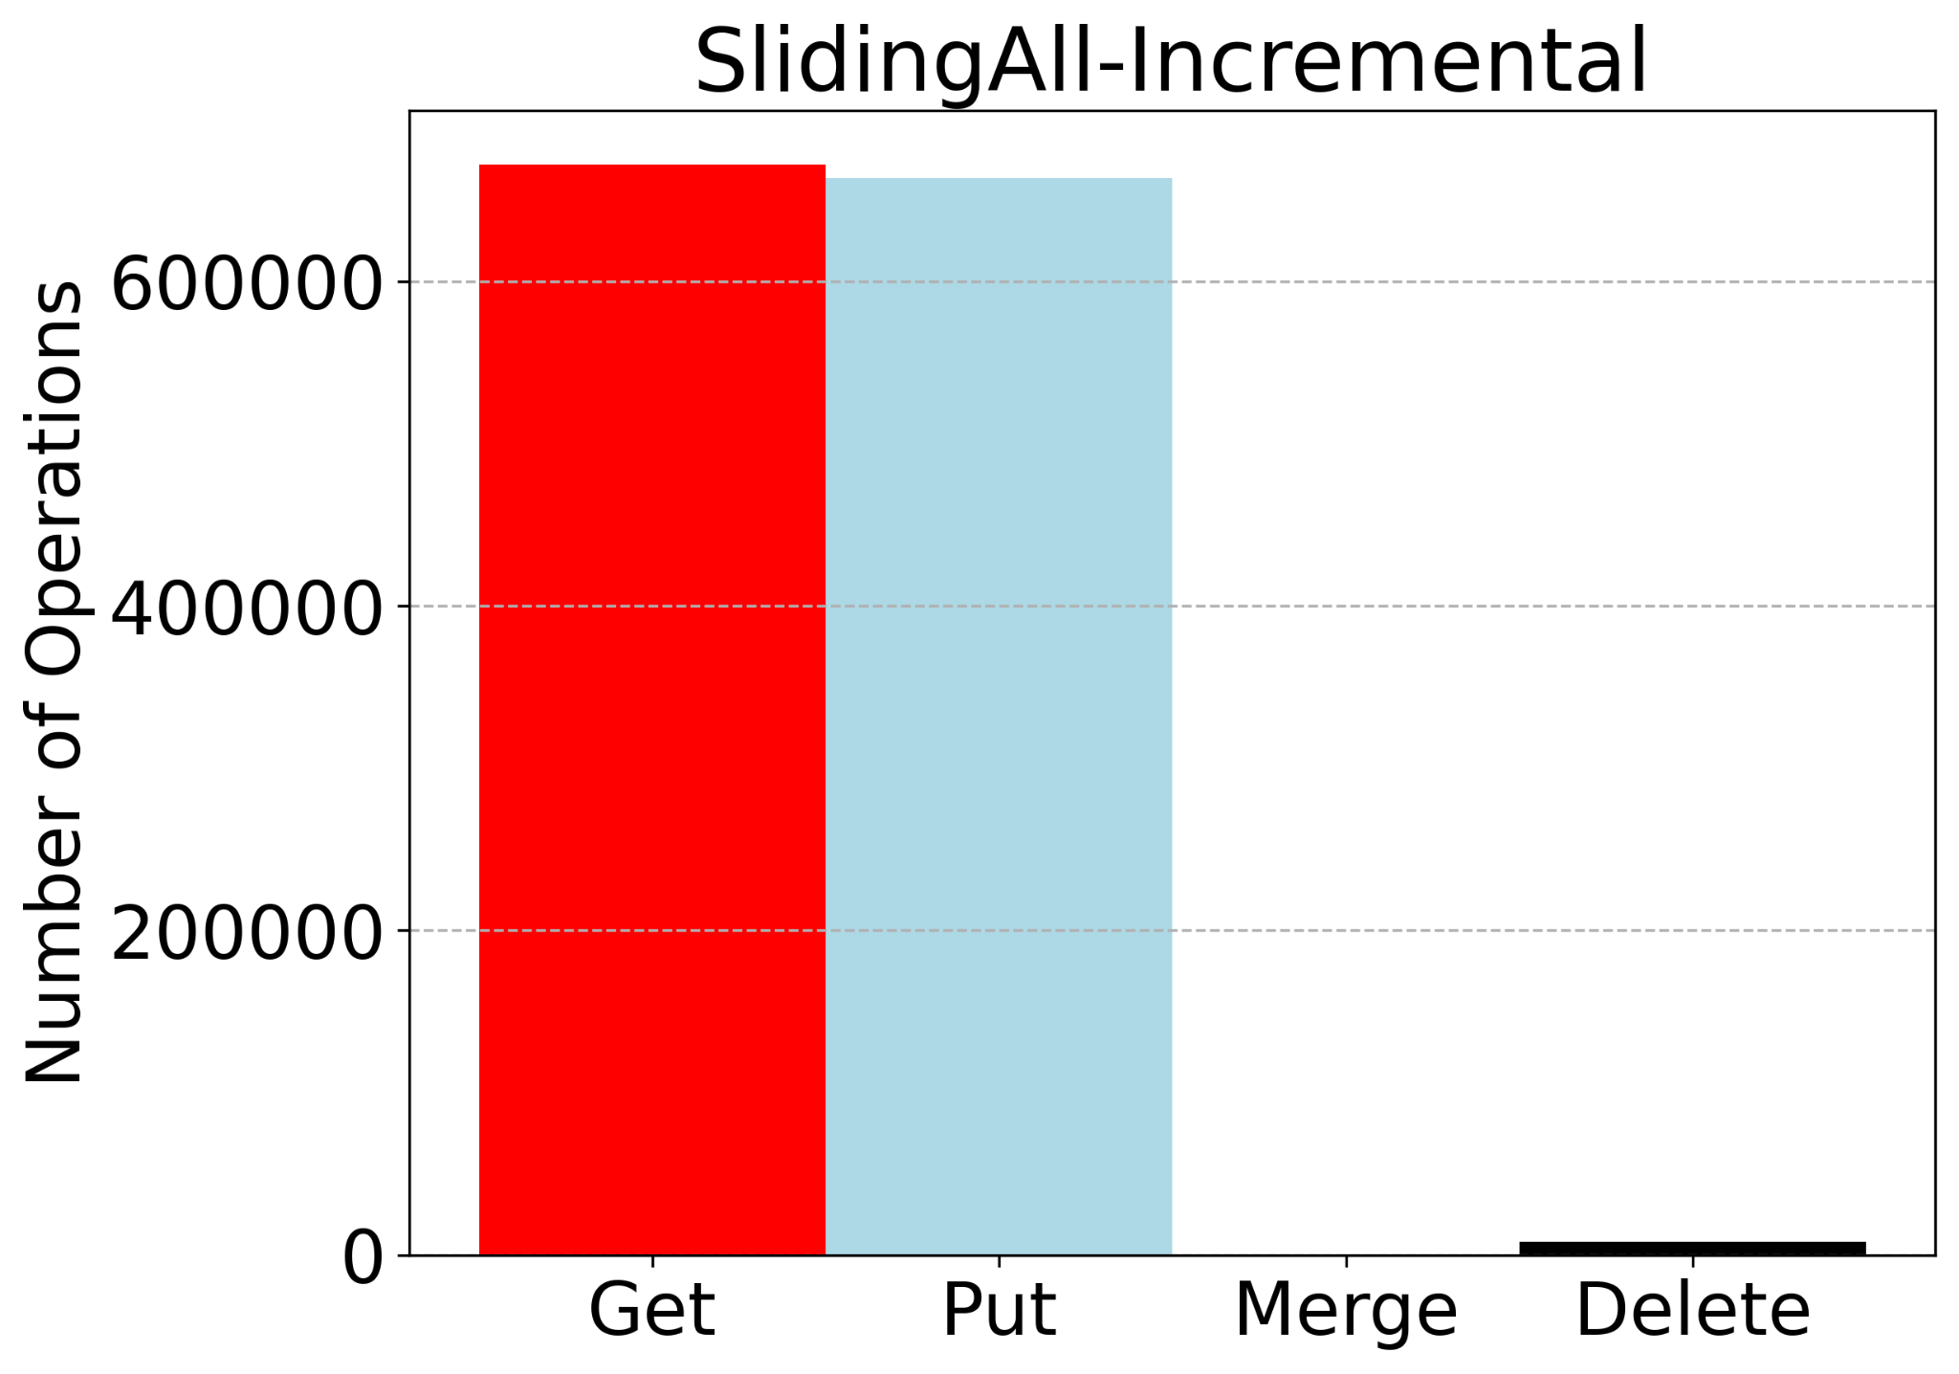
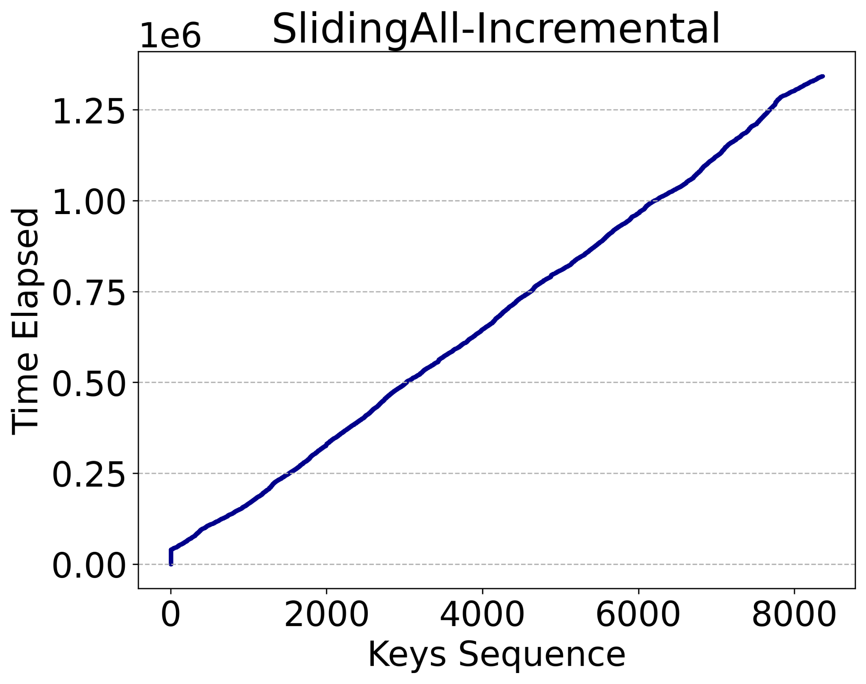
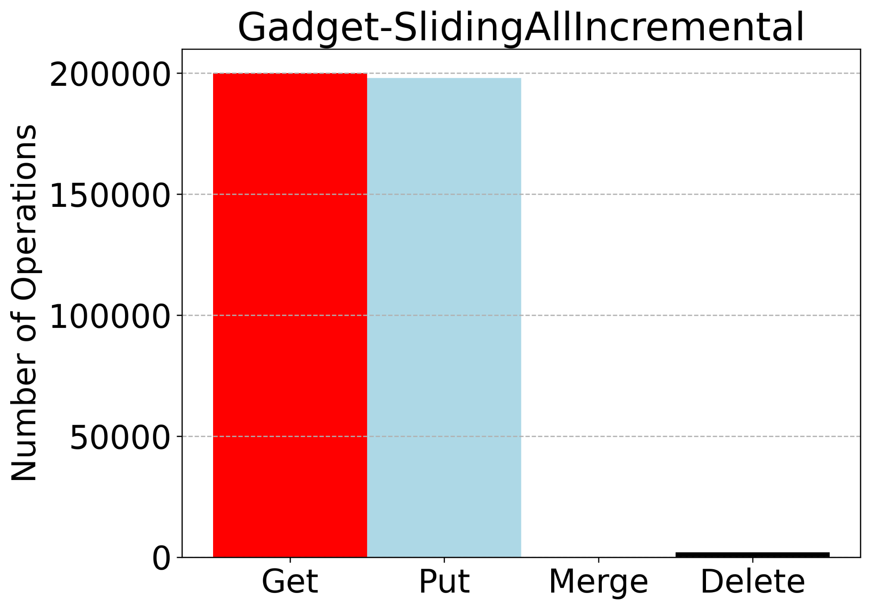
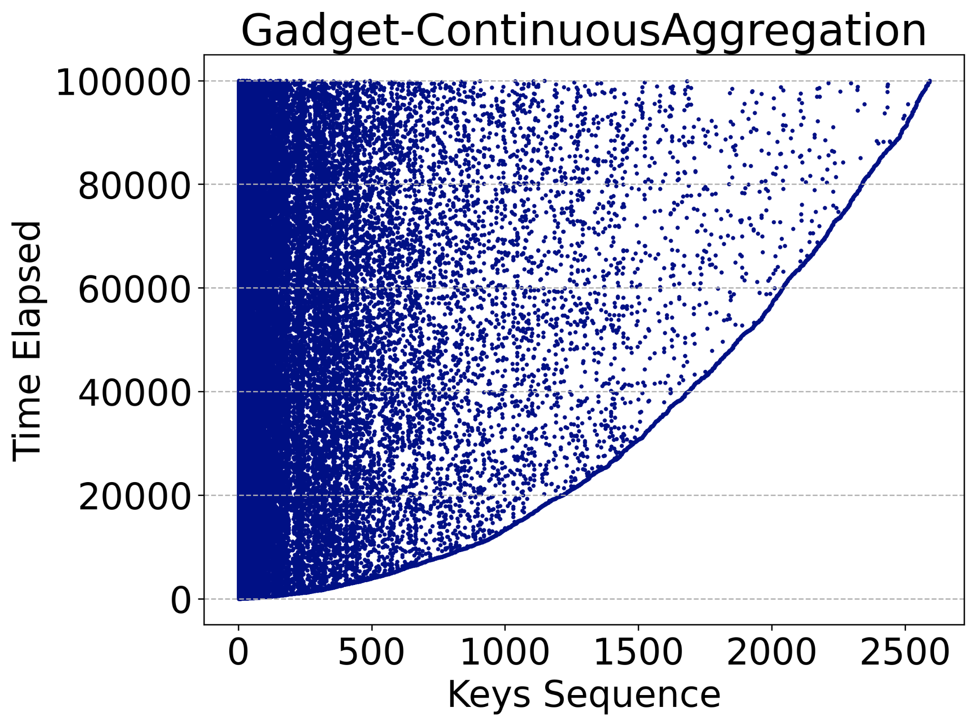
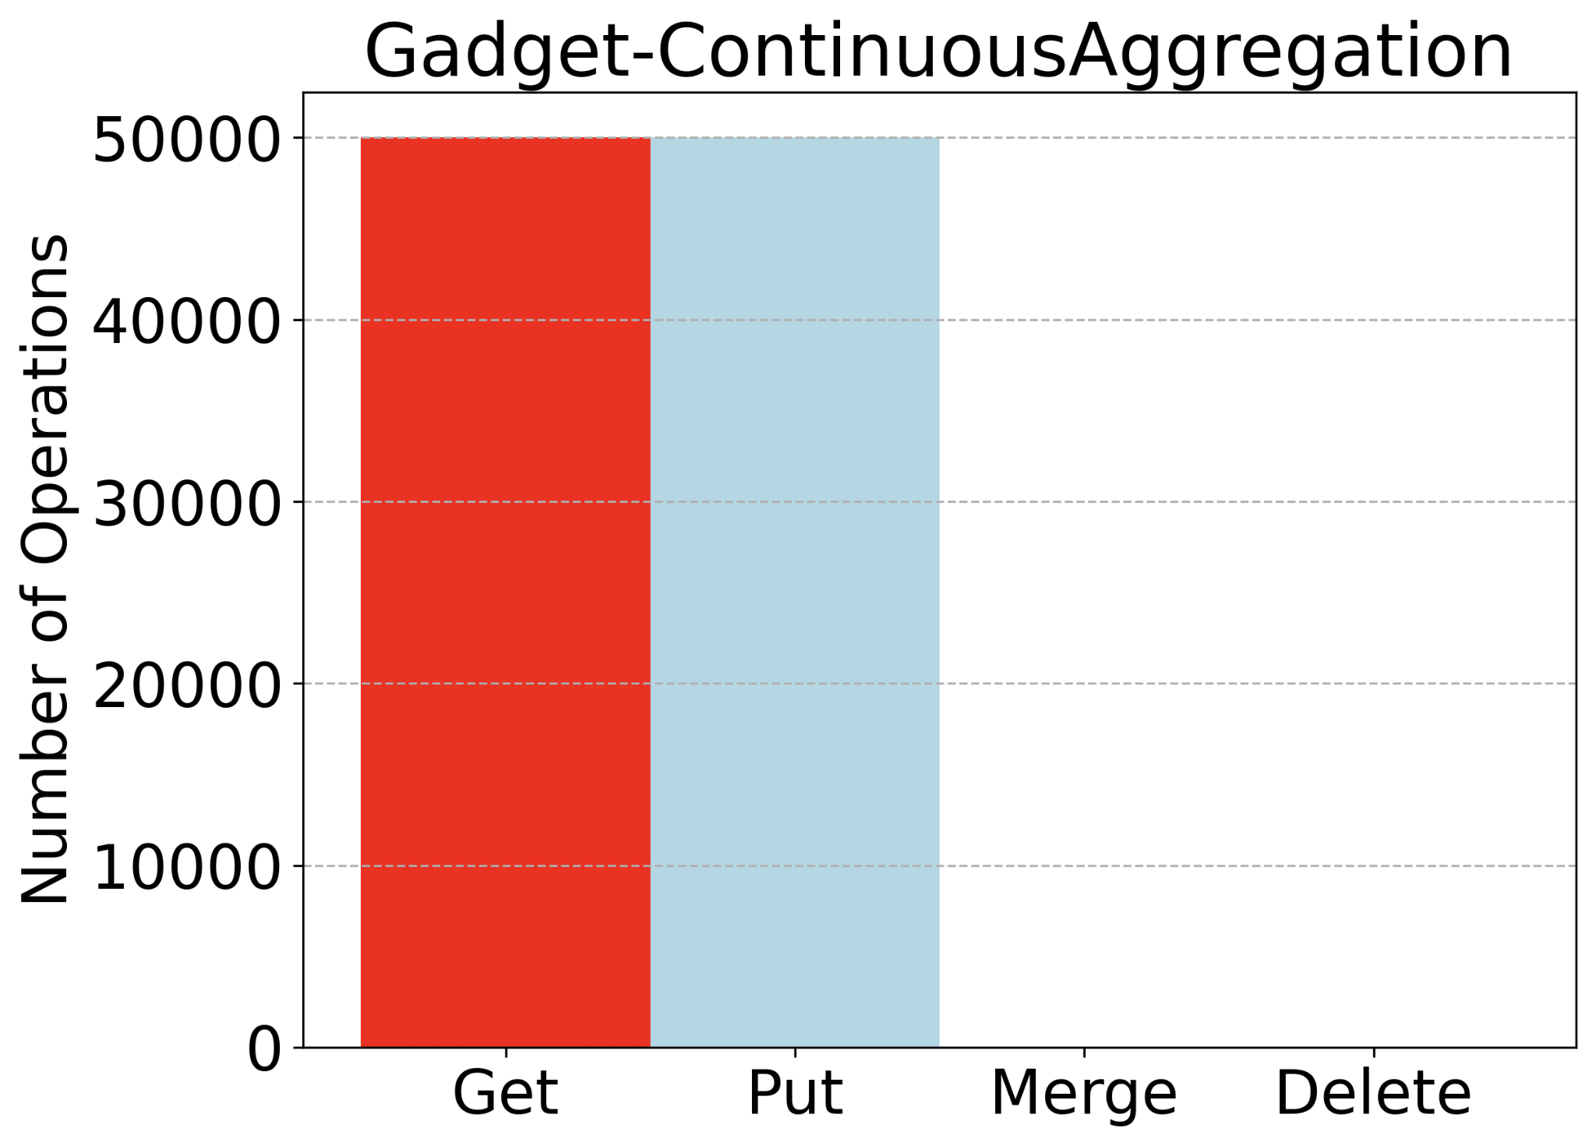
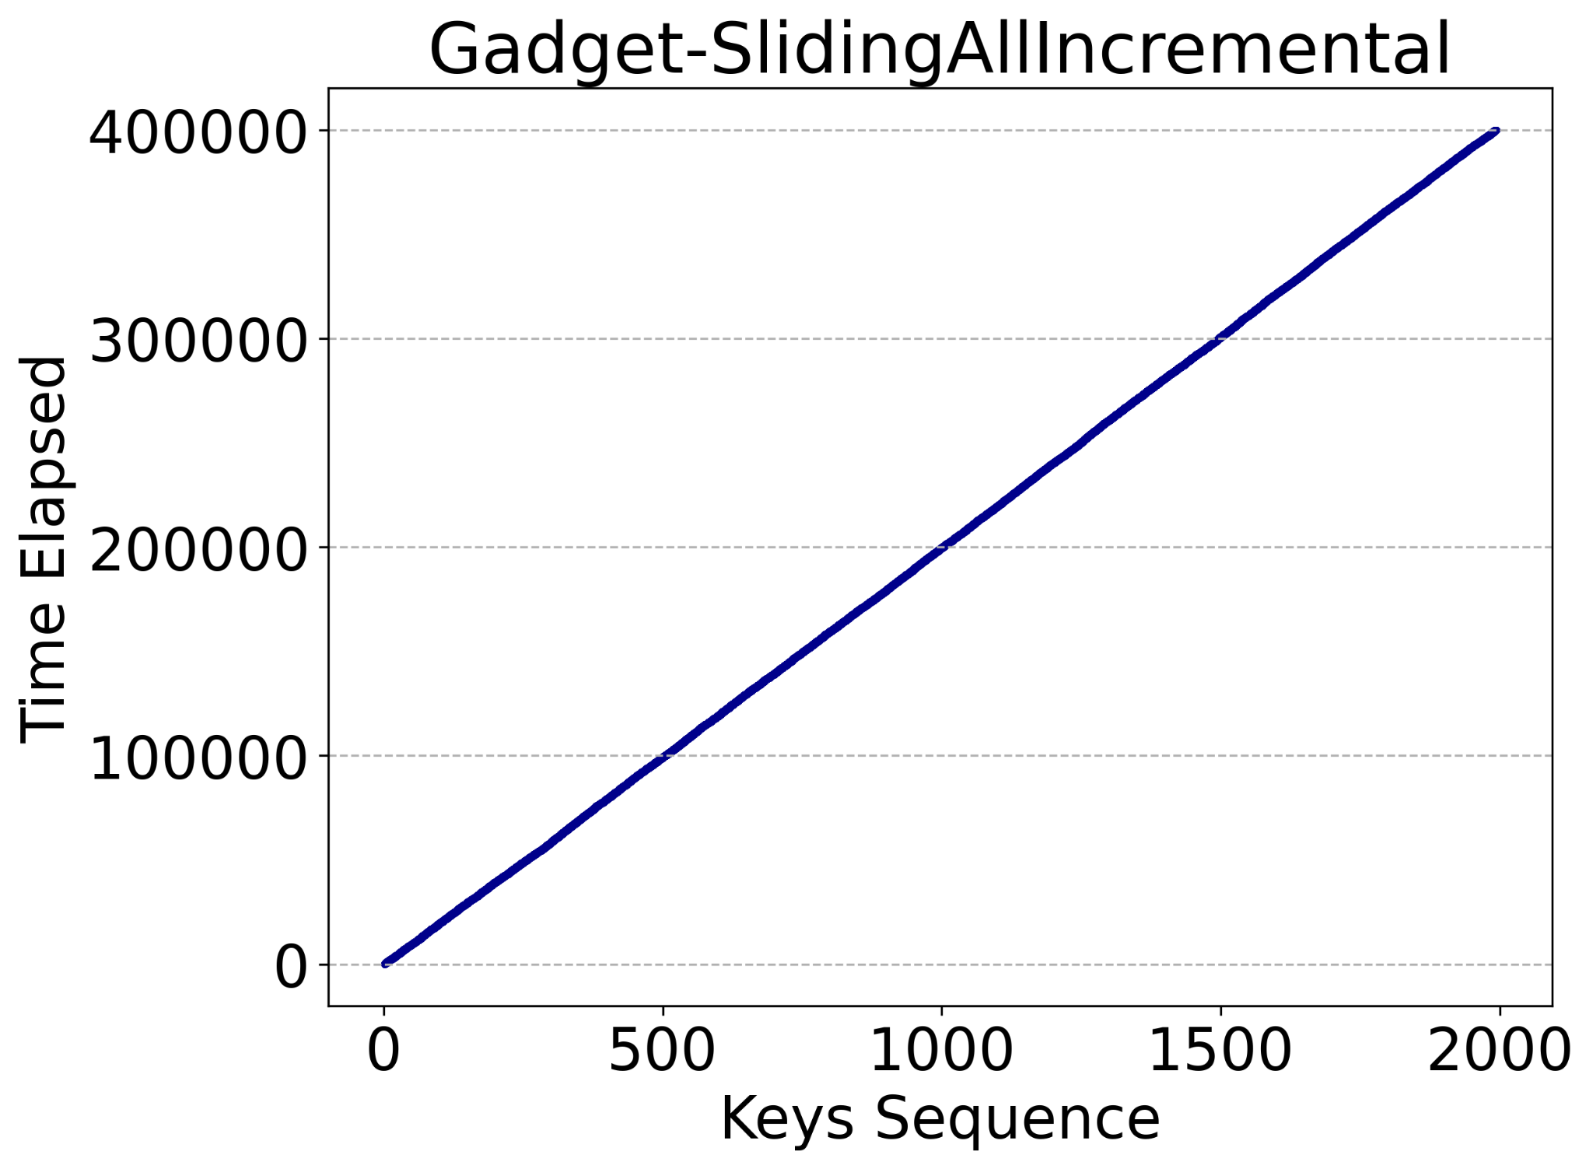
Preliminary Results
Flink- Read&Write Ratio
Flink- Temporal Locality
Gadget-Temporal Locality
Gadget Temporal Locality
12

Slide 14
Conclusion
Current research work demonstrate existing KV stores as state managers hamper the performance of streamings systems
We conduct a comprehensive analysis to characterize state workloads in streaming systems
We design and build a benchmarking system for fast and accurate evaluation of state managers
As the next step, we leverage our findings in the first step and our benchmarking system to design novel KV stores for streaming systems

Slide 15
Thank you

Slide 16
Some more experimental results for different operators

Slide 17
Read&Write Ratio
Temporal locality
Hit Rate
Key popularity
Window Size
Key space and Working set size
Event amplification
Operation Sequence

Slide 18
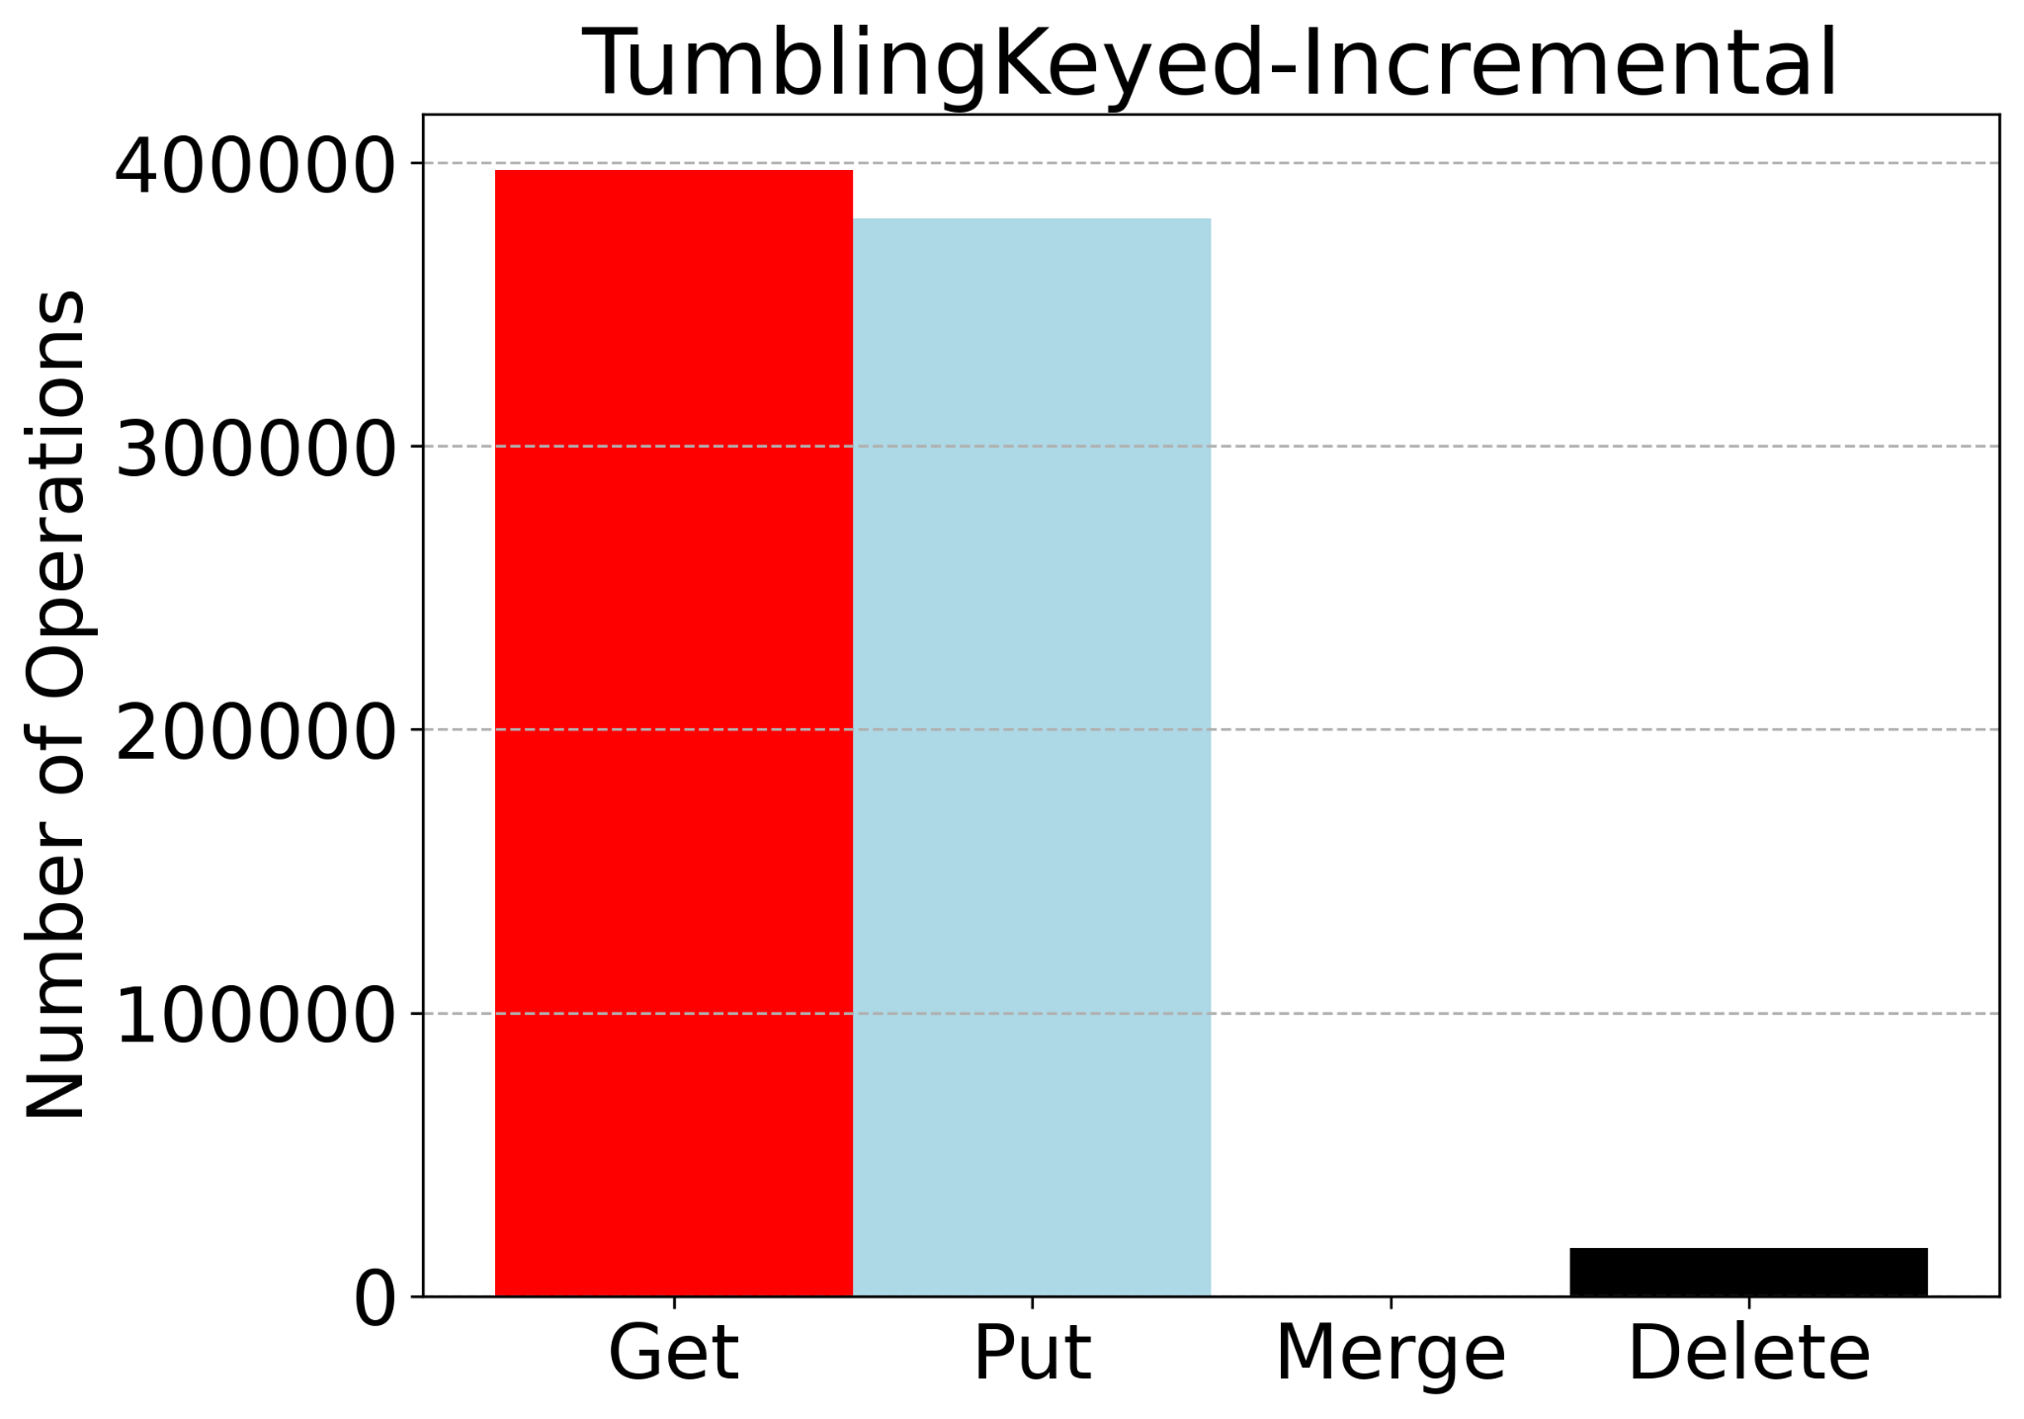
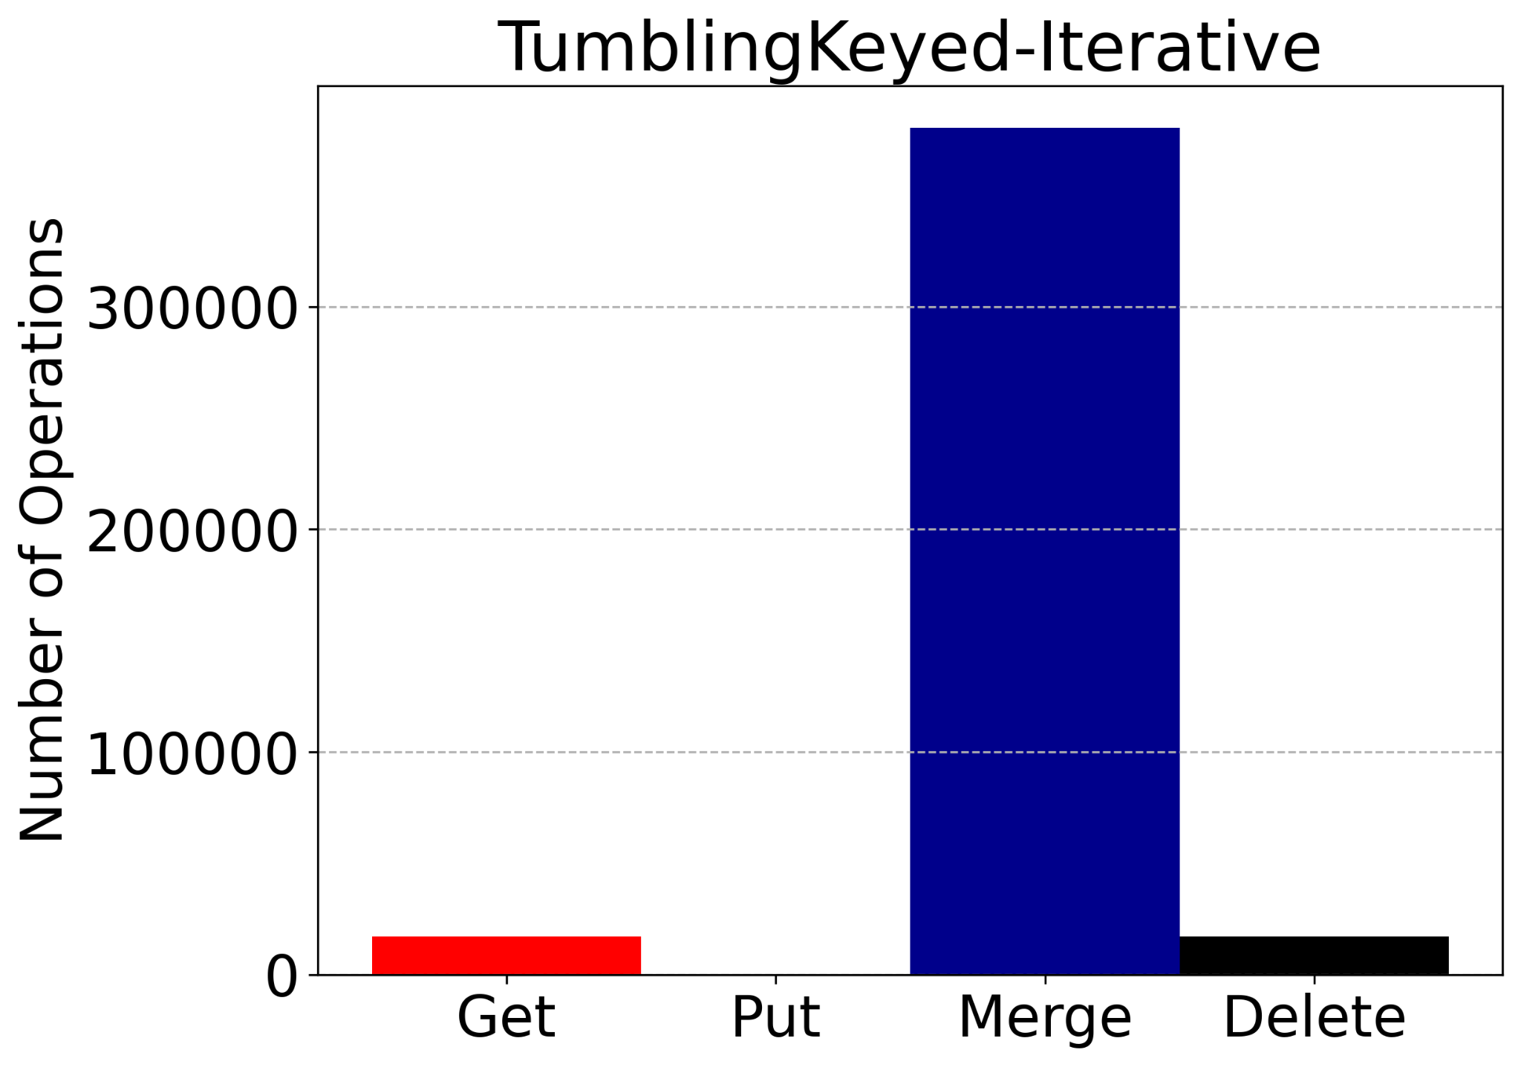
Read&Write Ratio
There are a mixture of operators while some of them are write-heavy, there are operators whose reads are more than writes.
YSCB sees the Sliding Keyed window and Continuous aggregation as the same operator (50% reads and 50% writes)
Notes:
hi

Slide 19
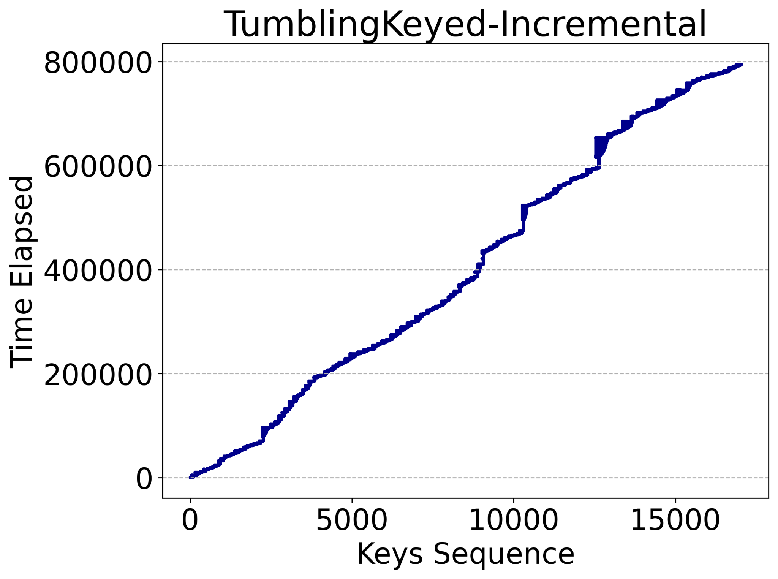
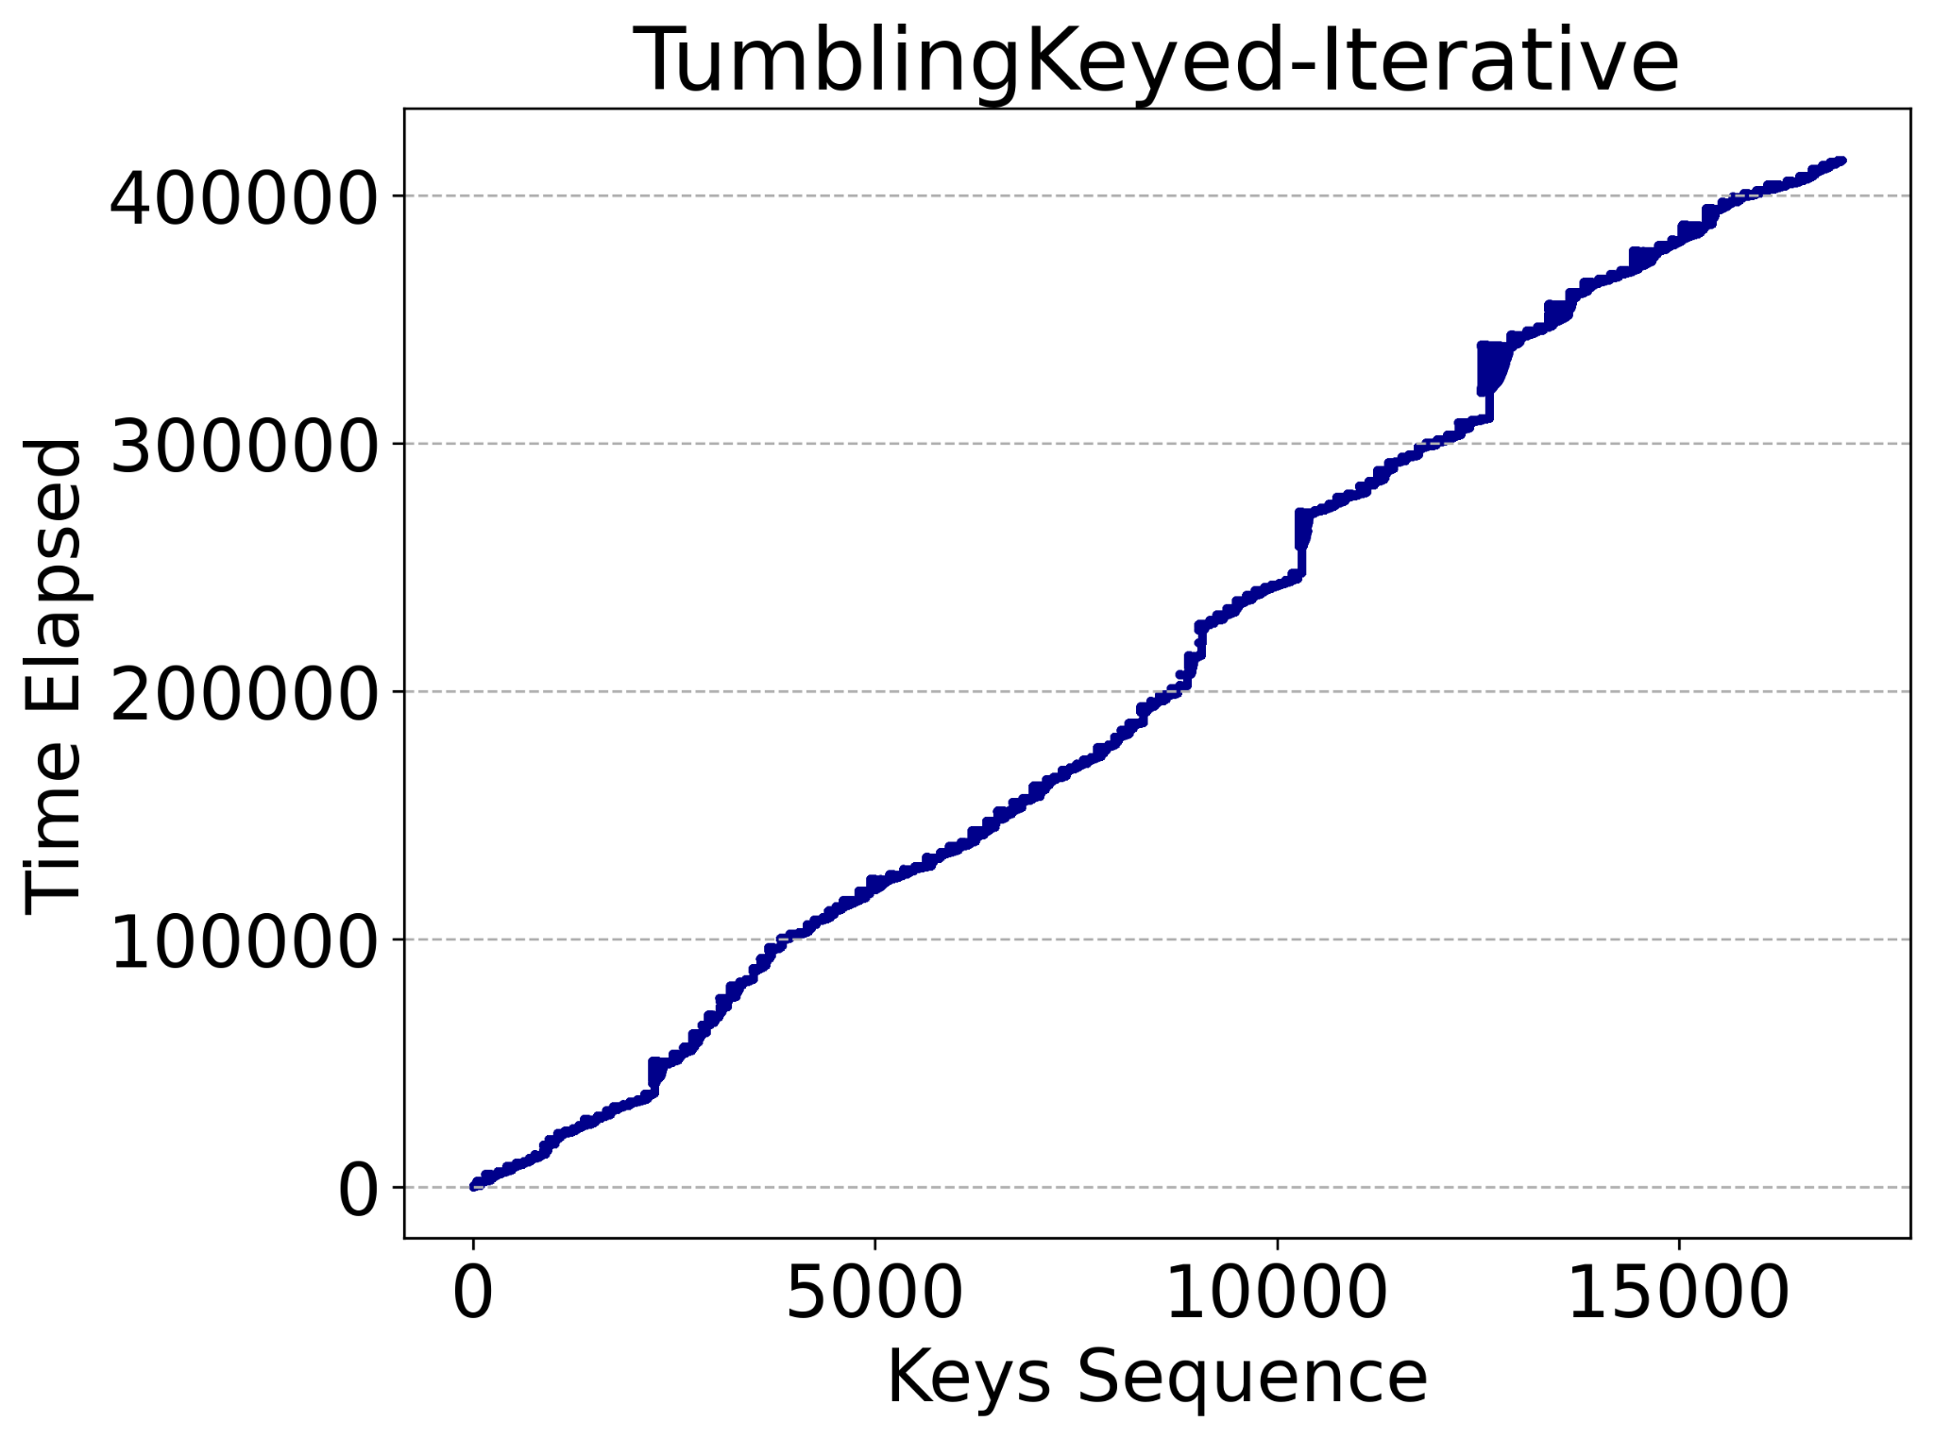
Temporal locality
Temporal locality shows how closely a current key will be accessed in the future
Most operators have high temporal locality
YCSB wrongly sees Sliding Keyed and Continuous Aggregation operators as the same operator

Slide 20
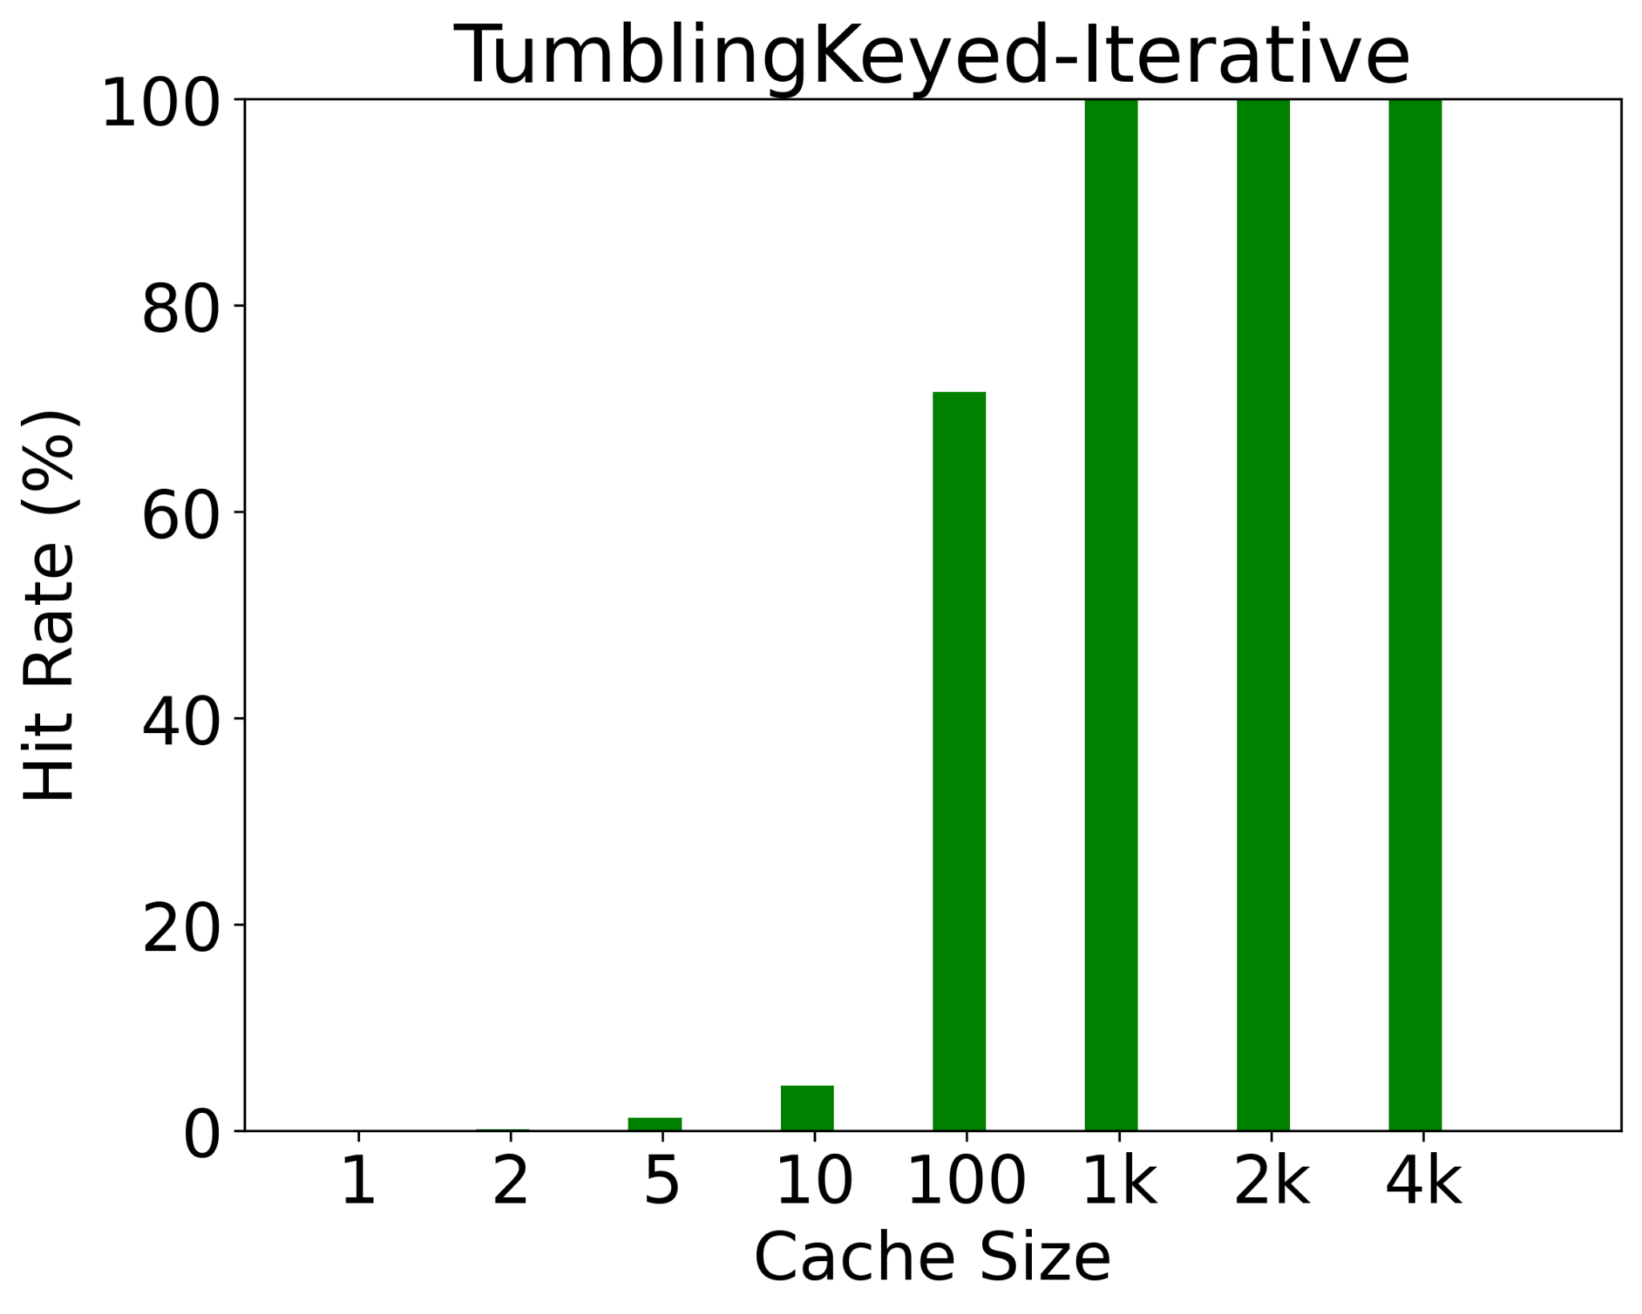
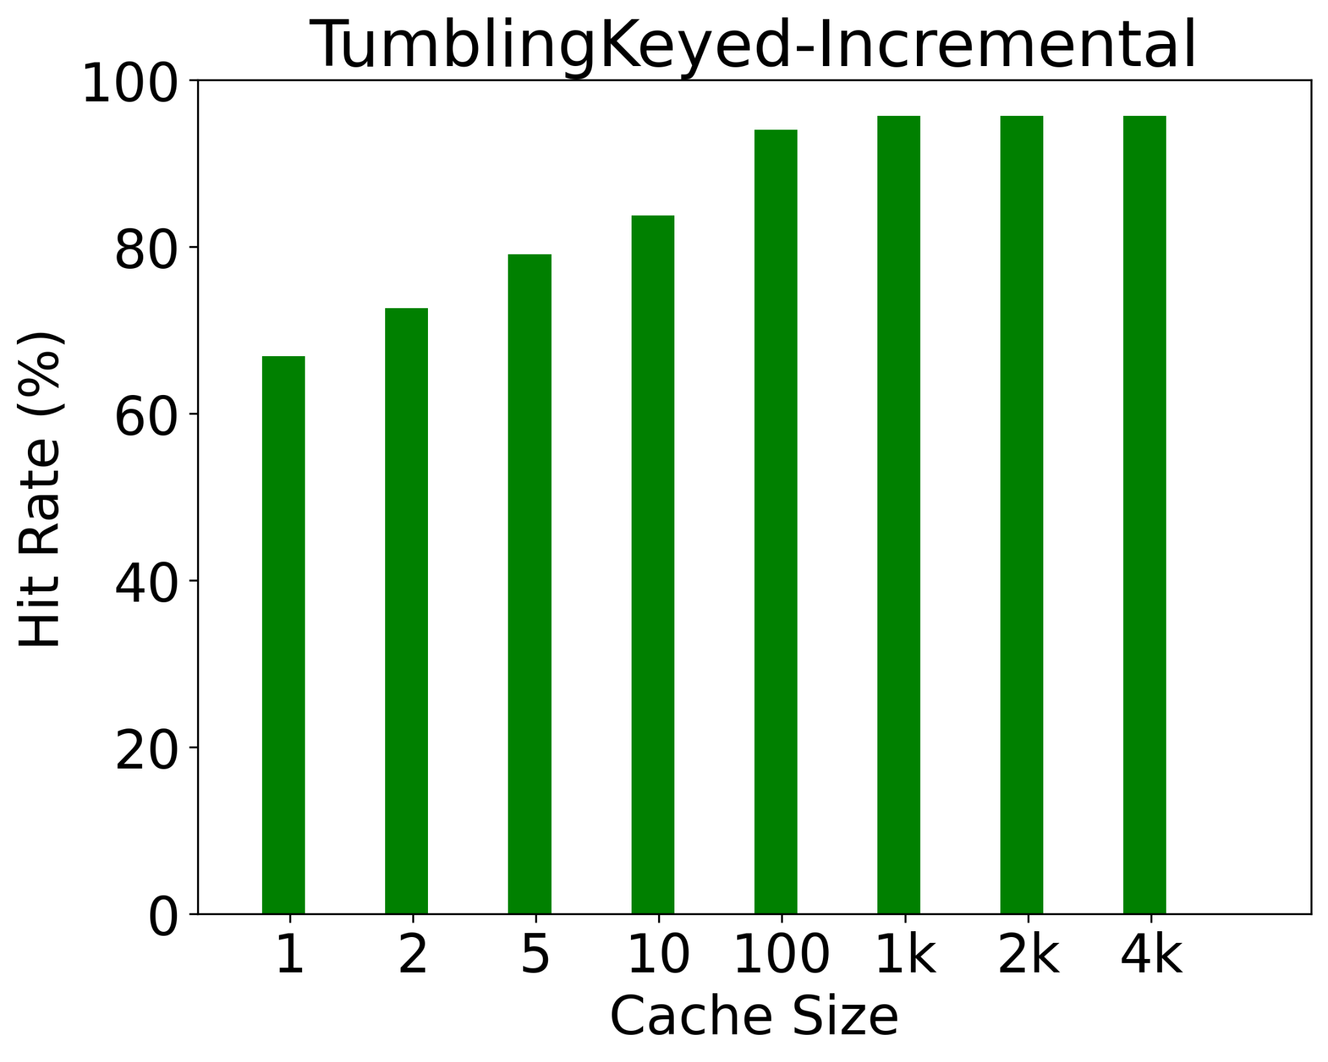
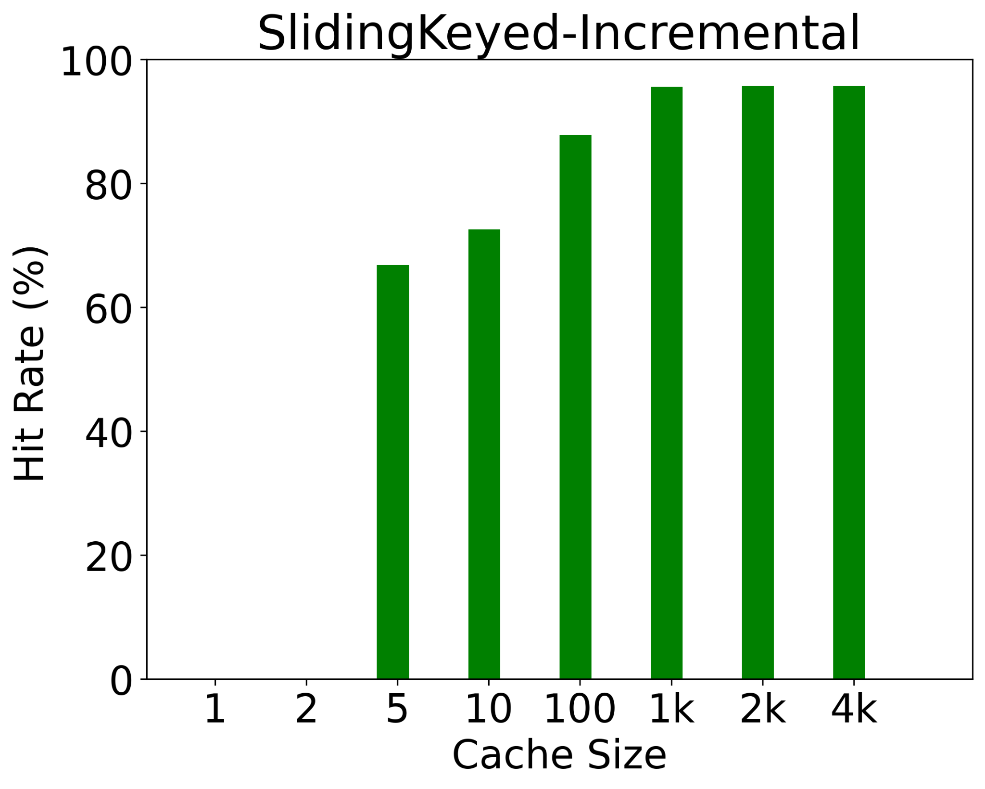
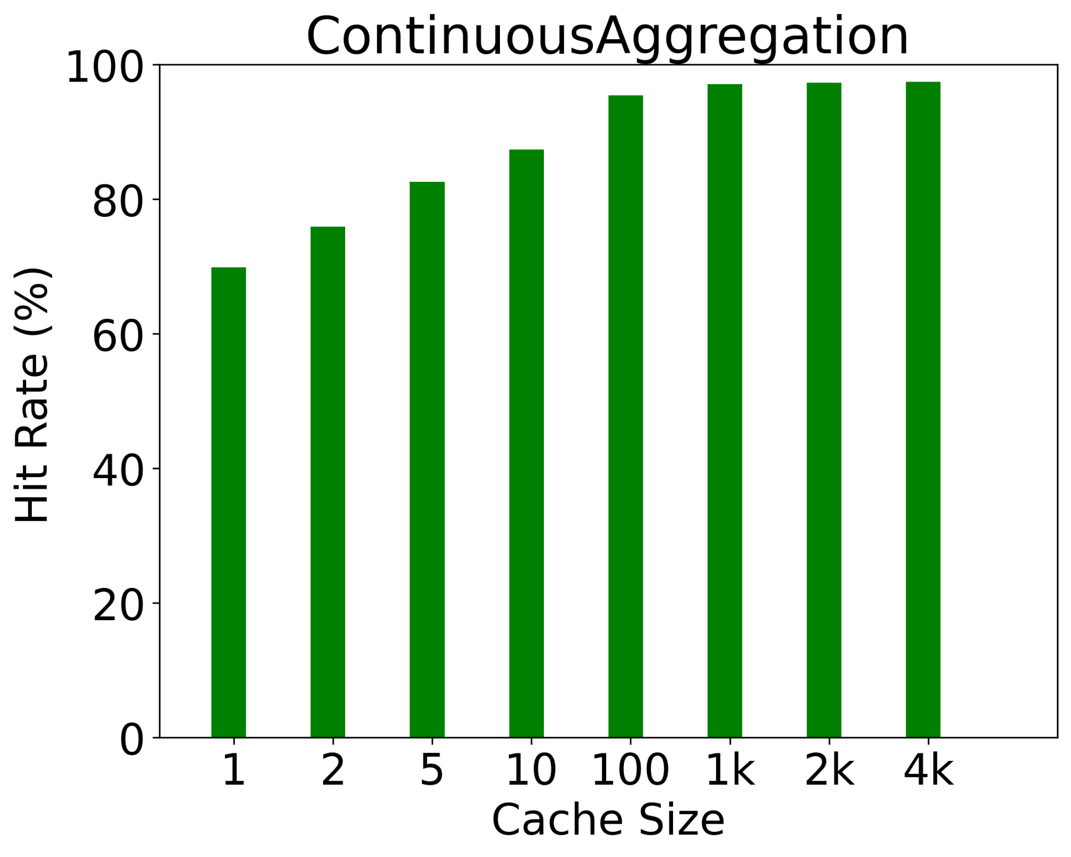
Hit Rate
Hit rate demonstrates the ratio of hits if the keys are being cached in caches with different sizes
Most operators have high hit rates

Slide 21
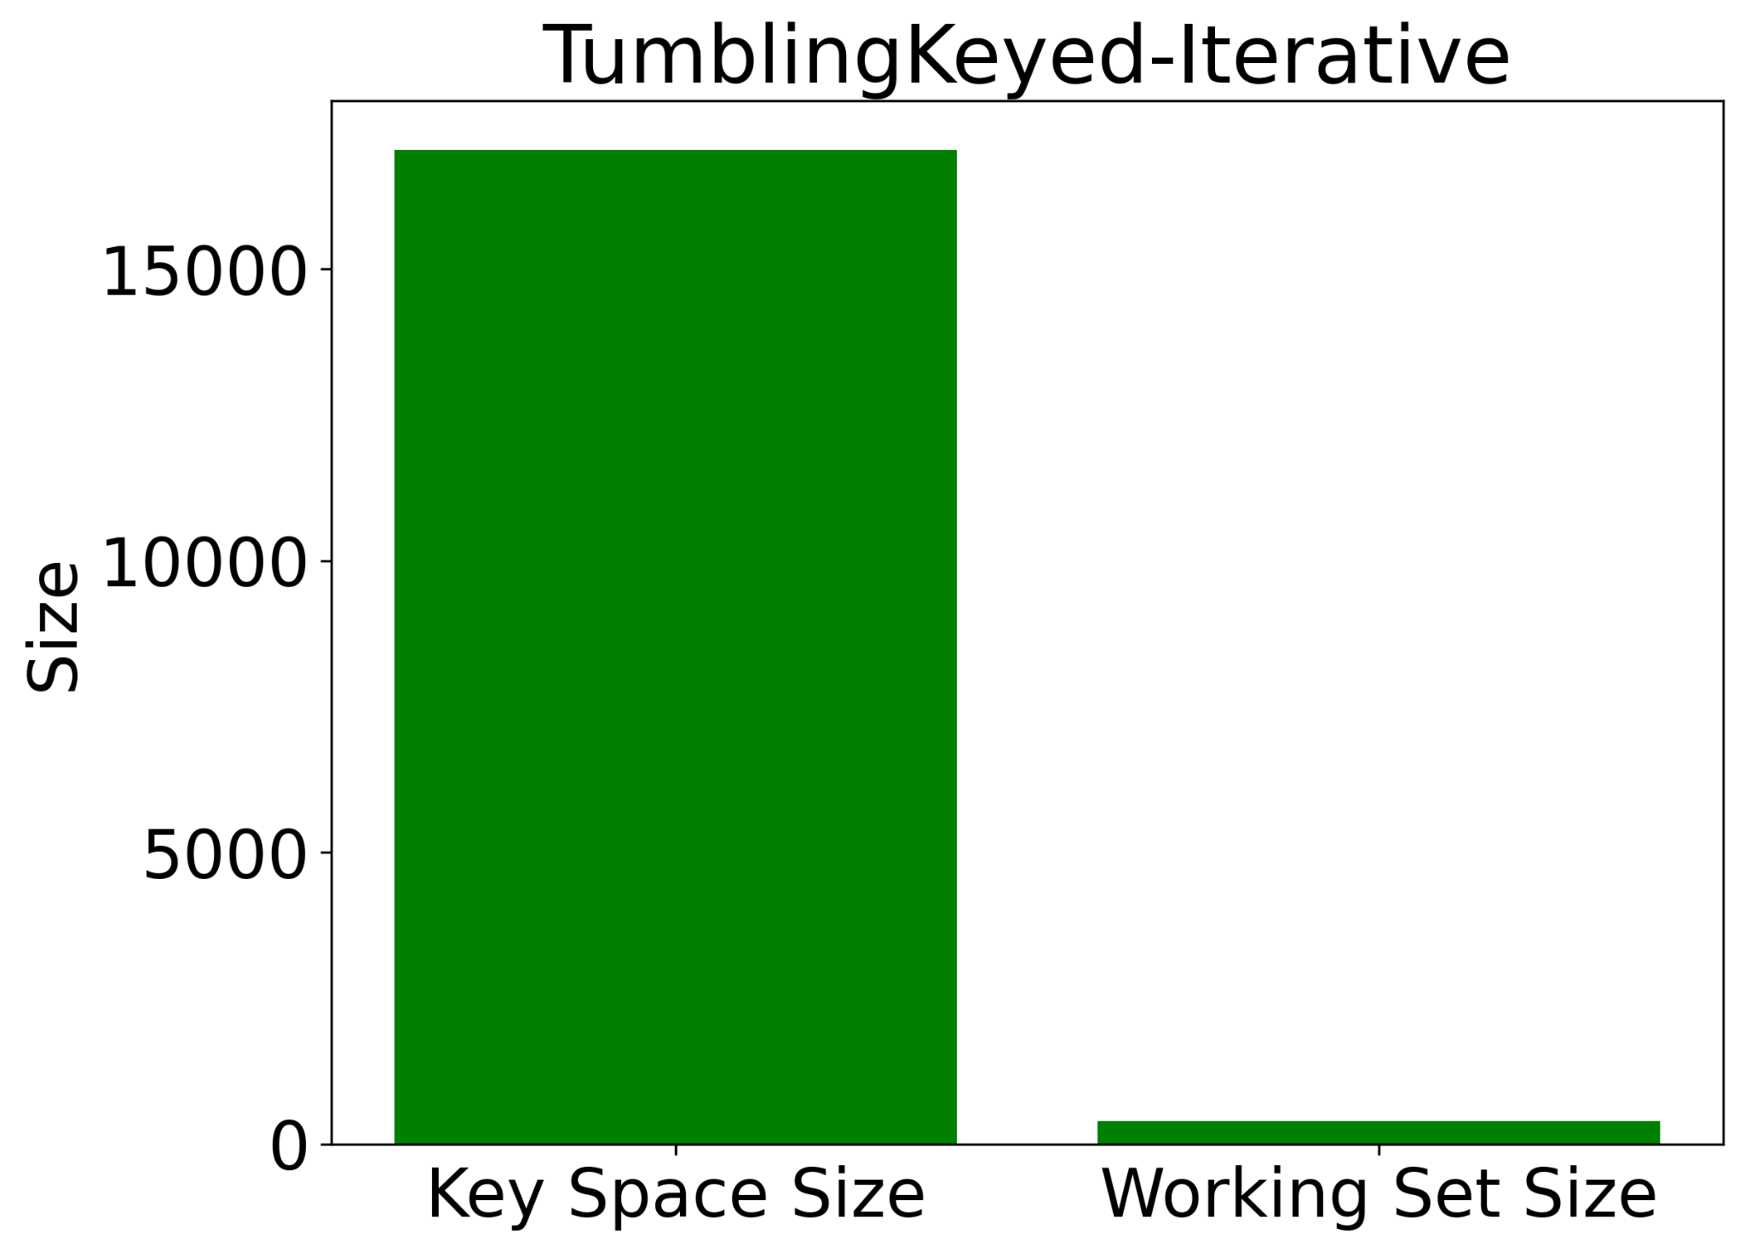
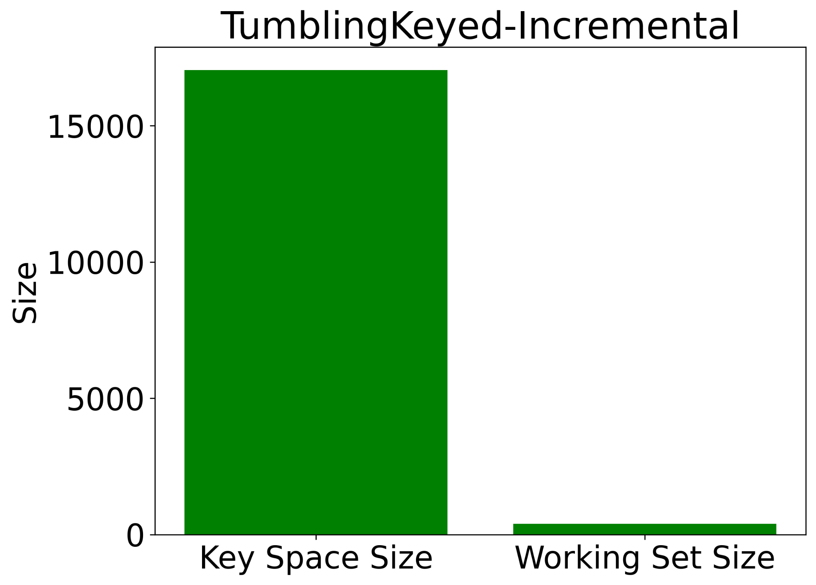
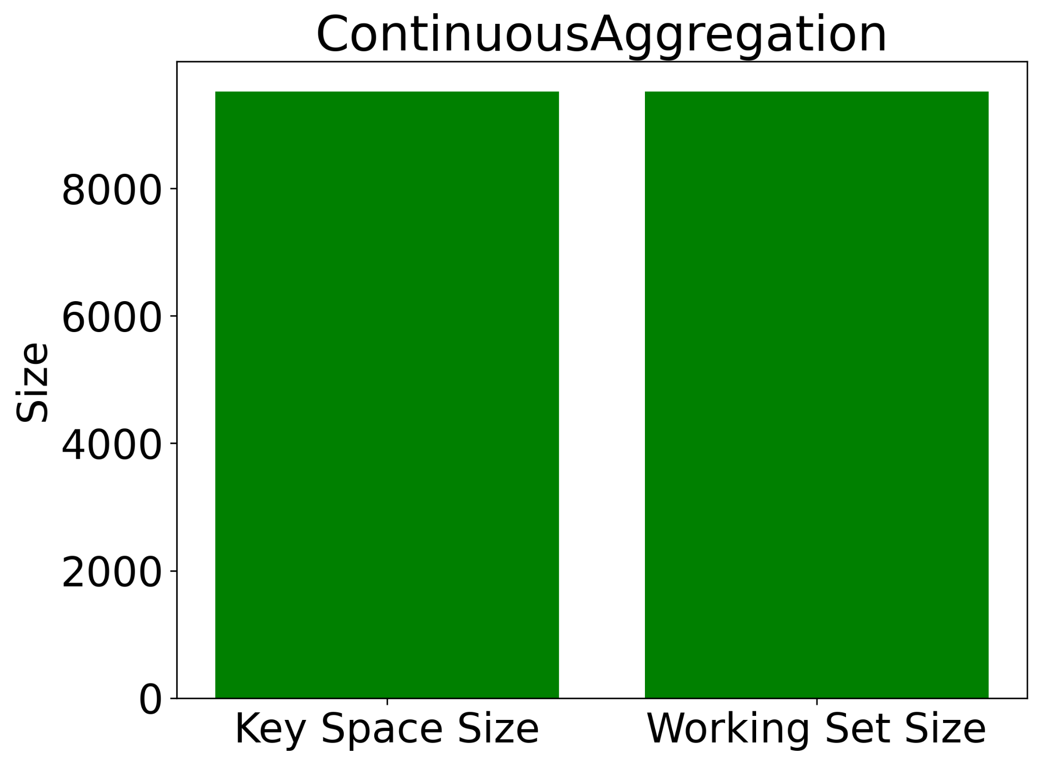
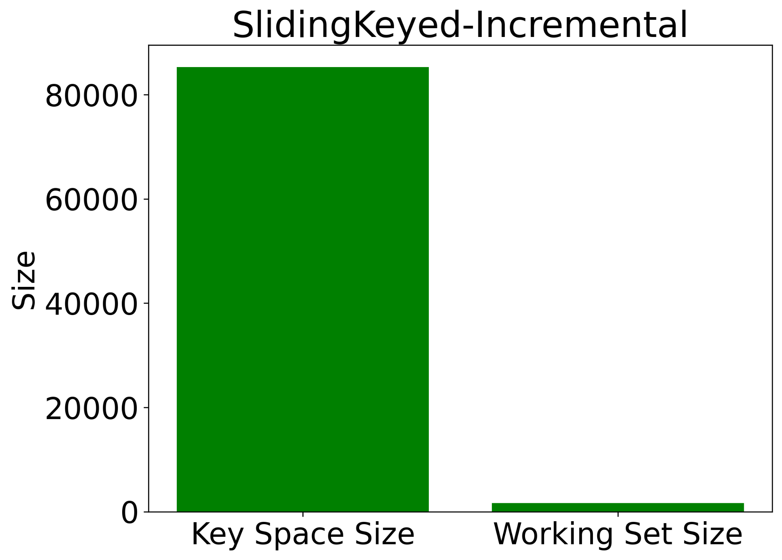
Key Space Size and Working Set Size
Working Set Size shows a cache size the achieves the highest possible hit rate
Most operators have a small working set size

Slide 22
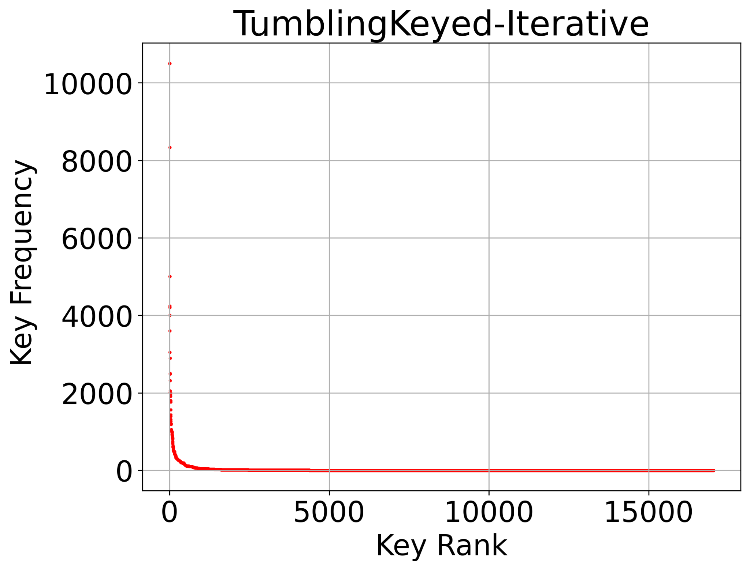
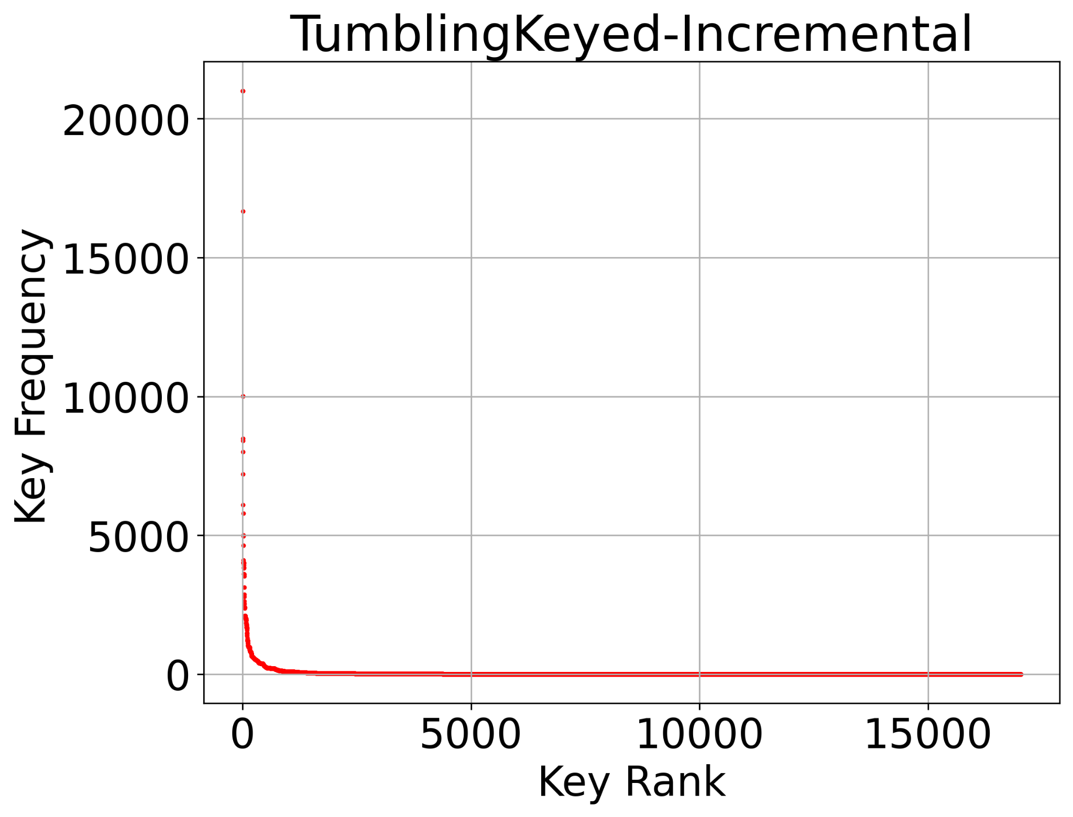
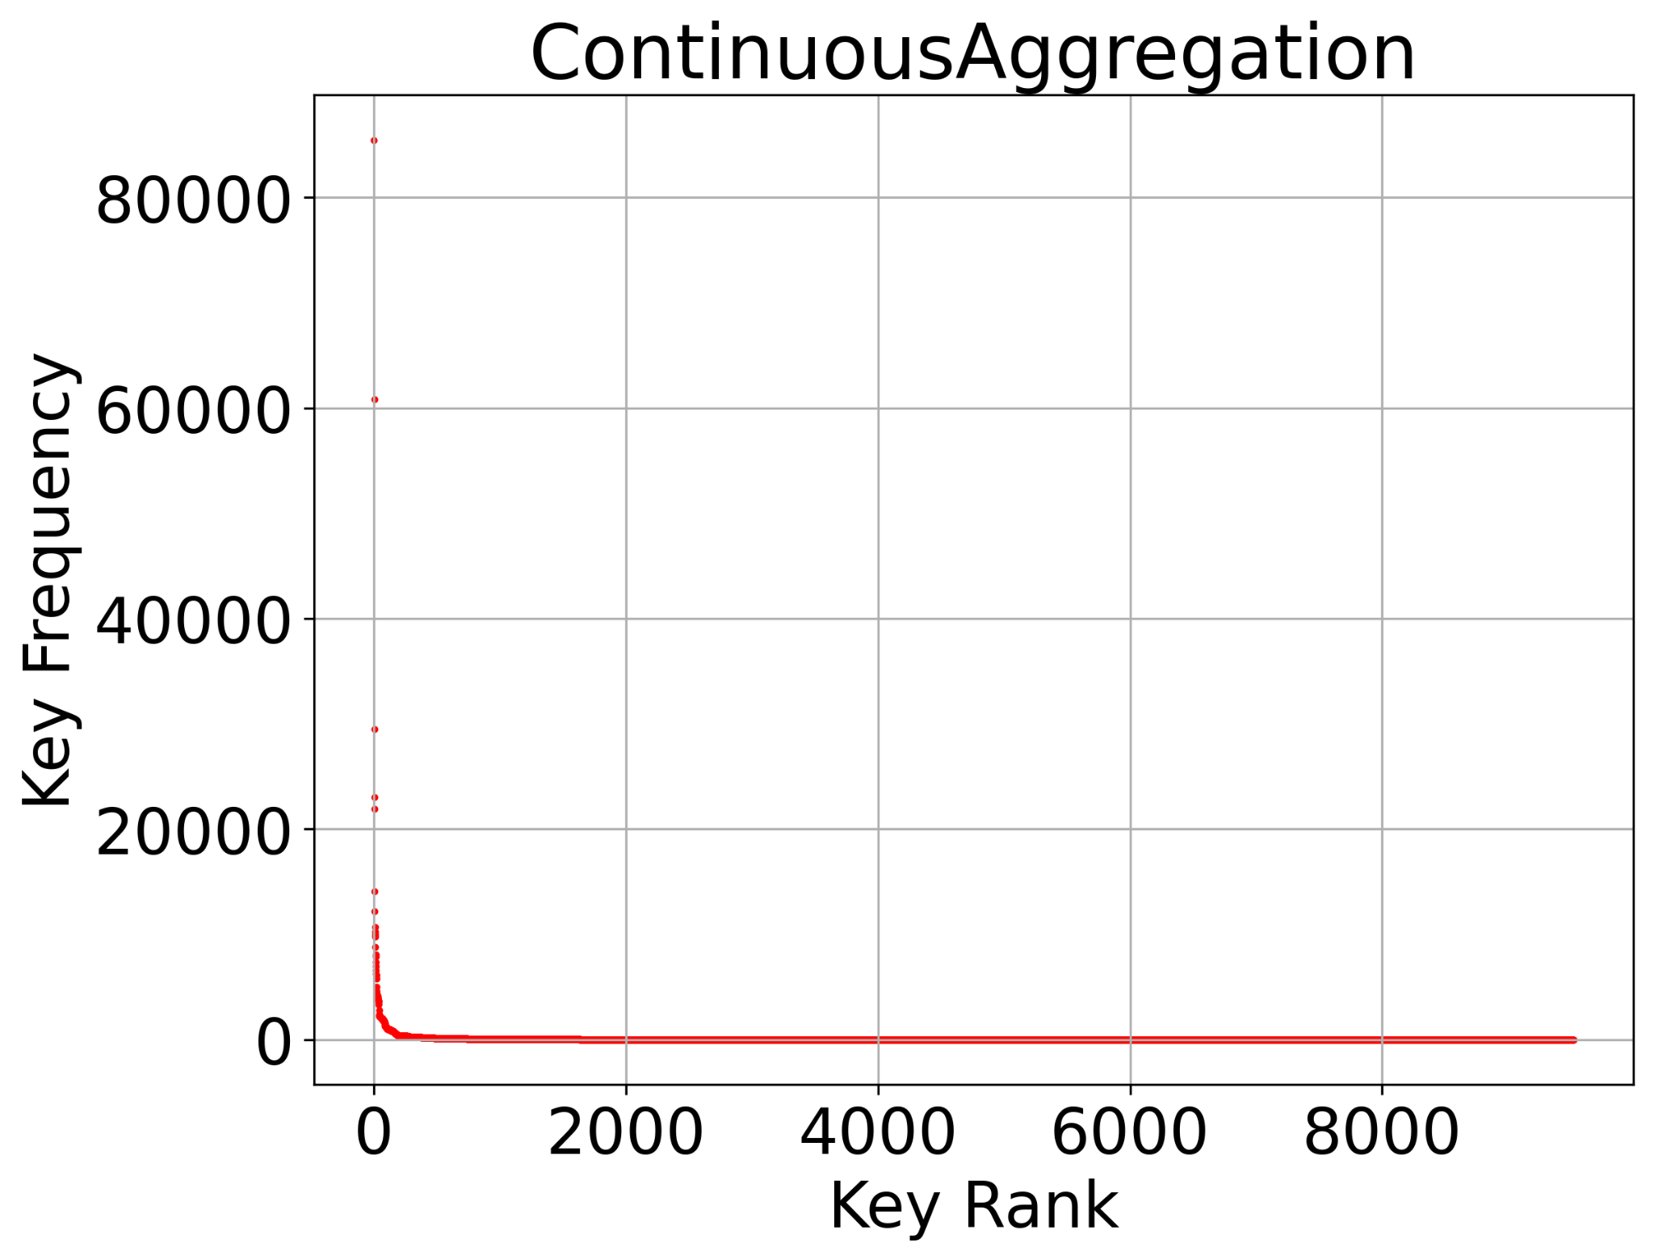
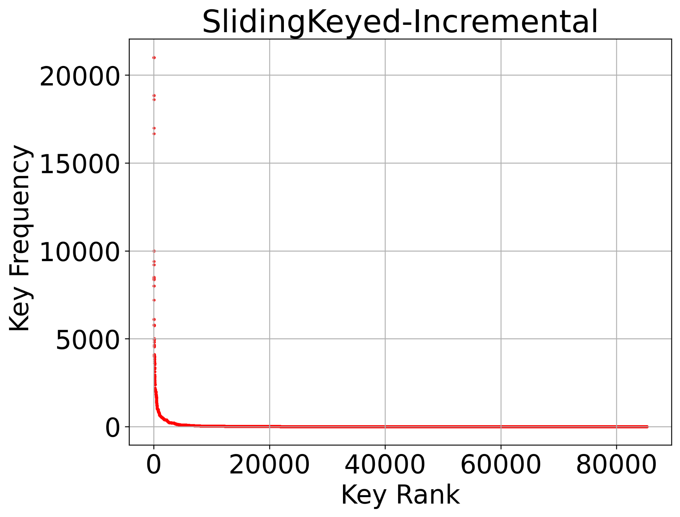
Key Popularity
Key popularity shows the popularity of keys compared to one another
Keys are evenly popular in almost all operators

Slide 23
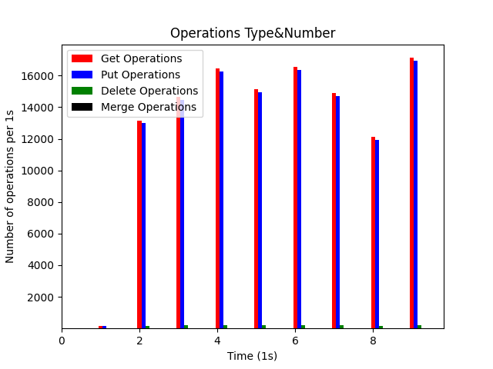
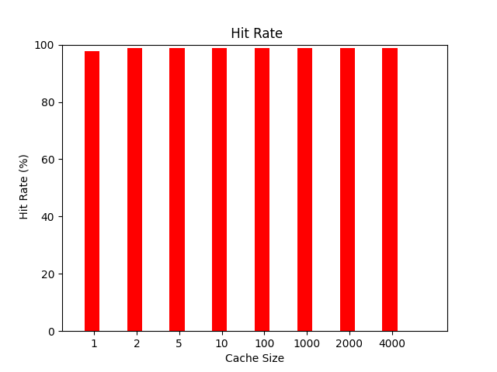
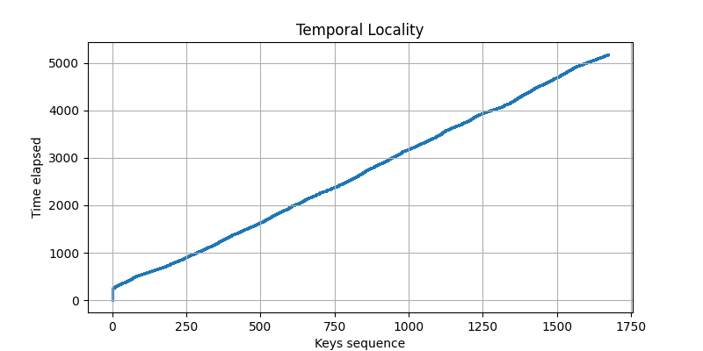
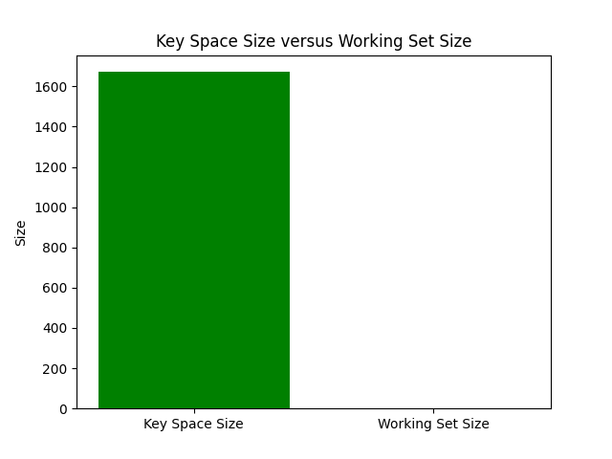
Experiment Results (Tumbling All Window Aggregation)
Number of gets= 134322
Number of puts= 132650
Number of deletes= 1672
Number of merges= 0
working set = 2
key space size = 1672

Slide 24
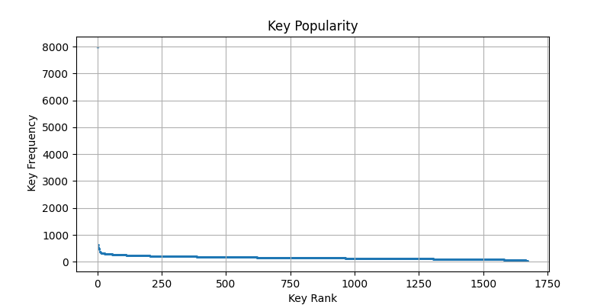
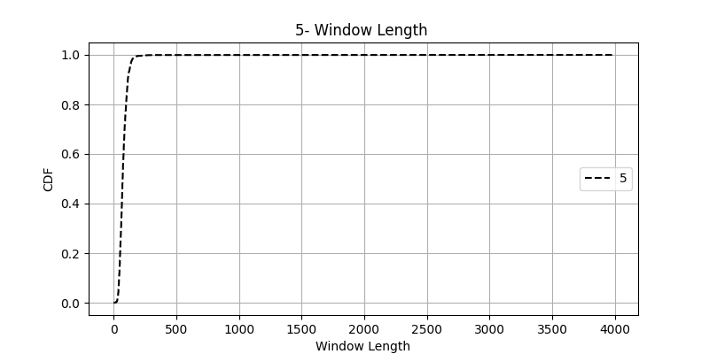
Tumbling ALL Window Aggregation
Amplification
Input= 134322
Interactions with state: 268644

Slide 25
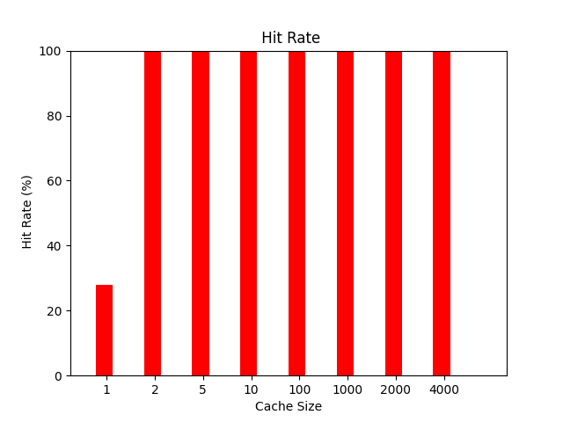
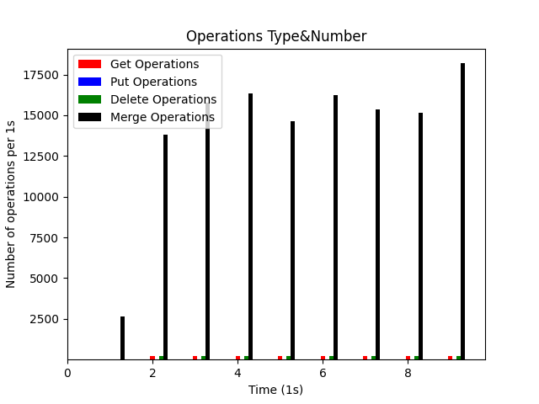
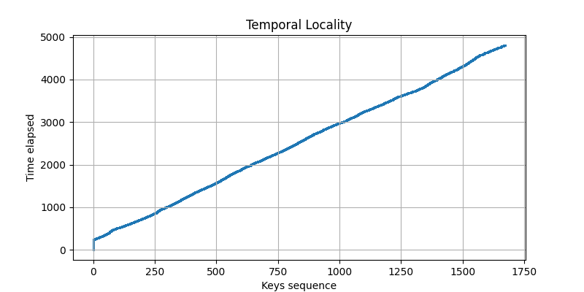
Tumbling ALL Window - Apply
Number of gets= 1672
Number of puts= 0
Number of deletes= 1672
Number of merges= 132650
working set = 2
key space size = 1672

Slide 26
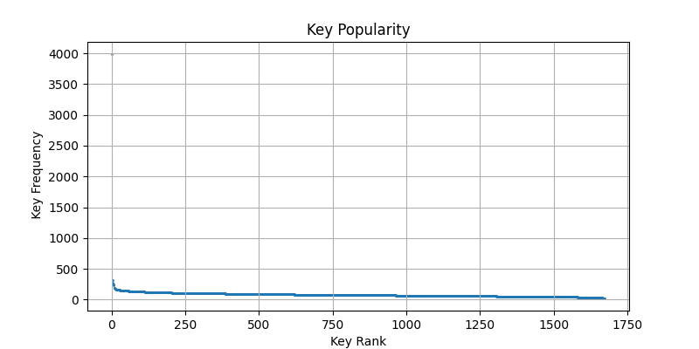
Tumbling ALL Window - Apply
Amplification
Input= 134322
Interactions with state: 135994

Slide 27
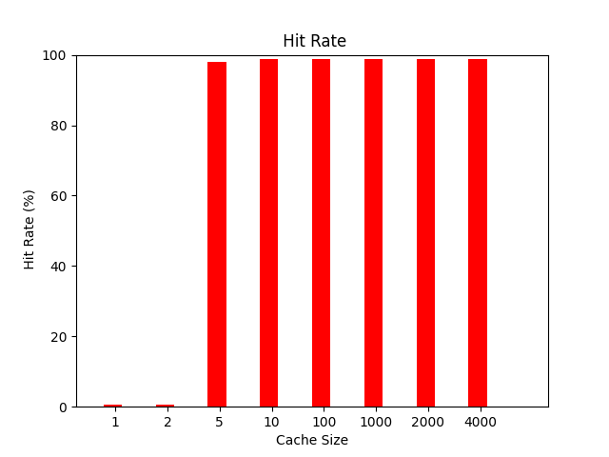
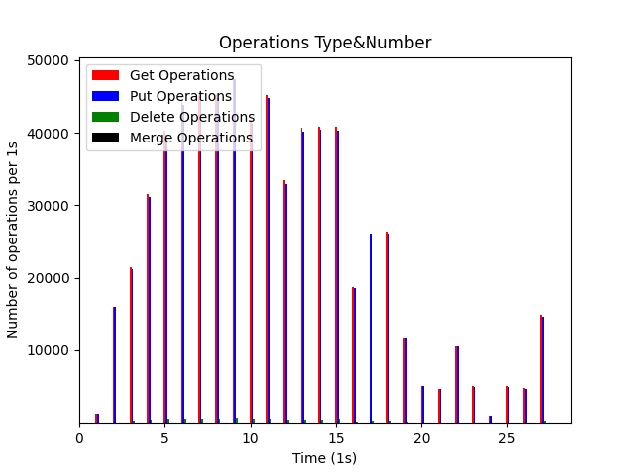
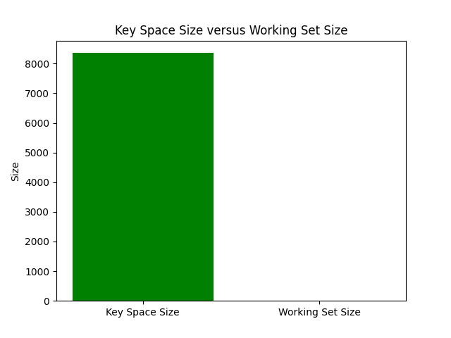
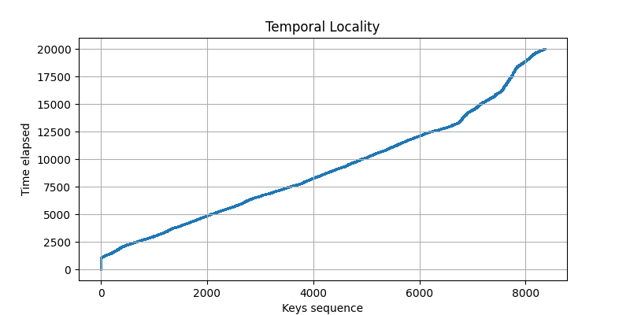
Sliding All Window - Aggregation
Number of gets= 671615
Number of puts= 663254
Number of deletes= 8361
Number of merges= 0
Working set = 6
Key space size = 8361

Slide 28
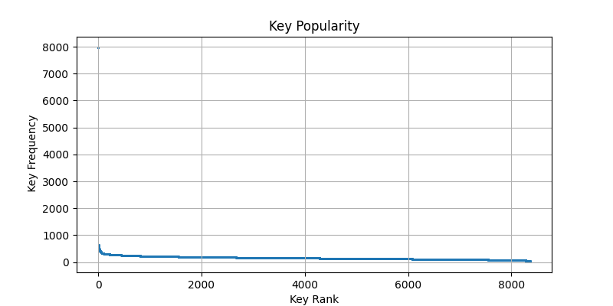
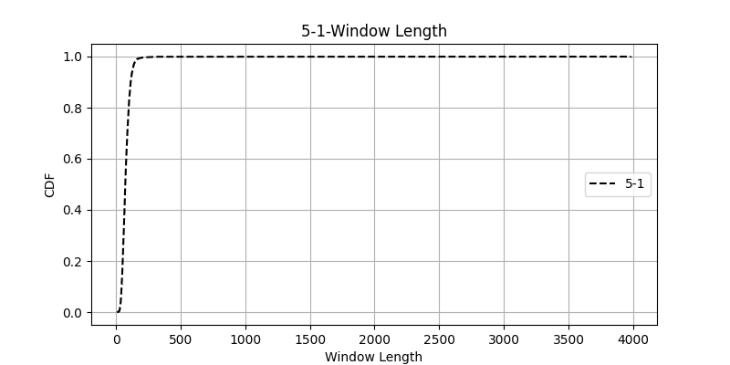
Sliding All Window - Aggregation
Amplification
Input= 134322
Interactions with state: 1343230

Slide 29
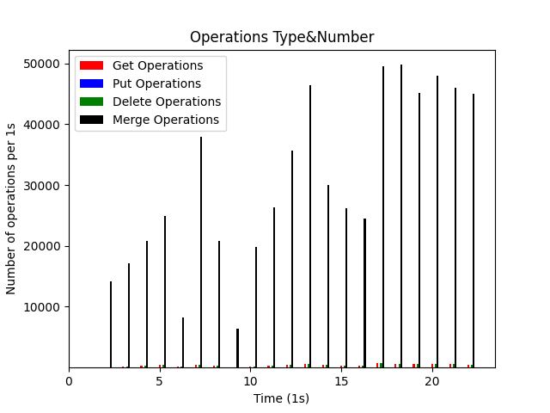
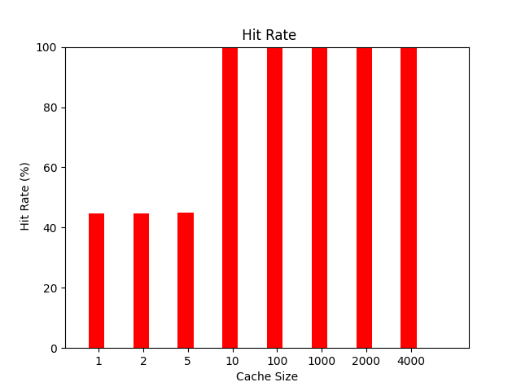
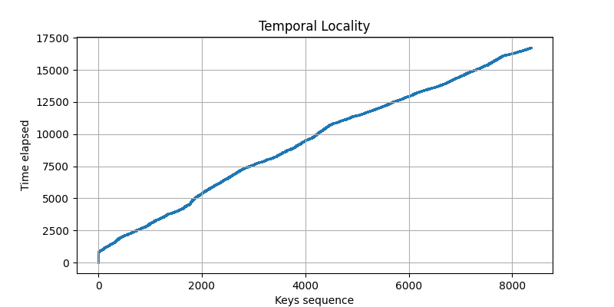
Sliding All Window- Apply
Number of gets= 8361
Number of puts= 0
Number of deletes= 8361
Number of merges= 663254
working set = 6
key space size = 8361

Slide 30
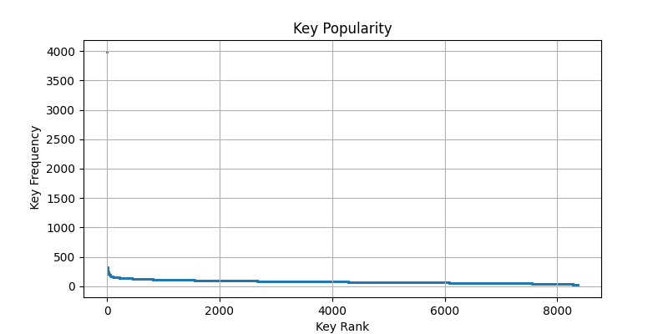
Sliding All Window- Apply
Amplification
Input= 134322
Interactions with state: 679976

Slide 31
Keyed Windows

Slide 32
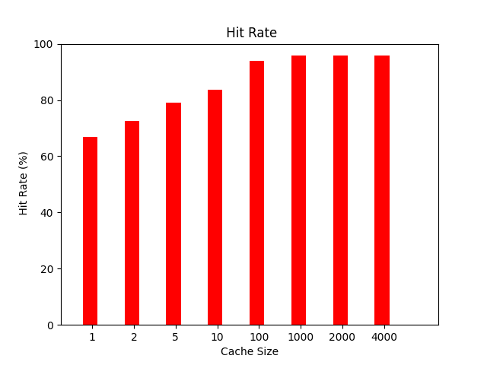
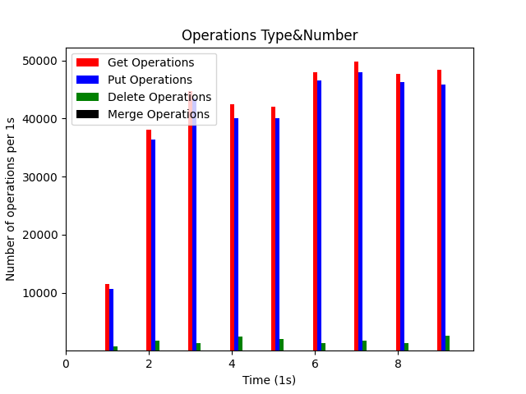
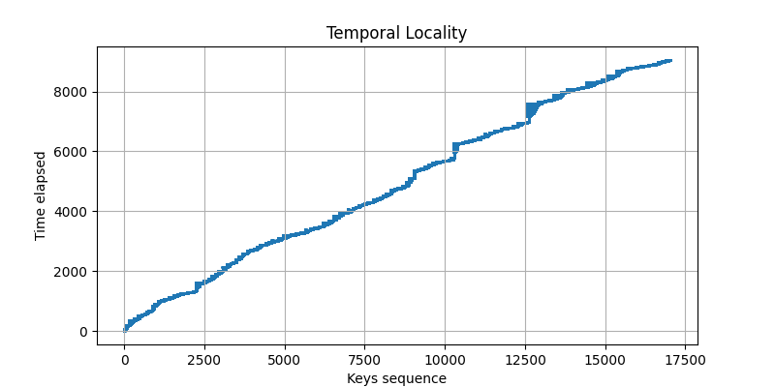
Tumbling Keyed Window- Aggregation
Number of gets= 397265
Number of puts= 380235
Number of deletes= 17030
Number of merges= 0
working set = 399
key space size = 17030

Slide 33
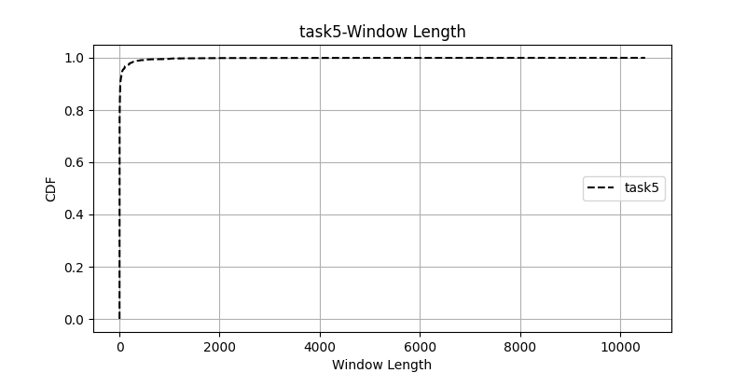
Tumbling Keyed Window- Aggregation
Amplification
input : 380235
interactions : 794530

Slide 34
Tumbling Keyed Window- Process
Number of gets= 17030
Number of puts= 0
Number of deletes= 17030
Number of merges= 380235
working set = 399
key space size = 17030

Slide 35
Tumbling Keyed Window- Process
Amplification
input : 380235
interactions : 414295

Slide 36
Sliding Keyed Window- Aggregation
Number of gets= 1986430
Number of puts= 1901175
Number of deletes= 85255
Number of merges= 0
working set = 1672
key space size = 85255

Slide 37
Sliding Keyed Window- Aggregation
Amplification
input : 380235
interactions : 3972860

Slide 38
Sliding Keyed Window- Process
Number of gets= 85255
Number of puts= 0
Number of deletes= 85255
Number of merges= 1901175
working set = 1672
key space size = 85255

Slide 39
Sliding Keyed Window- Process
Amplification
input : 380235
interactions : 2071685

Slide 40
Join Tumbling
Number of gets= 22907
Number of puts= 0
Number of deletes= 22907
Number of merges= 394038
working set = 4222
key space size = 22907

Slide 41
Join Tumbling
Amplification
input : 394038
interactions : 439852

Slide 42
Join Sliding
Number of gets= 137616
Number of puts= 0
Number of deletes= 137616
Number of merges= 2364228
working set = 23864
key space size = 137616

Slide 43
Join Sliding
Amplification
input : 394038
interactions : 2639460

Slide 44
Keyed Session window - Process
Number of gets= 408107
Number of puts= 0
Number of deletes= 129666
Number of merges= 468347
working set = 804
key space size = 115811

Slide 45
Session window - Process
Amplification
Input: input : 394038
Interactions: 1006120

Slide 46
Keyed Session window - Aggregate
Number of gets= 788342
Number of puts= 380235
Number of deletes= 129666
Number of merges= 88112
working set = 804
key space size = 115811

Slide 47
Keyed Session window - Aggregate
Amplification
Input: input : 394038
Interactions: 1386355

Slide 48
Continuous Join
Total number of deletes: 0
Total number of puts: 38187
Total number of gets: 76940
Total number of merges: 0
working set = 3967
key space size = 3967

Slide 49
Continuous Join

Slide 50
Continuous Aggregation
Total number of deletes: 0
Total number of puts: 373605
Total number of gets: 373605
Total number of merges: 0
working set = 9518
key space size = 9518

Slide 51
Continuous Aggregation

