Slide 1
Lecture outline
Classification
Naïve Bayes classifier
Nearest-neighbor classifier

Slide 2
Eager vs Lazy learners
Eager learners: learn the model as soon as the training data becomes available
Lazy learners: delay model-building until testing data needs to be classified
Rote classifier: memorizes the entire training data

Slide 3
k-nearest neighbor classifiers
k-nearest neighbors of a record x are data points that have the k smallest distance to x

Slide 4
k-nearest neighbor classification
Given a data record x find its k closest points
Closeness: Euclidean, Hamming, Jaccard distance
Determine the class of x based on the classes in the neighbor list
Majority vote
Weigh the vote according to distance
e.g., weight factor, w = 1/d²
Probabilistic voting

Slide 5
Characteristics of nearest-neighbor classifiers
Instance of instance-based learning
No model building (lazy learners)
Lazy learners: computational time in classification
Eager learners: computational time in model building
Decision trees try to find global models, k-NN take into account local information
K-NN classifiers depend a lot on the choice of proximity measure

Slide 6
Bayes Theorem
X, Y random variables
Joint probability: Pr(X=x,Y=y)
Conditional probability: Pr(Y=y | X=x)
Relationship between joint and conditional probability distributions
Bayes Theorem:

Slide 7
Bayes Theorem for Classification
X: attribute set
Y: class variable
Y depends on X in a non-determininstic way
We can capture this dependence using
Pr(Y|X) : Posterior probability
vs
Pr(Y): Prior probability

Slide 8
Building the Classifier
Training phase:
Learning the posterior probabilities Pr(Y|X) for every combination of X and Y based on training data
Test phase:
For test record X’, compute the class Y’ that maximizes the posterior probability
Pr(Y’|X’)

Slide 9
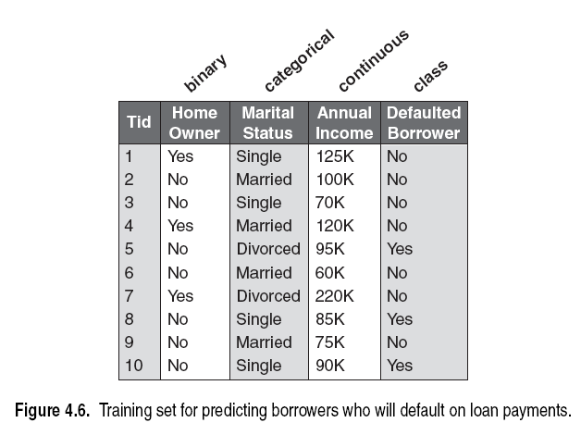
Bayes Classification: Example
X’=(Home Owner=No, Marital Status=Married, AnnualIncome=120K)
Compute: Pr(Yes|X’), Pr(No|X’) pick No or Yes with max Prob.
How can we compute these probabilities??

Slide 10
Computing posterior probabilities
Bayes Theorem
P(X) is constant and can be ignored
P(Y): estimated from training data; compute the fraction of training records in each class
P(X|Y)?

Slide 11
Naïve Bayes Classifier
Attribute set X = {X₁,…,X_{d}} consists of d attributes
Conditional independence:
X conditionally independent of Y, given X: Pr(X|Y,Z) = Pr(X|Z)
Pr(X,Y|Z) = Pr(X|Z)xPr(Y|Z)

Slide 12
Naïve Bayes Classifier
Attribute set X = {X₁,…,X_{d}} consists of d attributes

Slide 13
Conditional probabilities for categorical attributes
Categorical attribute X_{i}
Pr(Xi = xi|Y=y): fraction of training instances in class y that take value x_{i} on the i-th attribute
Pr(homeOwner = yes|No) = 3/7
Pr(MaritalStatus = Single| Yes) = 2/3

Slide 14
Estimating conditional probabilities for continuous attributes?
Discretization?
How can we discretize?

Slide 15
Naïve Bayes Classifier: Example
X’ = (HomeOwner = No, MaritalStatus = Married, Income=120K)
Need to compute Pr(Y|X’) or Pr(Y)xPr(X’|Y)
But Pr(X’|Y) is
Y = No:
Pr(HO=No|No)xPr(MS=Married|No)xPr(Inc=120K|No) = 4/7x4/7x0.0072 = 0.0024
Y=Yes:
Pr(HO=No|Yes)xPr(MS=Married|Yes)xPr(Inc=120K|Yes) = 1x0x1.2x10⁻⁹ = 0

Slide 16
Naïve Bayes Classifier: Example
X’ = (HomeOwner = No, MaritalStatus = Married, Income=120K)
Need to compute Pr(Y|X’) or Pr(Y)xPr(X’|Y)
But Pr(X’|Y = Yes) is 0?
Correction process:
n_{c}: number of training examples from class y_{j} that take value x_{i}
n: total number of instances from class y_{j}
m: equivalent sample size (balance between prior and posterior)
p: user-specified parameter (prior probability)

Slide 17
Characteristics of Naïve Bayes Classifier
Robust to isolated noise points
noise points are averaged out
Handles missing values
Ignoring missing-value examples
Robust to irrelevant attributes
If X_{i} is irrelevant, P(X_{i}|Y) becomes almost uniform
Correlated attributes degrade the performance of NB classifier

