Slide 1
Lecture outline
Clustering aggregation
  Reference: A. Gionis, H. Mannila, P. Tsaparas: Clustering aggregation, ICDE 2004
Co-clustering (or bi-clustering)
References:
  A. Anagnostopoulos, A. Dasgupta and R. Kumar: Approximation Algorithms for co-clustering, PODS 2008.
  K. Puolamaki. S. Hanhijarvi and G. Garriga: An approximation ratio for biclustering, Information Processing Letters 2008.

Slide 2
Clustering aggregation
Many different clusterings for the same dataset!
  Different objective functions
  Different algorithms
  Different number of clusters
Which clustering is the best?
  Aggregation: we do not need to decide, but rather find a reconciliation between different outputs

Slide 3
The clustering-aggregation problem
Input
  n objects X = {x₁,x₂,…,x_{n}}
  m clusterings of the objects C₁,…,C_{m}
    partition: a collection of disjoint sets that cover X
Output
  a single partition C, that is as close as possible to all input partitions
How do we measure closeness of clusterings?
  disagreement distance

Slide 4
Disagreement distance
For object x and clustering C, C(x) is the index of set in the partition that contains x
For two partitions C and P, and objects x,y in X define
if I_{P,Q}(x,y) = 1 we say that x,y create a disagreement between partitions P and Q
U | C | P
x₁ | 1 | 1
x₂ | 1 | 2
x₃ | 2 | 1
x₄ | 3 | 3
x₅ | 3 | 4
D(P,Q) = 4

Slide 5
Metric property for disagreement distance
For clustering C: D(C,C) = 0
D(C,C’)≥0 for every pair of clusterings C, C’
D(C,C’) = D(C’,C)
Triangle inequality?
It is sufficient to show that for each pair of points x,y єX: I_{x,y}(C₁,C₃)≤ I_{x,y}(C₁,C₂) + I_{x,y}(C₂,C₃)
I_{x,y} takes values 0/1; triangle inequality can only be violated when
  I_{x,y}(C₁,C₃)=1 and I_{x,y}(C₁,C₂) = 0 and I_{x,y}(C₂,C₃)=0
  Is this possible?

Slide 6
Clustering aggregation
Given partitions C₁,…,C_{m} find C such that
is minimized
the aggregation cost
U | C₁ | C₂ | C₃ | C
x₁ | 1 | 1 | 1 | 1
x₂ | 1 | 2 | 2 | 2
x₃ | 2 | 1 | 1 | 1
x₄ | 2 | 2 | 2 | 2
x₅ | 3 | 3 | 3 | 3
x₆ | 3 | 4 | 3 | 3

Slide 7
Why clustering aggregation?
Clustering categorical data
The two problems are equivalent
U | City | Profession | Nationality
x₁ | New York | Doctor | U.S.
x₂ | New York | Teacher | Canada
x₃ | Boston | Doctor | U.S.
x₄ | Boston | Teacher | Canada
x₅ | Los Angeles | Lawer | Mexican
x₆ | Los Angeles | Actor | Mexican

Slide 8
Why clustering aggregation?
Identify the correct number of clusters
  the optimization function does not require an explicit number of clusters
Detect outliers
  outliers are defined as points for which there is no consensus

Slide 9
Why clustering aggregation?
Improve the robustness of clustering algorithms
  different algorithms have different weaknesses.
  combining them can produce a better result.

Slide 10
Why clustering aggregation?
Privacy preserving clustering
  different companies have data for the same users. They can compute an aggregate clustering without sharing the actual data.

Slide 11
Complexity of Clustering Aggregation
The clustering aggregation problem is NP-hard
  the median partition problem [Barthelemy and LeClerc 1995].
Look for heuristics and approximate solutions.
ALG(I) ≤ c OPT(I)

Slide 12
A simple 2-approximation algorithm
The disagreement distance D(C,P) is a metric
The algorithm BEST: Select among the input clusterings the clustering C* that minimizes D(C*).
  a 2-approximate solution. Why?

Slide 13
A 3-approximation algorithm
The BALLS algorithm:
  Select a point x and look at the set of points B within distance ½ of x
  If the average distance of x to B is less than ¼ then create the cluster BU{p}
  Otherwise, create a singleton cluster {p}
  Repeat until all points are exhausted
Theorem: The BALLS algorithm has worst-case approximation factor 3

Slide 14
Other algorithms
AGGLO:
  Start with all points in singleton clusters
  Merge the two clusters with the smallest average inter-cluster edge weight
  Repeat until the average weight is more than ½
LOCAL:
  Start with a random partition of the points
  Remove a point from a cluster and try to merge it to another cluster, or create a singleton to improve the cost of aggregation.
  Repeat until no further improvements are possible

Slide 15
Clustering Robustness

Slide 16
Lecture outline
Clustering aggregation
  Reference: A. Gionis, H. Mannila, P. Tsaparas: Clustering aggregation, ICDE 2004
Co-clustering (or bi-clustering)
References:
  A. Anagnostopoulos, A. Dasgupta and R. Kumar: Approximation Algorithms for co-clustering, PODS 2008.
  K. Puolamaki. S. Hanhijarvi and G. Garriga: An approximation ratio for biclustering, Information Processing Letters 2008.

Slide 17
Clustering
m points in R^{n}
Group them to k clusters
Represent them by a matrix A∈R^{m×n}
  A point corresponds to a row of A
Cluster: Partition the rows to k groups
R^{n}
n
3 | 0 | 6 | 8 | 9 | 7
2 | 3 | 4 | 12 | 8 | 10
1 | 2 | 3 | 10 | 9 | 8
0 | 8 | 4 | 8 | 7 | 9
2 | 4 | 3 | 11 | 9 | 10
16 | 10 | 13 | 6 | 7 | 5
10 | 8 | 9 | 2 | 3 | 7
m
A

Slide 18
Co-Clustering
Co-Clustering: Cluster rows and columns of A simultaneously:
ℓ = 2
Co-cluster
3 | 0 | 6 | 8 | 9 | 7
2 | 3 | 4 | 12 | 8 | 10
1 | 2 | 3 | 10 | 9 | 8
0 | 8 | 4 | 8 | 9 | 7
2 | 4 | 3 | 11 | 9 | 10
16 | 10 | 13 | 6 | 7 | 5
10 | 8 | 9 | 2 | 3 | 7
k = 2
A

Slide 19

Motivation: Sponsored Search
Ads
Main revenue for search engines
Advertisers bid on keywords
A user makes a query
Show ads of advertisers that are relevant and have high bids
User clicks or not an ad

Slide 20
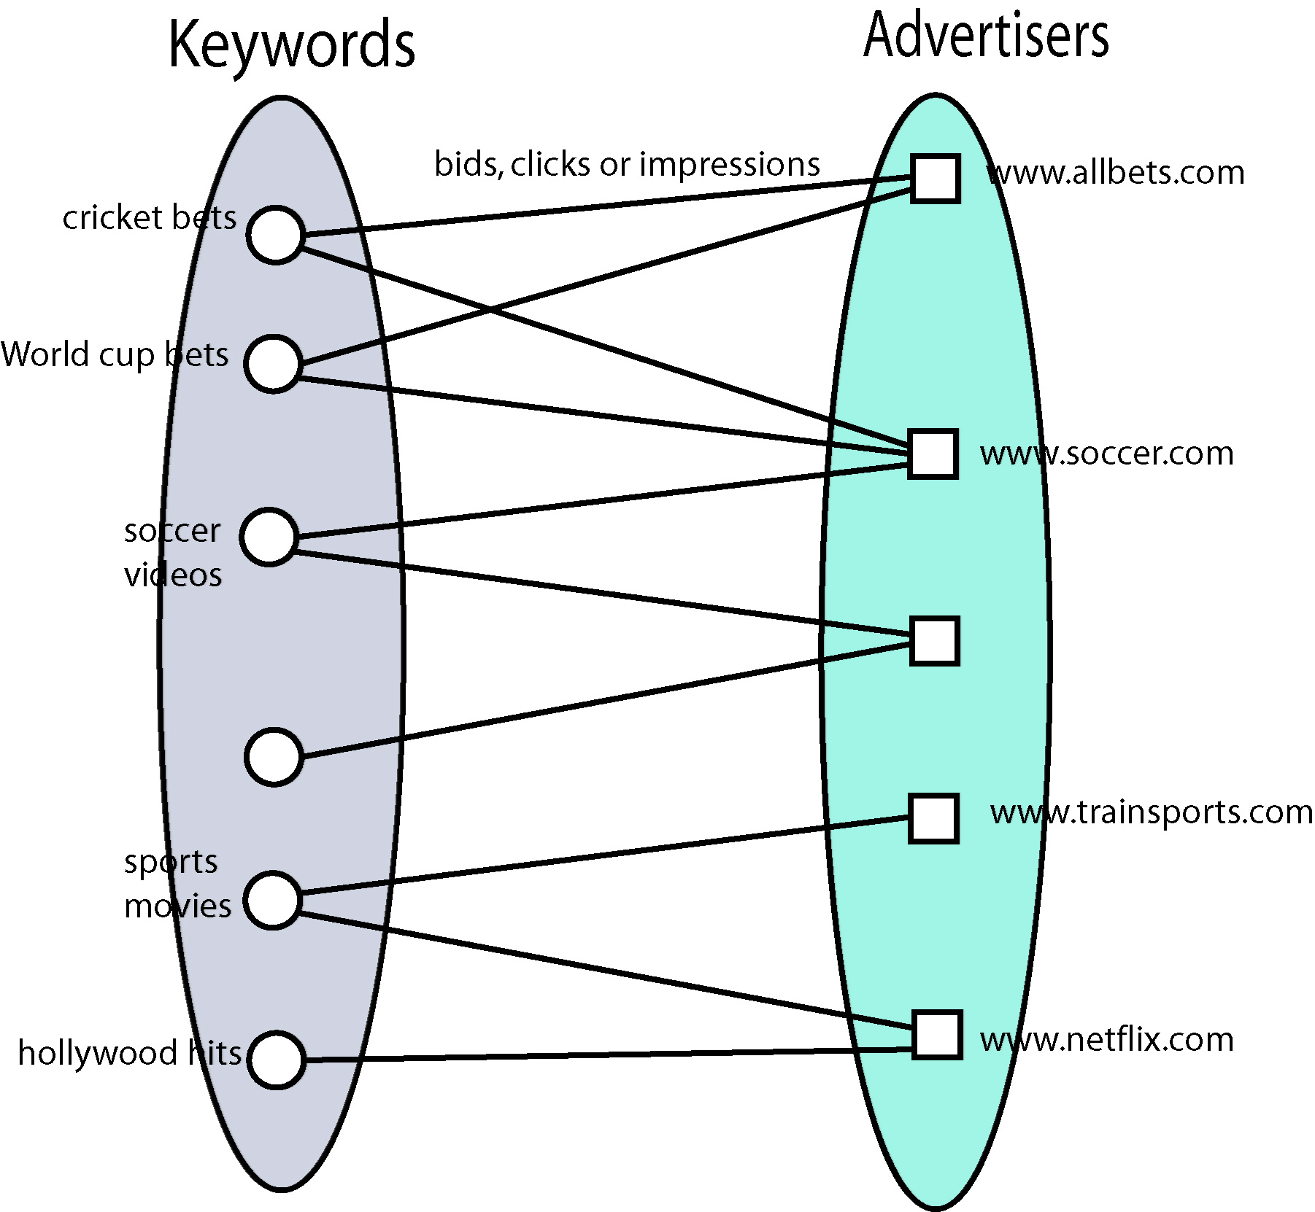
Motivation: Sponsored Search
For every
(advertiser, keyword) pair
we have:
  Bid amount
  Impressions
  # clicks
Mine information at query time
  Maximize # clicks / revenue

Slide 21
Co-Clusters in Sponsored Search
Bids of skis.com for “ski boots”
Ski boots
Vancouver
All these keywords are relevant
to a set of advertisers
Keywords
Markets = co-clusters
Air France
Skis.com
Advertiser

Slide 22
Co-Clustering in Sponsored Search
Applications:
Keyword suggestion
  Recommend to advertisers other relevant keywords
Broad matching / market expansion
  Include more advertisers to a query
Isolate submarkets
  Important for economists
  Apply different advertising approaches
Build taxonomies of advertisers / keywords

Slide 23
Clustering of the rows
m points in R^{n}
Group them to k clusters
Represent them by a matrix A∈R^{m×n}
  A point corresponds to a row of A
Clustering: Partitioning of the rows into k groups
R^{n}
n
3 | 0 | 6 | 8 | 9 | 7
2 | 3 | 4 | 12 | 8 | 10
1 | 2 | 3 | 10 | 9 | 8
0 | 8 | 4 | 8 | 7 | 9
2 | 4 | 3 | 11 | 9 | 10
16 | 10 | 13 | 6 | 7 | 5
10 | 8 | 9 | 2 | 3 | 7
m
A

Slide 24
Clustering of the columns
R^{n}
n points in R^{m}
Group them to k clusters
Represent them by a matrix A∈R^{m×n}
  A point corresponds to a column of A
Clustering: Partitioning of the columns into k groups
n
3 | 0 | 6 | 8 | 9 | 7
2 | 3 | 4 | 12 | 8 | 10
1 | 2 | 3 | 10 | 9 | 8
0 | 8 | 4 | 8 | 7 | 9
2 | 4 | 3 | 11 | 9 | 10
16 | 10 | 13 | 6 | 7 | 5
10 | 8 | 9 | 2 | 3 | 7
3 | 3 | 3 | 9 | 9 | 9
3 | 3 | 3 | 9 | 9 | 9
3 | 3 | 3 | 9 | 9 | 9
3 | 3 | 3 | 9 | 9 | 9
3 | 3 | 3 | 9 | 9 | 9
11 | 11 | 11 | 5 | 5 | 5
11 | 11 | 11 | 5 | 5 | 5
m
A
R

Slide 25
Cost of clustering
3 | 0 | 6 | 8 | 9 | 7
2 | 3 | 4 | 12 | 8 | 10
1 | 2 | 3 | 10 | 9 | 8
0 | 8 | 4 | 8 | 7 | 9
2 | 4 | 3 | 11 | 9 | 10
16 | 10 | 13 | 6 | 7 | 5
10 | 8 | 9 | 2 | 3 | 7
1.6 | 3.4 | 4 | 9.8 | 8.4 | 8.8
1.6 | 3.4 | 4 | 9.8 | 8.4 | 8.8
1.6 | 3.4 | 4 | 9.8 | 8.4 | 8.8
1.6 | 3.4 | 4 | 9.8 | 8.4 | 8.8
1.6 | 3.4 | 4 | 9.8 | 8.4 | 8.8
13 | 9 | 11 | 4 | 5 | 6
13 | 9 | 11 | 4 | 5 | 6
A_{I}
A
R M
Original data points A
Data representation A’
In A’ every point in A (row or column) is replaced by the corresponding representative (row or column)
The quality of the clustering is measured by computing distances between the data in the cells of A and A’.
k-means clustering: cost = ∑_{i=1…n} ∑_{j=1…m} (A(i,j)-A’(i,j))²
k-median clustering: cost = ∑_{i=1…n} ∑_{j=1…m} |A(i,j)-A’(i,j)|

Slide 26
Co-Clustering
Co-Clustering: Cluster rows and columns of A∈R^{m×n} simultaneously
k row clusters, ℓ column clusters
Every cell in A is represented by a cell in A’
All cells in the same co-cluster are represented by the same value in the cells of A’
3 | 0 | 6 | 8 | 9 | 7
2 | 3 | 4 | 12 | 8 | 10
1 | 2 | 3 | 10 | 9 | 8
0 | 8 | 4 | 8 | 9 | 7
2 | 4 | 3 | 11 | 9 | 10
16 | 10 | 13 | 6 | 7 | 5
10 | 8 | 9 | 2 | 3 | 7
3 | 3 | 3 | 9 | 9 | 9
3 | 3 | 3 | 9 | 9 | 9
3 | 3 | 3 | 9 | 9 | 9
3 | 3 | 3 | 9 | 9 | 9
3 | 3 | 3 | 9 | 9 | 9
11 | 11 | 11 | 5 | 5 | 5
11 | 11 | 11 | 5 | 5 | 5
Original data A
Co-cluster representation A’
A
R
M
C
R M C

Slide 27
Co-Clustering Objective Function
3 | 0 | 6 | 8 | 9 | 7
2 | 3 | 4 | 12 | 8 | 10
1 | 2 | 3 | 10 | 9 | 8
0 | 8 | 4 | 8 | 7 | 9
2 | 4 | 3 | 11 | 9 | 10
16 | 10 | 13 | 6 | 7 | 5
10 | 8 | 9 | 2 | 3 | 7
3 | 3 | 3 | 9 | 9 | 9
3 | 3 | 3 | 9 | 9 | 9
3 | 3 | 3 | 9 | 9 | 9
3 | 3 | 3 | 9 | 9 | 9
3 | 3 | 3 | 9 | 9 | 9
11 | 11 | 11 | 5 | 5 | 5
11 | 11 | 11 | 5 | 5 | 5
A
R M C
In A’ every point in A (row or column) is replaced by the corresponding representative (row or column)
The quality of the clustering is measured by computing distances between the data in the cells of A and A’.
k-means Co-clustering: cost = ∑_{i=1…n} ∑_{j=1…m} (A(i,j)-A’(i,j))²
k-median Co-clustering: cost = ∑_{i=1…n} ∑_{j=1…m} |A(i,j)-A’(i,j)|

Slide 28
Some Background
A.k.a.: biclustering, block clustering, …
Many objective functions in co-clustering
  This is one of the easier
  Others factor out row-column average (priors)
  Others based on information theoretic ideas (e.g. KL divergence)
A lot of existing work, but mostly heuristic
  k-means style, alternate between rows/columns
  Spectral techniques

Slide 29
Algorithm
Cluster rows of A
Cluster columns of A
Combine

Slide 30
Properties of the algorithm
Theorem 1. Algorithm with optimal row/column clusterings is 3-approximation to co-clustering optimum.
Theorem 2. For L₂ distance function, the algorithm with optimal row/column clusterings is a 2-approximation.

Slide 31
Algorithm--details
Clustering of the n rows of A assigns every row to a cluster with cluster name {1,…,k}
  R(i)= r_{i} with 1≤ r_{i} ≤k
Clustering of the m columns of A assigns every column to a cluster with cluster name {1,…,ℓ}
  C(j)=c_{j} with 1≤ c_{j} ≤ℓ
A’(i,j) = {r_{i},c_{j}}
(i,j) is in the same co-cluster as (i’,j’) if A’(i,j)=A’(i’,j’)

