Slide 1
Lecture outline
Nearest-neighbor search in low dimensions
kd-trees
Nearest-neighbor search in high dimensions
LSH
Applications to data mining

Slide 2
Definition
Given: a set X of n points in R^{d}
Nearest neighbor: for any query point qєR^{d} return the point xєX minimizing D(x,q)
Intuition: Find the point in X that is the closest to q

Slide 3
Motivation
Learning: Nearest neighbor rule
Databases: Retrieval
Data mining: Clustering
Donald Knuth in vol.3 of The Art of Computer Programming called it the post-office problem, referring to the application of assigning a resident to the nearest-post office

Slide 4
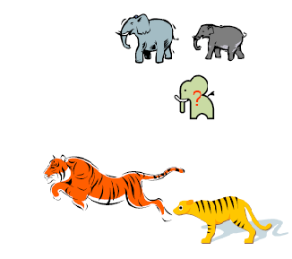
Nearest-neighbor rule

Slide 5
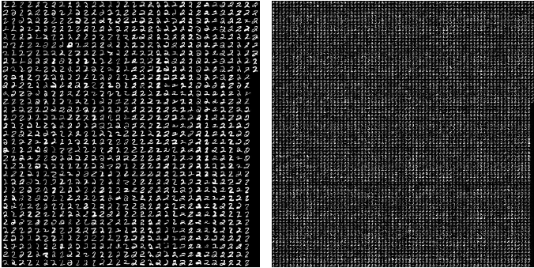
MNIST dataset “2”

Slide 6
Methods for computing NN
Linear scan: O(nd) time
This is pretty much all what is known for exact algorithms with theoretical guarantees
In practice:
kd-trees work “well” in “low-medium” dimensions

Slide 7
2-dimensional kd-trees
A data structure to support range queries in R²
Not the most efficient solution in theory
Everyone uses it in practice
Preprocessing time: O(nlogn)
Space complexity: O(n)
Query time: O(n^{1/2}+k)

Slide 8
2-dimensional kd-trees
Algorithm:
Choose x or y coordinate (alternate)
Choose the median of the coordinate; this defines a horizontal or vertical line
Recurse on both sides
We get a binary tree:
Size O(n)
Depth O(logn)
Construction time O(nlogn)

Slide 9
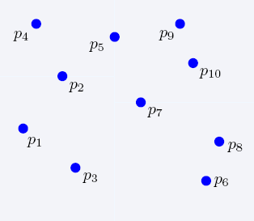
Construction of kd-trees

Slide 10
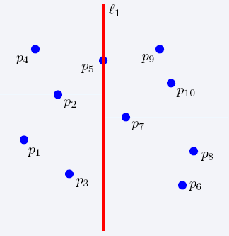
Construction of kd-trees

Slide 11
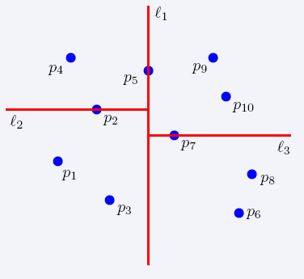
Construction of kd-trees

Slide 12
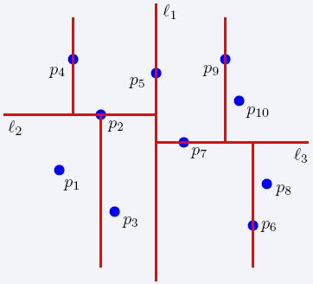
Construction of kd-trees

Slide 13
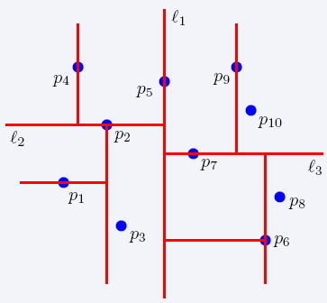
Construction of kd-trees

Slide 14
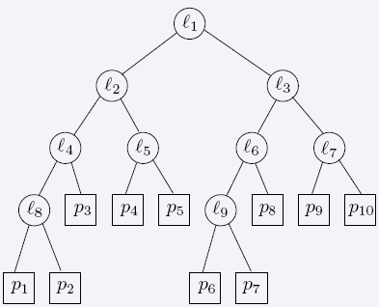
The complete kd-tree

Slide 15
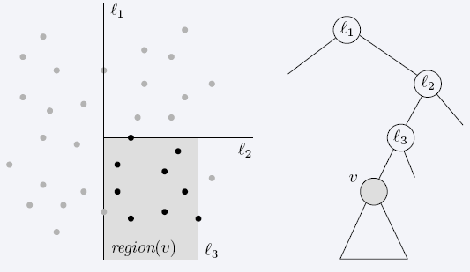
Region of node v
Region(v) : the subtree rooted at v stores the points in black dots

Slide 16
Searching in kd-trees
Range-searching in 2-d
Given a set of n points, build a data structure that for any query rectangle R reports all point in R

Slide 17
kd-tree: range queries
Recursive procedure starting from v = root
Search (v,R)
If v is a leaf, then report the point stored in v if it lies in R
Otherwise, if Reg(v) is contained in R, report all points in the subtree(v)
Otherwise:
If Reg(left(v)) intersects R, then Search(left(v),R)
If Reg(right(v)) intersects R, then Search(right(v),R)

Slide 18
Query time analysis
We will show that Search takes at most O(n^{1/2}+P) time, where P is the number of reported points
The total time needed to report all points in all sub-trees is O(P)
We just need to bound the number of nodes v such that region(v) intersects R but is not contained in R (i.e., boundary of R intersects the boundary of region(v))
gross overestimation: bound the number of region(v) which are crossed by any of the 4 horizontal/vertical lines

Slide 19
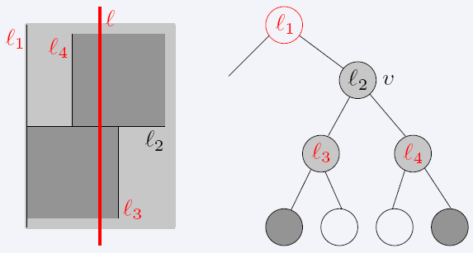
Query time (Cont’d)
Q(n): max number of regions in an n-point kd-tree intersecting a (say, vertical) line?
If ℓ intersects region(v) (due to vertical line splitting), then after two levels it intersects 2 regions (due to 2 vertical splitting lines)
The number of regions intersecting ℓ is Q(n)=2+2Q(n/4) → Q(n)=(n^{1/2})

Slide 20
d-dimensional kd-trees
A data structure to support range queries in R^{d}
Preprocessing time: O(nlogn)
Space complexity: O(n)
Query time: O(n^{1-1/d}+k)

Slide 21
Construction of the d-dimensional kd-trees
The construction algorithm is similar as in 2-d
At the root we split the set of points into two subsets of same size by a hyperplane vertical to x₁-axis
At the children of the root, the partition is based on the second coordinate: x₂-coordinate
At depth d, we start all over again by partitioning on the first coordinate
The recursion stops until there is only one point left, which is stored as a leaf

Slide 22
Locality-sensitive hashing (LSH)
Idea: Construct hash functions h: R^{d}→ U such that for any pair of points p,q:
If D(p,q)≤r, then Pr[h(p)=h(q)] is high
If D(p,q)≥cr, then Pr[h(p)=h(q)] is small
Then, we can solve the “approximate NN” problem by hashing
LSH is a general framework; for a given D we need to find the right h

Slide 23
Approximate Nearest Neighbor
Given a set of points X in R^{d} and query point qєR^{d} c-Approximate r-Nearest Neighbor search returns:
Returns p∈P, D(p,q) ≤ r
Returns NO if there is no p’∈X, D(p’,q) ≤ cr

Slide 24
Locality-Sensitive Hashing (LSH)
A family H of functions h: R^{d}→U is called (P₁,P₂,r,cr)-sensitive if for any p,q:
if D(p,q)≤r, then Pr[h(p)=h(q)] ≥ P1
If D(p,q)≥ cr, then Pr[h(p)=h(q)] ≤ P2
P1 > P2
Example: Hamming distance
LSH functions: h(p)=p_{i}, i.e., the i-th bit of p
Probabilities: Pr[h(p)=h(q)]=1-D(p,q)/d

Slide 25
Algorithm -- preprocessing
g(p) = <h₁(p),h₂(p),…,h_{k}(p)>
Preprocessing
Select g₁,g₂,…,g_{L}
For all pєX hash p to buckets g₁(p),…,g_{L}(p)
Since the number of possible buckets might be large we only maintain the non empty ones
Running time?

Slide 26
Algorithm -- query
Query q:
Retrieve the points from buckets g₁(q),g₂(q),…, g_{L}(q) and let points retrieved be x₁,…,x_{L}
If D(x_{i},q)≤r report it
Otherwise report that there does not exist such a NN
Answer the query based on the retrieved points
Time O(dL)

Slide 27
Applications of LSH in data mining
Numerous….

Slide 28
Applications
Find pages with similar sets of words (for clustering or classification)
Find users in Netflix data that watch similar movies
Find movies with similar sets of users
Find images of related things

Slide 29
How would you do it?
Finding very similar items might be computationally demanding task
We can relax our requirement to finding somewhat similar items

Slide 30
Running example: comparing documents
Documents have common text, but no common topic
Easy special cases:
Identical documents
Fully contained documents (letter by letter)
General case:
Many small pieces of one document appear out of order in another. What do we do then?

Slide 31
Finding similar documents
Given a collection of documents, find pairs of documents that have lots of text in common
Identify mirror sites or web pages
Plagiarism
Similar news articles

Slide 32
Key steps
Shingling: convert documents (news articles, emails, etc) to sets
LSH: convert large sets to small signatures, while preserving the similarity
Compare the signatures instead of the actual documents

Slide 33
Shingles
A k-shingle (or k-gram) is a sequence of k characters that appears in a document
If doc = abcab and k=3, then 2-singles: {ab, bc, ca}
Represent a document by a set of k-shingles

Slide 34
Assumption
Documents that have similar sets of k-shingles are similar: same text appears in the two documents; the position of the text does not matter
What should be the value of k?
What would large or small k mean?

Slide 35
Data model: sets
Data points are represented as sets (i.e., sets of shingles)
Similar data points have large intersections in their sets
Think of documents and shingles
Customers and products
Users and movies

Slide 36
Similarity measures for sets
Now we have a set representation of the data
Jaccard coefficient
A, B sets (subsets of some, large, universe U)

Slide 37
Find similar objects using the Jaccard similarity
Naïve method?
Problems with the naïve method?
There are too many objects
Each object consists of too many sets

Slide 38
Speedingup the naïve method
Represent every object by a signature (summary of the object)
Examine pairs of signatures rather than pairs of objects
Find all similar pairs of signatures
Check point: check that objects with similar signatures are actually similar

Slide 39
Still problems
Comparing large number of signatures with each other may take too much time (although it takes less space)
The method can produce pairs of objects that might not be similar (false positives). The check point needs to be enforced

Slide 40
Creating signatures
For object x, signature of x (sign(x)) is much smaller (in space) than x
For objects x, y it should hold that sim(x,y) is almost the same as sim(sing(x),sign(y))

Slide 41
Intuition behind Jaccard similarity
Consider two objects: x,y
a: # of rows of form same as a
sim(x,y)= a /(a+b+c)
 | x | y
a | 1 | 1
b | 1 | 0
c | 0 | 1
d | 0 | 0

Slide 42
A type of signatures -- minhashes
Randomly permute the rows
h(x): first row (in permuted data)
in which column x has an 1
Use several (e.g., 100) independent
hash functions to design a signature
 | x | y
a | 1 | 1
b | 1 | 0
c | 0 | 1
d | 0 | 0
 | x | y
a | 0 | 1
b | 0 | 0
c | 1 | 1
d | 1 | 0

Slide 43
“Surprising” property
The probability (over all permutations of rows) that h(x)=h(y) is the same as sim(x,y)
Both of them are a/(a+b+c)
So?
The similarity of signatures is the fraction of the hash functions on which they agree

Slide 44
Minhash algorithm
Pick k (e.g., 100) permutations of the rows
Think of sign(x) as a new vector
Let sign(x)[i]: in the i-th permutation, the index of the first row that has 1 for object x

Slide 45
Example of minhash signatures
Input matrix
 | x1 | x2 | x3 | X4
1 | 1 | 0 | 1 | 0
2 | 1 | 0 | 0 | 1
3 | 0 | 1 | 0 | 1
4 | 0 | 1 | 0 | 1
5 | 0 | 1 | 0 | 1
6 | 1 | 0 | 1 | 0
7 | 1 | 0 | 1 | 0
 | x1 | x2 | x3 | X4
1 | 1 | 0 | 1 | 0
3 | 0 | 1 | 0 | 1
7 | 1 | 0 | 1 | 0
6 | 1 | 0 | 1 | 0
2 | 1 | 0 | 0 | 1
5 | 0 | 1 | 0 | 1
4 | 0 | 1 | 0 | 1
1
3
7
6
2
5
4
1 | 2 | 1 | 2

Slide 46
Example of minhash signatures
Input matrix
 | x1 | x2 | x3 | X4
1 | 1 | 0 | 1 | 0
2 | 1 | 0 | 0 | 1
3 | 0 | 1 | 0 | 1
4 | 0 | 1 | 0 | 1
5 | 0 | 1 | 0 | 1
6 | 1 | 0 | 1 | 0
7 | 1 | 0 | 1 | 0
 | x1 | x2 | x3 | X4
4 | 0 | 1 | 0 | 1
2 | 1 | 0 | 0 | 1
1 | 1 | 0 | 1 | 0
3 | 0 | 1 | 0 | 1
6 | 1 | 0 | 1 | 0
7 | 1 | 0 | 1 | 0
5 | 0 | 1 | 0 | 1
4
2
1
3
6
7
5
2 | 1 | 3 | 1

Slide 47
Example of minhash signatures
Input matrix
 | x1 | x2 | x3 | X4
1 | 1 | 0 | 1 | 0
2 | 1 | 0 | 0 | 1
3 | 0 | 1 | 0 | 1
4 | 0 | 1 | 0 | 1
5 | 0 | 1 | 0 | 1
6 | 1 | 0 | 1 | 0
7 | 1 | 0 | 1 | 0
 | x1 | x2 | x3 | X4
3 | 0 | 1 | 0 | 1
4 | 0 | 1 | 0 | 1
7 | 1 | 0 | 1 | 0
6 | 1 | 0 | 1 | 0
1 | 1 | 0 | 1 | 0
2 | 1 | 0 | 0 | 1
5 | 0 | 1 | 0 | 1
3
4
7
6
1
2
5
3 | 1 | 3 | 1

Slide 48
Example of minhash signatures
Input matrix
 | actual | signs
(x1,x2) | 0 | 0
(x1,x3) | 0.75 | 2/3
(x1,x4) | 1/7 | 0
(x2,x3) | 0 | 0
(x2,x4) | 0.75 | 1
(x3,x4) | 0 | 0
 | x1 | x2 | x3 | X4
1 | 1 | 0 | 1 | 0
2 | 1 | 0 | 0 | 1
3 | 0 | 1 | 0 | 1
4 | 0 | 1 | 0 | 1
5 | 0 | 1 | 0 | 1
6 | 1 | 0 | 1 | 0
7 | 1 | 0 | 1 | 0
x1 | x2 | x3 | X4
1 | 2 | 1 | 2
2 | 1 | 3 | 1
3 | 1 | 3 | 1
≈

Slide 49
Is it now feasible?
Assume a billion rows
Hard to pick a random permutation of 1…billion
Even representing a random permutation requires 1 billion entries!!!
How about accessing rows in permuted order?
☹

Slide 50
Being more practical
Approximating row permutations: pick k=100 (?) hash functions (h₁,…,h_{k})
for each row r
for each column c
if c has 1 in row r
for each hash function h_{i} do
if h_{i} (r ) is a smaller value than M(i,c) then
M (i,c) = h_{i} (r);
M(i,c) will become the smallest value of h_{i}(r) for which column c has 1 in row r; i.e., h_{i} (r) gives order of rows for i-th permutation.

Slide 51
Example of minhash signatures
Input matrix
 | x1 | x2
1 | 1 | 0
2 | 0 | 1
3 | 1 | 1
4 | 1 | 0
5 | 0 | 1
 | x1 | x2
1 | 0 | 1
2 | 2 | 0
h(r) = r + 1 mod 5
g(r) = 2r + 1 mod 5

