Slide 1
Lecture outline
Support vector machines

Slide 2
Support Vector Machines
Find a linear hyperplane (decision boundary) that will separate the data

Slide 3
Support Vector Machines
One Possible Solution

Slide 4
Support Vector Machines
Another possible solution

Slide 5
Support Vector Machines
Other possible solutions

Slide 6
Support Vector Machines
Which one is better? B1 or B2?
How do you define better?

Slide 7
Support Vector Machines
Find hyperplane maximizes the margin => B1 is better than B2

Slide 8
Support Vector Machines

Slide 9
Support Vector Machines
We want to maximize:
Which is equivalent to minimizing:
But subjected to the following constraints:
This is a constrained optimization problem
Numerical approaches to solve it (e.g., quadratic programming)

Slide 10
Support Vector Machines
What if the problem is not linearly separable?

Slide 11
Support Vector Machines
What if the problem is not linearly separable?
Introduce slack variables
Need to minimize:
Subject to:

Slide 12
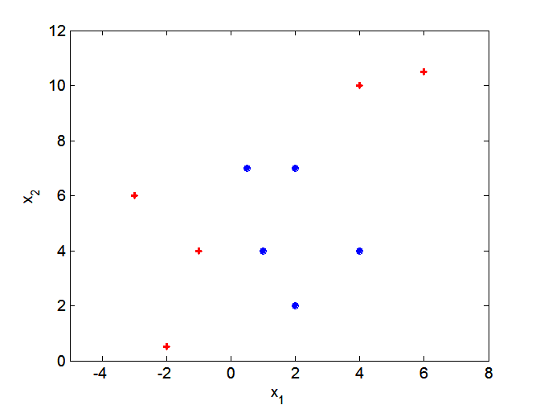
Nonlinear Support Vector Machines
What if decision boundary is not linear?

Slide 13
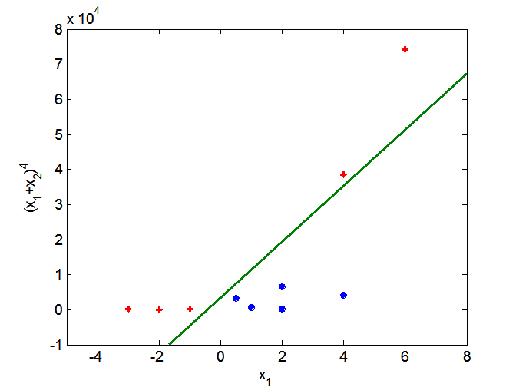
Nonlinear Support Vector Machines
Transform data into higher dimensional space

