Slide 1
Weighted synergy graphs for effective team formation with heterogeneous ad hoc agents
Somchaya Liemhetcharat, Manuela Veloso
Presented by:
Raymond Mead

Slide 2
Problem
Written for RoboCup Rescue Simulator, where teams of robots are used to solve tasks.
We want to choose the best team of robots to tackle a disaster.
Around 50 possible agents.
How can we form the best team when everyone’s abilities, and how well people work together, are known?
Given observations of groups and their performances, how can we generate a graph to model each person’s ability, and how well people work together?

Slide 3
Modeling Teams
For forming teams, we want to look at:
The compatibility between members of the team.
Each person’s ability.
Using a weighted graph:
Each vertex represents a person, who has a certain ability
Edges are used to show similarity between people
A person’s ability is modeled as a normal distribution
For someone, $a_{i}$, their ability is $C_{i}\sim N(μ_{i},{σ_{i}}^{2})$

Slide 4
Example Graph

Slide 5
Compatibility
$d(a_{i},a_{j})$ is the minimum distance between $a_{i},a_{j}∈A$
$φ(d)$, is a compatibility function.
Models how well people work together.
Larger distance → Less compatible
$φ\left(d\right)=\frac{1}{d}$
$φ\left(d\right)=exp⁡(−\frac{d\ln\left(2\right)}{h})$, exponential decay

Slide 6
Synergy of a Pair
A pair of people: $a_{i},a_{j}$
For a pair’s Synergy, add their abilities, $C_{i},C_{j}$, and scale it by how compatible they are, $φ(d)$.
$𝕊_{2}\left(a_{i},a_{j}\right)=φ(d)∙(C_{i}+C_{j})$
Normal distribution ~ $N\left(μ_{i,j},{σ_{i,j}}^{2}\right)$
$μ_{i,j} =φ\left(d\right)∙\left(μ_{i}+μ_{j}\right)$
${σ_{i,j}}^{2}={φ(d)}^{2}∙({σ_{i}}^{2}+{σ_{j}}^{2})$

Slide 7
Synergy of a Team
Average the Synergy between all pairs in a team $A$
$𝕊\left(A\right)= \frac{1}{\left({\left|A\right| \atop 2}\right)}\sum_{a_{i},a_{j}∈A}{𝕊_{2}(a_{i},a_{j})}$
Normal Distribution ~ $N\left(μ_{A},{σ_{A}}^{2}\right)$
$μ_{A} =\frac{1}{\left({\left|A\right| \atop 2}\right)} \sum_{a_{i},a_{j}∈A}{ φ(d\left(a_{i},a_{j}\right))∙(μ_{i}+μ_{j})}$
${σ_{A}}^{2}=\frac{1}{\left({\left|A\right| \atop 2}\right)} \sum_{a_{i},a_{j}∈A}{{ φ}^{2}(d\left(a_{i},a_{j}\right))∙({σ_{i}}^{2}+{σ_{j}}^{2})}$

Slide 8
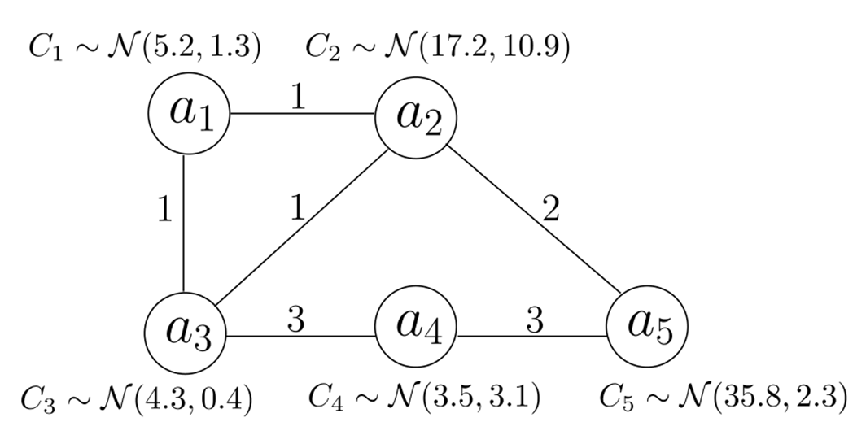
Example Synergies
$𝕊\left(\left\{a_{1},a_{2},a_{3}\right\}\right) \sim N(17.8,2.8)$
$𝕊\left(\left\{a_{1},…,a_{5} \right\}\right) \sim N\left(13.0,0.3\right)$

Slide 9
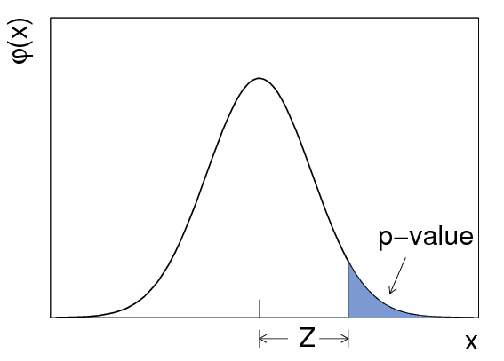
Evaluating a Team
$δ$-value of a team is $δ_{A}$ s.t. $P\left(𝕊\left(A\right)≥δ_{A}\right)=δ$.
Probability of a team’s performance being $≥δ_{A}$ is $δ$.
If $δ=.5$, then $δ_{A}=μ_{A}$
$δ≤.5→$ high risk, high reward
$δ≥.5→$ low risk, low reward
$A^{′}$ is better than $A$ if$:$
$δ_{A^{′}}≥δ_{A}$
$δ$-optimal team: ${A_{δ}}^{∗}$
Has largest $δ_{A}$

Slide 10
Problem: Finding the $δ$-Optimal Team
Among all possible teams, find the best team for given $δ$.
Need to check all possible sizes of teams
Need to check most, if not all teams for each team size.
NP-Hard
Reduce the Max-Clique problem to Finding the Optimal Team.
Max-Clique: Find the largest subgraph, where there is an edge between every pair of vertices.
NP-Complete

Slide 11
Algorithm: $δ$-optimal team of size $n$
Branch and Bound Algorithm:
$A$ is a team used for exploring possible teams.
Bound performance of $A$ to decide to keep exploring or not.
$A_{best}$ is the current known best team, with $δ_{best}$.
Initially, $A,A_{best}=∅$, and $δ_{best}=−∞$.
Check all pairs, unless a new best is not possible with the current members.
$O(\left({N \atop n}\right))$ if the best $n$ is known
$O(2^{N})$ otherwise

Slide 12
Algorithm: $δ$-optimal team of size $n$
$$FindδOpt\left(n,δ,S,A,A_{best},δ_{best}\right):$$
If $\left|A\right|=n$, compare $A$ and $A_{best}:$
Return $\left(A,δ_{A}\right)$ if $A$ is better, ${(A}_{best},δ_{best})$ otherwise.
For $k=i+1,…,N$, where $i←Largest index in A$
$$A^{′}=A∪\{a_{k}\}$$
$$\left\{{Min}_{A^{′}},{Max}_{A^{′}}\right\}←BoundδVal(A^{′}, n, δ, S)$$
All nodes that can be added are assumed to be worst or best case
Min compatibility with min ability → worst
Max compatibility with max ability → best
$${Max}_{A^{′}}≥δ_{best}:$$
$$\left(A_{best},δ_{best} \right)←FindδOpt(n,δ,S,A^{′},A_{best},δ_{best})$$

Slide 13
Reducing the Max-Clique Problem
$G=(V,E)$, is unweighted - want to find the max-clique.
The max-clique in $G$ will be the largest optimal team.
Create $G^{′}=(V,E^{′})$ to run with $FindδOpt$
Each edge in $E$ corresponds to an edge of weight 1 in $E′$
Everyone’s ability is $\sim N(1,1)$
$δ=.5$, Evaluating a team only depends on mean, always 1.
$φ\left(d\right)=$ $\left\{\begin{matrix}1 & d≤1 \\ 0 & otherwise\end{matrix}\right.$

Slide 14
Max-Clique → Best Team
Evaluating $𝕊(A)$:
$=\frac{1}{\left({\left|A\right| \atop 2}\right)}\sum_{a_{i},a_{j}∈A}{𝕊_{2}(a_{i},a_{j})}$, definition
$=\frac{1}{\left({\left|A\right| \atop 2}\right)}\sum_{a_{i},a_{j}∈A}{2∙φ(d\left(a_{i},a_{j}\right))}$, only mean matters
$$=\frac{1}{\left({\left|A\right| \atop 2}\right)}2\left|\left\{edges of weight 1 for pairs of A\right\}\right|$$
$φ\left(d\right)=1$ only when there is an edge between a pair in $A$
$0$ otherwise
Maximized when there is an edge between every pair of $A$

Slide 15
Approximation Algorithm
Simulated Annealing
Looking at teams similar to the current best, and comparing them
Generate a random team
Repeat constant times:
Find a new team similar to the current best, swap a node in $A$
Evaluate both teams
Replace if the new team is better
Return the best team found
Runs in $O(n^{2})$ if $n$ is known.
Evaluating $𝕊(A)$ is $O\left(n^{2}\right)$, where $n=\left|A\right|$
$O(N^{3})$ if n is unknown

Slide 16
Approximation Algorithm
$$ApproxδOptTeam\left(n,δ,S\right):$$
$$A_{best}←Random\left(S,n\right)$$
Repeat $k$ times$:$
$$A_{new}←Swap some a∈A_{best} with a′∈V\backslash A_{best}$$
Compare $A_{new}$ and $A_{best}$
Replace $A_{best}$ if $A_{new}$ is better
Return $A_{best}$

Slide 17
Comparison
Effectiveness of team $A$ is $=\frac{δ_{A}−δ_{min}}{δ_{max}−δ_{min}}$
Where $A$’s performance fits between best and worst.

Slide 18
Learning the Synergy Graph
We have observations, $O$, containing all people, $\overline{A}$.
Each observation is $o=(A,p)$, team $A$, performance, $p$.
Find a synergy graph that best fits the observations.
Need to find ability of each person.
Need to find the compatibility between people.
Strategy: Simulated Annealing

Slide 19
Learning Algorithm
$LearnSynergyGraph(O)$:
$$G←RandomGraph\left(\overline{A}\right)$$
$$C←FitAbilitiesToGraph(G,O)$$
$$score←LogLikelihood(G,C,O)$$
Repeat constant times:
$$G^{′}←SimilarGraph(G)$$
$$C^{′}←FitAbilitiesToGraph(G′,O)$$
Compare scores of $G$, and $G^{′}$
$G←G^{′}$ if $G^{′}$ is better
Return $G$

Slide 20
Generating G and Finding Similar G’
$RandomGraph\left(\overline{A}\right)$
Vertices represent each person
Randomly put edges of random weights between vertices
$SimilarGraph(G)$
Do one of the following to $G$:
Increase a random edge’s weight by 1
Decrease a random edge’s weight by 1
Remove a random edge
Add a random edge of random weight

Slide 21
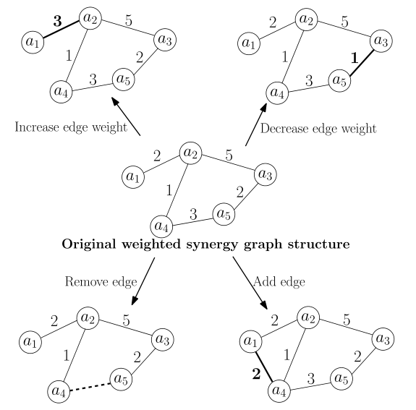
Similar Graph:

Slide 22
Fitting Abilities to a Graph
Look at all teams of size 2 or 3 of $\overline{A}$, $A_{2,3}$.
Each $A∈A_{2,3}$, there are observations of $A$, each with a performance.
Fit a normal distribution to the observed performance of $A$.
$D_{A} \sim N(x_{A},s_{A})$, is the observed distribution of $A$
$D$ is the set of all $D_{A}$
We want the distribution of $𝕊\left(A\right)$ to match the distribution of $D_{A}$.
Fit $𝕊\left(A\right) \sim N(μ_{A},{σ_{A}}^{2})$ to $D_{A} \sim N(x_{A},s_{A})$ as best we can choosing $(μ_{i},{σ_{i}}^{2})$ for each person

Slide 23
Fitting Abilities
For $𝕊(A)$ with $A$ of size 2:
$μ_{A}=φ\left(d\right)μ_{i}+φ(d)μ_{j}$
${σ_{A}}^{2}={φ(d)}^{2}{σ_{i}}^{2}+{φ(d)}^{2}{σ_{j}}^{2}$
Similar for $A$ of size 3.
Know $φ\left(d\right)$, from the graph, and $x_{A}, s_{A}$ we want to fit to.
$M_{1}$, matrix of $φ(d)$, one row per team, $B_{1}=(x_{A1}, …, x_{\left|D\right|})$
Fit $M_{1}X_{1}=B_{1}$, for $X_{1}=(μ_{1},…,μ_{N})$
$M_{2}$ matrix of $φ^{2}(d)$, one row per team, $B_{2}=({s_{1}}^{2},…,{s_{N}}^{2})$
Fit $M_{2}X_{2}=B_{2}$ for $X_{2}=({σ_{1}}^{2},…,{σ_{N}}^{2})$

Slide 24
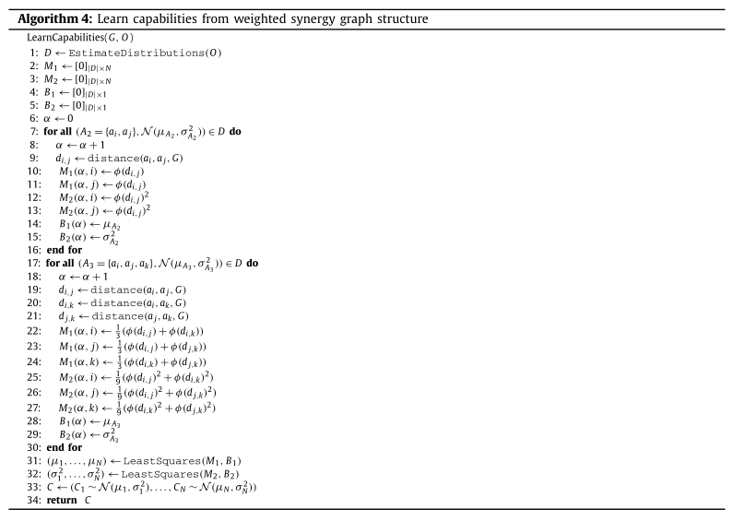
Code:

Slide 25
Log-Likelihood
Sum of log-likelihoods for each observation, given synergy graph, and abilities.
For an observation $o=(A,p)$:
$$log⁡(\frac{1}{σ_{A}\sqrt[2]{2π}}\exp\left(\frac{{\left(p−μ_{A}\right)}^{2}}{{{2σ}_{A}}^{2}}\right))$$
Probability density of normal distribution at value $p$.

Slide 26
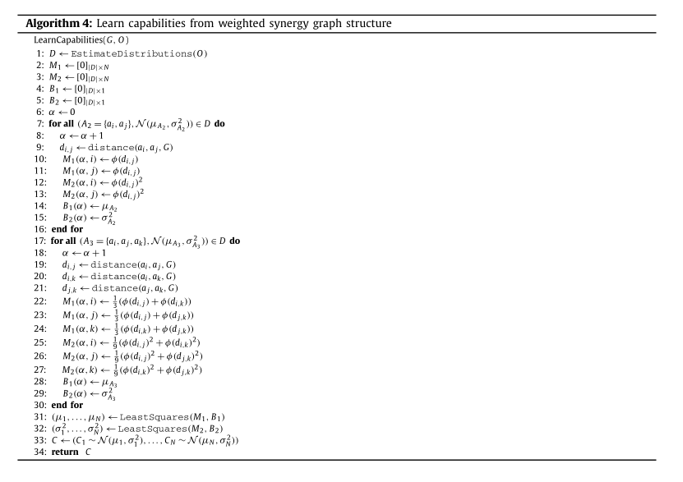
Code

Slide 27
Evaluation
Generate a hidden graph, with compatibility and abilities.
Generate a set of observations
Run the learning Algorithm
Compare Log-Likelihood of learned graph with true graph.

Slide 28
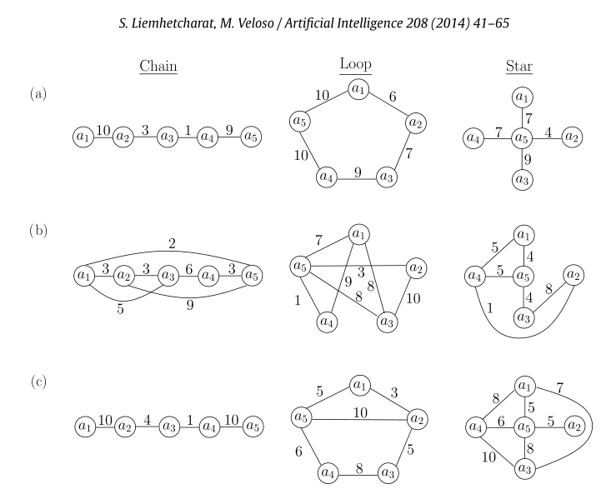
Results

Slide 29
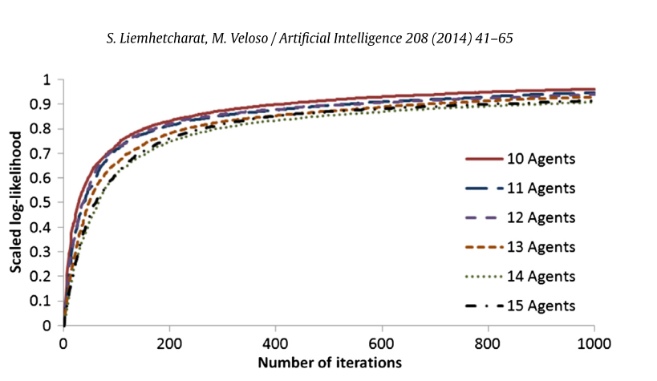
Results

Slide 30
Using for RoboCup

Slide 31
Thoughts:
Domain specific:
Works well for the given problem, but may not be good for other applications.
Tested for relatively small graphs.
May not be generalizable to large sparse graphs.
Due to randomness of search.
Modifying for learning large graphs:
Generate a better initial graph.
Make better choice for a similar graph.
More localized evaluation.

