Slide 1
Trends in Sentiments of Yelp Reviews
Namank Shah
CS 591

Slide 2
Outline
Background about reviews/dataset
Sentiment Analysis at various levels
Mining features and sentiments from Customer Reviews
Time Series Analysis – Divide and Segment

Slide 3
Yelp Dataset
Data is about businesses in Phoenix
Includes reviews, businesses, users, business attributes
Focus on Sentiment Analysis of the review text
Find trends over time

Slide 4
Sentiment Analysis of Reviews
Find feature-based summary of a set of reviews
Feature 1:
Positive Count
<individual review sentences>
Negative Count
<individual review sentences>
Feature 2:
…

Slide 5
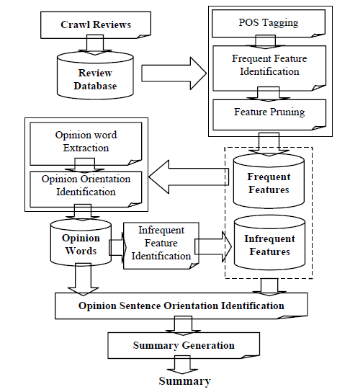
Outline of steps

Slide 6
Gathering Features
POS tagging (features are assumed to be nouns)
Frequent explicit features using association mining
Compactness pruning (remove phrases not likely to appear together)
Redundancy pruning (remove one word features if they are a part of longer feature name)

Slide 7
Opinion Words
Assumed to be adjectives tied to a specific feature
Effective opinion is ‘closest’ adjective to the feature in the sentence
Ex: The white and fluffy snow covered the ground.
Identify each effective opinion as positive or negative

Slide 8
Orientation Identification
Start with a seed list of adjectives
For target adjectives, find synonyms/antonyms in seed list
Synonym: use same orientation
Antonym: use opposite orientation
Add the new word to the list and repeat until all orientation are known
Unknown words can be dropped or tagged manually

Slide 9
Finding Infrequent Features
For all sentences that have opinion words but no features, mark nearest noun phrase as infrequent feature
Useful if same adjectives mention multiple features (but some not prominent)

Slide 10
Opinion Sentence Orientation
Use majority of orientations of opinion words
If there is a tie:
Look at majority of only effective opinions
If still tied, use the previous sentence’s orientation
If opinion word has a negation phrase (not, but, however, yet, etc.), use opposite orientation

Slide 11
Summary Generation
List all features in decreasing order of frequency
For each feature, opinion sentences are categorized into positive or negative lists
Infrequent features at the end of the list

Slide 12
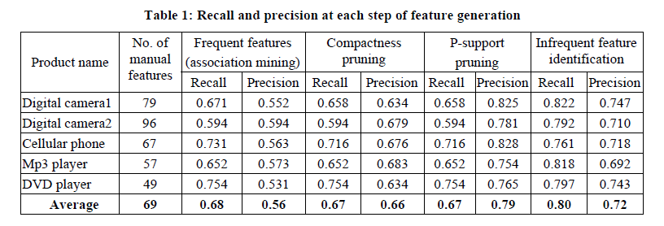
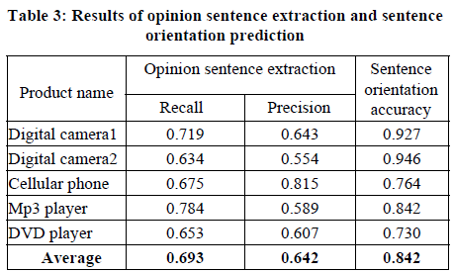
Results

Slide 13
Issues with this approach
Only use adjectives for opinions
Ex: ‘I recommend its serving sizes’
Features cannot be pronouns or implicit
Ex: ‘While cheap, the food quality is great’
Opinion strength is ignored
Ex: ‘They have amazingly savory crepes’
Infrequent features may not be relevant
Common adjectives describe more than product features

Slide 14
Time Series analysis of data
Reviews are sequential data
Starting point: Visualization
Finding trends of reviews
By users
By businesses
Find a way to summarize the trends in data
Using homogenous segments

Slide 15
K-segmentation problem
Given a sequence T = {t₁, t₂, … , t_{n}}, partition T into k contiguous segments {s₁, s₂, … , s_{k}}, such that:
Each segment s_{i} is represented by single representative value μ_{s}
The error of this representation is minimized
$$E_{p}\left(S\right)= \sum_{s∈S}{{(\sum_{t∈s}{\left({\left|t−μ_{s}\right|}^{p}\right)})}^{\frac{1}{p}}}$$

Slide 16
Optimal Solution
Use Dynamic Programming (Bellman ‘61)
Running time: O(n²k)
Heuristic algorithms have no approximation bounds

Slide 17
Divide and Segment
Partition T into m disjoint intervals
Solve k-segmentation on each of these intervals optimally using DP
On the m*k representative points, solve k-segmentation optimally using DP, and output that segmentation

Slide 18
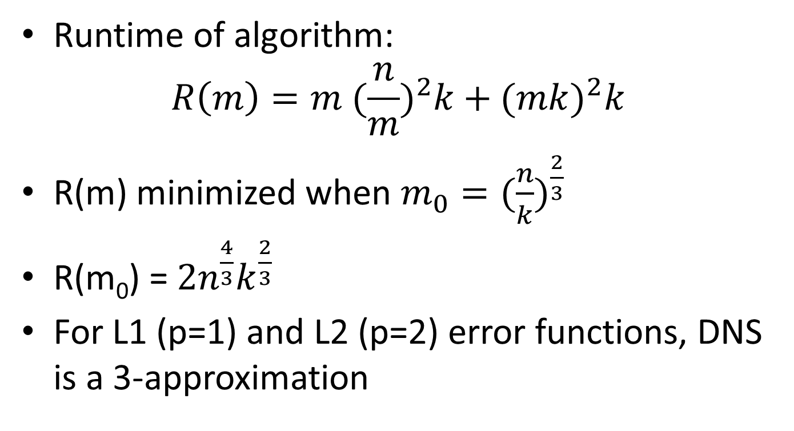
Analysis and Runtime
Runtime of algorithm:
$$R\left(m\right)=m {(\frac{n}{m})}^{2}k+{(mk)}^{2}k$$
R(m) minimized when $m_{0}={(\frac{n}{k})}^{\frac{2}{3}}$
R(m₀) = $2n^{\frac{4}{3}}k^{\frac{2}{3}}$
For L1 (p=1) and L2 (p=2) error functions, DNS is a 3-approximation

Slide 19
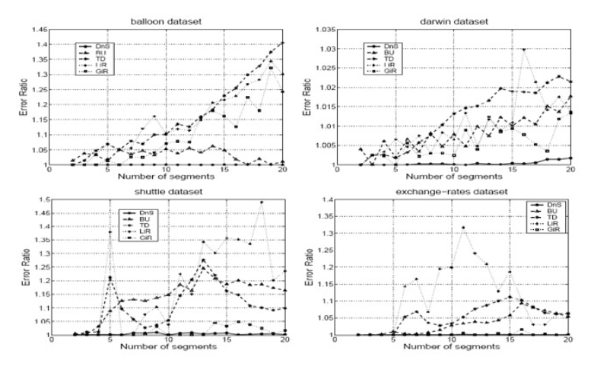
Results

Slide 20
References
Bing Liu and Minqing Hu. Mining and Summarizing Customer Reviews. KDD ‘04.
Evimaria Terzi and Panayiotis Tsaparas. Efficient algorithms for sequence segmentation. SDM ‘06.
Evimaria Terzi. Data Mining Lecture Slides, Fall 2013.
Bing Liu. Sentiment Analysis and Opinion Mining. Morgan & Claypool Publishers. May 2012.

