Slide 1
Using Ford-Fulkerson’s MIN CUT algorithm to study Fission in Small Groups
An Information Flow Model for Conflict and Fission in Small Groups
Wayne W. Zachary
Journal of Anthropological Research
CS591 Paper Presentation
A. Conrad Nied

Slide 2
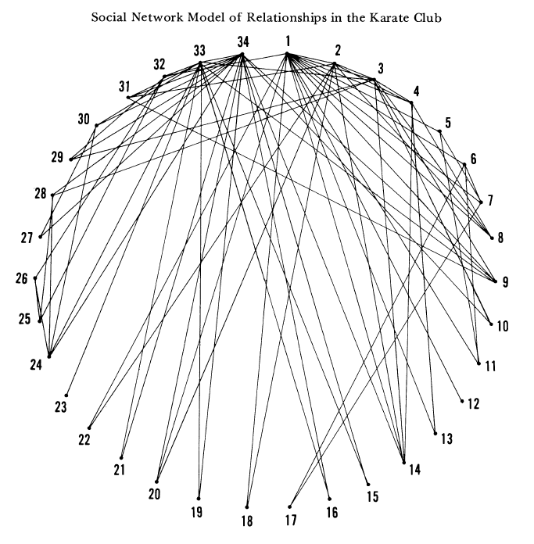
Graph
Diagram

Slide 3
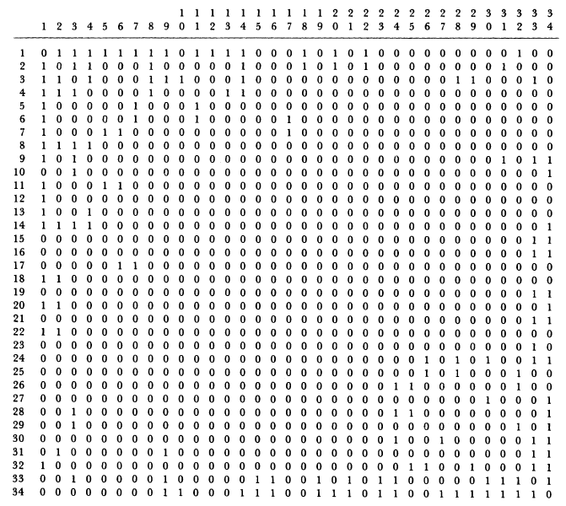
Graph
Adjacency Matrix

Slide 4
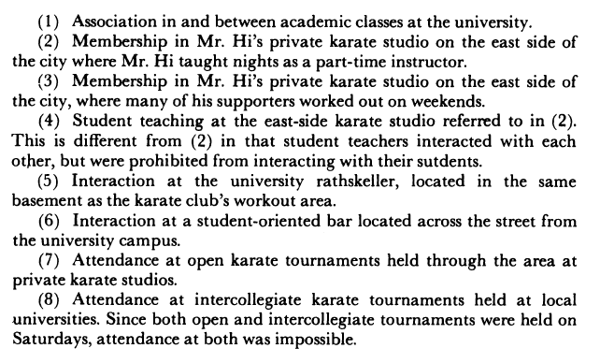
Capacities
Criteria

Slide 5
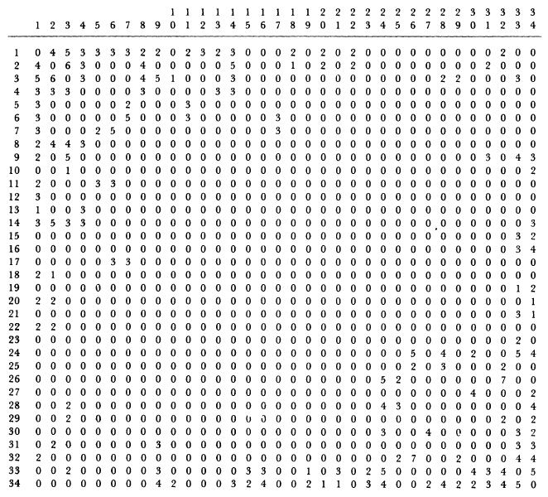
Capacities
Matrix

Slide 6
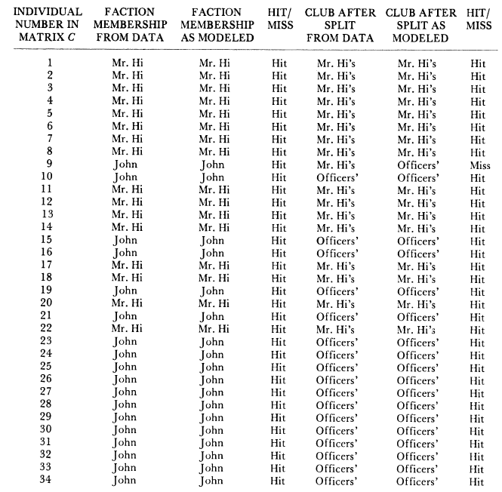
Compare

Slide 7
Graph
17
25
7
6
26
32
5
11
34
24
1
29
28
27
30
3
10
12
8
33
15
9
4
14
16
13
31
2
19
21
22
20
23
18

Slide 8
Capacities
3
3
2
3
5
2
2
7
2
3
2
4
3
5
3
3
3
t
2
4
4
s
2
4
2
2
2
2
4
5
2
4
5
1
2
3
4
4
2
5
3
2
2
5
3
3
3
3
3
6
4
3
4
3
3
3
3
3
3
1
4
2
3
5
3
2
3
3
4
2
2
2
1
2
1
2
2
1
2

Slide 9
Algorithm
6
7
13
13
14
2
21
8
9
t
13
s
4
11
2
2
6
1
12
26
2
3
3
13
7
33
5
10
12
14
3
7
5
9
23
2
3
4
4
4
1
2
3

Slide 10
Graph
17
25
7
6
26
32
5
11
34
24
1
29
28
27
30
3
10
12
8
33
15
9
4
14
16
13
31
2
19
21
22
20
23
18

Slide 11
Compare (Model)
17
Min Cut = 23
25
7
6
26
32
5
11
34
24
1
29
28
27
30
3
10
12
8
33
15
9
4
14
16
13
31
2
19
21
22
20
23
18

Slide 12
Compare (Data)
17
Min Cut = 26
25
7
6
26
32
5
11
34
24
1
29
28
27
30
3
10
12
8
33
15
9
4
14
16
13
31
2
19
21
22
20
23
18

Slide 13
Compare (Model)
17
Min Cut = 23
25
7
6
26
32
5
11
34
24
1
29
28
27
30
3
10
12
8
33
15
9
4
14
16
13
31
2
19
21
22
20
23
18

Slide 14
Compare (Data)
17
Min Cut = 26
25
7
6
26
32
5
11
34
24
1
29
28
27
30
3
10
12
8
33
15
9
4
14
16
13
31
2
19
21
22
20
23
18

