Slide 1
De-anonymizing social networks
Arvind Narayanan, Vitaly Shmatikov

Slide 2
Bob
Bob has accounts in both facebook and myspace

Slide 3
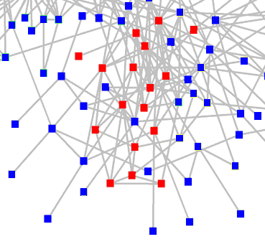
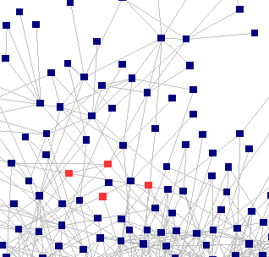
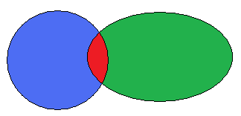
overlap
Facebook graph
Myspace graph

Slide 4
Goal
Given the auxiliary information, information (nodes, edges) about one social network(auxiliary network) and a small number of members of target network, the attacker wants to learn sensitive information about other members of target network.

Slide 5
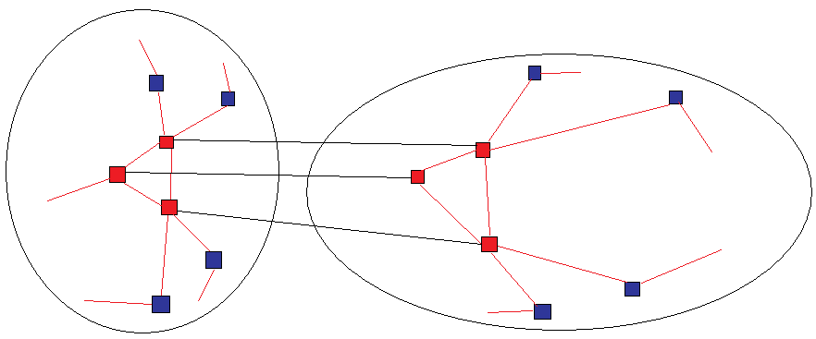
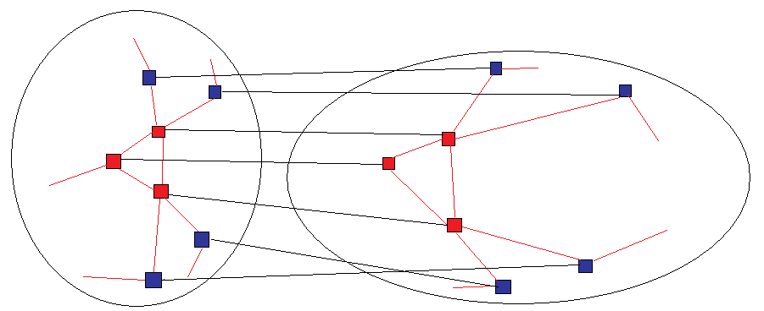
Goal
Facebook graph
Myspace graph

Slide 6
Social network is based on graph
Name, location
Name, location
A
B
Friends
Advisor/student
C
Name, location

Slide 7
Algorithm
2 stages
1. Seed identification
2. Propagation

Slide 8
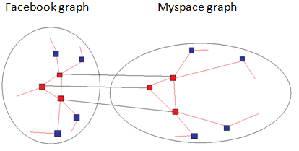
Seed identification
Identify a small number of seed nodes in both target graph and auxiliary graph, and maps them to each other
What is the seed
Seeds are in an entity, like a clique
How small

Slide 9
Seed identification
Input:
1. A target graph
2. K seed nodes in the auxiliary graph
3. K nodes’ information, such as, degree values and pairs of common-neighbor counts
4. Error parameter ε
Method
Using brute-force search in the target graph with matching(with a factor of 1 ± ε) nodes degrees and common-neighbor counts.

Slide 10
Seed identification
Output
The mapping between seeds in auxiliary graph and target graph.
This method does not gurantee an unique k-clique in target graph.
Besides, the running time is exponential in k. Once we find a matched clique in target graph, stop searching so that it can decrease running time.

Slide 11
Propagation
Propagation stage is a self-reinforcing process that seed mapping is extended to new nodes and new mapping is fed back to the algorithm.
Input
1. G1(V1, E1)
2. G2(V2, E2)
3. A “seed” mapping between the two.
No matter which is auxiliary graph or target graph
Output
New Mappings between nodes in G1 and G2 besides seed mappings.

Slide 12
Propagation
Method
G1
G2
B
Y
A
X
Z
C
E
D
W
Mapping list={(B,Y), (C, Z),(D, W)}
Score(A, X) = 2, Score(E, Z) = 0

Slide 13
Propagation
We will get lots of scores such as, score(A, P), score(A, Q), score(A, R) and so on where P, Q and R are nodes in G2 and A is in G1. Which mapping should we keep?
Add additional details
1. Edge directionality. Score = incoming edge score + outgoing edge score.
2. Node degrees.
Score(u, v_{i})=score(u, v_{i})/√degree of v_{i}
3. Eccentricity. It measures how much an item in a set X “stands out” from the rest. If > θ, keep the mapping; otherwise, it is rejected, where θ is a parameter.
4. Switching the input graph, if v gets mapped back to u, the mapping is retained; otherwise, it is rejected.
5. Revisiting nodes. As the number of mapped nodes increases, we need to revisit already mapped nodes.
6. Do the iteration until convergence.

Slide 14
Complexity
O((|E1|+|E2|)*d1*d2) where d1 is a bound on the degree of nodes in G1. D2 is a bound on the degree of nodes in G2.
Without revisiting nodes and reverse matches
O(|E1|*d2)
Without reverse matches
O(|E1|*d1*d2)

Slide 15
Experiment
“follow” relation on Twitter; “contact” relation on Flickr; “friend” relation on LiveJournal.
Network | Nodes | Edges | Av. Degree
Twitter | 224K | 8.5M | 37.7
Flickr | 3.3M | 53M | 32.2
LiveJournal | 5.3M | 77M | 29.3

Slide 16
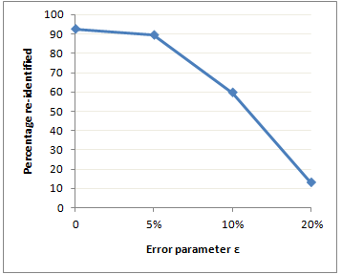
Seed indentification
Test on LiveJournal

Slide 17
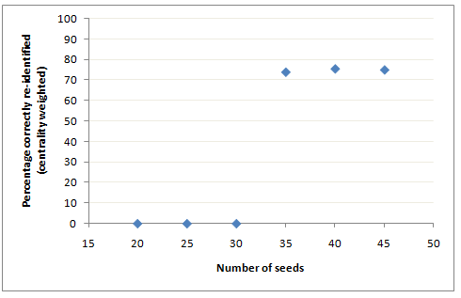
Propagation
Number of seeds decides whether propagation step dies out or not. The graph is over 100,000 nodes.
Node overlap: 25% Edge overlap: 50%

Slide 18
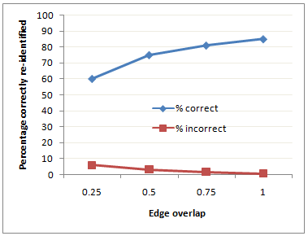
Propagation
Imprecision of auxiliary information decrease percentage of correctly re-identified rate
Node overlap: 25% Number of seeds: 50

Slide 19
Propagation
Auxiliary graph: Flickr. Target graph: Twitter
Seed mapping consists of 150 pairs of nodes with the constraints that the degree of each node in auxiliary graph is at least 80.
We have around 27,000 mappings.

Slide 20
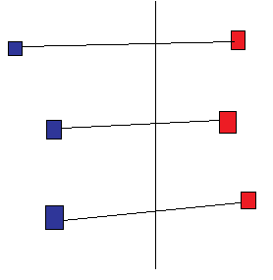
Accuracy(acc) on mappings
acc =
error =
G1
G2
u
v

Slide 21
Result of accuracy
30.8% of mappings(27,000) were re-identified correctly, 12.1% were identified incorrectly, and 57% were not identified.
41% of the incorrectly identified mappings were mapped to nodes which are at a distance 1 from the true mapping.
55% of the incorrectly identified mappings were mapped to the nodes where the same location was reported.
The above two categories overlap; 27% of incorrect mappings fall into completely erroneous.

