Slide 1
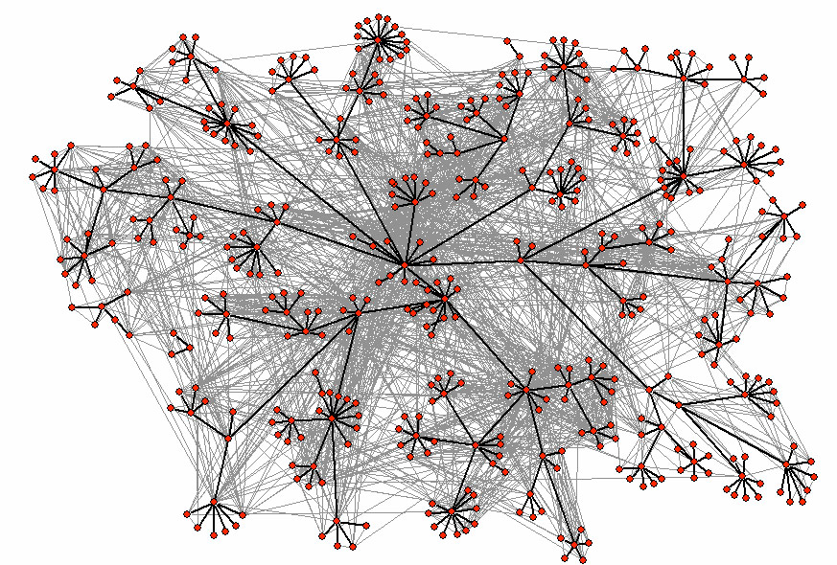














Epidemics in Social Networks

Slide 2
Epidemic Processes
Viruses, diseases
Online viruses, worms
Fashion
Adoption of technologies
Behavior
Ideas

Slide 3
Example: Ebola virus
First emerged in Zaire 1976 (now Democratic Republic of Kongo)
Very lethal: it can kill somebody within a few days
A small outbreak in 2000
From 10/2000 – 01/2009 173 people died in African villages

Slide 4
Example: HIV
Less lethal than Ebola
Takes time to act, lots of time to infect
First appeared in the 70s
Initially confined in special groups: homosexual men, drug users, prostitutes
Eventually escaped to the entire population

Slide 5
Example: Melissa computer worm
Started on March 1999
Infected MS Outlook users
The user
  Receives email with a word document with a virus
  Once opened, the virus sends itself to the first 50 users in the outlook address book
First detected on Friday, March 26
On Monday had infected >100K computers

Slide 6
Example: Hotmail
Example of Viral Marketing: Hotmail.com
Jul 1996: Hotmail.com started service
Aug 1996: 20K subscribers
Dec 1996: 100K
Jan 1997: 1 million
Jul 1998: 12 million
Bought by Microsoft for $400 million
Marketing: At the end of each email sent there was
a message to subscribe to Hotmail.com
“Get your free email at Hotmail"

Slide 7
The Bass model
Introduced in the 60s to describe product adoption
Can be applied for viruses
No network structure
F(t): Ratio of infected at time t
p: Rate of infection by outside
q: Rate of contagion

Slide 8
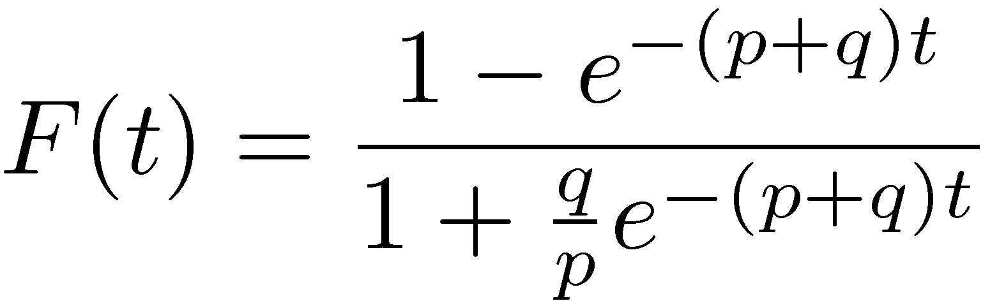
The Bass model
Explosive
phase
F(t): Ratio of infected at time t
p: Rate of infection by outside
q: Rate of contagion
Slow growth
phase
Burnout
phase

Slide 9
Network Structure
The Bass model does not take into account network structure
Let’s see some examples

Slide 10
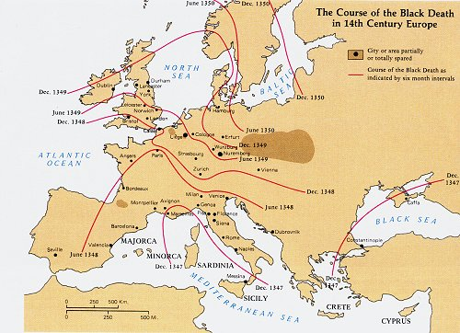
Example: Black Death (Plague)
Started in 1347 in a village in South Italy from a ship that arrived from China
Propagated through rats, etc.
Dec 1350
Jun 1350
Dec 1349
Jun 1349
Dec 1348
Jun 1348
Dec 1347

Slide 11
Example: Mad-cow disease
Jan. 2001: First cases observed in UK
Feb. 2001: 43 farms infected
Sep. 2001: 9000 farms infected
Measures to stop: Banned movement, killed millions of animals

Slide 12
Network Impact
In the case of the plague it is like moving in a lattice
In the mad cow we have weak ties, so we have a small world
  Animals being bought and sold
  Soil from tourists, etc.
To protect:
  Make contagion harder
  Remove weak ties (e.g., mad cows, HIV)

Slide 13
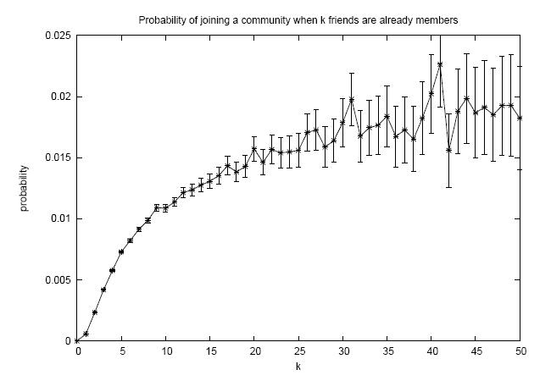
Example: Join an online group

Slide 14
Example: Publish in a conference

Slide 15
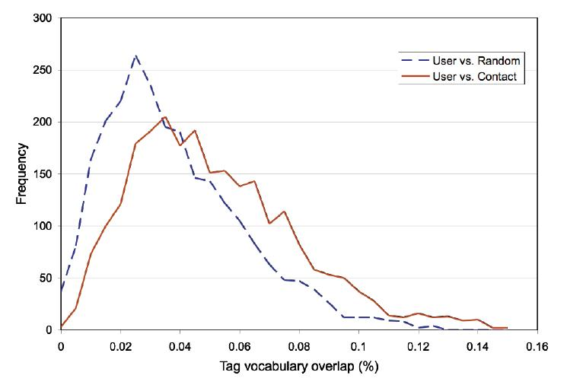
Example: Use the same tag

Slide 16
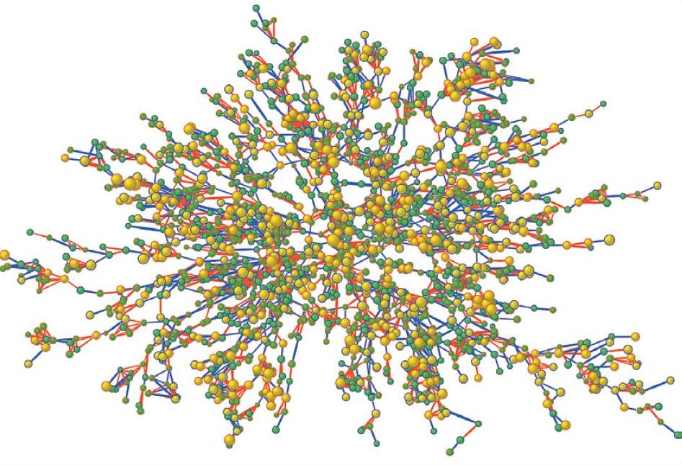
Obesity study

Slide 17
Example: obesity study
Christakis and Fowler, “The Spread of Obesity in a Large Social Network over 32 Years”, New England Journal of Medicine, 2007.
Data set of 12,067 people from 1971 to 2003 as part of Framingham Heart Study
Results
  Having an obese friend increases chance of obesity by 57%.
  obese sibling ! 40%, obese spouse ! 37%

Slide 18
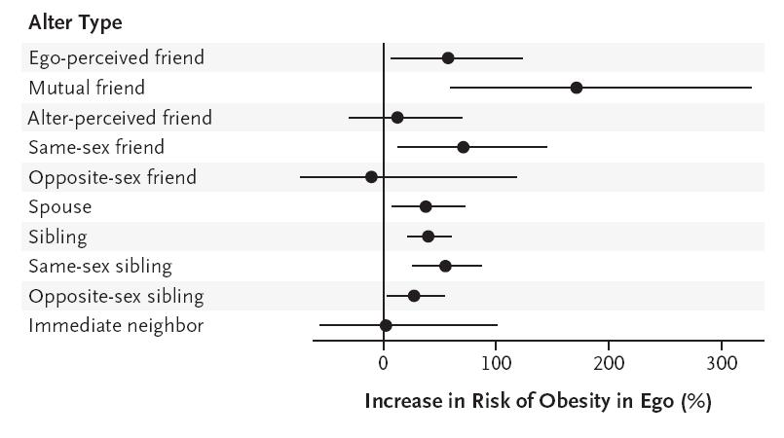
Obesity study

Slide 19
Models of Influence
We saw that often decision is correlated with the number/fraction of friends
This suggests that there might be influence: the more the number of friends, the higher the influence
Models to capture that behavior:
  Linear threshold model
  Independent cascade model

Slide 20
Linear Threshold Model
A node v has threshold θ_{v} ~ U[0,1]
A node v is influenced by each neighbor w according to a weight b_{vw} such that
A node v becomes active when at least
(weighted) θ_{v} fraction of its neighbors are active
Examples: riots, mobile phone networks
Notes:
Given a random choice of thresholds, and an initial set of
active nodes A0 (with all other nodes inactive), the diffusion process
unfolds deterministically in discrete steps: in step t, all nodes
that were active in step t-1 remain active, and we activate any
node v for which the total weight of its active neighbors is at least
Theta(v)

Slide 21
Example
Inactive Node
0.6
Active Node
0.3
0.2
0.2
Threshold
X
Active neighbors
0.1
0.4
U
0.5
0.3
Stop!
0.2
w
0.5
v

Slide 22
Independent Cascade Model
When node v becomes active, it has a single chance of activating each currently inactive neighbor w.
The activation attempt succeeds with probability p_{vw} .
Notes:
We again start with an initial set of active nodes A0, and the process unfolds in discrete steps according to
the following randomized rule. When node v first becomes active
in step t, it is given a single chance to activate each currently inactive
neighbor w; it succeeds with a probability pv;w —a parameter
of the system — independently of the history thus far. (If w has
multiple newly activated neighbors, their attempts are sequenced in
an arbitrary order.) If v succeeds, then w will become active in step
t+1; but whether or not v succeeds, it cannot make any further attempts
to activate w in subsequent rounds. Again, the process runs
until no more activations are possible.

Slide 23

Example
0.6
Inactive Node
0.3
0.2
0.2
Active Node
X
U
Newly active
node
0.1
0.4
Successful
attempt
0.5
0.3
0.2
Unsuccessful
attempt
w
0.5
v
Stop!

Slide 24
Optimization problems
Given a particular model, there are some natural optimization problems.
  How do I select a set of users to give coupons to in order to maximize the total number of users infected?
  How do I select a set of people to vaccinate in order to minimize influence/infection?
  If I have some sensors, where do I place them to detect an epidemic ASAP?

Slide 25
Influence Maximization Problem
Influence of node set S: f(S)
  expected number of active nodes at the end, if set S is the initial active set
Problem:
  Given a parameter k (budget), find a k-node set S to maximize f(S)
  Constrained optimization problem with f(S) as the objective function
Notes:
the influence of a set of nodes A: the expected number of active nodes at the end of the process.

Slide 26
f(S): properties (to be demonstrated)
Non-negative (obviously)
Monotone:
Submodular:
  Let N be a finite set
  A set function is submodular iff
  (diminishing returns)
Notes:
A function f maps a finite ground set U to non-negative real numbers, and satisfies a natural “diminishing returns” property, then f is a submodular function.
Diminishing returns property:
The marginal gain from adding an element to a set S is at least as high as the marginal gain from adding the same element to a superset of S.

Slide 27
Bad News
For a submodular function f, if f only takes non-negative value, and is monotone, finding a k-element set S for which f(S) is maximized is an NP-hard optimization problem[GFN77, NWF78].
It is NP-hard to determine the optimum for influence maximization for both independent cascade model and linear threshold model.
Notes:
Known results:
For a submodular function f, if f only takes non-negative value, and is monotone.
Finding a k-element set S for which f(S) is maximized is an NP-hard optimization problem[GFN77, NWF78].

Slide 28
Good News
We can use Greedy Algorithm!
  Start with an empty set S
  For k iterations:
    Add node v to S that maximizes f(S +v) - f(S).
How good (bad) it is?
  Theorem: The greedy algorithm is a (1 – 1/e) approximation.
  The resulting set S activates at least (1- 1/e) > 63% of the number of nodes that any size-k set S could activate.
Notes:
The algorithm that achieves this performance guarantee is a natural greedy hill-climbing strategy
selecting elements one at a time, each time choosing an element that provides
the largest marginal increase in the function value.
f(S) >= (1-1/e) f(S*)
This algorithm approximate the optimum within a factor of (1-1/e) ( where e is the base of the natural logarithm).

Slide 29
Key 1: Prove submodularity

Slide 30
Submodularity for Independent Cascade
0.6
Coins for edges are flipped during activation attempts.
0.3
0.2
0.2
0.1
0.4
0.5
0.3
0.5

Slide 31
Submodularity for Independent Cascade
Coins for edges are flipped during activation attempts.
Can pre-flip all coins and reveal results immediately.
0.6
0.3
0.2
0.2
0.1
0.4
0.5
0.3
0.5
Active nodes in the end are reachable via green paths from initially targeted nodes.
Study reachability in green graphs
Notes:
Our proof deals with these difficulties by formulating an equivalent
view of the process, which makes it easier to see that there
is an order-independent outcome, and which provides an alternate
way to reason about the submodularity property.
From the point of view of the process, it clearly does not matter whether the
coin was flipped at the moment that v became active, or whether it
was flipped at the very beginning of the whole process and is only
being revealed now. With all the coins flipped in advance, the process can be viewed
as follows. The edges in G for which the coin flip indicated an
activation will be successful are declared to be live; the remaining
edges are declared to be blocked. If we fix the outcomes of the coin
flips and then initially activate a set A, it is clear how to determine
the full set of active nodes at the end of the cascade process:
CLAIM 2.3. A node x ends up active if and only if there is a
path from some node in A to x consisting entirely of live edges.
(We will call such a path a live-edge path.)

Slide 32
Submodularity, Fixed Graph
Fix “green graph” G. g(S) are nodes reachable from S in G.
Submodularity: g(T +v) - g(T) g(S +v) - g(S) when S T.
g(S +v) - g(S): nodes reachable from S + v, but not from S.
From the picture: g(T +v) - g(T) g(S +v) - g(S) when S T (indeed!).
Notes:
g(S +v) - g(S): Exactly nodes reachable from v, but not from S.

Slide 33
Submodularity of the Function
Fact: A non-negative linear combination of submodular functions is submodular
g_{G}(S): nodes reachable from S in G.
Each g_{G}(S): is submodular (previous slide).
Probabilities are non-negative.

Slide 34
Submodularity for Linear Threshold
Use similar “green graph” idea.
Once a graph is fixed, “reachability” argument is identical.
How do we fix a green graph now?
Each node picks at most one incoming edge, with probabilities proportional to edge weights.
Equivalent to linear threshold model (trickier proof).

Slide 35
Key 2: Evaluating f(S)
Notes:
Both in choosing the nodes to target with the greedy algorithm,
and in evaluating the performance of the algorithms, we need to
compute the value (A). It is an open question to compute this
quantity exactly by an efficient method, but very good estimates
can be obtained by simulating the random process

Slide 36
Evaluating ƒ(S)
How to evaluate ƒ(S)?
Still an open question of how to compute efficiently
But: very good estimates by simulation
  repeating the diffusion process often enough (polynomial in n; 1/ε)
  Achieve (1± ε)-approximation to f(S).
Generalization of Nemhauser/Wolsey proof shows: Greedy algorithm is now a (1-1/e- ε′)-approximation.

Slide 37
Experiment Data
A collaboration graph obtained from co-authorships in papers of the arXiv high-energy physics theory section
co-authorship networks arguably capture many of the key features of social networks more generally
Resulting graph: 10748 nodes, 53000 distinct edges

Slide 38
Experiment Settings
Linear Threshold Model: multiplicity of edges as weights
  weight(v→ω) = C_{vw} / dv, weight(ω→v) = C_{wv} / dw
Independent Cascade Model:
  Case 1: uniform probabilities p on each edge
  Case 2: edge from v to ω has probability 1/ dω of activating ω.
Simulate the process 10000 times for each targeted set, re-choosing thresholds or edge outcomes pseudo-randomly from [0, 1] every time
Compare with other 3 common heuristics
  (in)degree centrality, distance centrality, random nodes.
Notes:
Independent Cascade Model:
If nodes u and v have cu;v parallel edges, then
we assume that for each of those cu;v edges, u has a chance of p
to activate v, i.e. u has a total probability of 1 - (1 - p)cu;v of
activating v once it becomes active.
The independent cascade model with uniform probabilities p on
the edges has the property that high-degree nodes not only have
a chance to influence many other nodes, but also to be influenced
by them. Motivated by this, we chose to also consider an alternative interpretation, where edges
into high-degree nodes are assigned smaller probabilities. We study
a special case of the Independent Cascade Model that we term
“weighted cascade”, in which each edge from node u to v is assigned
probability 1/dv of activating v.
The high-degree heuristic chooses nodes v in order of decreasing
degrees dv.
“Distance centrality” buildg on the assumption that a node with short
paths to other nodes in a network will have a higher chance of influencing
them. Hence, we select nodes in order of increasing average
distance to other nodes in the network. As the arXiv collaboration
graph is not connected, we assigned a distance of n — the number
of nodes in the graph — for any pair of unconnected nodes. This
value is significantly larger than any actual distance, and thus can
be considered to play the role of an infinite distance. In particular,
nodes in the largest connected component will have smallest
average distance.

Slide 39
Outline
Models of influence
  Linear Threshold
  Independent Cascade
Influence maximization problem
  Algorithm
  Proof of performance bound
  Compute objective function
Experiments
  Data and setting
  Results

Slide 40
Results: linear threshold model
Notes:
The greedy algorithm outperforms the high-degree node heuristic by about 18%, and the central node
heuristic by over 40%. (As expected, choosing random nodes is
not a good idea.) This shows that significantly better marketing
results can be obtained by explicitly considering the dynamics of
information in a network, rather than relying solely on structural
properties of the graph.
When investigating the reason why the high-degree and centrality
heuristics do not perform as well, one sees that they ignore such
network effects. In particular, neither of the heuristics incorporates
the fact that many of the most central (or highest-degree) nodes
may be clustered, so that targeting all of them is unnecessary.

Slide 41
Independent Cascade Model – Case 1
P = 1%
P = 10%
Notes:
The graph for the independent cascade model with probability 1%, seems very similar to the previous two at
first glance. Notice, however, the very different scale: on average, each targeted node only activates three additional nodes. Hence, the network effects in the independent cascade model with very
small probabilities are much weaker than in the other models.
This suggests that the network effects observed for the linear threshold and weighted cascade models rely heavily on
low-degree nodes as multipliers, even though targeting high-degree nodes is a reasonable heuristic. Also notice that in the independent cascade model, the heuristic of choosing random nodes performs significantly better than in the previous two models.
The improvement in performance of the “random nodes” heuristic is even more pronounced for the independent cascade model with probabilities equal to 10%. In that model, it starts to outperform both the high-degree and the central nodes heuristics when more than 12 nodes are targeted. The first targeted node, if chosen somewhat judiciously, will activate a large fraction of the network, in our case almost 25%. However, any additional nodes will only reach a small additional fraction of the network. In particular, other central or high-degree nodes are very likely to be activated by the initially chosen one, and thus have hardly any marginal gain. This explains the shapes of the
curves for the high-degree and centrality heuristics, which leap up to about 2415 activated nodes, but make virtually no progress afterwards. The greedy algorithm, on the other hand, takes the effect of the first chosen node into account, and targets nodes with smaller marginal gain afterwards. Hence, its active set keeps growing, although
at a much smaller slope than in other models.

Slide 42
Independent Cascade Model – Case 2
Reminder: linear threshold model
Notes:
Notice the striking similarity to the linear threshold model; the scale
is slightly different (all values are about 25% smaller), but the
behavior is qualitatively the same, even with respect to the exact
nodes whose network influence is not reflected accurately by their
degree or centrality. The reason is that in expectation, each node is
influenced by the same number of other nodes in both models (see
Section 2), and the degrees are relatively concentrated around their
expectation of 1.

