Slide 1
Towards identity-anonymization on graphs
  K. Liu & E. Terzi, SIGMOD 2008
A framework for computing the privacy score of users in social networks
  K. Liu, E. Terzi, ICDM 2009

Slide 2

Growing Privacy Concerns
Person specific information is being routinely collected.
“Detailed information on an individual’s credit, health, and financial status, on characteristic purchasing patterns, and on other personal preferences is routinely recorded and analyzed by a variety of governmental and commercial organizations.”
- M. J. Cronin, “e-Privacy?” Hoover Digest, 2000.

Slide 3
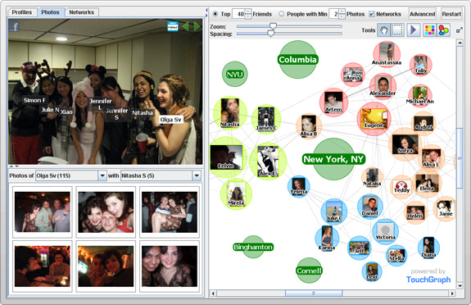



Proliferation of Graph Data
http://www.touchgraph.com/

Slide 4
Privacy breaches on graph data
Identity disclosure
  Identity of individuals associated with nodes is disclosed
Link disclosure
  Relationships between individuals are disclosed
Content disclosure
  Attribute data associated with a node is disclosed

Slide 5
Identity anonymization on graphs
Question
  How to share a network in a manner that permits useful analysis without disclosing the identity of the individuals involved?
Observations
  Simply removing the identifying information of the nodes before publishing the actual graph does not guarantee identity anonymization.
  L. Backstrom, C. Dwork, and J. Kleinberg, “Wherefore art thou R3579X?: Anonymized social netwoks, hidden patterns, and structural steganography,” In WWW 2007.
  J. Kleinberg, “Challenges in Social Network Data: Processes, Privacy and Paradoxes, ” KDD 2007 Keynote Talk.
Can we borrow ideas from k-anonymity?

Slide 6
What if you want to prevent the following from happening
Assume that adversary A knows that B has 327 connections in a social network!
If the graph is released by removing the identity of the nodes
  A can find all nodes that have degree 327
  If there is only one node with degree 327, A can identify this node as being B.

Slide 7
Privacy model
[k-degree anonymity] A graph G(V, E) is k-degree anonymous if every node in V has the same degree as k-1 other nodes in V.
A (2)
A (2)
B (1)
E (1)
B (2)
E (2)
anonymization
C (1)
D (1)
C (1)
D (1)
  [Properties] It prevents the re-identification of individuals by adversaries with a priori knowledge of the degree of certain nodes.

Slide 8
Problem Definition
Given a graph G(V, E) and an integer k, modify G via a minimal set of edge addition or deletion operations to construct a new graph G’(V’, E’) such that
1) G’ is k-degree anonymous;
2) V’ = V;
3) The symmetric difference of G and G’ is as small as possible
Symmetric difference between graphs G(V,E) and G’(V,E’) :

Slide 9
GraphAnonymization algorithm
Input: Graph G with degree sequence d, integer k Output: k-degree anonymous graph G’
[Degree Sequence Anonymization]: Contruct an anonymized degree sequence d’ from the original degree sequence d [Graph Construction]: [Construct]: Given degree sequence d', construct a new graph G⁰(V, E⁰) such that the degree sequence of G⁰ is d‘ [Transform]: Transform G⁰(V, E⁰) to G’(V, E’) so that SymDiff(G’,G) is minimized.

Slide 10
Degree-sequence anonymization
[k-anonymous sequence] A sequence of integers d is k-anonymous if every distinct element value in d appears at least k times.
[100,100, 100, 98, 98,15,15,15]
[degree-sequence anonymization] Given degree sequence d, and integer k, construct k-anonymous sequence d’ such that ||d’-d|| is minimized
Increase/decrease of degrees correspond to additions/deletions of edges

Slide 11
Algorithm for degree-sequence anonymization
Original degree sequence
k=4
k=2

Slide 12
DP for degree-sequence anonymization
d (1) ≥ d (2) ≥… ≥ d (i) ≥… ≥ d (n) : original degree sequence.
d’ (1) ≥ d’ (2) ≥…≥ d’ (i) ≥…≥ d’ (n) : k-anonymized degree sequence.
C(i, j) : anonymization cost when all nodes i, i+1, …, j are put in the same anonymized group, i.e.,
DA(1, n) : the optimal degree-sequence anonymization cost
Dynamic Programming with O(n²)
Dynamic Programming with O(nk)
Dynamic Programming can be done in O(n) with some additional bookkeeping

Slide 13
GraphAnonymization algorithm
Input: Graph G with degree sequence d, integer k Output: k-degree anonymous graph G’
[Degree Sequence Anonymization]: Contruct an anonymized degree sequence d’ from the original degree sequence d [Graph Construction]: [Construct]: Given degree sequence d', construct a new graph G⁰(V, E⁰) such that the degree sequence of G⁰ is d‘ [Transform]: Transform G⁰(V, E⁰) to G’(V, E’) so that SymDiff(G’,G) is minimized.

Slide 14
Are all degree sequences realizable?
A degree sequence d is realizable if there exists a simple undirected graph with nodes having degree sequence d.
Not all vectors of integers are realizable degree sequences
  d = {4,2,2,2,1} ?
How can we decide?

Slide 15
Realizability of degree sequences
[Erdös and Gallai] A degree sequence d with d(1) ≥ d(2) ≥… ≥ d(i) ≥… ≥ d(n) and Σd(i) even, is realizable if and only if
Input: Degree sequence d’
Output: Graph G⁰(V, E⁰) with degree sequence d’ or NO!
→If the degree sequence d’ is NOT realizable?
  Convert it into a realizable and k-anonymous degree sequence

Slide 16
GraphAnonymization algorithm
Input: Graph G with degree sequence d, integer k Output: k-degree anonymous graph G’
[Degree Sequence Anonymization]: Contruct an anonymized degree sequence d’ from the original degree sequence d [Graph Construction]: [Construct]: Given degree sequence d', construct a new graph G⁰(V, E⁰) such that the degree sequence of G⁰ is d‘ [Transform]: Transform G⁰(V, E⁰) to G’(V, E’) so that SymDiff(G’,G) is minimized.

Slide 17
Graph-transformation algorithm
GreedySwap transforms G⁰ = (V, E⁰) into G’(V, E’) with the same degree sequence d’, and min symmetric difference SymDiff(G’,G) .
GreedySwap is a greedy heuristic with several iterations.
At each step, GreedySwap swaps a pair of edges to make the graph more similar to the original graph G, while leaving the nodes’ degrees intact.
Notes:
Overall process dp-erdosgallai-transform the graph into something close to the original graph

Slide 18
Valid swappable pairs of edges
A swap is valid if the resulting graph is simple

Slide 19
GreedySwap algorithm
Input: A pliable graph G⁰(V, E⁰) , fixed graph G(V,E) Output: Graph G’(V, E’) with the same degree sequence as G⁰(V,E⁰)
i=0 Repeat find the valid swap in G^{i} that most reduces its symmetric difference with G , and form graph G^{i+1} i++

Slide 20
Experiments
Datasets: Co-authors, Enron emails, powergrid, Erdos-Renyi, small-world and power-law graphs
Goal: degree-anonymization does not destroy the structure of the graph
  Average path length
  Clustering coefficient
  Exponent of power-law distribution

Slide 21
Experiments: Clustering coefficient and Avg Path Length
Co-author dataset
APL and CC do not change dramatically even for large values of k

Slide 22
Experiments: Edge intersections
Edge intersection achieved by the GreedySwap algorithm for different datasets.
Parenthesis value indicates the original value of edge intersection
Synthetic datasets
Small world graphs* | 0.99 (0.01)
Random graphs | 0.99 (0.01)
Power law graphs** | 0.93 (0.04)
Real datasets
Enron | 0.95 (0.16)
Powergrid | 0.97 (0.01)
Co-authors | 0.91(0.01)
(*) L. Barabasi and R. Albert: Emergence of scaling in random networks. Science 1999.
(**) Watts, D. J. Networks, dynamics, and the small-world phenomenon. American Journal of Sociology 1999

Slide 23
Experiments: Exponent of power law distributions
Original | 2.07
k=10 | 2.45
k=15 | 2.33
k=20 | 2.28
k=25 | 2.25
k=50 | 2.05
k=100 | 1.92
Co-author dataset
Exponent of the power-law distribution as a function of k

Slide 24
Towards identity-anonymization on graphs
  K. Liu & E. Terzi, SIGMOD 2008
A framework for computing the privacy score of users in social networks
  K. Liu, E. Terzi, ICDM 2009

Slide 25
What is privacy risk score and why is it useful?
What?
  It is a credit-score-like indicator to measure the potential privacy risks of online social-networking users.
Why?
  It aims to boost public awareness of privacy, and to reduce the cognitive burden on end-users in managing their privacy settings.
    privacy risk monitoring & early alarm
    comparison with the rest of population
    help sociologists to study online behaviors, information propagation

Slide 26


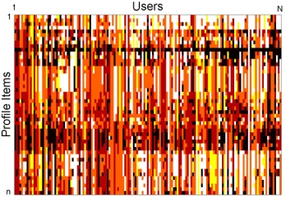

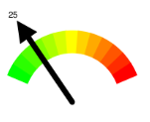

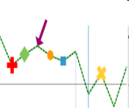

Privacy Score Overview
Privacy Score measures the potential privacy risks of online social-networking users.
Privacy Settings
privacy score of the user
Privacy Score Calculation
Utilize Privacy Scores
Privacy Risk Monitoring
Comprehensive Privacy Report
Privacy Settings Recommendation
Notes:
This is the life cycle of a privacy score. The system takes as inputs the current privacy settings of the users profile items and calculates the privacy score. The score is delivered to the user as a privacy-o-meter. With this score, the users can monitor his privacy take a more active role in safe-gurading his information if necessary.
The user can also compare his privacy risk score with the rest of the population to know where he stands. In the case where the overall privacy risks of a user’s social graph are lower than that of the user, the system can recommend the user stronger privacy settings based on the information from his social neighbors.
Privacy settings for a user profile control what subset of profile items are accessible by whom. For example, friends have full access, but strangers have restricted access to a user profile.

Slide 27
How is Privacy Score Calculated? – Basic Premises
Sensitivity: The more sensitive the information revealed by a user, the higher his privacy risk.
Visibility: The wider the information about a user spreads, the higher his privacy risk.
mother’s maiden name is more sensitive than mobile-phone number
home address known by everyone poses higher risks than by friends only
Notes:
There could be many different ways to compute privacy score. Here is our way. It exhibits several advantages which I will discuss later.
From the technical point of view, our definition of privacy score satisfies the following properties: 1) the more sensitive information a user reveals, the higher his privacy risk; and 2) the more visible the disclosed the information becomes in the network, the higher his privacy risk.
Next I am going to show how to combine these two factors in the calculation of the privacy risk score.

Slide 28
Privacy Score Calculation
name, or gender, birthday, address, phone number, degree, job, etc.
Privacy Score of User j due to Profile Item i
sensitivity of profile item i
visibility of profile item i
Notes:
To calculate a user’s privacy score, we need to first look at his profile items. These items include but are not limited to user’s real name, email, hometown, mobile-phone number, relationship status, sexual orientation, IM screen name, etc.
The contribution of a single profile item i in the overall privacy score of a user j is a function of the sensitivity of the item and the visibility it gets.
Note that x can be an arbitrary combination function as long as PR(i,j) is monotonically increasing with beta_i and V(i,j).

Slide 29
Privacy Score Calculation
name, or gender, birthday, address, phone number, degree, job, etc.
Privacy Score of User j due to Profile Item i
sensitivity of profile item i
visibility of profile item i
Overall Privacy Score of User j
Notes:
To compute the overall privacy score of user j, denoted by Pr (j), we can simply combine the privacy score of this user due to all different profile items.

Slide 30
The Naïve Approach
User_1
User_j
User_N
Profile Item_1
(birthday)
R(1, 1)
R(1, 2)
R(1, N)
Profile Item_i
(cell phone #)
R(i, j)
Profile Item_n
R(n, 1)
R(n, N)
share, R(i, j) = 1
not share, R(i, j) = 0
Notes:
How to compute the sensitivity and visibility? Here I am going to present two different ways. For simplicity, let’s consider a dichotomous case, where for a user and a profile item, the user will either share it with the public or not at all. Now we can represent the information sharing of all users and all profile items using a single big table. Each row represents one profile item, and each column a user. If the cell located at the i-row and j-th column is white, meaning user j will disclose item i, if grey user j will NOT disclose item i.

Slide 31
The Naïve Approach
User_1
User_j
User_N
Profile Item_1
(birthday)
R(1, 1)
R(1, 2)
R(1, N)
Profile Item_i
(cell phone #)
R(i, j)
Profile Item_n
R(n, 1)
R(n, N)
share, R(i, j) = 1
not share, R(i, j) = 0
Sensitivity:
Notes:
Intuitively speaking, if a profile item is very sensitive, then very few people will share it, many people will not share it. Thus, we simply compute the proportion of users that are reluctant to disclose item I, and use this value as the sensitivity. The sensitivity, as computed here takes values between 0 and 1; the higher the value of βi, the more sensitive item I, the more people who are reluctant to disclose it.

Slide 32
The Naïve Approach
User_1
User_j
User_N
Profile Item_1
(birthday)
R(1, 1)
R(1, 2)
R(1, N)
Profile Item_i
(cell phone #)
R(i, j)
Profile Item_n
R(n, 1)
R(n, N)
share, R(i, j) = 1
not share, R(i, j) = 0
Sensitivity:
Visibility:
Notes:
The simplest way to compute the visibility of an item i belonging to a user j is to use the explicit setting from the i-th row and j-th column table – i.e., the corresponding cell value in the table, i.e.., R(i, j), which is either 1 or 0, meaning share or not share.
From a statistician’s point of view , what we have observed is just a sample from some underlying probability distribution. This table is no exception either. Therefore, we are more interested in the expected value in each cell, not just the observed value. In this case, the visibility of an item I belonging to user j becomes the probability that j will share I – that is, a cell value is 1. Then, what is the probability the value of a cell such as R(i, j) is equal to 1?
Assuming independence between items and individuals, we can compute Pij to be the probability of an 1 in the i-th row times the probability of an 1 in the j-th column. In other words, if the user j has high tendency to disclose lots of his profile items, he is more likely to disclose item I too. Also, if many other users have shared this item, the sensitivity is low, then it is very likely that user j will also share this item.

Slide 33
Advantages and Disadvantages of Naïve
Computational Complexity O (Nn) – best one can hope
Scores are sample dependent
  Studies show that Facebook users reveal more identifying information than MySpace users
  Sensitivity of the same information estimated from Facebook and from MySpace are different
What properties do we really want?
  Group Invariance: scores calculated from different social networks and/or user base are comparable.
  Goodness-of-Fit: mathematical models fit the observed user data well.
Notes:
Computing the sensitivity value for each item, and the visibility for each item and individual can be done with a single pass over the response matrix. The overall computation of privacy risk for all the N users can be done in time O(nN). The running time is the best one can hope, any algorithm has to at least go through the input data.
Sample dependent: sensitivity values of profile items depend on the actual user population used for their extraction and cannot be used for computing the privacy risk of a different group of users. For example, Facebook subjects expressed a greater amount of trust, ad reported more willingness to share identifying information.

Slide 34
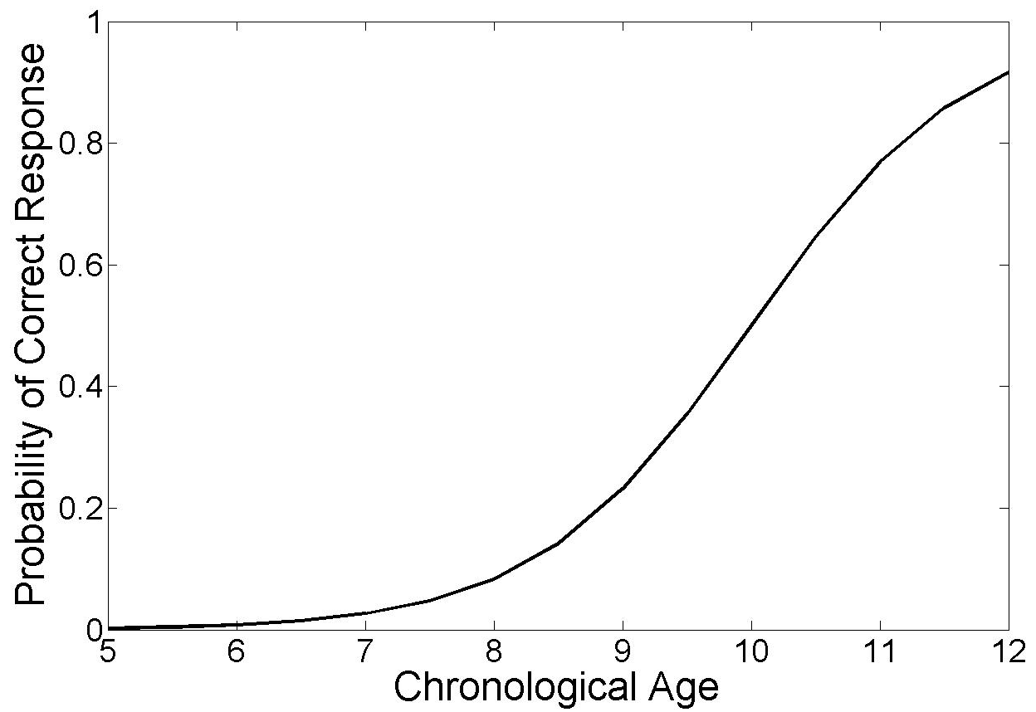
Item Response Theory (IRT)
IRT (Lawley,1943 and Lord,1952) has its origin in psychometrics.
It is used to analyze data from questionnaires and tests.
It is the foundation of Computerized Adaptive Test like GRE, GMAT
Ability
Notes:
French psychologist Alfred Binet and physician Theodore Simon developed a method of identifying intellectually deficient children for their placement in special education programs.
An item of interest was administrated to a number of kids with age ranging from 5 to 12 years. The free response of each kid to the item was scored as right or wrong. The proportion of correct response at each age level was obtained and presented in tabular form. In his 1916 revision of the Binet-Simon scale, the Stanford psychologist Lewis Terman plotted the proportion of correct response at a function of age and fitted a smooth line to these points by graphical means. This fitted line, shown in this figure is called the ICC.
From this example, it can be seen that the ICC is the functional relationship between the proportion of correct response to an item and a criterion variable. This relationship is characterized by the location and shape of the ICC.
This curve has an appearance of a cumulative distribution function. The ICC can be defined as a member of a family of two-parameter monotonic functions of the ability variable. Let us next formalize the ICC using appropriate statistical notation.

Slide 35
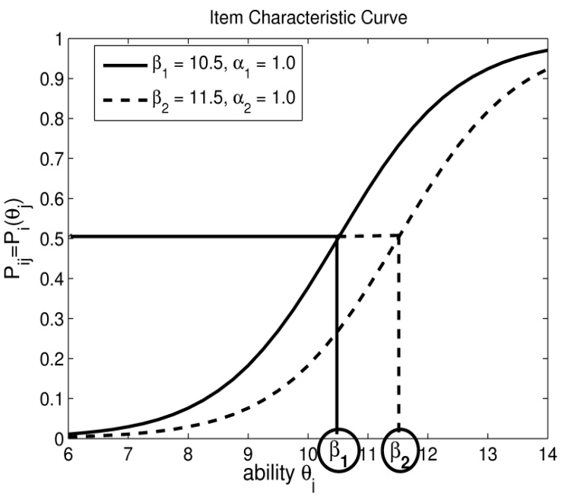
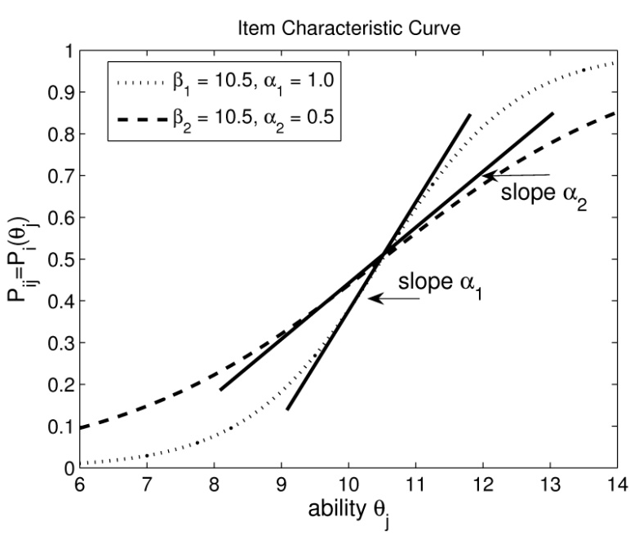
Item Characteristic Curve (ICC)
(ability): is an unobserved hypothetical variable such as intelligence, scholastic ability, cognitive capabilities, physical skills, etc.
(difficulty): is the location parameter, indicates the point on the ability scale at which the probability of correct response is .50
(discrimination): is the scale parameter that indexes the discriminating power of an item
Notes:
Formally, the ICC can be defined by the mathematical funciton.
1. Theta: generically, this latent trait is referred to as ability although it must be kept in mind that a wide variety of cognitive capabilities or physical skills can be labeled as ability.
2. Beta: is the location parameter, indicates the point on the ability scale at which the probability of correct response is .50. It indicates where the median of the ICC falls on the ability scale. In psychophysics, it is known as the limen value and in bioassay, it is called the median lethal dose LD50 or X50.
3. Alpha: the steeper the ICC, the greater the increase in the proportion of correct response as a function of age, and the better the item is able to discriminate between adjacent age levels.
The history of item characteristic curve and the methods for estimating its parameters is threaded through pasychophysics, quantal-response bioassay, educational measurement, and psychological scaling. Each of these fields has a different perspective, but they share a common set of concepts, models and mathematics.

Slide 36
Mapping from PRS to IRT
Student_1
User_1
Student_ j
User_j
Student_N
User_N
Question Item_1
Profile Item_1
R(1, 1)
R(1, 1)
R(1, 2)
R(1, 2)
……
……
……
……
……
……
……
……
……
……
……
……
……
……
R(1, N)
R(1, N)
Profile Item_i
Question Item_i
R(i, j)
R(i, j)
Question Item_n
Profile Item_n
R(n, 1)
R(n, 1)
……
……
……
……
……
……
……
……
……
……
……
……
……
……
……
……
R(n, N)
R(n, N)
correct answer, R(i, j) = 1
share, R(i, j) = 1
wrong answer, R(i, j) = 0
not share, R(i, j) = 0
discrimination → discrimination
ability → attitude/privacy concerns
difficulty → sensitivity
Prob of correct answer → Prob of share the profile

Slide 37
Computing PRS using IRT
Overall Privacy Risk Score of User j
Sensitivity:
Visibility:
Byproduct: profile item’s discrimination and user’s attitude

Slide 38
Calculating Privacy Score using IRT
Overall Privacy Score of User j
Sensitivity:
Visibility:
byproducts: profile item’s discrimination and user’s attitude
All the parameters can be estimated using Maximum Likelihood Estimation and EM.
Notes:
The problem is that we do not know these parameters. We only know the observations, and the objective is to use the observed data to estimate these parameters.
IRT defines for each user and each profile item, how likely this user is to disclose/share this item. From this perspective, IRT can be viewed as a generative model. We can compute the log likelihood of the data using this generative model and then use MLE or EM to estimate the parameters.

Slide 39
Advantages of the IRT Model
The mathematical model fits the observed data well
The quantities IRT computes (i.e., sensitivity, attitude and visibility) have intuitive interpretations
Computation is parallelizable using e.g. MapReduce
Privacy scores calculated within different social networks are comparable
Notes:
The IRT model seems arbitrary. It seems that any model could be used. Why IRT?
The advantages of the IRT framework can be summarized as follows:
1) IRT defines for each user and each profile item, how likely this user is to disclose/share this item. From this perspective, IRT can be viewed as a generative model. Our experiments shows that this generative model fits the real-world data very well in terms of χ2 goodness-of-fit test. That is, real data does follow the distributions defined by IRT.
2) The quantities IRT computes, i.e., sensitivity, attitude and visibility, have an intuitive interpretation. For example, the attitude can serve as a psychometric instrument that sociologists can use to study online behaviors of people. The sensitivity of information can be used to send early alerts to users when the sensitivities of their shared profile items are out of the comfortable region.
3) Due some mild assumptions, many of the computations in MLE can be parallelized, which makes the algorithm practically efficient.
Most importantly, the estimates obtained from IRT framework are sample independent. This property is also called group invariance.

Slide 40
Estimating the Parameters of a Profile Item
Attitude level
Share
Not share
# of users at this attitude level
θ_1
θ_2
θ_3
……
θ_g
……
……
θ_K
r_i1 | f_1 – r_i1
r_i2 | f_2 – r_i2
r_i3 | f_3 – r_i3
…… | ……
r_ig | f_g – r_ig
…… | ……
…… | ……
r_iK | f_g – r_iK
f_1
f_2
f_3
……
f_g
……
……
f_K
Known Input:

Slide 41
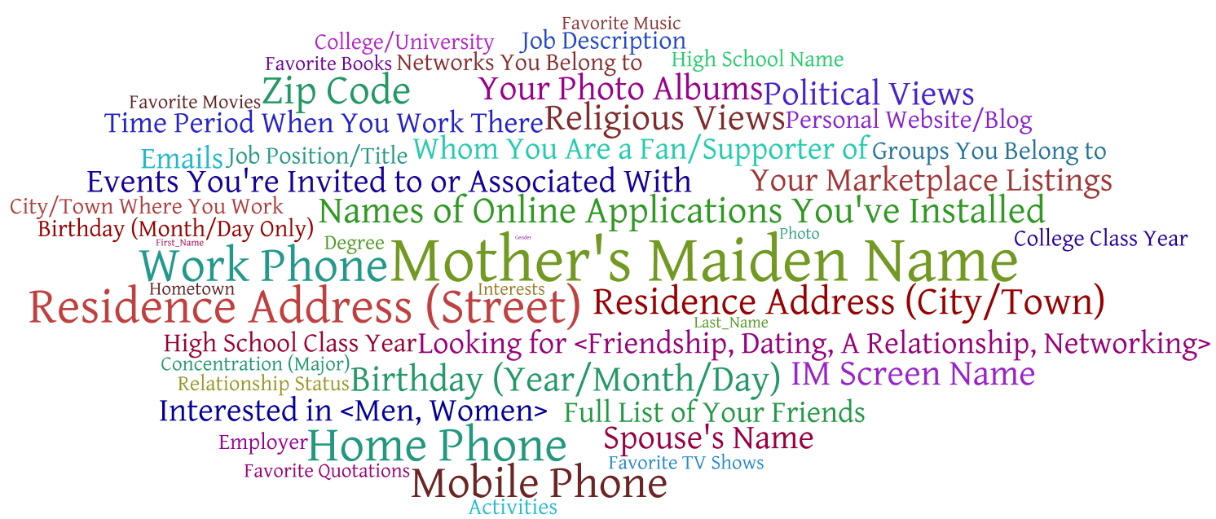
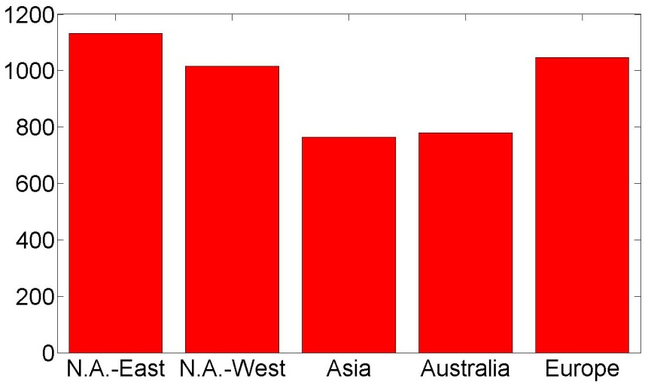
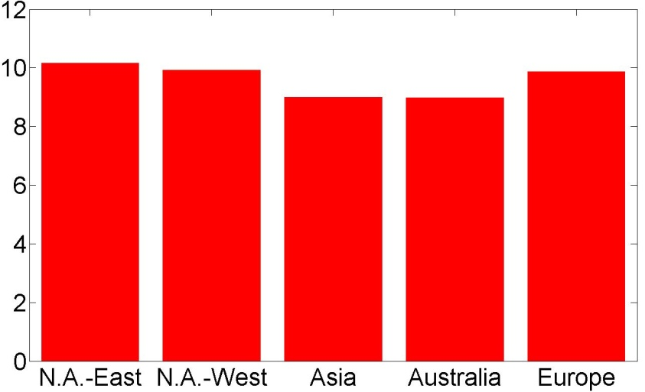
Experiments – Interesting Results

Slide 42
