Slide 1
Signed Networks in Social Media
J. Leskovec, D. Huttenlocher, J. Kleinberg
Paper Review by Rachel Katz
Notes:
In social networks, users develop rich, complex relationships with one another, but most network analysis reduces these relationships to simple links for research purposes. This paper looks deeper and examines network structure in the presence of both positive and negative links.
Prior evaluations of Structural Balance Theory
Empirical investigations generally focused on small networks with social relations observed through direct interaction
Bias toward abundance of certain kinds of triangles

Slide 2
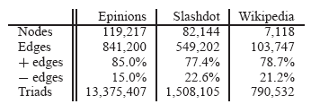
Network Structures
Trust network: Signed, directed relations among users indicating trust (+) or distrust (-)
Social network (blog): Signed relations among users indicating friend(+) or foe(-)
Information network (votes): Implicit signed, directed network defined by public votes in favor (+) or against (-) admin candidates
Notes:
System as a whole has roughly 80% positive edges
Transition – 2 theories of signed networks

Slide 3
Structural Balance Theory
Considers undirected signed triads of three individuals
Apply to signed networks: disregard the directions of the links
T₃ (balanced) and T₁
More plausible
Should be more prevalent in networks (overrepresented relative to chance)
Triad T₃: mutual friends
Triad T₁: common enemy
Weak Structural Balance
Only T₂ triads are implausible in real networks
Triad T₂: common friend
Triad T₀: mutual enemies
Notes:
-- originated in social psychology in the mid-20th century
-- T3 = balanced = “the friend of my friend is my friend”
-- T1 = “the friend of my enemy is my enemy”, “the enemy of my friend is my enemy”, “the enemy of my enemy is my friend”

Slide 4
Theory of Status
Considers directed networks of signed links
Positive cycles are directed triads with positive links from A to B to C back to A
A
B
C
Positive directed link:
Creator views recipient as having higher status
Negative directed link:
Creator views recipient as having lower status
Note: The sign of a link from A to B is generated by A
Notes:
Flush/straight/pair?

Slide 5
Balance vs. Status
A
Balance Theory:
Since C is a friend of A’s friend B, the link should be positive
?
B
C
C
Status Theory:
Since A regards B as having higher status, and B regards C as having higher status, C should regard A has having lower status and the link should be negative
B
?
A
Notes:
Transition: look at how theories hold up against our datasets

Slide 6
Undirected Networks
Consider the frequencies of different types of signed triads
Determine the fraction of triads of type T_{i} from the datasets
Calculate p fraction of positive edges in the network
Develop a priori probability of T_{i} based on sign distribution
Shuffle the signs of all edges in the graph, keeping the same fraction p of positive edges
Determine the fraction of triads T_{i} after shuffling
Calculate the surprise s(T_{i}) as the number of standard deviations by which the observed number of triads T_{i} differs from the expected number
If {fraction of triads T_{i} observed} > {a priori probability of T_{i}}, then triads of type T_{i} are overrepresented in the data
Due to the Central Limit Theorem and the scale of the data, almost all observations are statistically significant
Notes:
S(Ti) is approximately a standard normal distribution
“what would it look like if edge signs were produced at random from the same background distribution of positive and negative signs”
Expected number of triads T_{i}, E[T_{i}] = p₀(T_{i})∆
Surprise, s(T_{i}) = number of standard deviations by which |T_{i}| differs from E[T_{i}]

Slide 7
Undirected Networks
 | Structural Balance Theory | Weak Structural Balance Theory | Network Observations
T₃ Triads | Over-represented | Over-represented | Over-represented, by 40%
T₂ Triads | Under-represented | Under-represented | Under-represented, by 50-75%
T₁ Triads | Over-represented | No reason to favor one over the other | Relative abundances vary between datasets
T₀ Triads | Under-represented

Slide 8
Evolving Directed Networks
Consider the order in which links are added to the network
Consider the diversity of users’ linking habits
Generative Baseline: overall fraction of positive signs a user creates
Receptive Baseline: overall fraction of positive signs a user receives
A
 | A | B | C
Generative Baseline | 1 | 0 | 1
Receptive Baseline | 1/2 | 1 | 0
B
C
Notes:
Transition: Develop a more robust model!

Slide 9
Evolving Directed Networks
Balance Theory Conflicts
Positive cycles are underrepresented
When A→B and B→C links are positive, negative C→A links are overrepresented (predicted by status in previous example)
In the case of joint positive endorsement (where X links positively to A and B), the link closing the triad (from A to B) is more likely to be positive than the generative baseline of A, but less likely to be positive than the receptive baseline of B
Balance theory simply suggests the link should be positive
Theory of Status
More effective at explaining local patterns of signed links
Extends to capture richer behavior (ie: evolution over time)

Slide 10
Status Theory: Motivating Example
Imagine a Soccer Team…
Ask players A with teammates B: “A, how do you think the skill of player B compares to your own?”
Suppose team members agree on ranking by skill (status)
Produce signed directed graph
Nodes: players
Directed edges: from A to B if we asked A for her opinion of B
Positive link: A thinks highly of B’s skill relative to her own
Negative link: A thinks she is better than B
Can use network context to make inferences about the signs of links we haven’t yet observed

Slide 11
Status Theory: Motivating Example
Suppose A and B have each received a positive evaluation from a third player X
Since B has been positively evaluated by another team member, B is more likely to have above-average skill
So, the evaluation that A gives B should be more likely to be positive than an evaluation given by A to a random team member
Since A has been positively evaluated by another team member, A is more likely to have above-average skill
So, the evaluation that A gives B should be less likely to be positive than an evaluation received by B from a random team member
Context causes the sign of the A-B link to deviate from the random baseline in different directions depending on point of view

Slide 12
Status Theory: Contextualized Links
Contextualized Link (c-link)
Triple (A, B; X) with the property that a link forms from A to B after each of A and B already has a link either to or from X
B
A
X
For a type t of c-link, look at the set of all c-links of this type
Generative Baseline for type t
Sum of the generative baselines for all nodes A_{i}
Generative Surprise s_{g}(t)
Signed number of standard deviations by which the actual number of positive A_{i}-B_{i} edges differs from the expectation
Receptive Baseline for type t
Sum of the receptive baselines for all nodes B_{i}
Receptive Surprise s_{r}(t)
Signed number of standard deviations of difference
Notes:
Evaluate the sign of a link created from A to B in the context of A and B’s relations to additional nodes X
Edges between X and A and X and B can go in either direction and have either sign = 16 possibilities
Generative Baseline for type t: expected number of positive edges we would get if we let each Ai-Bi link form according to the generative baseline of Ai
If the context provided by node X and its links with A and B had no effect on the sign of the A-B link being formed, we should expect a generative surprise of 0 for type t

Slide 13
Status Theory: Contextualized Links
t₁
t₂
t₃
t₄
B
B
B
B
A
X
A
X
A
X
A
X
t₅
t₆
t₇
t₈
B
B
B
B
A
X
A
X
A
X
A
X
t₉
B
t₁₀
B
t₁₁
t₁₂
B
B
A
X
A
X
A
X
A
X
t₁₃
t₁₄
t₁₅
t₁₆
B
B
B
B
A
X
A
X
A
X
A
X

Slide 14
Status Theory: Role of Status
Assign status values to c-links
Assign node X status 0
If X links positively to A, or if A links negatively to X
Assign node A status 1
Otherwise, assign node A status -1
If X links positively to B, or if B links negatively to X
Assign node A status 1
Otherwise, assign node B status -1
Notes:
Consistent scenarios:
Generative surprise: + if A generates more + than random (A has low status)
B’s status: + if B has higher status than peers ---- peers will link positively to B since B is higher than A
Receptive surprise: + if B gets more + than random (high status)
A’s status: - if A has lower status than peers –-- will link positively to B since B is higher than A

Slide 15
Theory Evaluation
Generative surprise for type t is consistent with status if it has the same sign as B’s status
Receptive surprise for type t is consistent with status if it has the opposite sign as A’s status
Generative surprise for type t is consistent with balance if it has the same sign as the edge predicted by balance
Receptive surprise for type t is consistent with balance if it has the same sign as the edge predicted by balance

Slide 16
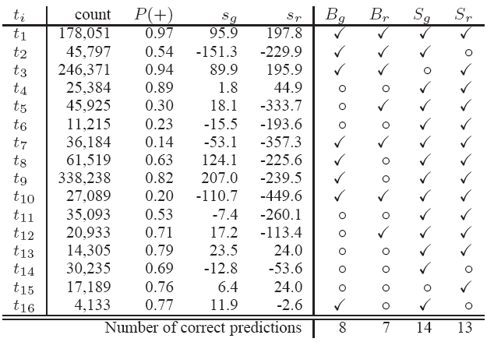
Theory Evaluation
Balance
Status
Notes:
Bg = balance, consistency with generative baseline
Br = balance, consistency with receptive baseline
Sg = status, consistency with generative baseline
Sr = status, consistency with receptive baseline

Slide 17
Theory Evaluation
Predictions of status perform much better than predictions of structural balance on the vast majority of c-types (13-14 out of 16 are consistent)
Joint endorsement (t₉) – X links positively to A and B
Counterpoint of joint endorsement (t₈) – A and B link negatively to X
Positive cycle (t₁₁)
Cases where Status Theory fails
Types where A has low status relative to X and B
Types where A and B both have low status relative to X
Suggests that users may be relying on balance-based reasoning in this situation (if we both like a third party, we should like each other)
Notes:
Better performance = consistent with s_{g}(t) and s_{r}(t)

Slide 18
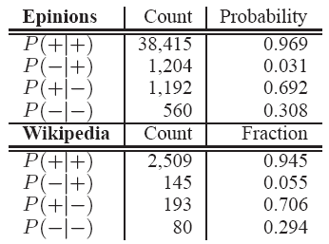
Reciprocation of Directed Edges
Consider collection of reciprocal edges:
Subset of network where directed edges create symmetric relationships
If the A-B link forms before the B-A link, then B reciprocates the link to A
Approximately 3-5% of edges are reciprocal edges
Balance is more pronounced in small portions of the network where links are mutual
Reciprocation of positive edges is consistent with balance; reciprocation of negative edges follows a hybrid of both
Users respond to a negative link with a positive link the majority of the time but at a lower rate than the system as a whole (deviation toward balanced-based interpretation)
Notes:
Have data on timing of link creation for epinions and wikipedia
Users treat each other differently in the context of back-and-forth interaction than when they are using links to refer to others who do not link back
System as a whole has 80% positive links

Slide 19
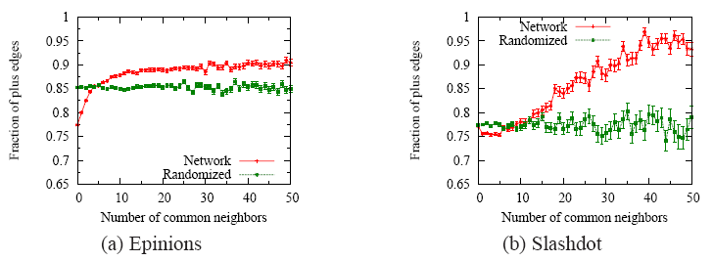
Embeddedness
Consider the number of common neighbors of edge endpoints
Positive ties are more likely to be clumped together, with negative ties acting as bridges
Green (random baseline): Sign probability with edge signs determined randomly with probability p
Red (real data): Edges that are not well embedded are more negative than expected; as edges become more embedded sign tends to be increasingly positive
Notes:
Embeddedness: Number of distinct triads the edge participates in
Not part of balance theory, but consistent with social theory: embedded edges are on display

Slide 20
Single-Sign Networks
Consider single-sign sub-networks:
Compare to randomized baselines (randomly shuffle edge signs in full network, extract single-sign sub-networks)
Clustering: fraction of A-B-C paths where A-C edge is also present (forming a closed triad)
All-positive networks have higher clustering than random
All-negative networks have lower clustering than random
Connected Components:
Single-sign networks are less well-connected than expected
Largest connected components are smaller than random
Reinforces observation that positive edges tend to occur in clumps, with negative edges spanning clusters

Slide 21
Conclusion
Different predictions for frequency of patterns of signed links
Balance: when considering relationships between three people, only one or all three should be positive
Status: when a person A makes a positive link to person B, A is asserting that B has higher status
Strong consistency in how models fit data across the datasets
Balance theory is a reasonable approximation to the structure of signed networks when they are viewed as undirected graphs
A link is more likely to be positive when endpoints have multiple neighbors in common
Status theory better captures properties when the networks are viewed as directed graphs that grow over time
Inferences about the sign of a link can be drawn from mutual relationships with third parties

Slide 22
Thank You!

