Slide 1
Identifying Early Buyers from Purchase Data
Paat Rusmevichientong,
Shenghuo Zhu & David Selinger
Presented by: Vinita Shinde
Feb 18th, 2010.

Slide 2
Outline
Motivation/Aim
Problem Formulation
MAX-CUT Problem
Probabilistic Interpretation
Algorithm
Experiments

Slide 3
Why Care?
Consumers exhibit variety of different purchasing behaviors- some tend to purchase products earlier than others
Can help personalize marketing strategies
Predict product trends, forecast sales or guide new product information

Slide 4
Aim
Identify consumers who tend to purchase products before other consumers
Don’t know if these early buyers influence late buyers to adopt these products
Provide an approximation algorithm
Apply this algorithm to real purchase data from Amazon.com

Slide 5
Basic Idea
Input: Detailed purchase information of each consumer (including date & time)
Construct a weighted directed graph, whose nodes correspond to consumers & edges correspond to purchases that consumers have in common
Edge weights correspond to how frequently consumers purchase products earlier than others

Slide 6
Problem Formulation
Assume, we have ‘M’ consumers: 1, 2, …, M
and ‘n’ products
Represent this using Directed Weighted Graph
where each node v ∈ V={1, . . . ,M } corresponds to a consumer
The mapping w : V × V → R+ represents the non-negative weight on each edge.

Slide 7
We have an edge(i,j)∈V×V with weight
≥ 0 if, among the products that consumer i and j bought in common, of these products were bought by i before j
= 0 means that either consumer i and j never bought any product in common, or that consumer i always purchased them after consumer j
Notes:
A large value of relative w_ij to w_ji indicates that consumer i and j bought many of the same products, and in most cases, consumer i bought them before consumer j.
W_ij + w_ji = total no. of products bought by customers i & j

Slide 8
Formulation as MAX-CUT
Since weight of each edge measures how frequently a consumer bought products be- fore another consumer, formulate the problem as a Maximum cut problem
Hence, find a subset S ⊆ V with maximum weights of the outgoing edges

Slide 9
(Weighted) MAX-CUT
A cut is a partition of the vertices of a graph into two disjoint subsets
MAX-CUT: A cut whose size is not smaller than the size of any other cut.
We want a subset S of the vertex set such that the total weight of the edges between S and its complementary subset is as large as possible.

Slide 10
MAX-CUT Problem
Given an undirected graph and non-negative weights = on edges
find the set of vertices S that maximizes the weight of the edges in the cut ,
Weight of the cut is denoted by
Notes:
( ie. the weight of the edges with one end-point in S and another in S^bar )
Weight/Size of the cut is defined by the sum of the weights of the edges crossing the cut.

Slide 11
Example
Assume we have three customers {1, 2, 3} and following four edges with non-zero weights.
Early buyer (as per MAX-CUT formulation) is {1}, but {1} has bought more products than {2} only slightly more than half of the time.
1
10
3
9
2
3
3

Slide 12
Early buyers should correspond to customers who bought more products earlier relative to other consumers ➔ take into account incoming edges as well
Can put different weights on incoming and outgoing edges : EARLY BUYERS
Notes:
Beta and gamma are related to the probability that an early buyer will purchase a product before a late buyer

Slide 13
Probabilistic Interpretation
is the probability than an early buyer will purchase a product before late buyer
Find an assignment that maximizes the likelihood of graph G
So, we compute the log-likelihood
and find that
Notes:
Xi denotes the states of consumers , Xi = 1 if its early buyer and Xi=0 if late buyer
Assume that X1..XM are independent

Slide 14
EARLY BUYERS (Formal Definition)
For any and let denotes the optimal value of the EARLY BUYERS
problem
Notes:
Early Buyers (G,1,0) corresponds to std max-cut problem
(G, Beta, gamma) Is np-complete

Slide 15
Algorithms A Special Case when
For
where
Can determine the optimal cut from the difference, at each node, between the weights of outgoing and incoming edges
Notes:
Optimal cut corresponds to those vertices whose difference is non-negative.

Slide 16
Algorithms-General
Formulate the EARLY BUYERS problem as an Integer Quadratic Programming
Maximize
Subject to:
where for any
Notes:
y0 can be used to determine which side of the graph constitutes a cut
Given yi’s , define a cut S as the set {i:yi=y0}

Slide 17
Relax to Semi-Definite Programming problem
1. Solve (P) & obtain solutions
Here, and denotes the n-dimensional unit sphere
2. Generate a random vector r that is uniformly distributed on
3. Define as follows: if
otherwise.
4. Define a cut S as

Slide 18
Experiment Dataset
The top 50 most popular electronics items sold in the year 2002 on Amazon.com chosen as the set of products
Consider those consumers who bought at least four of these 50 products
Have edge weight ≥ 0 if among the 50 products that i and j have bought in common, of those products were bought by consumer i at least 24 hours prior to consumer j.
Notes:
To ensure that we have sufficiently many consumers, we chose the top 50 most popular electronics items sold
To eliminate consumers who purchased very few products, consider those who bought at least four of these 50 products

Slide 19
Performance Comparison
Algorithm | No. of Early Buyers (as % of Total Customers) | Objective Value
Top-Net-Weight | 34.31% | 700,037
SDP | 48.93% | 750,275
Since an early buyer is more likely to purchase a product before a late buyer, we want to exceed 0.5
Set
For Top-Net-Weight Algorithm, set of nodes is:
Notes:
Our algo based on SDP yields 7.18% improvement in the objective value

Slide 20
Overall Purchase Characteristics
Variable | Ratio between Early & Late Buyers (2002) | Ratio between Early & Late Buyers (2003)
Overall Revenue | 1.16 | 1.06
Electronics Revenue | 1.15 | 1.02
Overall Quantity | 1.16 | 1.05
Electronics Quantity | 1.14 | 0.98
Ratio between early and late buyers for 2002 & 2003
Notes:
For each of these characteristics, compute its average for each group of consumers. For each variable, the ratio between the average among the early buyers and the average among the late buyers for the year 2002 and 2003. If the ratio exceeds one, then the average value among the early buyers is higher than the average among the late buyers. All variables are statistically significant at p-value less than 5%.

Slide 21
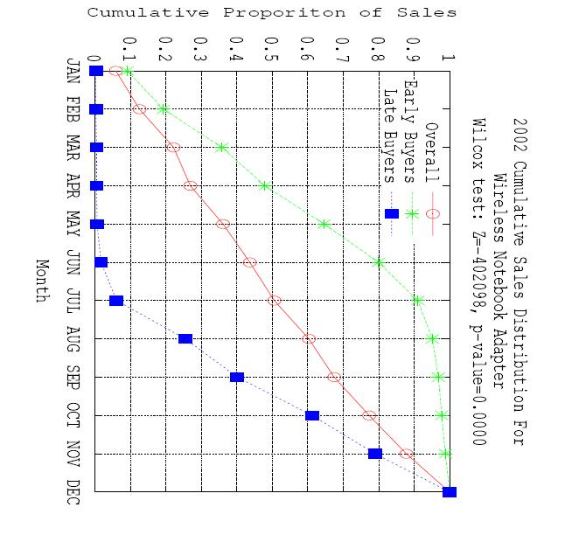
Sales Distribution Over Time
Cumulative sales distribution for the year 2002 among early buyers, late buyers, and the over- all population for a wireless notebook adapter
Notes:
90% of the sales have occurred from early buyers by July, but hardly 10% of sales from late buyers

Slide 22
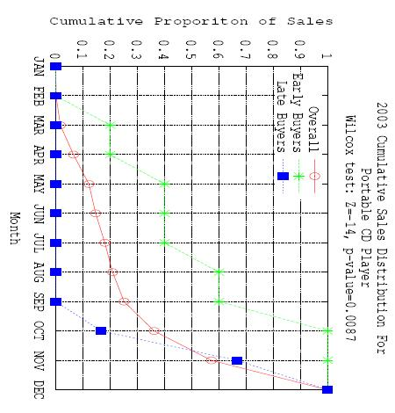
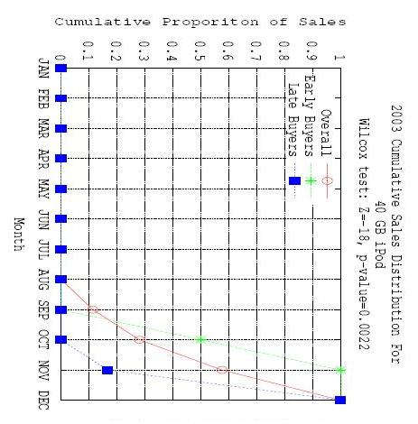
(a) Portable CD Player
(b) 40GB Ipod
Figure : Cumulative sales distribution in the year 2003 for (a) portable CD player and (b) 40GB iPod. These products were not released until 2003.

Slide 23
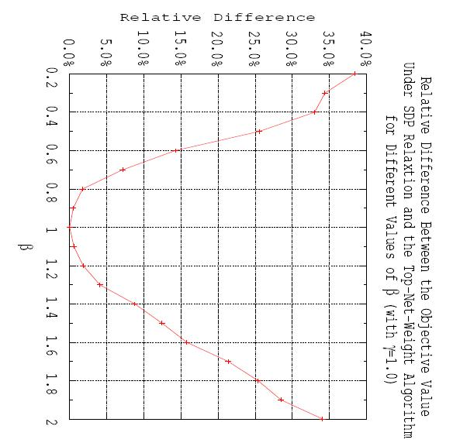
Performance for Different
Notes:
When beta=gamma=1, both algos yield optimal value, so difference is 0
As beta differs from gamma, SDP outperforms top-net yielding much higher objective value for all values of beta

Slide 24
Extensions
Scalability: SDP can handle only thousands of customers
No constraint on # of Early Buyers: We might want to know top 1% of the early buyers
Definition of Edge Weights: Can be extended to reflect the time between purchases
Differences in Product Life Cycles ignored
Choices of : estimate from data
Notes:
*SDP studied coz it gives performance guarantee
*currently we consider how frequently a customer purchases before another
*mature products exhibit very different sales patterns than emerging products
*if we know the probability that a buyer will purchase some product beforehand, can estimate beta and gamma from data

Slide 25
Thank You!

