Slide 1
Differential Privacy in Practice
Georgios Kellaris

Slide 2

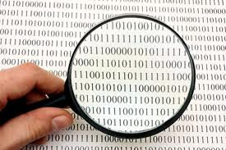


Privacy-preserving data publishing
A curator (e.g., a company, a hospital, an institution, etc.) wishes to publish data about its users
Third-parties (e.g., research labs, advertising agencies, etc.) wish to learn statistical facts about the published data
How can the curator release useful data while preserving user privacy?
Users
Curator
3rd party

Slide 3
ϵ-differential privacy
Publishing statistics can reveal potentially private information
Goal: Encourage user participation in the statistical analysis
How? Prove that whether they participate in the analysis or not, the revealed information is almost the same

Slide 4
ϵ-differential privacy
Prove that the participation of any single user in the published data will not increase the adversary’s knowledge

Slide 5
ϵ-differential privacy
Prove that the participation of any single user in the published data will not increase the adversary’s knowledge
Simply publishing statistics does not work
D
the database is hidden
 | l₁ | l₂ | l₃ | l₄ | l₅
u₁ | 0 | 0 | 1 | 0 | 0
u₂ | 1 | 0 | 0 | 0 | 0
u₃ | 1 | 0 | 0 | 0 | 0
u₄ | 0 | 1 | 0 | 0 | 0
u₅ | 0 | 0 | 1 | 0 | 0
u₆ | 0 | 0 | 1 | 0 | 0
u₇ | 0 | 0 | 1 | 0 | 0
u₈ | 0 | 0 | 0 | 0 | 1
u₉ | 0 | 0 | 0 | 0 | 1

Slide 6
ϵ-differential privacy
Prove that the participation of any single user in the published data will not increase the adversary’s knowledge
Simply publishing statistics does not work
D'
D
the database is hidden
 | l₁ | l₂ | l₃ | l₄ | l₅
u₁ | 0 | 0 | 1 | 0 | 0
u₂ | 1 | 0 | 0 | 0 | 0
u₃ | 1 | 0 | 0 | 0 | 0
u₄ | 0 | 1 | 0 | 0 | 0
u₅ | 0 | 0 | 1 | 0 | 0
u₆ | 0 | 0 | 1 | 0 | 0
u₇ | 0 | 0 | 1 | 0 | 0
u₈ | 0 | 0 | 0 | 0 | 1
u₉
c' | 2 | 1 | 4 | 0 | 1
 | l₁ | l₂ | l₃ | l₄ | l₅
u₁ | 0 | 0 | 1 | 0 | 0
u₂ | 1 | 0 | 0 | 0 | 0
u₃ | 1 | 0 | 0 | 0 | 0
u₄ | 0 | 1 | 0 | 0 | 0
u₅ | 0 | 0 | 1 | 0 | 0
u₆ | 0 | 0 | 1 | 0 | 0
u₇ | 0 | 0 | 1 | 0 | 0
u₈ | 0 | 0 | 0 | 0 | 1
u₉ | 0 | 0 | 0 | 0 | 1
Before publishing, the adversary happens to know everything, except for u₉

Slide 7
ϵ-differential privacy
Prove that the participation of any single user in the published data will not increase the adversary’s knowledge
Simply publishing statistics does not work
D'
D
the database is hidden
 | l₁ | l₂ | l₃ | l₄ | l₅
u₁ | 0 | 0 | 1 | 0 | 0
u₂ | 1 | 0 | 0 | 0 | 0
u₃ | 1 | 0 | 0 | 0 | 0
u₄ | 0 | 1 | 0 | 0 | 0
u₅ | 0 | 0 | 1 | 0 | 0
u₆ | 0 | 0 | 1 | 0 | 0
u₇ | 0 | 0 | 1 | 0 | 0
u₈ | 0 | 0 | 0 | 0 | 1
u₉
c' | 2 | 1 | 4 | 0 | 1
 | l₁ | l₂ | l₃ | l₄ | l₅
u₁ | 0 | 0 | 1 | 0 | 0
u₂ | 1 | 0 | 0 | 0 | 0
u₃ | 1 | 0 | 0 | 0 | 0
u₄ | 0 | 1 | 0 | 0 | 0
u₅ | 0 | 0 | 1 | 0 | 0
u₆ | 0 | 0 | 1 | 0 | 0
u₇ | 0 | 0 | 1 | 0 | 0
u₈ | 0 | 0 | 0 | 0 | 1
u₉ | 0 | 0 | 0 | 0 | 1
c | 2 | 1 | 4 | 0 | 2
Before publishing, the adversary happens to know everything, except for u₉
After publishing, the adversary can find info about u₉
Published counts

Slide 8
ϵ-differential privacy
Main idea
M
Randomized Mechanism
D
t

Slide 9
ϵ-differential privacy
Main idea
  Any output (called transcript) of M is produced with almost the same probability, whether any single user was in the database (D) or not (D’)
M
Randomized Mechanism
D
t
M
D
Randomized Mechanism
OR
t
D’

Slide 10
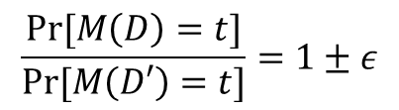
ϵ-differential privacy
Main idea
  Any output (called transcript) of M is produced with almost the same probability, whether any single user was in the database (D) or not (D’)
Formal Definition
  A mechanism M satisfies ϵ-differential privacy if
    for any two neighboring databases D, D', and
    for all possible transcripts t
M
Randomized Mechanism
D
t
$$\frac{Pr⁡[M\left(D\right)=t]}{Pr⁡[M\left(D′\right)=t]}=1±ε$$

Slide 11
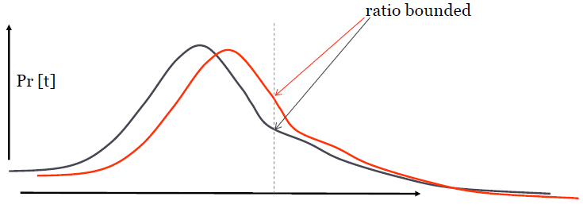
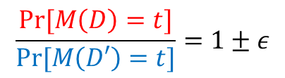
ϵ-differential privacy
Red line: Probability to receive a certain t given D
Blue line: Probability to receive a certain t given D’
For every t, the ratio of these probabilities must be bounded
$$\frac{Pr⁡[M\left(D\right)=t]}{Pr⁡[M\left(D′\right)=t]}=1±ε$$

Slide 12
Laplace Perturbation Algorithm (LPA)
It injects noise to every published statistic
D
 | l₁ | l₂ | l₃ | l₄ | l₅
u₁ | 0 | 0 | 1 | 0 | 0
u₂ | 1 | 0 | 0 | 0 | 0
u₃ | 1 | 0 | 0 | 0 | 0
u₄ | 0 | 1 | 0 | 0 | 0
u₅ | 0 | 0 | 1 | 0 | 0
u₆ | 0 | 0 | 1 | 0 | 0
u₇ | 0 | 0 | 1 | 0 | 0
u₈ | 0 | 0 | 0 | 0 | 1
u₉ | 0 | 0 | 0 | 0 | 1
c | 2 | 1 | 4 | 0 | 2

Slide 13
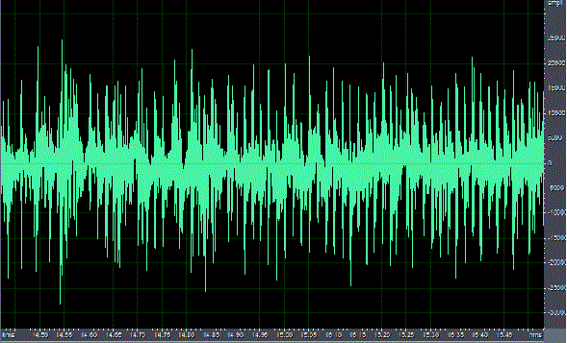
Laplace Perturbation Algorithm (LPA)
It injects noise to every published statistic
c | 2 | 1 | 4 | 0 | 2
c | 5 | 0 | 8 | 2 | 1

Slide 14
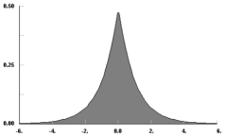
Laplace Perturbation Algorithm (LPA)
The noise is randomly drawn from a Laplace distribution with mean 0
c | 2 | 1 | 4 | 0 | 2
c | 5 | 0 | 8 | 2 | 1

Slide 15
Laplace Perturbation Algorithm (LPA)
The scale of the distribution depends on the sensitivity Δ
  Δ: maximum amount of statistical information that can be affected by any single user
    I.e. how much the statistics will change if we remove any single user
D
D'
 | l₁ | l₂ | l₃ | l₄ | l₅
u₁ | 0 | 0 | 1 | 0 | 0
u₂ | 1 | 0 | 0 | 0 | 0
u₃ | 1 | 0 | 0 | 0 | 0
u₄ | 0 | 1 | 0 | 0 | 0
u₅ | 0 | 0 | 1 | 0 | 0
u₆ | 0 | 0 | 1 | 0 | 0
u₇ | 0 | 0 | 1 | 0 | 0
u₈ | 0 | 0 | 0 | 0 | 1
u₉ | 0 | 0 | 0 | 0 | 1
c | 2 | 1 | 4 | 0 | 2
 | l₁ | l₂ | l₃ | l₄ | l₅
u₁ | 0 | 0 | 1 | 0 | 0
u₂ | 1 | 0 | 0 | 0 | 0
u₃ | 1 | 0 | 0 | 0 | 0
u₄ | 0 | 1 | 0 | 0 | 0
u₅ | 0 | 0 | 1 | 0 | 0
u₆ | 0 | 0 | 1 | 0 | 0
u₇ | 0 | 0 | 1 | 0 | 0
u₈ | 0 | 0 | 0 | 0 | 1
u₉ | 0 | 0 | 0 | 0 | 1
c | 2 | 1 | 4 | 0 | 1

Slide 16
Laplace Perturbation Algorithm (LPA)
Main Result
  If the scale of the noise is λ=Δ/ϵ, LPA satisfies ϵ-differential privacy
  The higher the noise scale, the less accurate the published statistics
Essentially, it hides the presence of any user, by hiding the effect she has on the published statistics

Slide 17
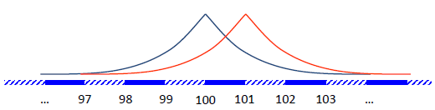
Example
We want to count the users at a certain location
Any user can affect the count by at most 1 (i.e. Δ=1)
True answer
  100 if user opts out (D’)
  101 if user opts in (D)
We add noise Lap(1/ϵ) to the true answer
We satisfy ϵ-differential privacy
Ratio bounded

Slide 18
Privacy Levels
  If a mechanism M adds noise Lap(aΔ/ϵ) to its statistics, it satisfies ϵ/a-differential privacy
E.g. let Δ=1 and a fixed ϵ
  If a mechanism adds noise Lap(1/ϵ), it satisfies ϵ-differential privacy
  If a mechanism adds noise Lap(2/ϵ), it satisfies ϵ/2-differential privacy
  If a mechanism adds noise Lap(3/ϵ), it satisfies ϵ/3-differential privacy
  Etc.

Slide 19

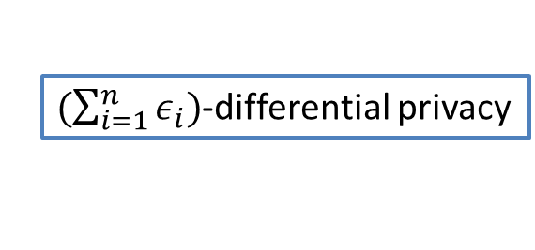
Composition Theorem [Dwork et al., TCC’06]
ϵ₁
M₁
ϵ₂
D
M₂
$(\sum_{i=1}^{n}{ε_{i})}$-differential privacy
…
ϵ_{n}
M_{n}

Slide 20
ϵ as privacy budget
We want to run multiple mechanisms on the same data
We want to satisfy ϵ-differential privacy
We view ϵ as privacy budget distributed among the mechanisms
ϵ

Slide 21
ϵ as privacy budget
D
ϵ

Slide 22
ϵ as privacy budget
ϵ/2
M₁
D
ϵ

Slide 23
ϵ as privacy budget
ϵ/2
M₁
D
ϵ/2

Slide 24
ϵ as privacy budget
ϵ/2
M₁
D
ϵ/3
M₂
ϵ/2

Slide 25
ϵ as privacy budget
ϵ/2
M₁
D
ϵ/3
M₂
ϵ/6

Slide 26
ϵ as privacy budget
ϵ/2
M₁
D
ϵ/3
M₂
ϵ/6
ϵ/6
M₃

Slide 27
ϵ as privacy budget
ϵ/2
M₁
D
ϵ/3
M₂
0
ϵ/6
M₃

Slide 28
ϵ as privacy budget
ϵ/2
M₁
D
ϵ/3
M₂
0
ϵ/6
M₃
We cannot run more mechanisms on the same data!

Slide 29

Sampling
Reduce the sensitivity by using a sample of the original data
Compute the statistics on the sample (maybe less accurate)
Add smaller noise for the same privacy level
 | l₁ | l₂ | l₃ | l₄ | l₅
u₁ | 0 | 0 | 1 | 0 | 0
u₂ | 1 | 0 | 0 | 0 | 0
u₃ | 1 | 0 | 0 | 0 | 0
u₄ | 0 | 1 | 0 | 0 | 0
u₅ | 0 | 0 | 1 | 0 | 0
u₆ | 0 | 0 | 1 | 0 | 0
u₇ | 0 | 0 | 1 | 0 | 0
u₈ | 0 | 0 | 0 | 0 | 1
u₉ | 0 | 0 | 0 | 0 | 1
 | l₁ | l₂ | l₃ | l₄ | l₅
u₁ | 0 | 0 | 1 | 0 | 0
u₃ | 1 | 0 | 0 | 0 | 0
u₄ | 0 | 1 | 0 | 0 | 0
u₇ | 0 | 0 | 1 | 0 | 0
u₉ | 0 | 0 | 0 | 0 | 1

Slide 30
1st Application
Publishing Counts
Geo-social network application: User “check-in” data
u₁
u₂
u₃
u₄
u₅
…
u_{n}
l₁
0
1
0
0
1
…
1
l₂
1
0
0
1
1
…
0
l₃
0
0
0
0
1
…
0
l₄
1
1
1
1
1
…
1
l₅
0
0
1
1
1
…
0
l₆
0
0
0
0
1
…
0
l₇
1
1
1
1
1
…
1
l₈
1
1
1
0
1
…
0
l₉
0
1
0
1
1
…
1
l₁₀
0
0
0
0
1
…
0
l₁₁
0
0
0
0
1
…
1
l₁₂
1
0
1
0
1
…
0

Slide 31
1st Application
Publishing Counts
Goal: Publish the count of “check-ins” per location with differential privacy
u₁
u₂
u₃
u₄
u₅
…
u_{n}
c
l₁
0
1
0
0
1
…
1
14
l₂
1
0
0
1
1
…
0
13
l₃
0
0
0
0
1
…
0
2
l₄
1
1
1
1
1
…
1
51
l₅
0
0
1
1
1
…
0
40
l₆
0
0
0
0
1
…
0
10
l₇
1
1
1
1
1
…
1
60
l₈
1
1
1
0
1
…
0
33
l₉
0
1
0
1
1
…
1
8
l₁₀
0
0
0
0
1
…
0
3
l₁₁
0
0
0
0
1
…
0
7
l₁₂
1
0
1
0
1
…
0
18

Slide 32
Sensitivity
A user can affect each count by one
u₁
u₂
u₃
u₄
u₅
…
u_{n}
c
l₁
0
1
0
0
1
…
1
14
l₂
1
0
0
1
1
…
0
13
l₃
0
0
0
0
1
…
0
2
l₄
1
1
1
1
1
…
1
51
l₅
0
0
1
1
1
…
0
40
l₆
0
0
0
0
1
…
0
10
l₇
1
1
1
1
1
…
1
60
l₈
1
1
1
0
1
…
0
33
l₉
0
1
0
1
1
…
1
8
l₁₀
0
0
0
0
1
…
0
3
l₁₁
0
0
0
0
1
…
0
7
l₁₂
1
0
1
0
1
…
0
18

Slide 33
Sensitivity
A user can affect each count by one
u₁
u₂
u₃
u₄
u₅
…
u_{n}
c
l₁
0
1
0
0
0
…
1
13
l₂
1
0
0
1
1
…
0
12
l₃
0
0
0
0
0
…
0
1
l₄
1
1
1
1
0
…
1
50
l₅
0
0
1
1
0
…
0
39
l₆
0
0
0
0
1
…
0
9
l₇
1
1
1
1
1
…
1
59
l₈
1
1
1
0
0
…
0
32
l₉
0
1
0
1
0
…
1
7
l₁₀
0
0
0
0
0
…
0
2
l₁₁
0
0
0
0
1
…
0
6
l₁₂
1
0
1
0
1
…
0
17

Slide 34
Sensitivity
Worst case: a user affects every count
Sensitivity: 12
u₁
u₂
u₃
u₄
u₅
…
u_{n}
c
l₁
0
1
0
0
1
…
1
14
l₂
1
0
0
1
1
…
0
13
l₃
0
0
0
0
1
…
0
2
l₄
1
1
1
1
1
…
1
51
l₅
0
0
1
1
1
…
0
40
l₆
0
0
0
0
1
…
0
10
l₇
1
1
1
1
1
…
1
60
l₈
1
1
1
0
1
…
0
33
l₉
0
1
0
1
1
…
1
8
l₁₀
0
0
0
0
1
…
0
3
l₁₁
0
0
0
0
1
…
0
7
l₁₂
1
0
1
0
1
…
0
18

Slide 35
Laplace Perturbation Algorithm (LPA)
u₁
u₂
u₃
u₄
u₅
…
u_{n}
c
l₁
0
1
0
0
1
…
1
14
l₂
1
0
0
1
1
…
0
13
l₃
0
0
0
0
1
…
0
2
l₄
1
1
1
1
1
…
1
51
l₅
0
0
1
1
1
…
0
40
l₆
0
0
0
0
1
…
0
10
l₇
1
1
1
1
1
…
1
60
l₈
1
1
1
0
1
…
0
33
l₉
0
1
0
1
1
…
1
8
l₁₀
0
0
0
0
1
…
0
3
l₁₁
0
0
0
0
1
…
0
7
l₁₂
1
0
1
0
1
…
0
18
Sensitivity: 12
Noise scale: 12/ϵ
Problem: Too much noise!

Slide 36
Idea
Group the counts
Smooth via averaging
Consider the average value of each group as the count of each group’s column
u₁
u₂
u₃
u₄
u₅
…
u_{n}
c
l₁
0
1
0
0
1
…
1
14
l₂
1
0
0
1
1
…
0
13
l₃
0
0
0
0
1
…
0
2
l₄
1
1
1
1
1
…
1
51
l₅
0
0
1
1
1
…
0
40
l₆
0
0
0
0
1
…
0
10
l₇
1
1
1
1
1
…
1
60
l₈
1
1
1
0
1
…
0
34
l₉
0
1
0
1
1
…
1
8
l₁₀
0
0
0
0
1
…
0
3
l₁₁
0
0
0
0
1
…
0
7
l₁₂
1
0
1
0
1
…
0
18
20
36
9

Slide 37
Sensitivity
Each user can affect each average value by one
u₁
u₂
u₃
u₄
u₅
…
u_{n}
c
l₁
0
1
0
0
1
…
1
14
l₂
1
0
0
1
1
…
0
13
l₃
0
0
0
0
1
…
0
2
l₄
1
1
1
1
1
…
1
51
l₅
0
0
1
1
1
…
0
40
l₆
0
0
0
0
1
…
0
10
l₇
1
1
1
1
1
…
1
60
l₈
1
1
1
0
1
…
0
34
l₉
0
1
0
1
1
…
1
8
l₁₀
0
0
0
0
1
…
0
3
l₁₁
0
0
0
0
1
…
0
7
l₁₂
1
0
1
0
1
…
0
18
20
36
9

Slide 38
Sensitivity
Each user can affect each average value by one
Before removing u₅, the first group average was (14+13+2+51)/4=20, now it is (13+12+1+50)/4=19
u₁
u₂
u₃
u₄
u₅
…
u_{n}
c
l₁
0
1
0
0
1
…
1
13
l₂
1
0
0
1
1
…
0
12
l₃
0
0
0
0
1
…
0
1
l₄
1
1
1
1
1
…
1
50
l₅
0
0
1
1
1
…
0
39
l₆
0
0
0
0
1
…
0
9
l₇
1
1
1
1
1
…
1
59
l₈
1
1
1
0
1
…
0
33
l₉
0
1
0
1
1
…
1
7
l₁₀
0
0
0
0
1
…
0
2
l₁₁
0
0
0
0
1
…
0
6
l₁₂
1
0
1
0
1
…
0
17
19
35
8

Slide 39
Sensitivity
Each user can affect each average value by one
Fewer values to publish
u₁
u₂
u₃
u₄
u₅
…
u_{n}
c
l₁
0
1
0
0
1
…
1
14
l₂
1
0
0
1
1
…
0
13
l₃
0
0
0
0
1
…
0
2
l₄
1
1
1
1
1
…
1
51
l₅
0
0
1
1
1
…
0
40
l₆
0
0
0
0
1
…
0
10
l₇
1
1
1
1
1
…
1
60
l₈
1
1
1
0
1
…
0
34
l₉
0
1
0
1
1
…
1
8
l₁₀
0
0
0
0
1
…
0
3
l₁₁
0
0
0
0
1
…
0
7
l₁₂
1
0
1
0
1
…
0
18
Sensitivity: 3
Noise scale: 3/ϵ
20
36
9

Slide 40
u₁
u₂
u₃
u₄
u₅
…
u_{n}
c
l₁
0
1
0
0
1
…
1
14
l₂
1
0
0
1
1
…
0
13
l₃
0
0
0
0
1
…
0
2
l₄
1
1
1
1
1
…
1
51
l₅
0
0
1
1
1
…
0
40
l₆
0
0
0
0
1
…
0
10
l₇
1
1
1
1
1
…
1
60
l₈
1
1
1
0
1
…
0
34
l₉
0
1
0
1
1
…
1
8
l₁₀
0
0
0
0
1
…
0
3
l₁₁
0
0
0
0
1
…
0
7
l₁₂
1
0
1
0
1
…
0
18
20
36
9
Problem: Arbitrary grouping – Bad Smoothing effect

Slide 41
Idea
Find optimal grouping by reordering the columns
u₁
u₂
u₃
u₄
u₅
…
u_{n}
c
l₁
0
1
0
0
1
…
1
14
l₂
1
0
0
1
1
…
0
13
l₃
0
0
0
0
1
…
0
2
l₄
1
1
1
1
1
…
1
51
l₅
0
0
1
1
1
…
0
40
l₆
0
0
0
0
1
…
0
10
l₇
1
1
1
1
1
…
1
60
l₈
1
1
1
0
1
…
0
33
l₉
0
1
0
1
1
…
1
8
l₁₀
0
0
0
0
1
…
0
3
l₁₁
0
0
0
0
1
…
0
7
l₁₂
1
0
1
0
1
…
0
18

Slide 42
Idea
Find optimal grouping by reordering the columns
u₁
u₂
u₃
u₄
u₅
…
u_{n}
c
l₃
0
0
0
0
1
…
0
2
l₁₀
0
0
0
0
1
…
0
3
l₁₁
0
0
0
0
1
…
0
7
l₉
0
1
0
1
1
…
1
8
l₆
0
0
0
0
1
…
0
10
l₂
1
0
0
1
1
…
0
13
l₁
0
1
0
0
1
…
1
14
l₁₂
1
0
1
0
1
…
0
18
l₈
1
1
1
0
1
…
0
33
l₅
0
0
1
1
1
…
0
40
l₄
1
1
1
1
1
…
1
51
l₇
1
1
1
1
1
…
1
60
5
13.75
46

Slide 43
u₁
u₂
u₃
u₄
u₅
…
u_{n}
c
l₃
0
0
0
0
1
…
0
2
l₁₀
0
0
0
0
1
…
0
3
l₁₁
0
0
0
0
1
…
0
7
l₉
0
1
0
1
1
…
1
8
l₆
0
0
0
0
1
…
0
10
l₂
1
0
0
1
1
…
0
13
l₁
0
1
0
0
1
…
1
14
l₁₂
1
0
1
0
1
…
0
18
l₈
1
1
1
0
1
…
0
33
l₅
0
0
1
1
1
…
0
40
l₄
1
1
1
1
1
…
1
51
l₇
1
1
1
1
1
…
1
60
5
13.75
46
Problem: Grouping reveals information – Not differentially private

Slide 44
Challenge: Find “good” groups while retaining differential privacy

Slide 45
Idea
Create two sequential mechanisms, each using budget ϵ/2
First mechanism: find groups on a sample (= lower sensitivity)
Second mechanism: group, smooth, add noise, and publish
Question: How do we sample???

Slide 46
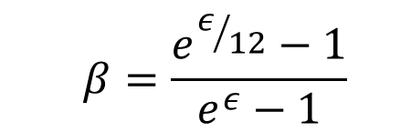
Row sampling
  $$β=\frac{e^{ε/{12}}−1}{e^{ε}−1}$$
Sample each row with probability
The sensitivity becomes 1
u₁
u₂
u₃
u₄
u₅
…
u_{n}
c
l₁
0
1
0
0
1
…
1
1
l₂
1
0
0
1
1
…
0
1
l₃
0
0
0
0
1
…
0
0
l₄
1
1
1
1
1
…
1
1
l₅
0
0
1
1
1
…
0
1
l₆
0
0
0
0
1
…
0
2
l₇
1
1
1
1
1
…
1
3
l₈
1
1
1
0
1
…
0
1
l₉
0
1
0
1
1
…
1
1
l₁₀
0
0
0
0
1
…
0
0
l₁₁
0
0
0
0
1
…
0
1
l₁₂
1
0
1
0
1
…
0
2

Slide 47
u₁
u₂
u₃
u₄
u₅
…
u_{n}
c
l₃
0
0
0
0
1
…
0
2
l₁₀
0
0
0
0
1
…
0
3
l₁
0
1
0
0
1
…
1
14
l₂
1
0
0
1
1
…
0
13
l₄
1
1
1
1
1
…
1
51
l₅
0
0
1
1
1
…
0
40
l₁₁
0
0
0
0
1
…
0
7
l₉
0
1
0
1
1
…
1
8
l₈
1
1
1
0
1
…
0
33
l₆
0
0
0
0
1
…
0
10
l₁₂
1
0
1
0
1
…
0
18
l₇
1
1
1
1
1
…
1
60
8
26.5
30.25
Problem: Bad sampling – Bad grouping

Slide 48
Column sampling
Keep all rows
Sample a single 1 from each row
The sensitivity becomes 1
u₁
u₂
u₃
u₄
u₅
…
u_{n}
c
l₁
0
1
0
0
1
…
1
7
l₂
1
0
0
1
1
…
0
6
l₃
0
0
0
0
1
…
0
0
l₄
1
1
1
1
1
…
1
20
l₅
0
0
1
1
1
…
0
16
l₆
0
0
0
0
1
…
0
5
l₇
1
1
1
1
1
…
1
29
l₈
1
1
1
0
1
…
0
15
l₉
0
1
0
1
1
…
1
4
l₁₀
0
0
0
0
1
…
0
1
l₁₁
0
0
0
0
1
…
0
3
l₁₂
1
0
1
0
1
…
0
8

Slide 49
u₁
u₂
u₃
u₄
u₅
…
u_{n}
c
l₃
0
0
0
0
0
…
0
2
l₁₀
0
0
0
0
0
…
0
3
l₁₁
0
0
0
0
1
…
0
7
l₉
0
1
0
1
0
…
1
8
l₆
0
0
0
0
1
…
0
10
l₂
1
0
0
1
1
…
0
13
l₁
0
1
0
0
0
…
1
14
l₁₂
1
0
1
0
1
…
0
18
l₈
1
1
1
0
0
…
0
33
l₅
0
0
1
1
0
…
0
40
l₄
1
1
1
1
0
…
1
51
l₇
1
1
1
1
1
…
1
60
5
13.75
46
Good Result

Slide 50
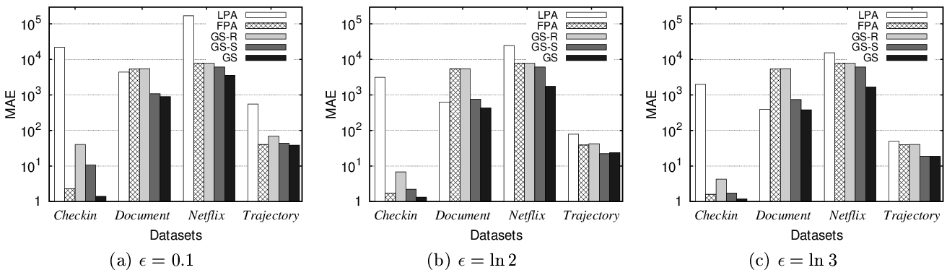
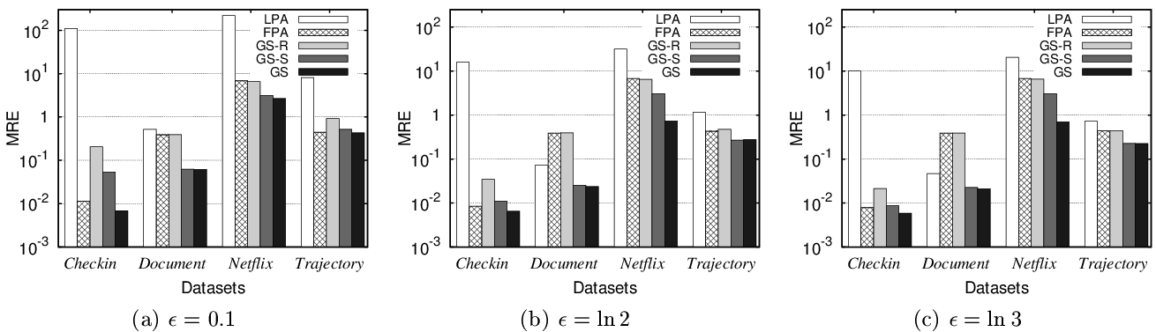
Experiments

Slide 51
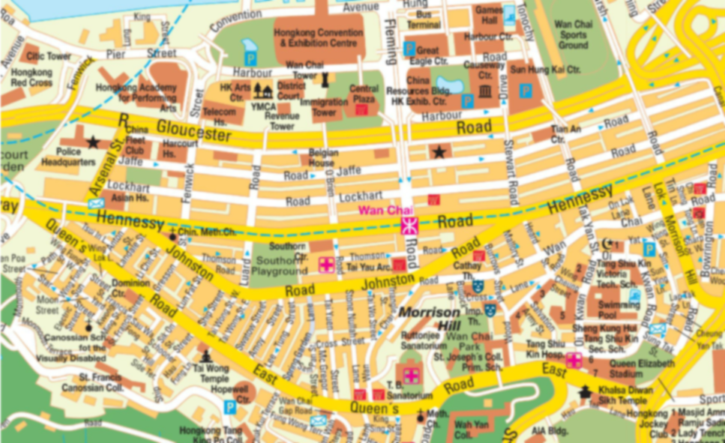
2nd Application
Traffic Reporting

Slide 52
2nd Application
Traffic Reporting
3
7
9
0
8
6

Slide 53

Privacy Concerns

Slide 54
Privacy Concerns
3
7
8
0
8
6

Slide 55
Privacy Concerns
Published Data
Adversary’s View
3
7
9
3
7
8
0
8
6
0
8
6
Missing user’s position revealed!!

Slide 56
Laplace Perturbation Algorithm
Real Data
Noise from Laplace Distribution
3
7
9
0
8
6
Sensitivity=1
At a specific point of time a user can
be only at one location
2
9
7
Published Data
1
7
8

Slide 57
Streaming Setting

Slide 58
Streaming Setting
6
7
5
2
8
5

Slide 59
Streaming Setting

Slide 60
Streaming Setting
3
7
9
0
8
6

Slide 61
Streaming Setting
Timestamp 1
Timestamp 2
Timestamp 3
Timestamp n
6
7
5
3
7
6
9
7
5
…
7
…
3
9
2
8
5
0
8
2
6
8
5
0
8
6

Slide 62
ϵ-Differential Privacy for Streams
Timestamp 1
Timestamp 2
Timestamp 3
Timestamp n
6
7
3
5
7
6
9
7
5
Real Data
…
3
7
9
2
8
0
5
8
2
6
8
5
0
8
6
LPA
LPA
LPA
…
LPA
Timestamp 1
Timestamp 2
Timestamp 3
Timestamp n
7
6
3
6
7
6
5
8
4
Published
Data
…
2
7
7
1
9
2
6
7
1
6
6
5
0
5
7

Slide 63
ϵ-Differential Privacy for Streams
Timestamp 1
Timestamp 2
Timestamp 3
Timestamp n
Event level
  Noise scale 1/ϵ
  ϵ-differential privacy at any timestamp
User level
  Noise scale n/ϵ
  ϵ-differential privacy at all timestamps
6
7
5
3
7
6
9
7
5
…
3
7
9
2
8
0
5
8
2
6
8
5
0
8
6
ϵ
ϵ
ϵ
ϵ
LPA
LPA
LPA
…
LPA
Timestamp 1
Timestamp 2
Timestamp 3
Timestamp n
7
6
3
6
7
6
5
8
4
2
7
7
1
9
6
…
2
7
1
6
6
5
0
5
7
Timestamp 1
Timestamp 2
Timestamp 3
Timestamp n
6
7
3
5
7
6
9
7
5
3
7
9
2
8
5
…
0
8
2
6
8
5
0
8
6
ϵ/n
LPA
ϵ/n
LPA
ϵ/n
LPA
…
ϵ/n
LPA
Timestamp 1
Timestamp 2
Timestamp 3
Timestamp n
7
6
3
6
7
6
5
8
4
2
7
7
1
9
6
…
2
7
1
6
6
5
0
5
7

Slide 64
w-Event Differential Privacy
Event level
  ϵ-differential privacy at any timestamp
  it does not protect user movement
  noise proportional to 1
w-Event level
  ϵ-differential privacy at any w consecutive timestamps
  it protects user movement that lasts at most w timestamps
  noise proportional to w<<n
User level
  ϵ-differential privacy at all timestamps
  it protects user movement
  noise proportional to n

Slide 65
w-Event Differential Privacy
Timeline
ϵ-differential privacy
Timestamp 1
Timestamp 2
Timestamp 3
Timestamp 4
Timestamp 5
Timestamp 6
6
7
3
5
7
6
9
7
3
5
7
6
9
7
3
5
7
9
…
2
8
0
5
8
2
6
8
0
5
8
2
6
8
0
5
8
6
w=3

Slide 66
w-Event Differential Privacy
Timeline
ϵ-differential privacy
Timestamp 1
Timestamp 2
Timestamp 3
Timestamp 4
Timestamp 5
Timestamp 6
6
7
3
5
7
6
9
7
3
5
7
6
9
7
3
5
7
9
…
2
8
0
5
8
2
6
8
0
5
8
2
6
8
0
5
8
6
w=3

Slide 67
w-Event Differential Privacy
Timeline
ϵ-differential privacy
Timestamp 1
Timestamp 2
Timestamp 3
Timestamp 4
Timestamp 5
Timestamp 6
6
7
3
5
7
6
9
7
3
5
7
6
9
7
3
5
7
9
…
2
8
0
5
8
2
6
8
0
5
8
2
6
8
0
5
8
6
w=3

Slide 68
w-Event Differential Privacy
Timeline
ϵ-differential privacy
Timestamp 1
Timestamp 2
Timestamp 3
Timestamp 4
Timestamp 5
Timestamp 6
6
7
3
5
7
6
9
7
3
5
7
6
9
7
3
5
7
9
…
2
8
0
5
8
2
6
8
0
5
8
2
6
8
0
5
8
6
ϵ₁
ϵ₂
ϵ₃
Guarantee: ϵ₁+ϵ₂+ϵ₃ ≤ ϵ
w=3
Challenge: Set the noise/budget on-the-fly

Slide 69
Uniform
Timestamp 1
Timestamp 2
Timestamp 3
Timestamp 4
Timestamp 5
Timestamp 6
Real Data
6
7
3
5
7
6
9
7
3
5
7
6
9
7
3
5
7
9
…
2
8
0
5
8
2
6
8
0
5
8
2
6
8
0
5
8
6
ϵ/3
LPA
ϵ/3
LPA
ϵ/3
LPA
ϵ/3
LPA
ϵ/3
LPA
ϵ/3
LPA
Timestamp 1
Timestamp 2
Timestamp 3
Timestamp 4
Timestamp 5
Timestamp 6
Published
Data
6
7
3
5
7
6
9
7
3
5
7
6
9
7
3
5
7
9
…
2
8
0
5
8
2
6
8
0
5
8
2
6
8
0
5
8
6

Slide 70
Uniform
ϵ
ϵ
ϵ
ϵ
ϵ/3
LPA
ϵ/3
LPA
ϵ/3
LPA
ϵ/3
LPA
ϵ/3
LPA
ϵ/3
LPA
Timestamp 1
Timestamp 2
Timestamp 3
Timestamp 4
Timestamp 5
Timestamp 6
Published
Data
6
7
3
5
7
6
9
7
3
5
7
6
9
7
3
5
7
9
…
2
8
0
5
8
2
6
8
0
5
8
2
6
8
0
5
8
6

Slide 71
Sample
Timestamp 1
Timestamp 2
Timestamp 3
Timestamp 4
Timestamp 5
Timestamp 6
Real Data
6
7
3
5
7
6
9
7
3
5
7
6
9
7
3
5
7
9
…
2
8
0
5
8
2
6
8
0
5
8
2
6
8
0
5
8
6
ϵ
LPA
LPA
LPA
ϵ
LPA
LPA
LPA
Timestamp 1
Timestamp 4
Published
Data
6
7
5
3
7
9
…
2
8
5
0
8
6

Slide 72
Sample
ϵ
ϵ
ϵ
ϵ
ϵ
LPA
LPA
LPA
ϵ
LPA
LPA
LPA
Timestamp 1
Timestamp 4
Published
Data
6
7
5
3
7
9
…
2
8
5
0
8
6

Slide 73
Observations
Uniform may lead to large noise
Sample may skip important information
Key Idea: If the counts to be published now are similar to the previous counts, skip them
  i.e., approximate them with the previous publication
  The similarity calculation is done in a special (private) manner – details omitted

Slide 74
Budget Distribution
Timestamp 1
Timestamp 2
Timestamp 3
Real Data
6
7
3
5
7
6
9
7
5
2
8
0
5
8
2
6
8
5
Available
Budget:
ϵ/2
LPA
LPA
ϵ/4
LPA
  ϵ/4
  ϵ/2
Timestamp 1
Timestamp 3
Published
Data
6
7
5
6
7
5
2
8
5
2
8
5

Slide 75
Budget Distribution
Timestamp 1
Timestamp 2
Timestamp 3
Timestamp 4
Real Data
6
7
3
5
7
6
9
7
3
5
7
9
2
8
0
5
8
2
6
8
0
5
8
6
Available
Budget:
ϵ/2
LPA
LPA
ϵ/4
LPA
  3ϵ/4
  ϵ/4
Timestamp 1
Timestamp 3
Published
Data
6
7
5
6
7
5
2
8
5
2
8
5

Slide 76
Budget Distribution
Timestamp 1
Timestamp 2
Timestamp 3
Timestamp 4
Real Data
6
7
3
5
7
6
9
7
3
5
7
9
2
8
0
5
8
2
6
8
0
5
8
6
Available
Budget:
ϵ/2
LPA
LPA
ϵ/4
LPA
3ϵ/8
LPA
  3ϵ/4
  3ϵ/8
Timestamp 1
Timestamp 3
Timestamp 4
Published
Data
6
7
5
6
7
3
5
7
9
2
8
5
2
8
0
5
8
6

Slide 77
Budget Distribution
Timestamp 1
Timestamp 2
Timestamp 3
Timestamp 4
Timestamp 5
Real Data
6
7
3
5
7
6
9
7
3
5
7
6
9
7
5
2
8
0
5
8
2
6
8
0
5
8
2
6
8
5
Available
Budget:
ϵ/2
LPA
LPA
ϵ/4
LPA
3ϵ/8
LPA
  3ϵ/8
Timestamp 1
Timestamp 3
Timestamp 4
Published
Data
6
7
5
6
7
3
5
7
9
2
8
5
2
8
0
5
8
6

Slide 78
Budget Distribution
Timestamp 1
Timestamp 2
Timestamp 3
Timestamp 4
Timestamp 5
Real Data
6
7
3
5
7
6
9
7
3
5
7
6
9
7
5
2
8
0
5
8
2
6
8
0
5
8
2
6
8
5
Available
Budget:
ϵ/2
LPA
LPA
ϵ/4
LPA
3ϵ/8
LPA
  3ϵ/8
Timestamp 1
Timestamp 3
Timestamp 4
Published
Data
6
7
5
6
7
3
5
7
9
2
8
5
2
8
0
5
8
6

Slide 79
Budget Distribution
Timestamp 1
Timestamp 2
Timestamp 3
Timestamp 4
Timestamp 5
Timestamp 6
Real Data
6
7
3
5
7
6
9
7
3
5
7
6
9
7
3
5
7
9
2
8
0
5
8
2
6
8
0
5
8
2
6
8
0
5
8
6
Available
Budget:
ϵ/2
LPA
LPA
ϵ/4
LPA
3ϵ/8
LPA
LPA
  5ϵ/8
  3ϵ/8
Timestamp 1
Timestamp 3
Timestamp 4
Published
Data
6
7
5
6
7
3
5
7
9
2
8
5
2
8
0
5
8
6

Slide 80
Budget Distribution
Timestamp 1
Timestamp 2
Timestamp 3
Timestamp 4
Timestamp 5
Timestamp 6
Real Data
6
7
3
5
7
6
9
7
3
5
7
6
9
7
3
5
7
9
…
2
8
0
5
8
2
6
8
0
5
8
2
6
8
0
5
8
6
Available
Budget:
ϵ/2
LPA
LPA
ϵ/4
LPA
3ϵ/8
LPA
LPA
LPA
  5ϵ/8
Timestamp 1
Timestamp 3
Timestamp 4
Published
Data
6
7
5
6
7
3
5
7
9
…
2
8
5
2
8
0
5
8
6

Slide 81
Budget Distribution
(3ϵ)/8 ≤ϵ
(5ϵ)/8 ≤ϵ
(5ϵ)/8 ≤ϵ
(3ϵ)/4 ≤ϵ
ϵ/2
LPA
LPA
ϵ/4
LPA
3ϵ/8
LPA
LPA
LPA
Timestamp 1
Timestamp 3
Timestamp 4
Published
Data
6
7
5
6
7
3
5
7
9
…
2
8
5
2
8
0
5
8
6

Slide 82
Budget Absorption
Timestamp 1
Timestamp 2
Timestamp 3
Real Data
6
7
3
5
7
6
9
7
5
2
8
0
5
8
2
6
8
5
ϵ/3
LPA
ϵ/3
LPA
2ϵ/3
LPA
ϵ/3
ϵ/3
ϵ/3
ϵ/3
Timestamp 1
Timestamp 3
Published
Data
6
7
5
6
7
5
2
8
5
2
8
5

Slide 83
Budget Absorption
Timestamp 1
Timestamp 2
Timestamp 3
Timestamp 4
Real Data
6
7
3
5
7
6
9
7
3
5
7
9
2
8
0
5
8
2
6
8
0
5
8
6
ϵ/3
LPA
LPA
2ϵ/3
LPA
ϵ/3
ϵ/3
Timestamp 1
Timestamp 3
Published
Data
6
7
5
6
7
5
2
8
5
2
8
5

Slide 84
Budget Absorption
Timestamp 1
Timestamp 2
Timestamp 3
Timestamp 4
Timestamp 5
Real Data
6
7
3
5
7
6
9
7
3
5
7
6
9
7
5
2
8
0
5
8
2
6
8
0
5
8
2
6
8
5
ϵ/3
LPA
LPA
2ϵ/3
LPA
ϵ/3
ϵ/3
Timestamp 1
Timestamp 3
Published
Data
6
7
5
6
7
5
2
8
5
2
8
5

Slide 85
Budget Absorption
Timestamp 1
Timestamp 2
Timestamp 3
Timestamp 4
Timestamp 5
Real Data
6
7
3
5
7
6
9
7
3
5
7
6
9
7
5
2
8
0
5
8
2
6
8
0
5
8
2
6
8
5
LPA
LPA
LPA
ϵ/3
LPA
2ϵ/3
ϵ/3
2ϵ/3
ϵ/3
Timestamp 1
Timestamp 3
Published
Data
6
7
5
6
7
5
2
8
5
2
8
5

Slide 86
Budget Absorption
Timestamp 1
Timestamp 2
Timestamp 3
Timestamp 4
Timestamp 5
Timestamp 6
Real Data
6
7
3
5
7
6
9
7
3
5
7
6
9
7
3
5
7
9
…
2
8
0
5
8
2
6
8
0
5
8
2
6
8
0
5
8
6
ϵ/3
LPA
LPA
2ϵ/3
LPA
LPA
2ϵ/3
LPA
Timestamp 1
Timestamp 3
Timestamp 6
Published
Data
6
7
5
6
7
5
3
7
9
…
2
8
5
2
8
5
0
8
6

Slide 87
Budget Absorption
(2ϵ)/3 ≤ϵ
(2ϵ)/3 ≤ϵ
(2ϵ)/3 ≤ϵ
ϵ
ϵ/3
LPA
LPA
2ϵ/3
LPA
LPA
2ϵ/3
LPA
Timestamp 1
Timestamp 3
Timestamp 6
Published
Data
6
7
5
6
7
5
3
7
9
…
2
8
5
2
8
5
0
8
6

Slide 88
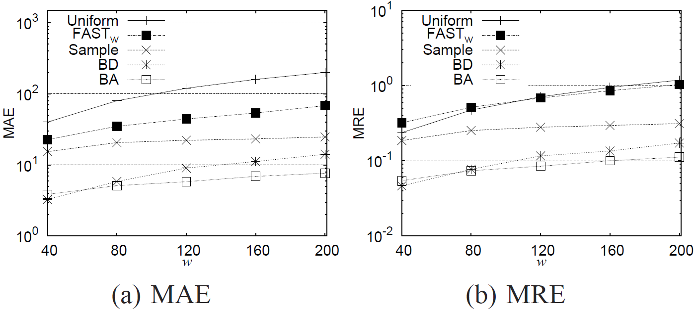
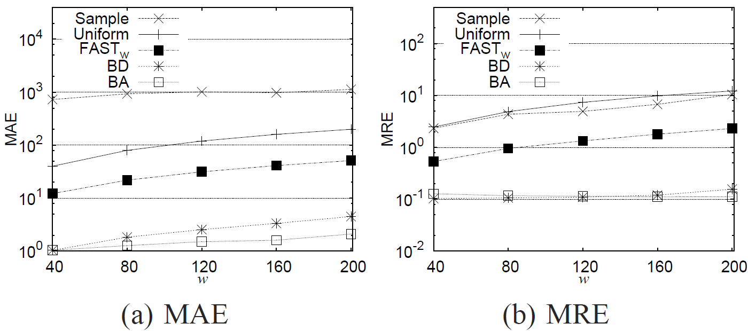
Experiments
Rome dataset
World Cup dataset

