Slide 1
Environment-Scale Fabrication
Replicating Outdoor Climbing Experiences
Emily Whiting ¹
Christos Mousas ³
Nada Ouf ²
Zhenyu Shu ⁴
Liane Makatura ³
Ladislav Kavan ⁵
Boston University ¹ University of Pennsylvania ² Dartmouth College ³
Ningbo Institute of Technology, Zhejiang University ⁴ University of Utah ⁵

Slide 2
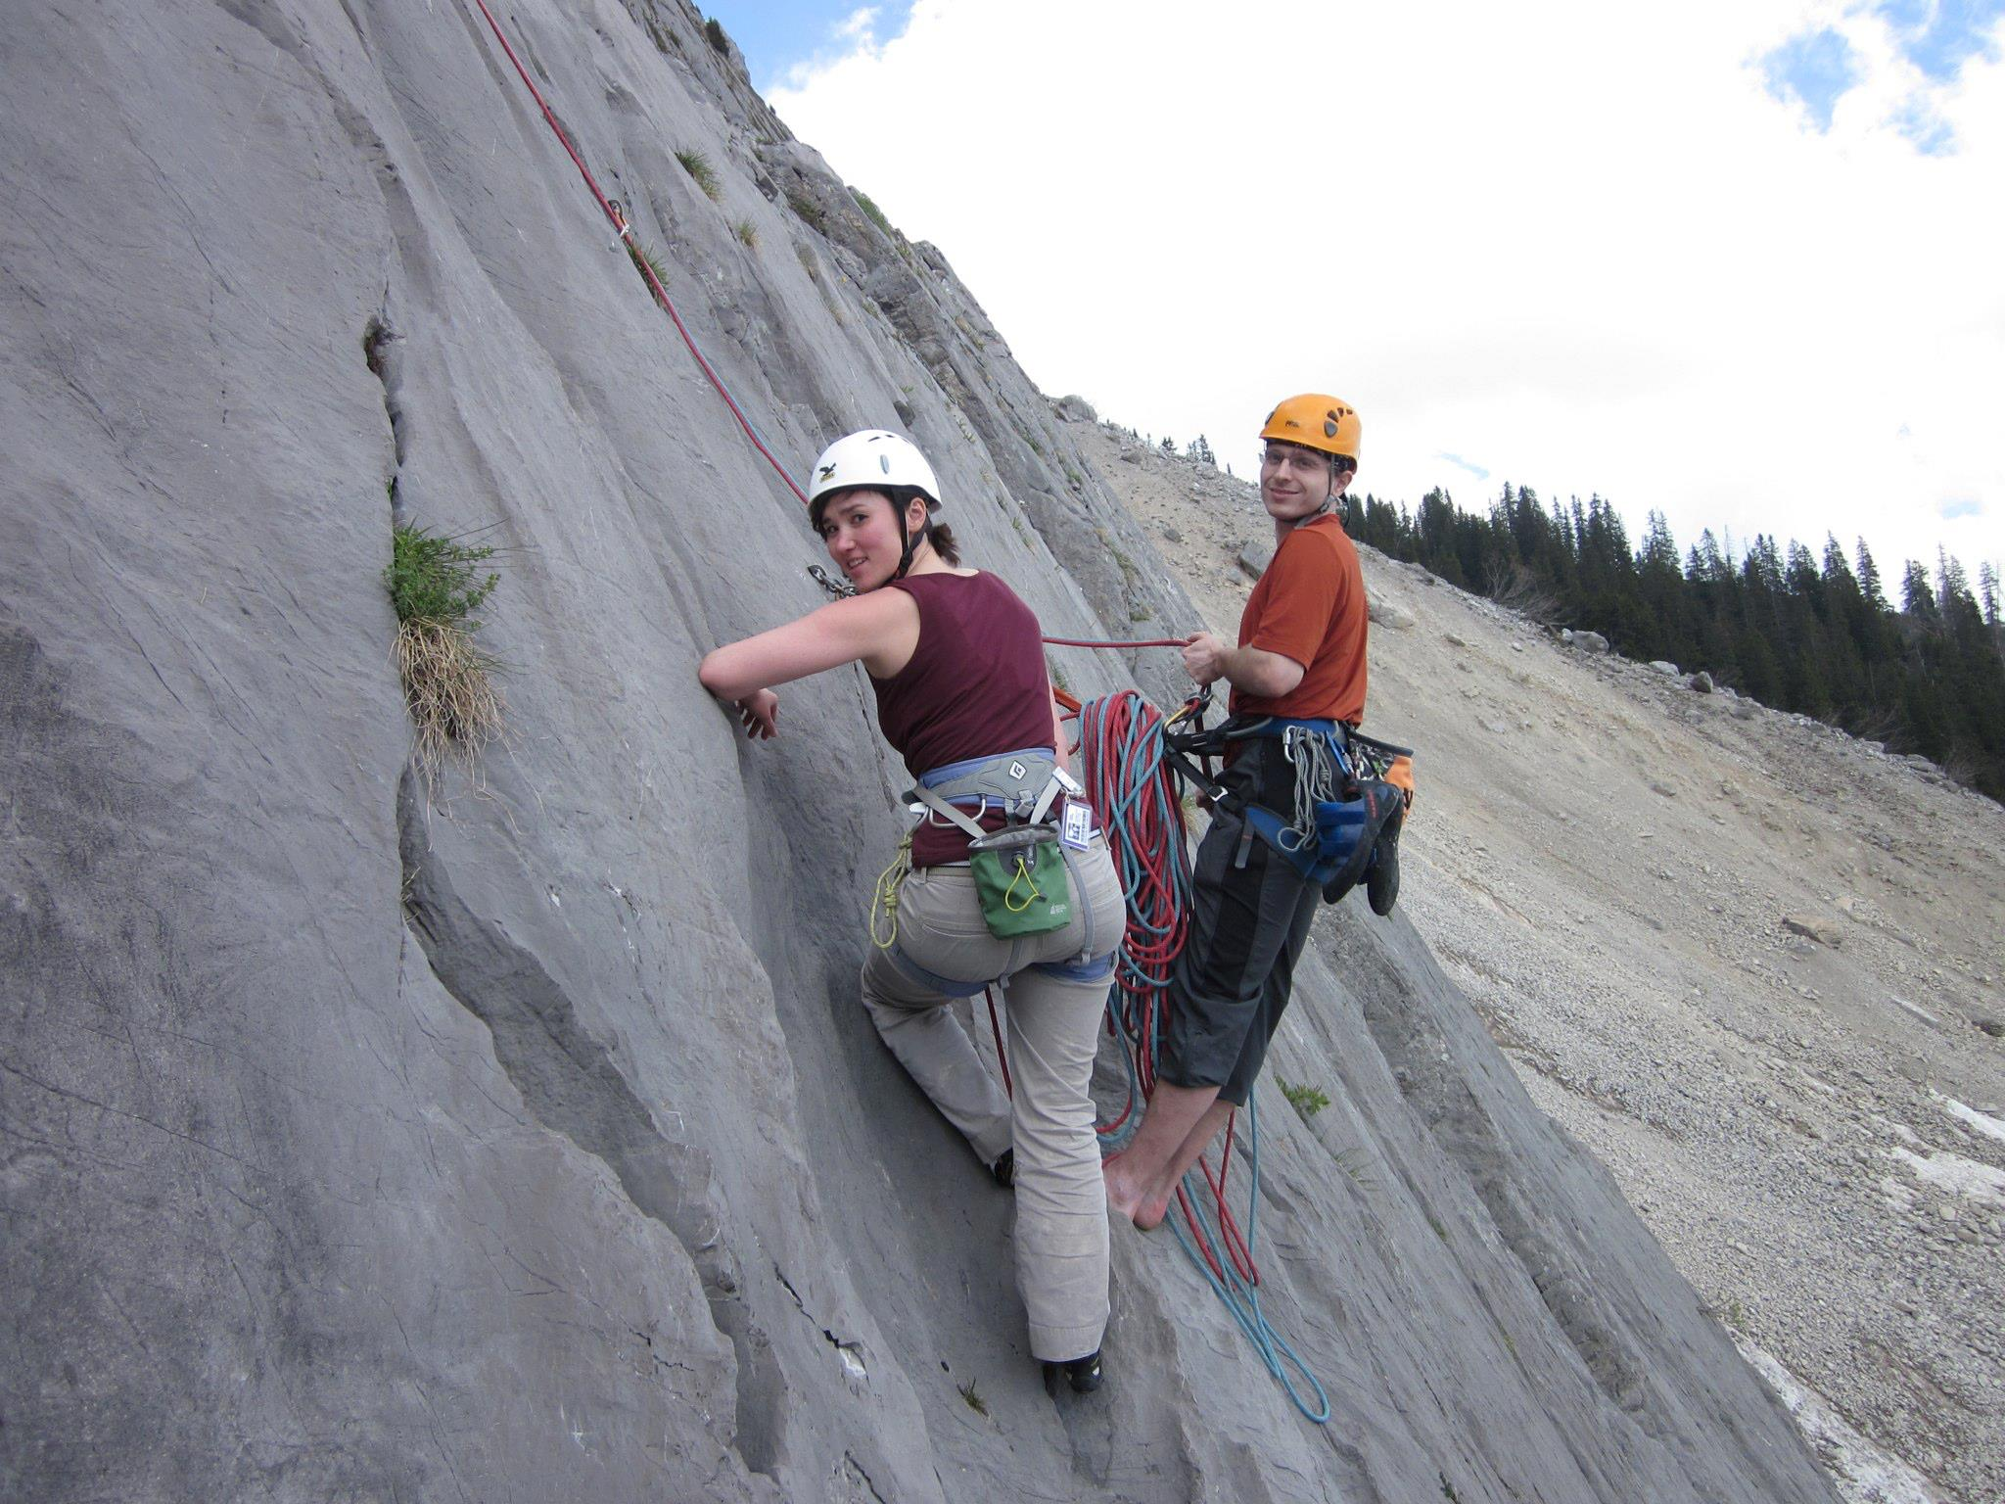
Postdocs in Switzerland (2012)
Notes:
The idea for this project was born when Emily and I were postdocs in Switzerland. One hobby we have in common is rock climbing.

Slide 3
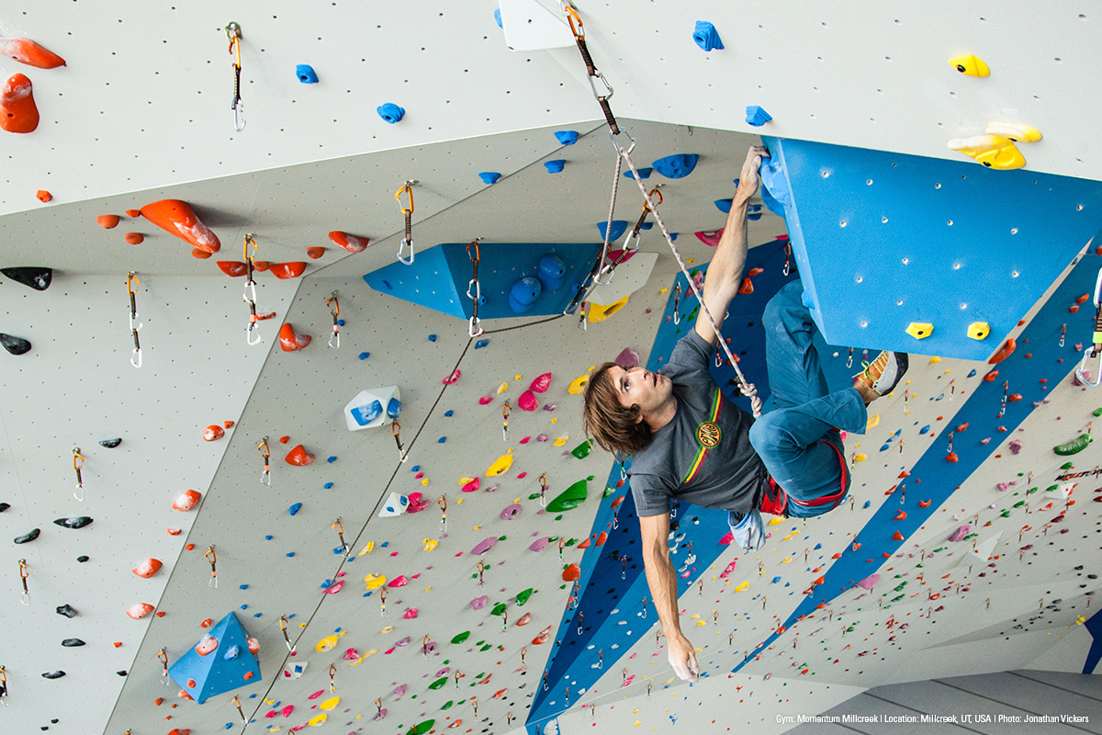
Climbing – indoor gyms
Notes:
Climbing is becoming an increasingly popular sport. This is partly thanks to indoor gyms which make climbing accessible to a wide range of people. Climbing has been officially approved for the 2020 Olympic Games in Tokyo.

Slide 4
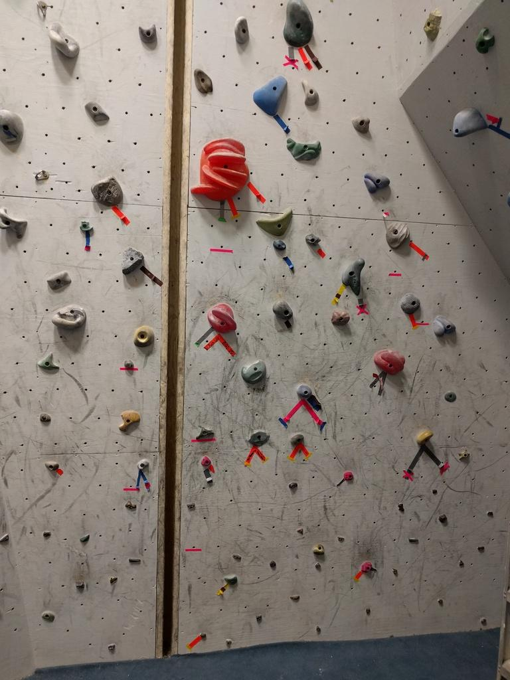
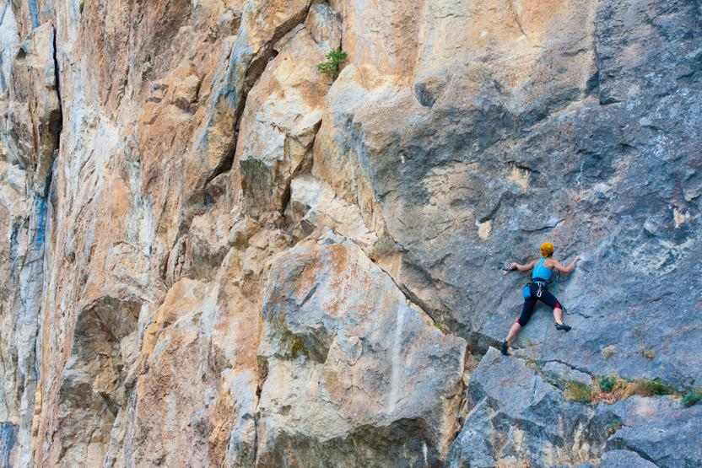
Outdoor and indoor rock climbing
Can we make them more similar?
Notes:
However, there is a big difference between climbing in an indoor gym and on a real rock [CLICK].
We can ask whether it’s possible to make these two experiences more similar [CLICK].
Why would we want to do that?

Slide 5
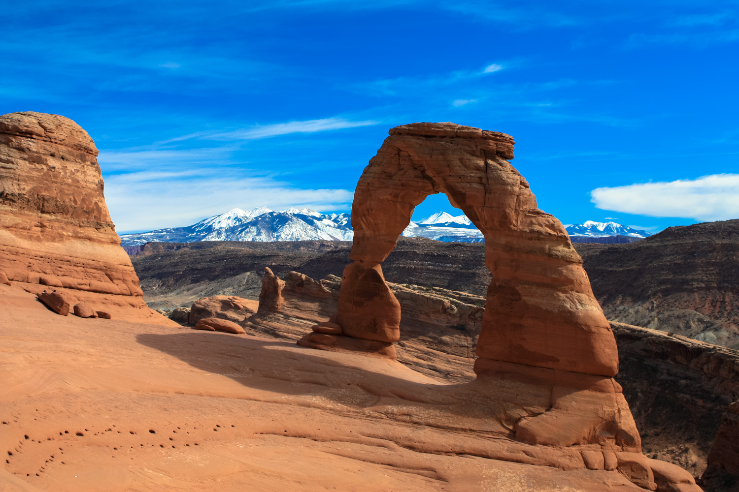
Some rock formations are off limits…
Notes:
Some well-known rock formations are prohibited for climbing. The Delicate Arch in Utah which you see in this picture actually has been climbed, but it caused a lot of controversy and resulted in new, stricter regulations of climbing access – for the entire Arches National Park.

Slide 6
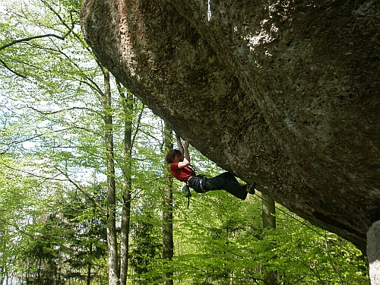
…others are extremely hard (Action Directe)
Notes:
Some other rocks can be climbed legally, but it’s barely within human possibilities. Here we can see a very famous route in Germany called Action Directe. This route has been climbed only by about a dozen of elite climbers and has some interesting stories about it.

Slide 7
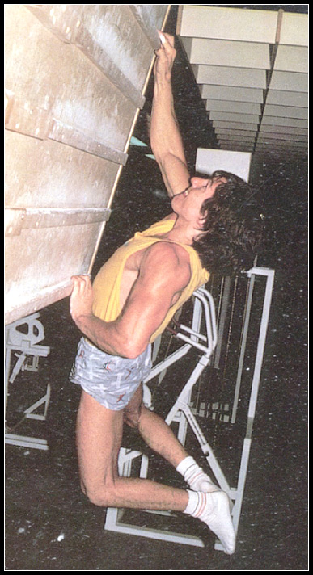
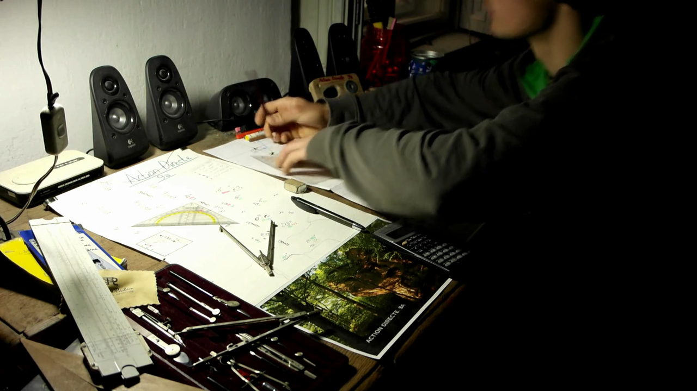
Action Directe (9a / 5.14d)
Wolfgang Gullich
Matyas Luzan
Notes:
The first ascent of Action Directe was done by Wolfgang Gullich in 1991 and when training for this route he invented the campus board which is now a standard training tool.
More recently [CLICK], a Romanian climber Matyas Luzan has been very motivated to join the elite club of people who managed to climb this route. Because he lives in Romania, he decided to build an indoor replica of the Action Directe route in his local climbing gym, so ho can train on it without having to travel to Germany. This project took several years and required remarkable craftsmanship.

Slide 8
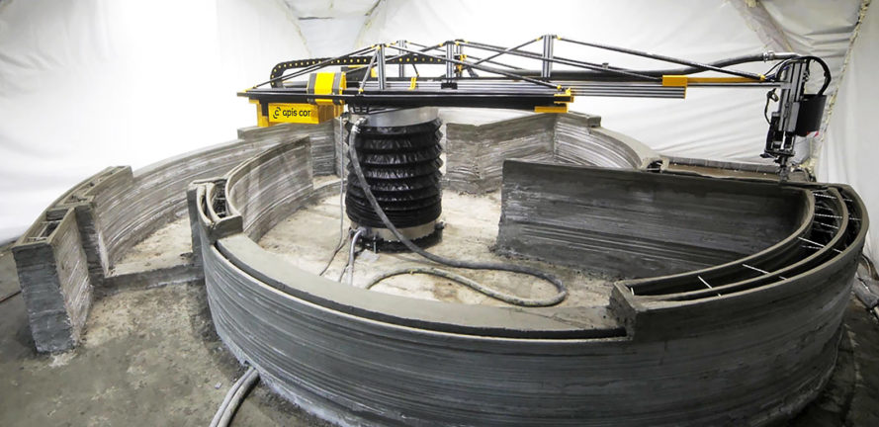
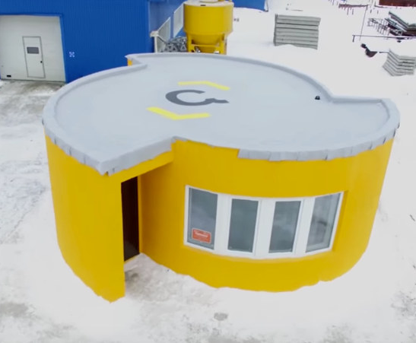
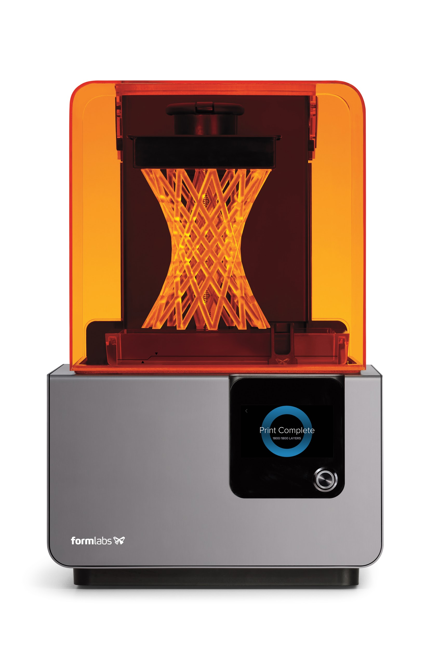
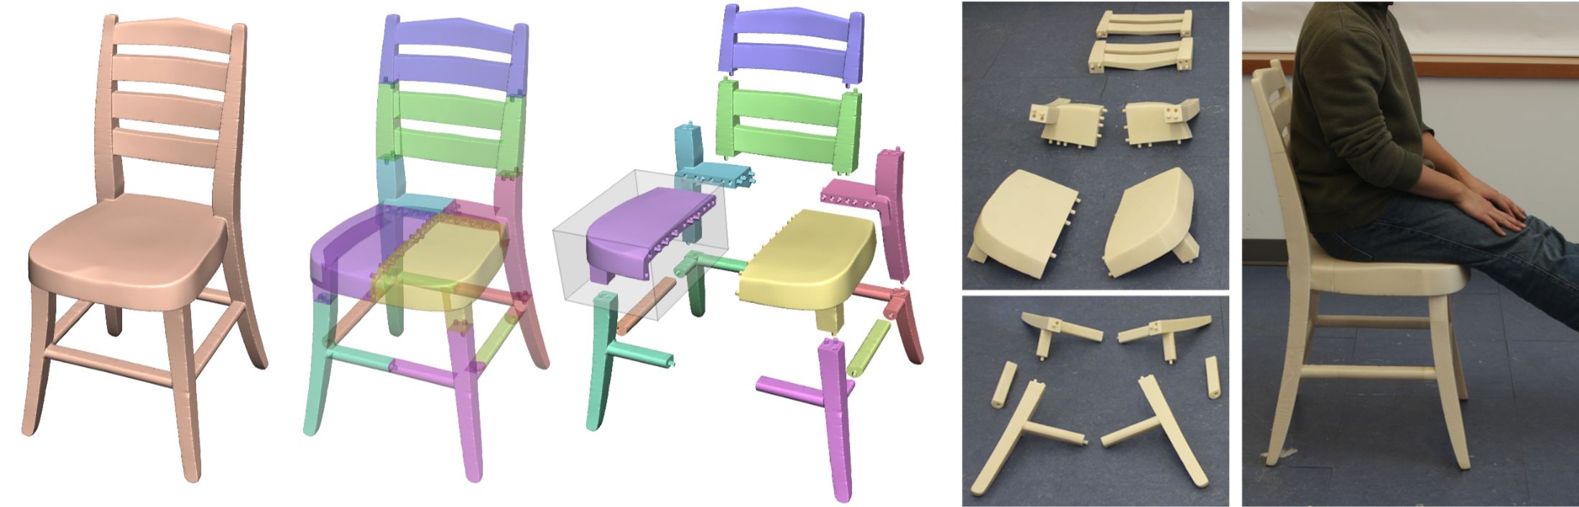
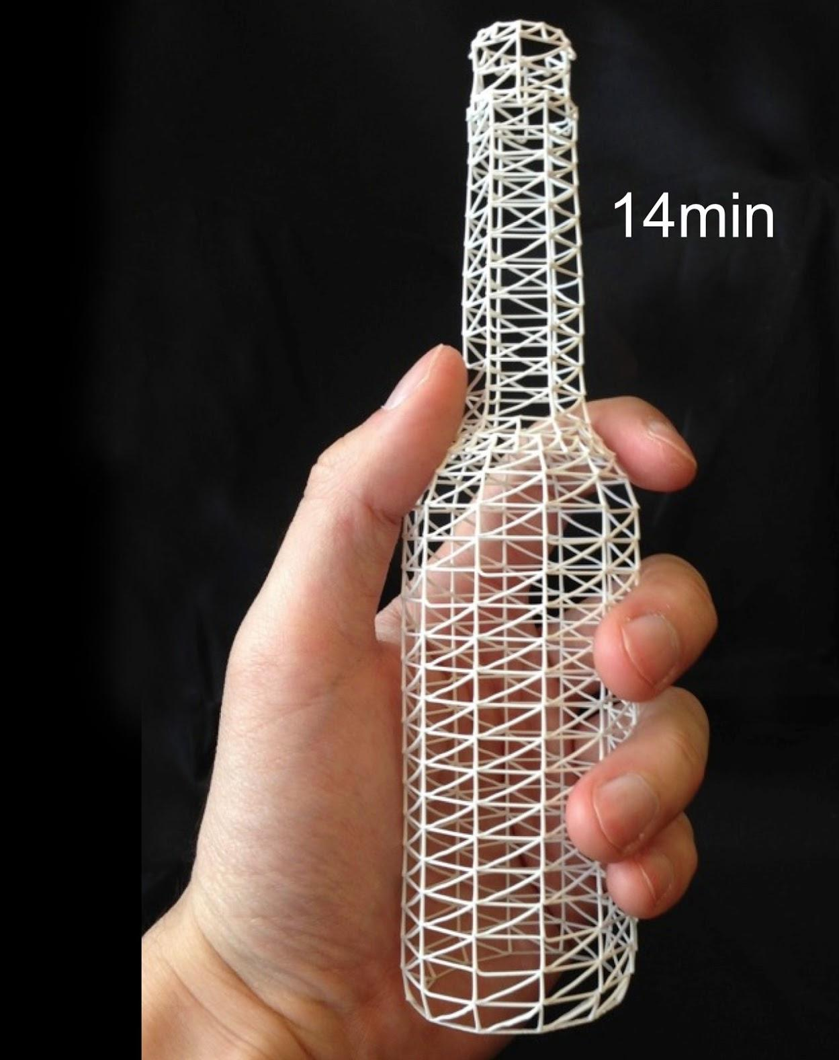
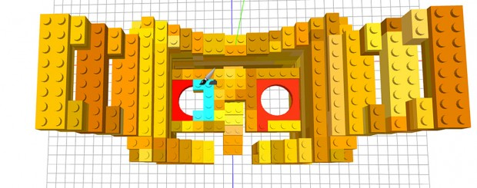
3D printing
Larger hardware
[Apis Cor]
Software solutions
[Luo et al. 2012]
Limited volume
Strategic prints
(WirePrint, faBrickation)
[Mueller et al. 2014]
Notes:
We are not elite climbers, not even remotely, we are computer scientists, so we approached the route replication problem from an engineering perspective.
We thought it might be promising to use the 3D printing technology to help us replicate rock climbing routes.
The problem is that usual 3D printers have only [CLICK] limited volume. If you want fabricate larger objects, there are several possibilities.
[CLICK] Use larger hardware, capable of printing entire buildings, but this takes a while and uses a lot of material.
[CLICK] Software solution: split larger object in carefully designed pieces which fit together. This works for mid-sized objects such as a chair.
[CLICK] Strategic prints, replicating only the relevant aspects of the input object
This is the option we chose to pursue [CLICK]. But what strategic prints means in our context?

Slide 9
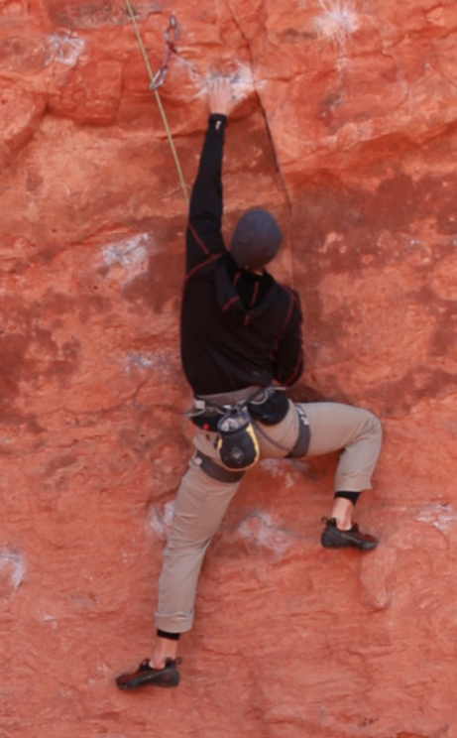
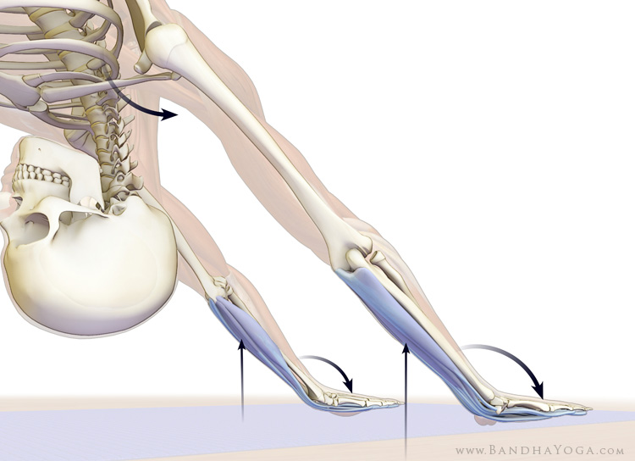
Goal: recreate the sensorimotor experience
Notes:
On a difficult rock wall, there are only a few good features the climber can grasp or stand on. The body senses the external forces [CLICK] – the gravity and the contact forces and the motor system sends signals to activate the muscles in such a way the climber can move up. We’d like to recreate precisely this “sensorimotor” experience.

Slide 10
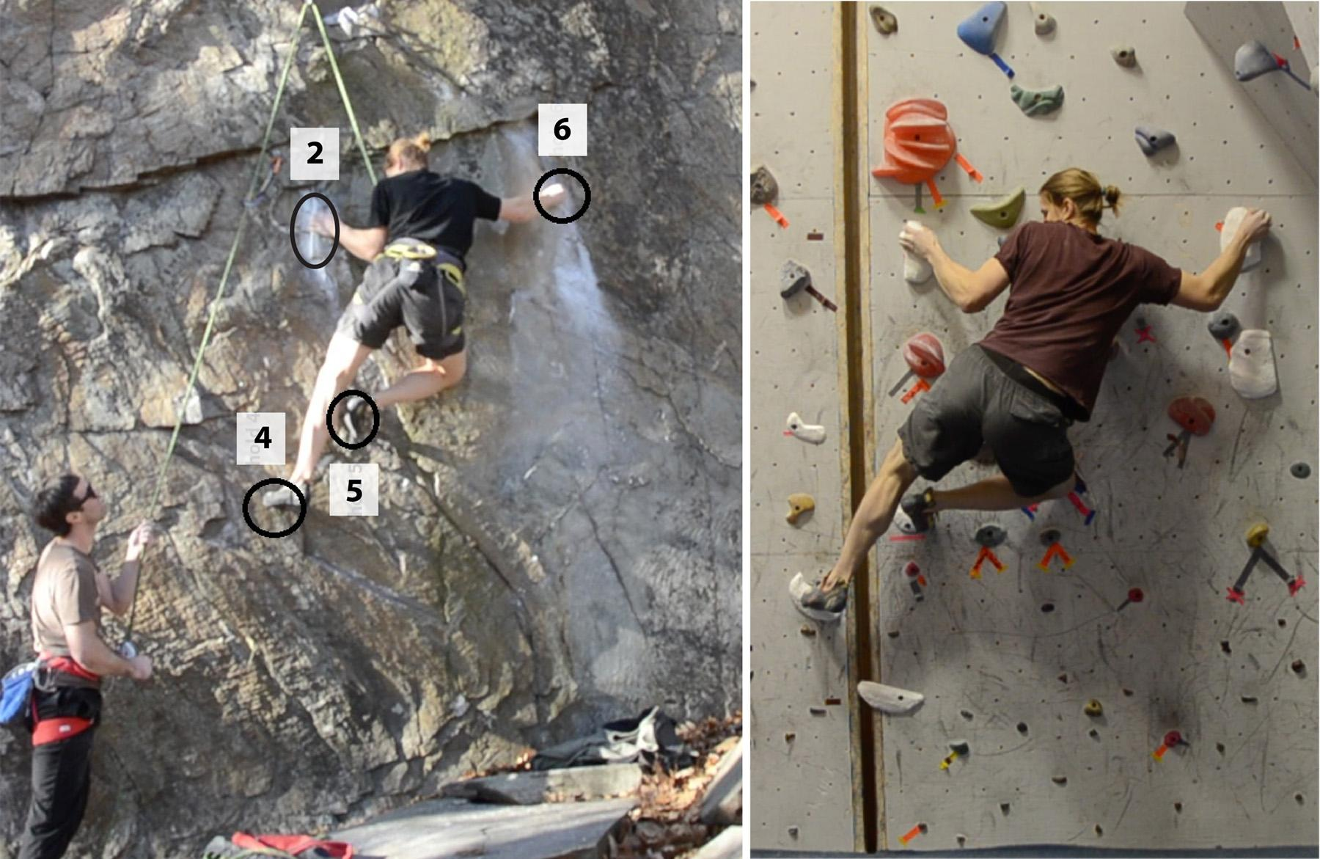
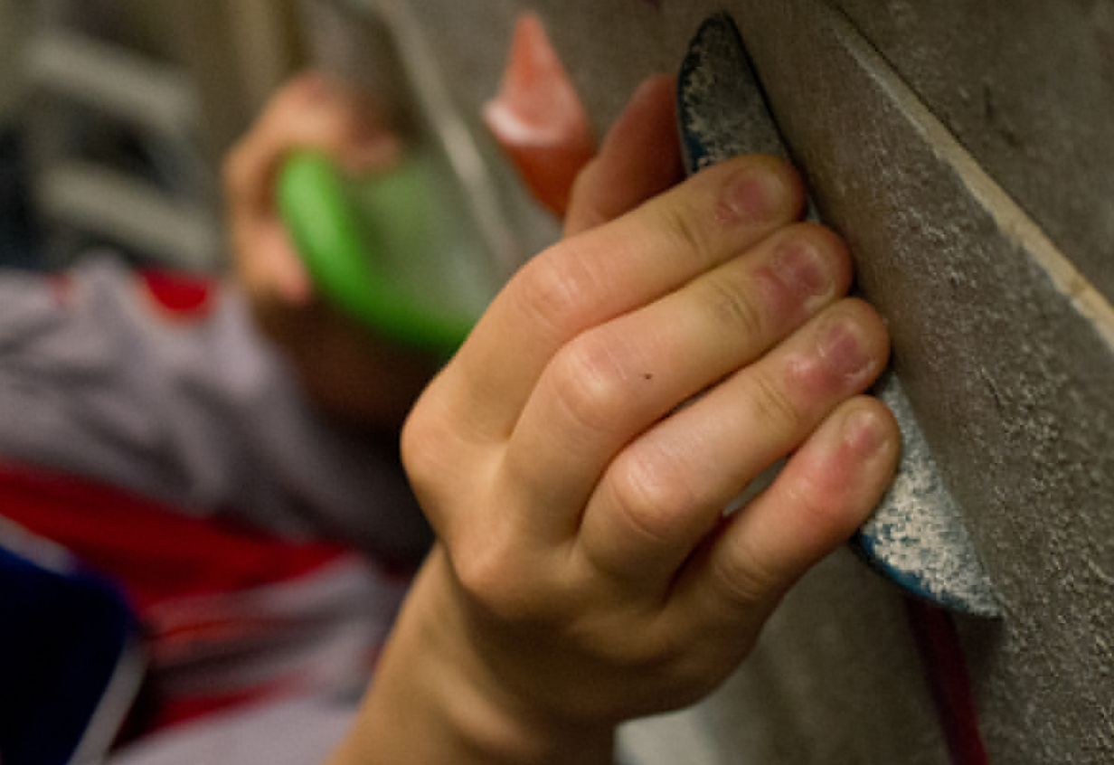
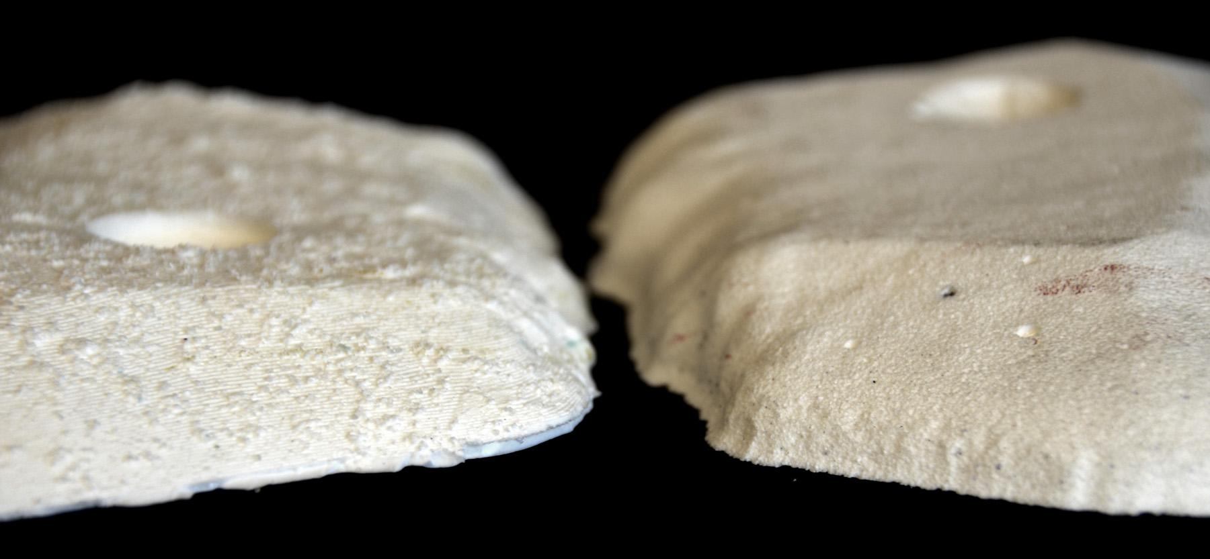
Key geometric aspects to replicate
Global
Spatial configuration
Local
Contact region
Micro
Friction properties
Flat vertical walls
Only the “crux”
Notes:
We approached the problem from a geometric perspective. Specifically, we have identified the following three geometric aspects:
First [CLICK] we want to replicate the same spatial configuration of the handholds and footholds – the global geometry of the climb.
Also, we need to preserve the details of the contact regions [CLICK] which determine the hand grasp and foot placement – matching the local geometry.
Finally, we also need to match the friction characteristics of the rock – micro geometry, if you will.
To make the problem tractable [CLICK] we introduced some simplifying assumptions:
We assume only vertical walls [CLICK], deferring overhanging or slab climbs to future work
Replicate only part of the entire route, the hardest sequence of moves, known as the “crux”

Slide 11
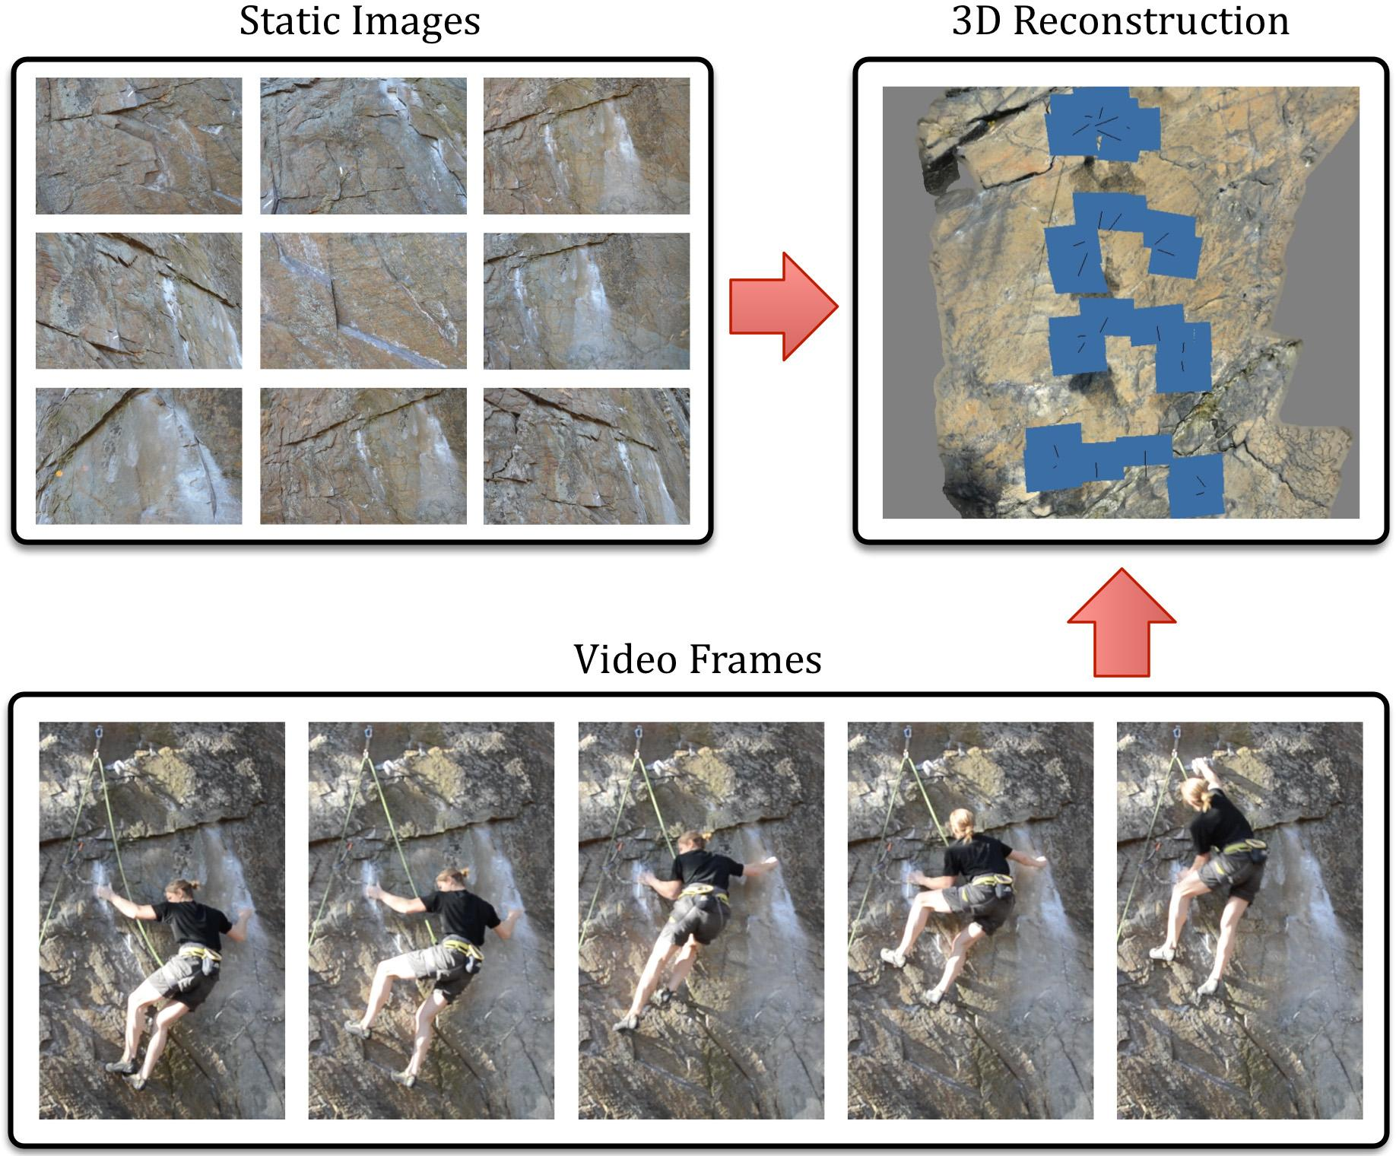
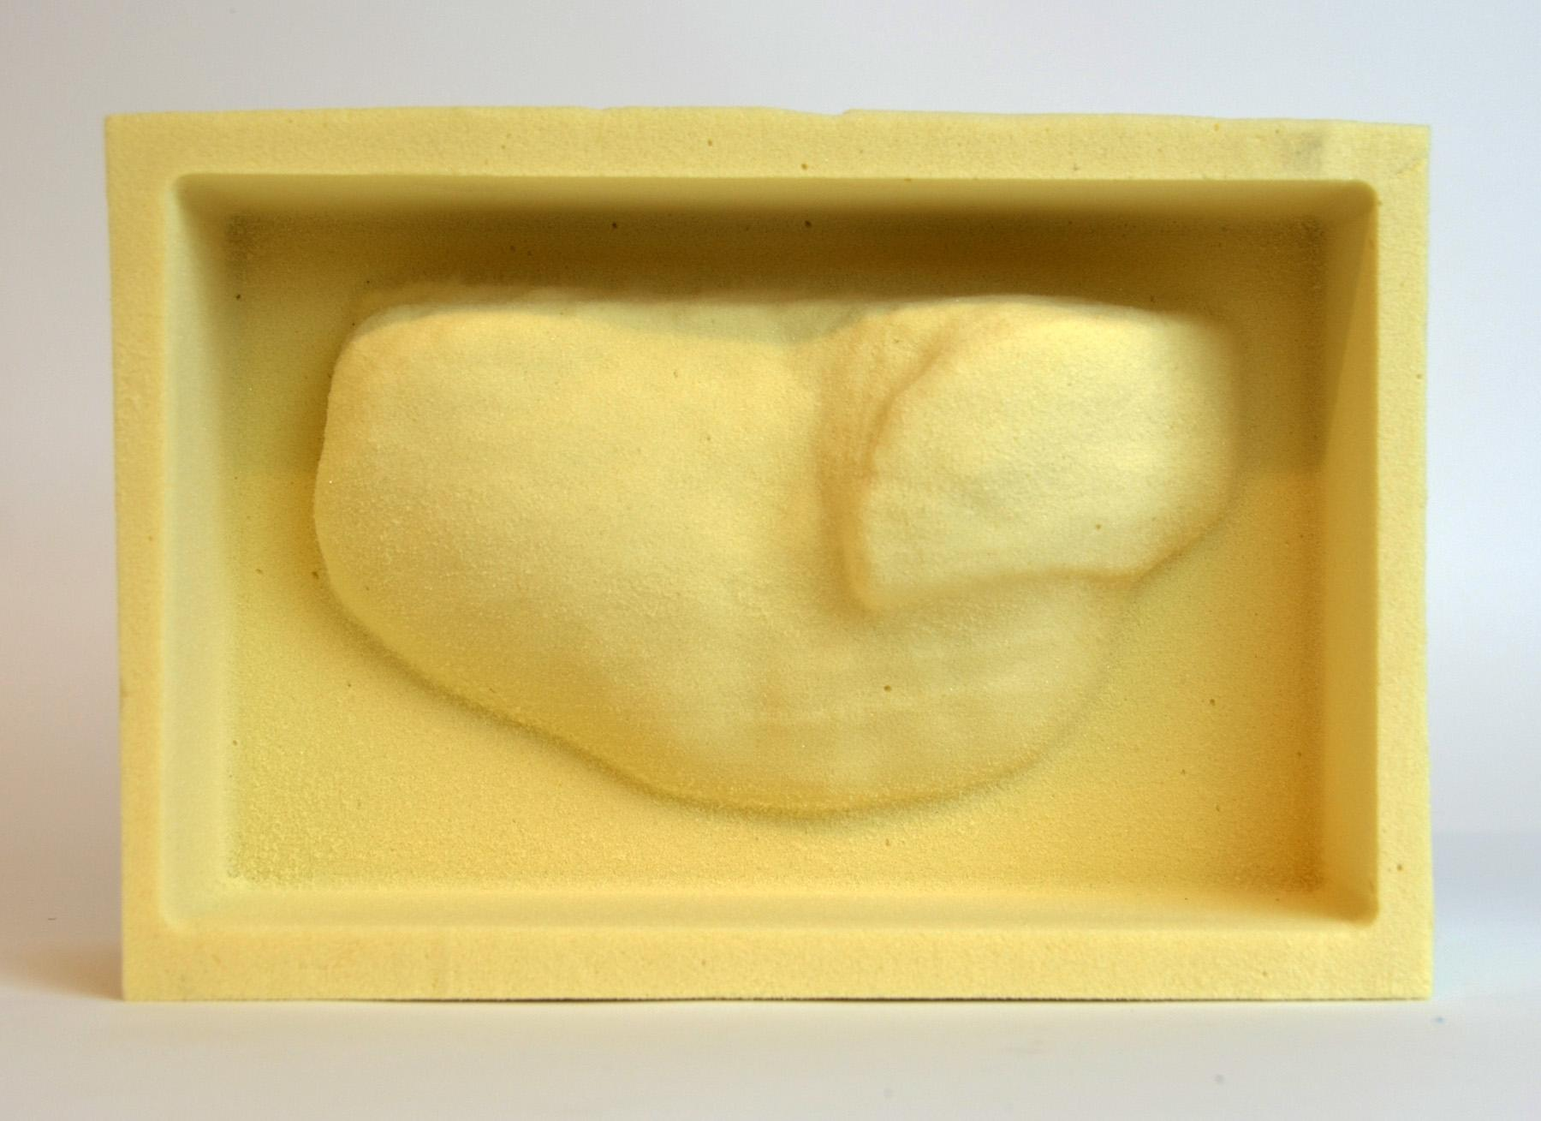
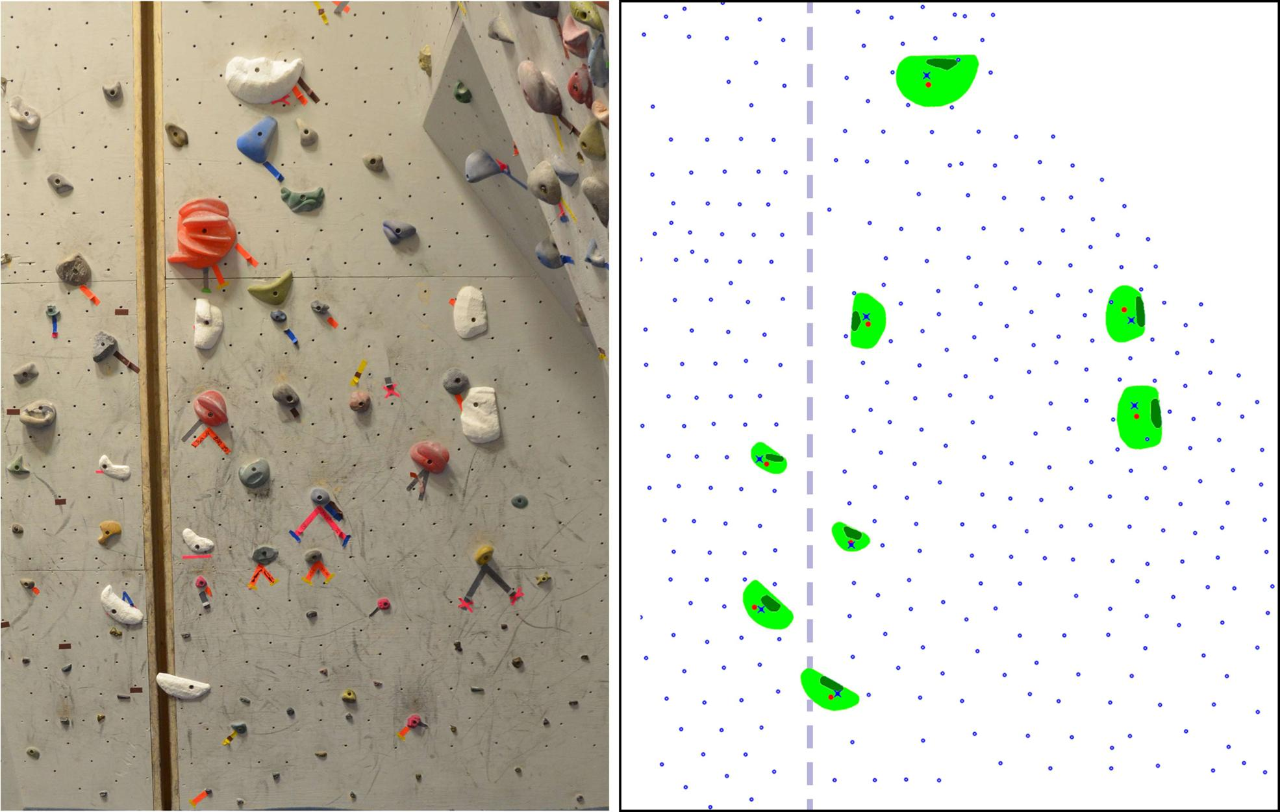
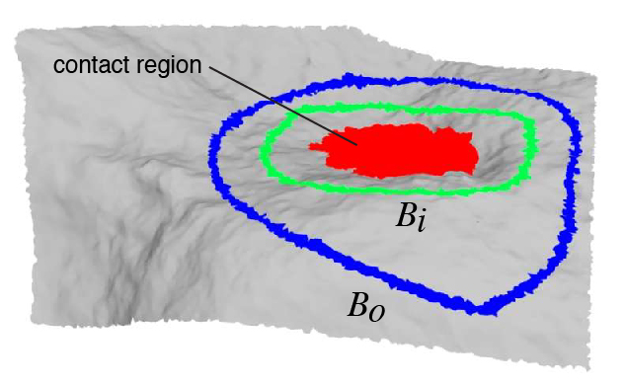
Pipeline
1. Acquisition
2. Hold Modeling
3. Fabrication
4. Configuration
Reconstruct 3D geometry
Create fabricable climbing holds
Realize the replicas
Optimize indoor arrangement
Notes:
Here is an overview how our system works.
First, [CLICK] We reconstruct the 3D geometry of the crux region using multi-view stereo
Next [CLICK], we create small-scale 3D models of the individual climbing holds.
Then [CLICK] we fabricate these holds – turning them into actual physical pieces, which can be mounted in an indoor gym.
The last step [CLICK] is figuring out how to place these fabricated pieces at a man-made wall, taking into account the constraints of our indoor climbing gym.
Let me explain each of these steps in more detail…

Slide 12
Acquisition
Notes:
… starting with the Acquisition part:
Given an outdoor route, we first climb it and setup a top rope anchor. This allows us to take a lot of photos of the crux region – we take between 2 to 5 hundred photographs from all possible angles to capture all of the details of the rock.
We feed these photos into a multi-view stereo software, which creates a pretty detailed 3D reconstruction of the rock wall.
We combine this with a video, capturing a climber scaling the route, which we use to identify the contact regions – they key rock features the climber used during an ascent.

Slide 13
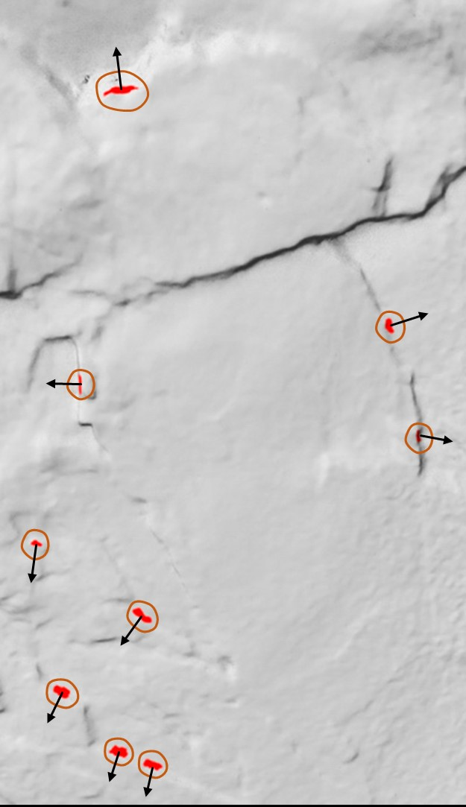
Contact regions
?
Notes:
We assume the climbing motion can be broken down in a sequence of almost static poses. In each of these poses, the hands and the feet of the climber are in contact with some of the rock features and we want to identify [CLICK] their locations in the 3D reconstruction. How exactly do we do this?

Slide 14
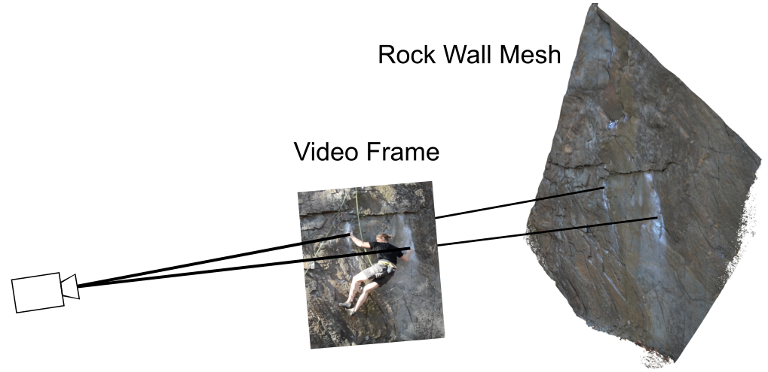
Contact regions
Notes:
We can use the multi-view stereo to find the parameters of the camera that was recording the video of the climber in action. This allows us to project the locations of the climbers hands and feet from a video frame to the reconstructed 3D geometry.

Slide 15
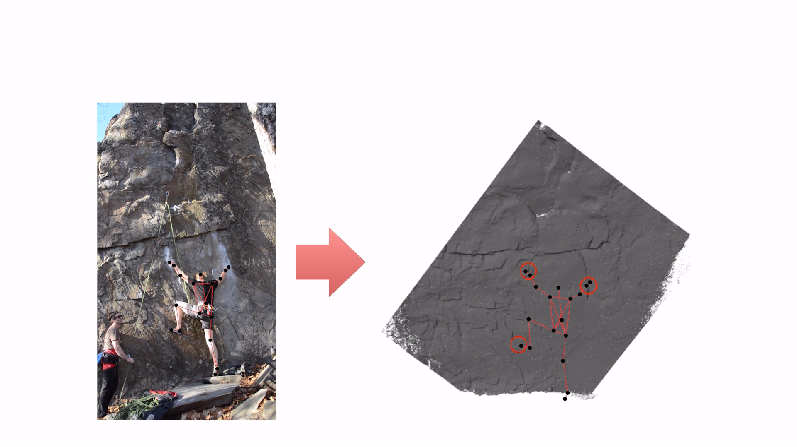
Contact regions
Notes:
But from the video we can get even more. We can run a motion capture algorithm to approximate the skeletal poses [CLICK] of the climber. In each of the poses, we are looking for rock features which the climber is grasping and standing on. We locate all of these contact regions along with approximate direction of the contact force between the climber’s body and the rock.

Slide 16
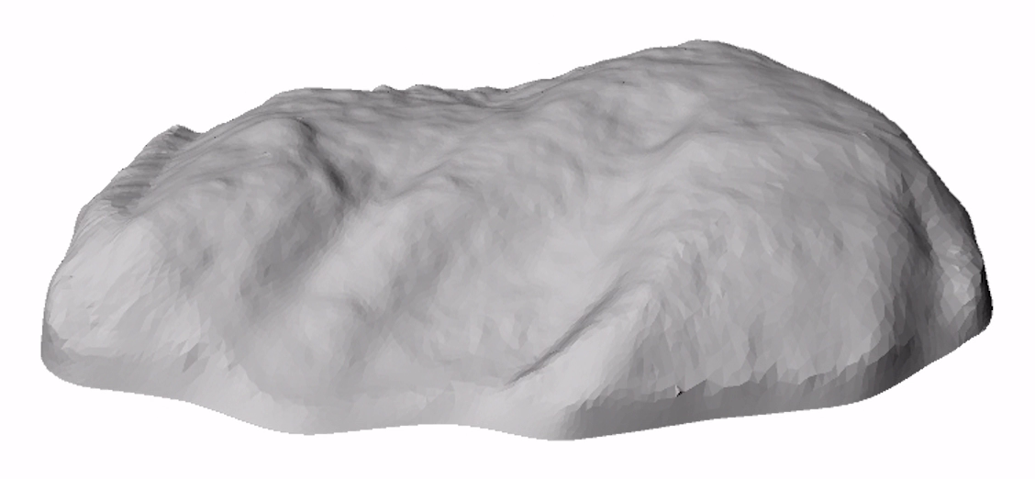
Hold Modeling
inner boundary
final 3D shape
outer boundary
Notes:
Once we’ve found all of the contact regions, the next task is to turn them into nice 3D shapes similar to standard indoor climbing holds.
To do this we define two boundaries, we call them inner and outer boundaries. The inner boundary (green curve) encloses the contact region (in red). The contact region is frozen, we do not want to modify it, because it captures the key details of the rock we are trying to replicate. The outer boundary (in blue) is where we cut off the hold from the 3D rock wall geometry. Between the inner and outer boundaries we create a smooth transition to get a nice shape which is suitable for fabrication, making sure we don’t create any new features which could be used for climbing.

Slide 17
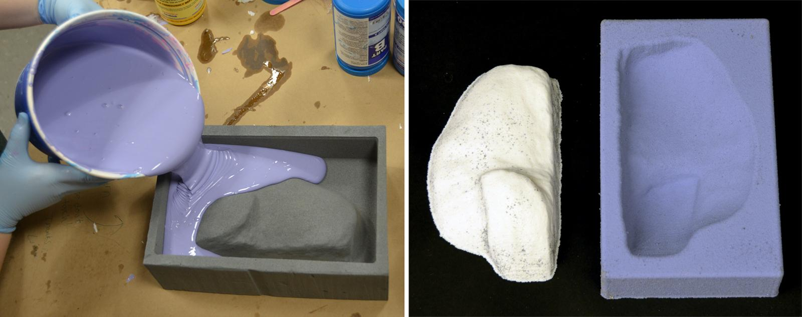
Fabrication
Rapid prototyping
Molding
Casting
Notes:
Fabrication is not completely straightforward, because the resulting holds must be durable – must be able to withstand the full body weight of a climber applied from different angles. Also, the surface texture should mimic the friction properties of the rock. We tried several possibilities and found the following fabrication process worked the best. We start by cutting the shape of the hold from a high density foam using a CNC router. Then we create a silicone mold and after it has cured we fill it with casting resin, which gives us a nice solid piece similar to standard indoor climbing holds, but replicating the 3D geometry of the outdoor route.

Slide 18
Fabrication
bolt
Notes:
When the piece is finished, we drill a hole in it [CLICK] where we put a bolt attaching the piece to the indoor climbing wall. This leads us to the next phase…

Slide 19
Indoor Configuration
Fixed
T-nuts
Notes:
… where we need to decide where exactly do we want to place our pieces in the indoor wall. The goal is to replicate the spatial configuration of the outdoor route, while using a fixed [CLICK], pre-existing set of T-nut fasteners where the pieces can be mounted – those are the little blue dots. We are not allowed to drill in the indoor wall to insert more T-nuts. Instead, we do the following: first, we create a model of our indoor gym wall: we perform multi-view stereo reconstruction just like we did with the actual rock walls. Then, we locate the 3D positions of all of the T-nuts and reduce the problem to two dimensions because we assumed we are replicating only a flat, vertical wall.

Slide 20
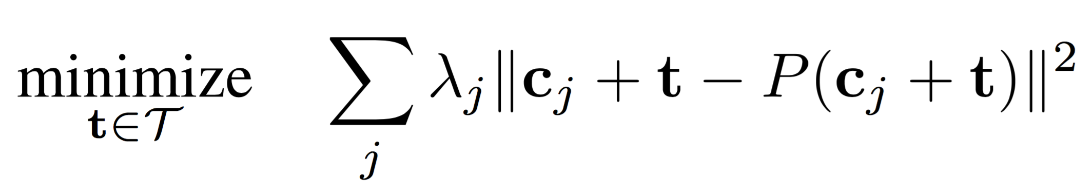
Indoor Configuration
Optimization problem
y
x
Notes:
For each of the fabricated pieces, we mark the ideal location where we’d like to drill the hole for the bolt – typically close to the center of mass of the piece, because drilling a hole close to the boundary would reduce durability. However, we are free to pick where exactly we position the replica in an indoor gym wall, within the region we are allowed use, of course. This means we have two degrees of freedom, global x and y translation. We want to find such a translation vector of our set of pieces that matches the best with the preinstalled T-nuts in the indoor wall. This can be formulated as an optimization problem and I’ll refer you to the paper for the technical details, but let me just explain the key idea:

Slide 21
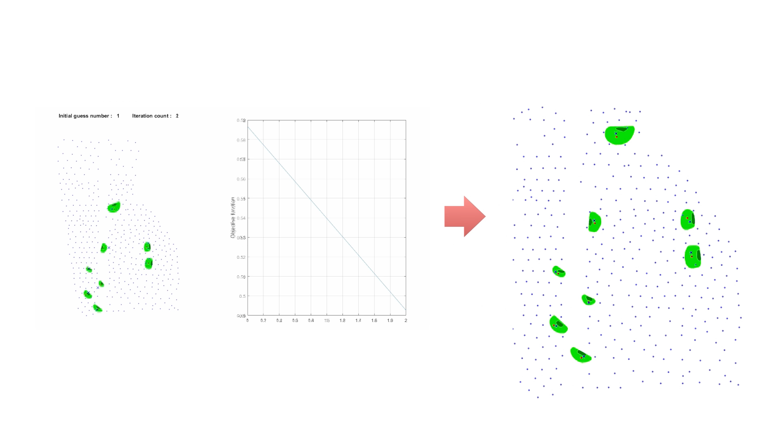
Indoor Configuration
Notes:
… the key idea is local/global alternation, which is an algorithm similar to k-means clustering, alternating between optimizing for the best two-dimensional translation and finding the closest T-nut for each piece. We run this optimization process from different starting points [CLICK], as you can see here, to increase our chances of finding a global optimum. At the end we pick the best solution and print the final configuration of our pieces [CLICK] which will serve as a blueprint to build our indoor replica.

Slide 22
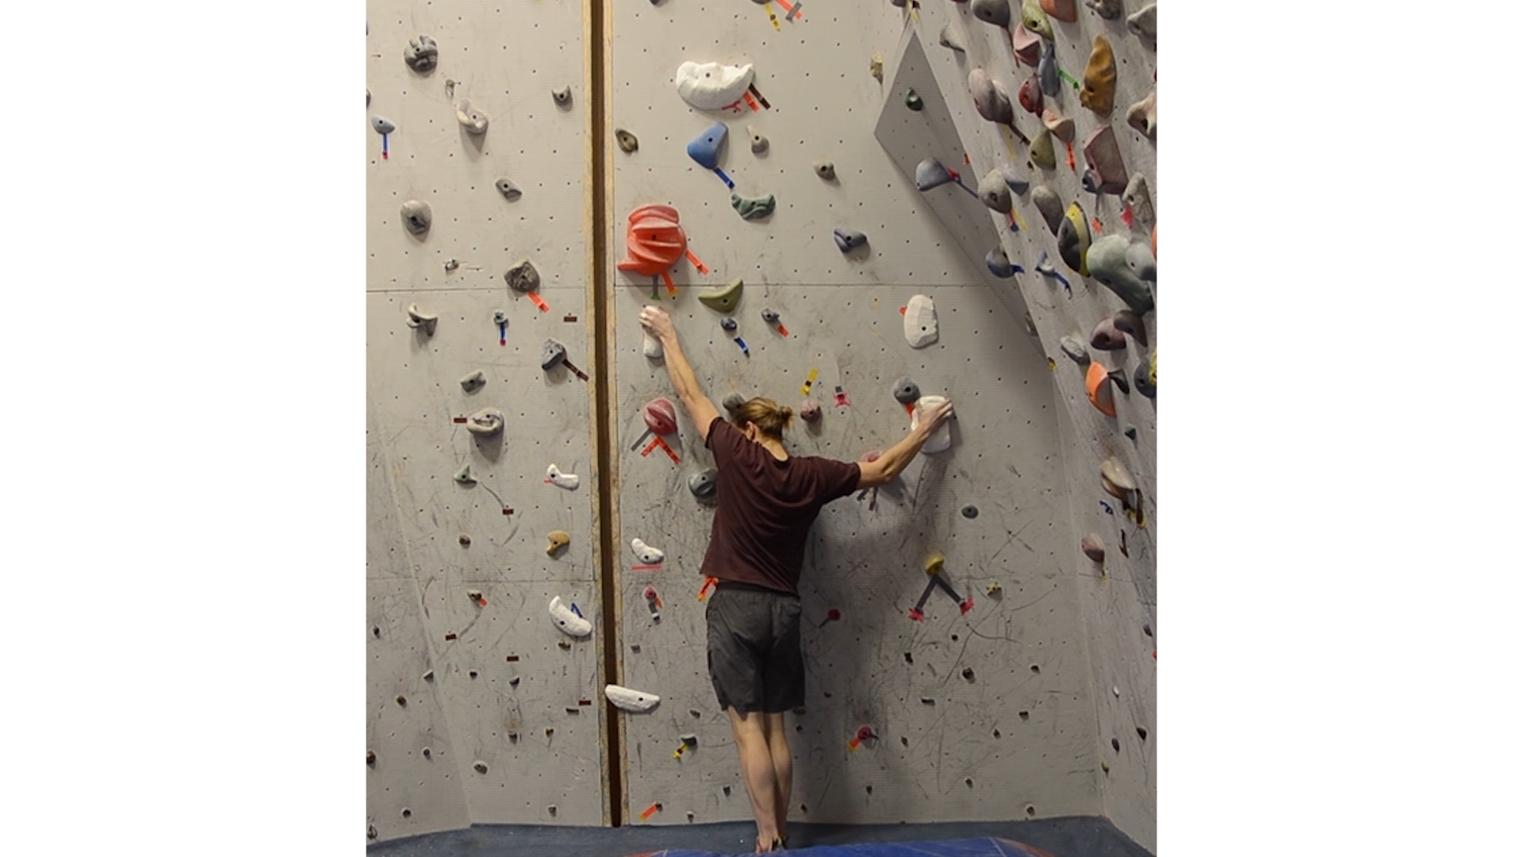
Result
Notes:
Finally we can mount our fabricated pieces in the indoor gym [CLICK] – our pieces are the white ones. The next step [CLICK] is to actually climb it ☺ Note that the climber is allowed to use only our holds. Our route can naturally co-exist with regular man-made indoor routes.
So how does climbing of the replica compare to climbing of the real rock?

Slide 23
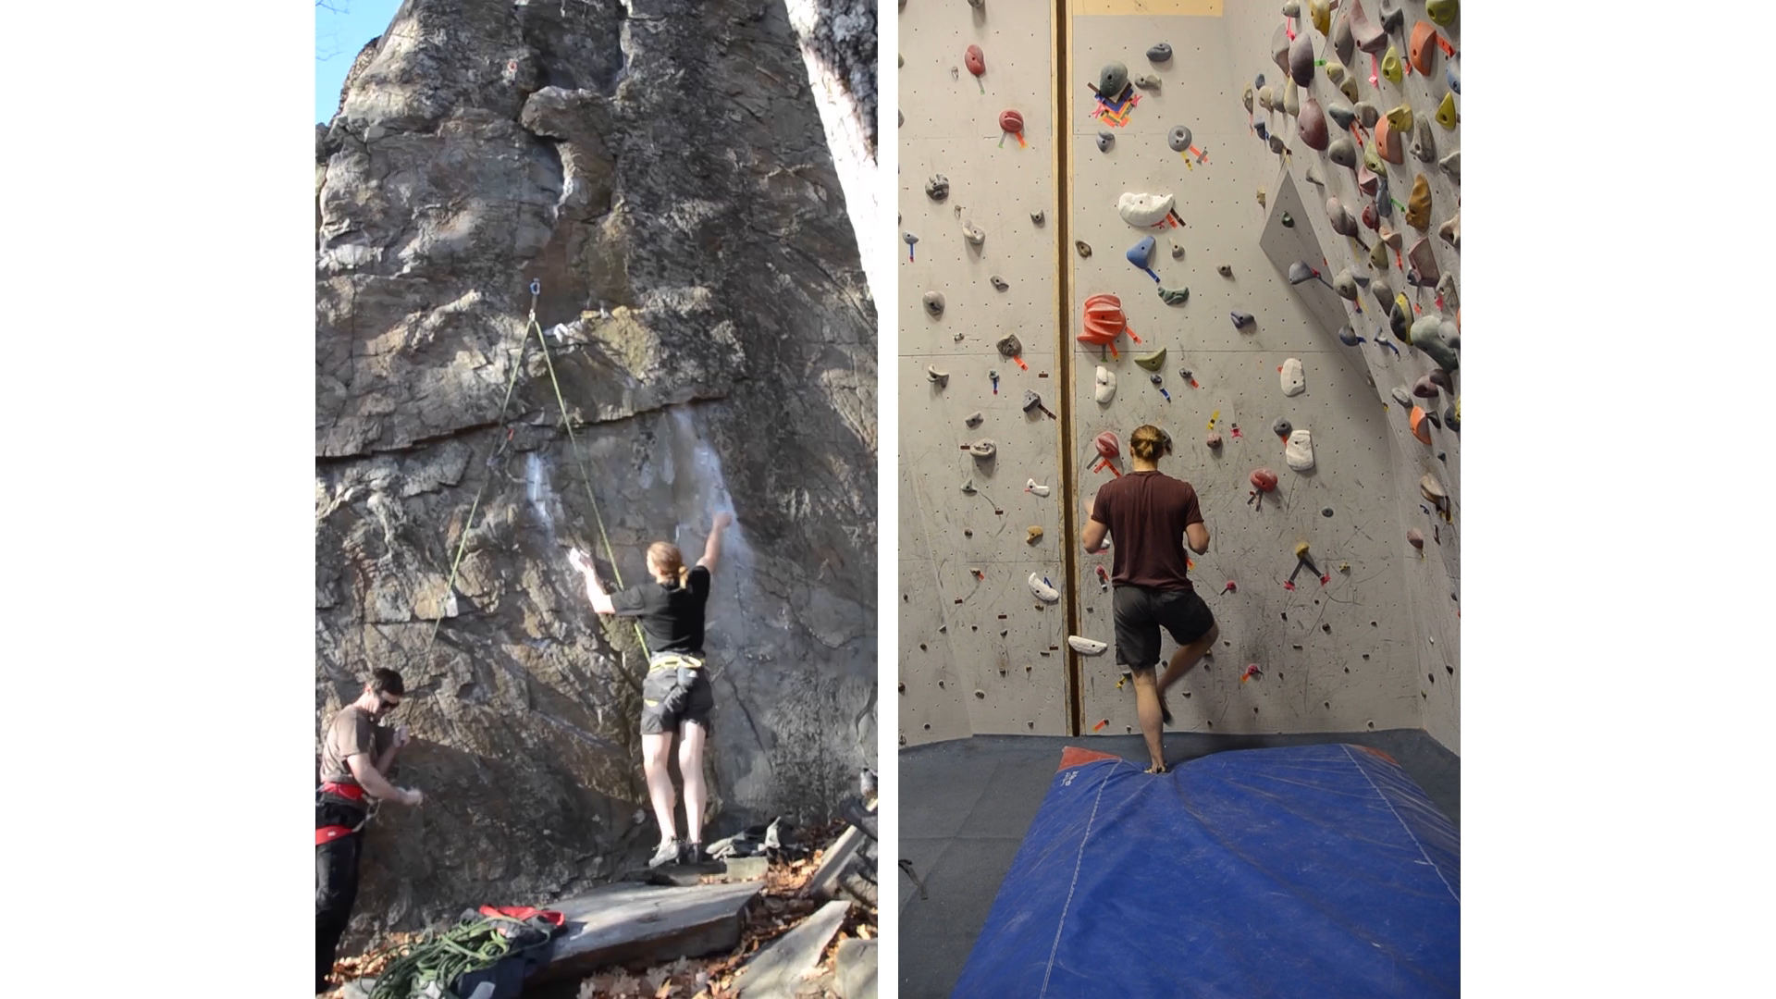
“TATAN”
route
(5.12a)
New
Hampshire
Notes:
In this video we put side by side recordings of the same climber scaling the original outdoor route and its indoor replica [CLICK].
The replica was built specifically for this climber. The body poses and the transitions between them are visually similar in both of the climbs, for example, notice the angles in the legs and the arms. Also, the climber commented the movements felt similar. Let me play this one more time. [CLICK CLICK] An advantage of training with an indoor replica is that it spares the real rock from deterioration.

Slide 24
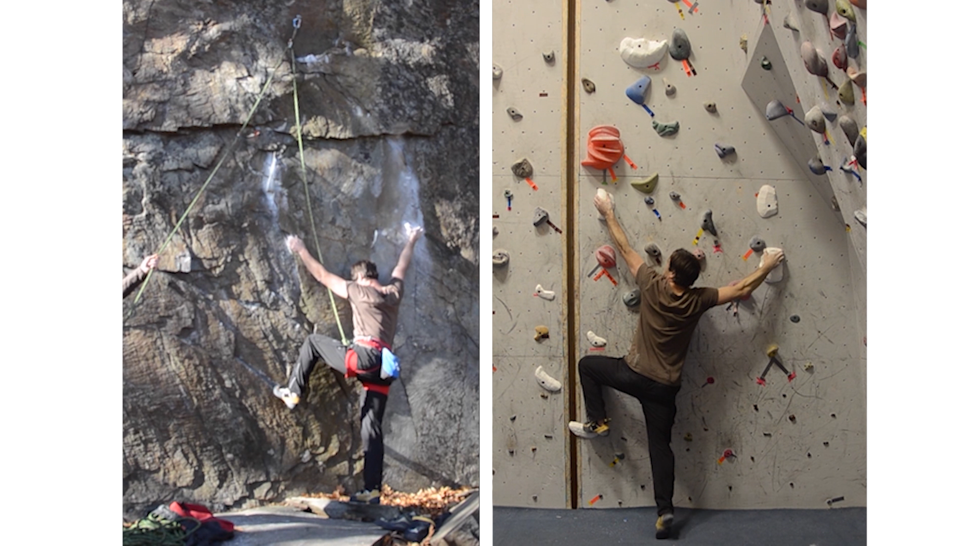
“TATAN”
route
(5.12a)
New
Hampshire
Notes:
This video shows another climber on the same route [CLICK], again comparing the original outdoor route and its replica.
This climber used a slightly different footwork on the outdoor route. This could be improved by fabricating additional footholds for this particular climber.

Slide 25
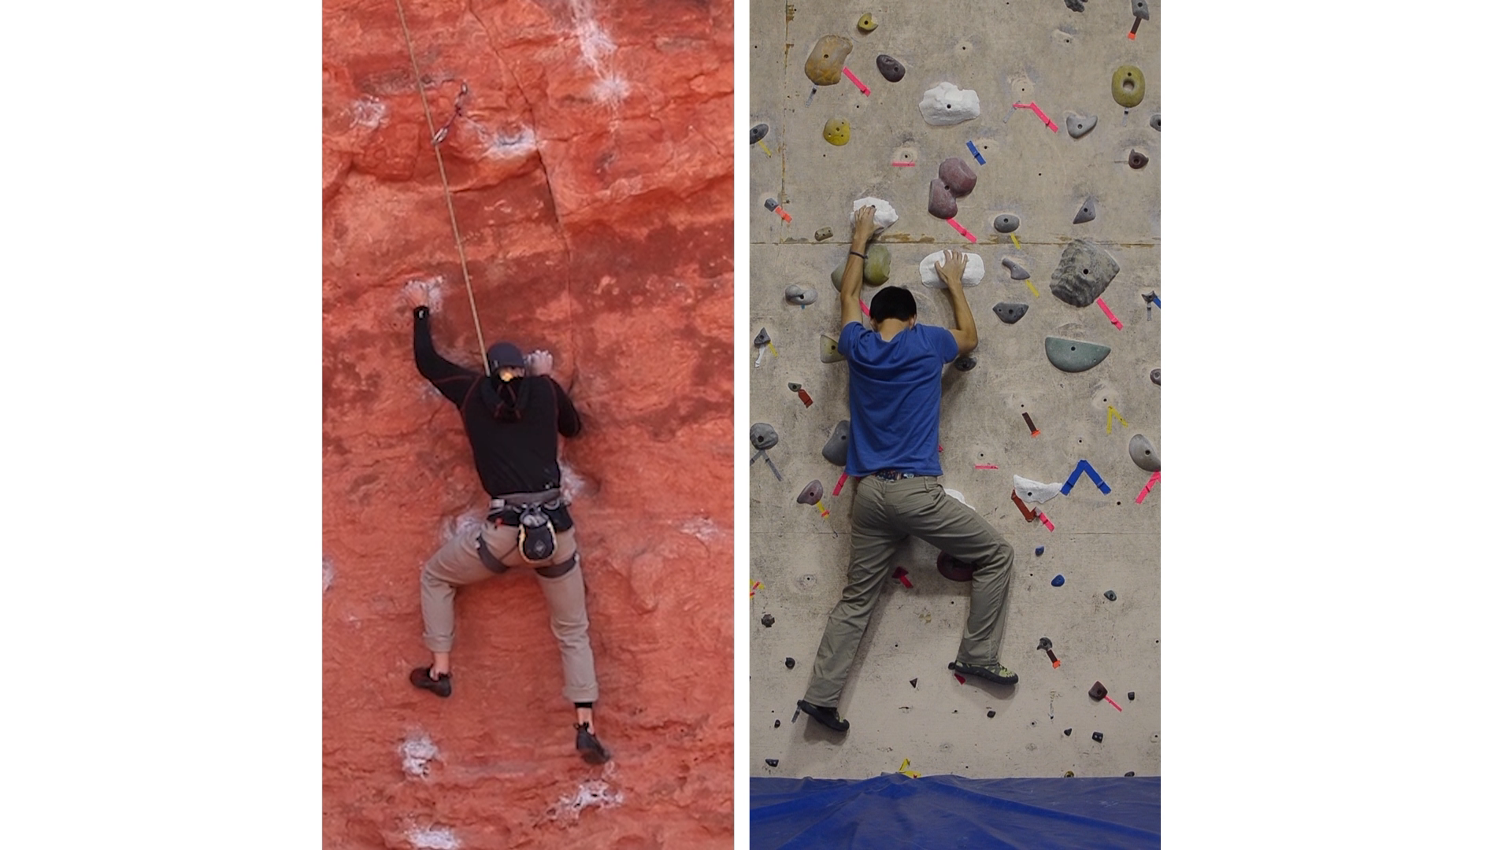
“Pilgrimage” route
(5.12a)
Utah
New Hampshire
Notes:
We replicated yet another route called “Pilgrimage” from Southern Utah. It’s a completely different type of rock (sandstone), but it has the same difficulty rating (5.12a). This move [CLICK] is the “crux”. These guys make it look easy, but it’s really hard – I tried it ☺ Note that here we are comparing two different climbers, because the original rock route is in Utah, whereas the replica was built in an indoor gym at New Hampshire, more than 2000 miles away. We were quite excited about this, but of course, there are still a lot of limitations in our current system:

Slide 26
Limitations
Future Work
Vertical wall with small, sharp features
Availability of capable lead climber
Only based on 1 climber’s ascent
Overhangs, slabs, climbing volumes
Drone photography
Merge multiple climbers’ data
More general environmental-scale fabrication: crime scenes, historical sites, …
Notes:
First [CLICK], we made the simplifying assumption of focusing only on vertical walls, with small sharp features.
In the future [CLICK] it’d be great to extend this to model overhanging or inclined routes, possibly using climbing volumes to model larger rock features economically.
Second [CLICK] we assume that a lead climber can ascent the route, so we can get the photos for 3D reconstruction. This may not be always possible or allowed, such as with the Delicate Arch in Utah.
In the future [CLICK] we could explore drone photography instead, without any person actually climbing the real rock.
So far we’ve used only one climber’s ascent [CLICK] to create our replica, but – of course – [CLICK] more general replicas could be produced by using videos of multiple climbers ascending the same route.
And finally [CLICK], while we focused on rock climbing only, we believe that the idea of environmental-scale fabrication could be useful in many other contexts, for example, we may want to replicate a crime scene, where the spatial configuration of the evidence may contain important clues, or we want to replicate historical sites, for example pre-historic settlements or cave dwellings. Each of these problems will, of course, have its own challenges.

Slide 27
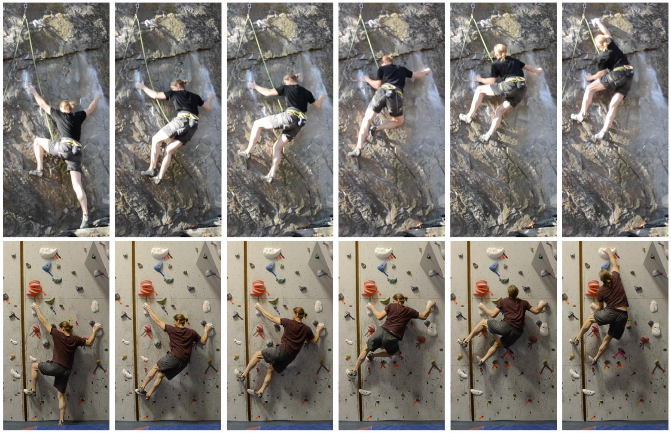
Thank you! Questions?

Slide 28
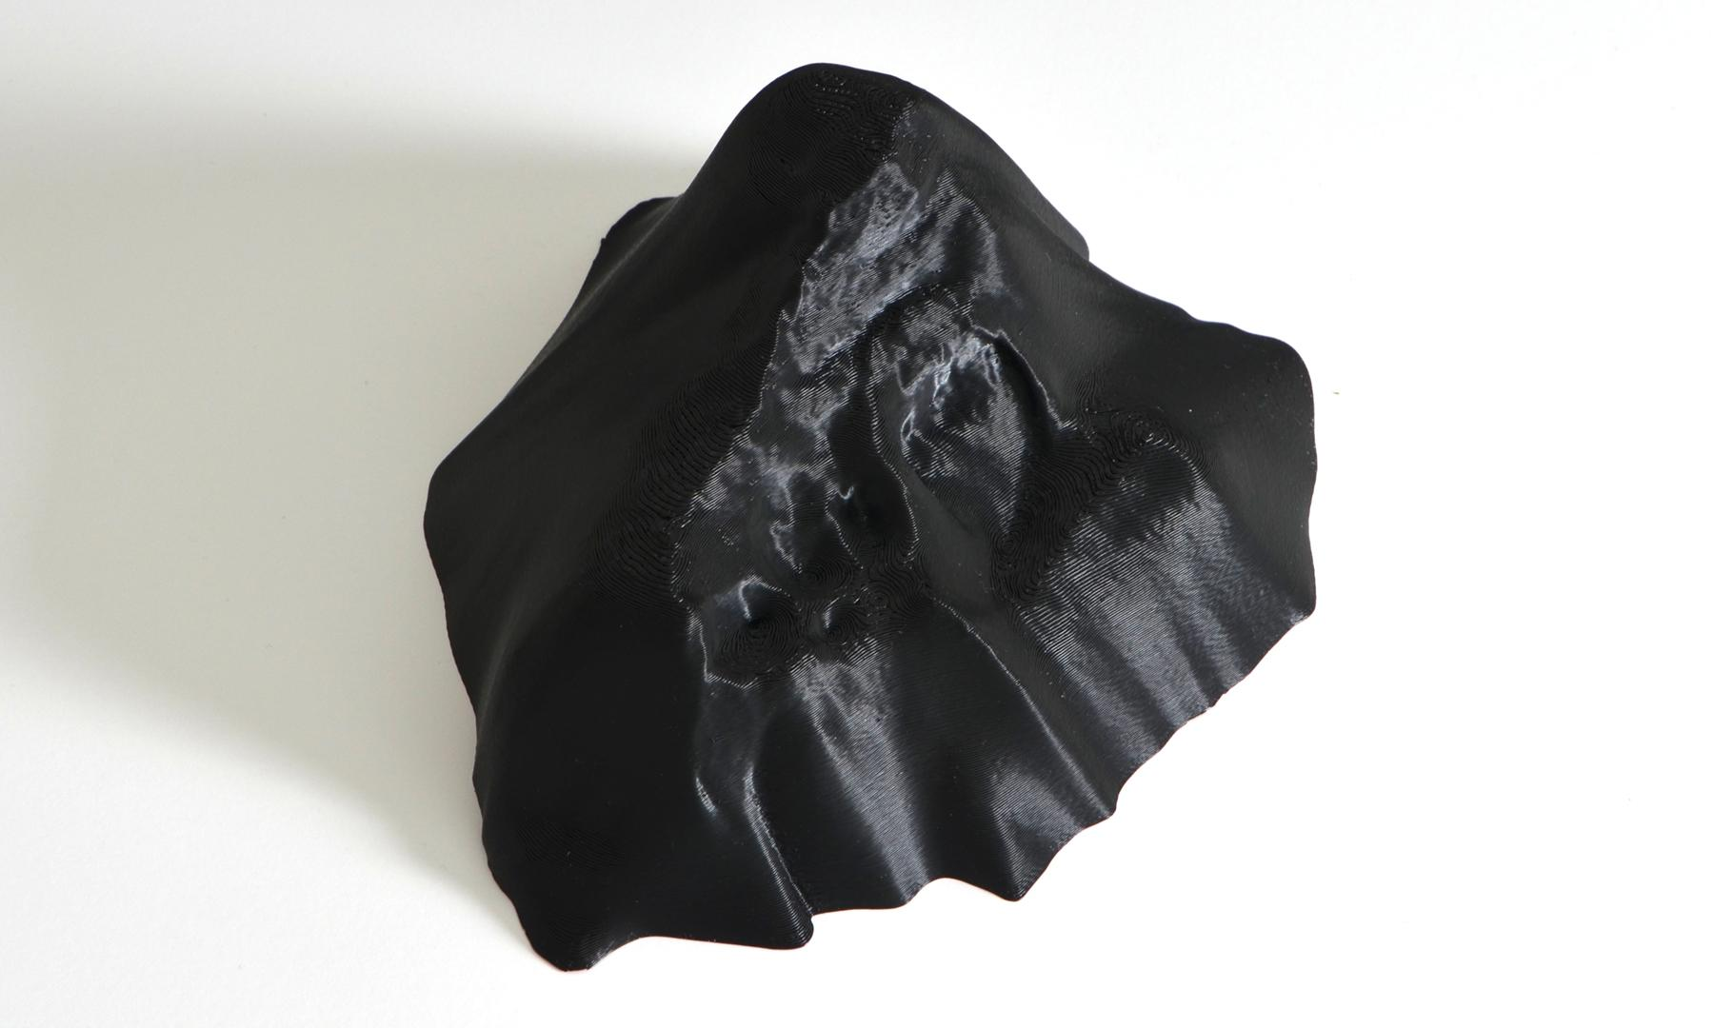
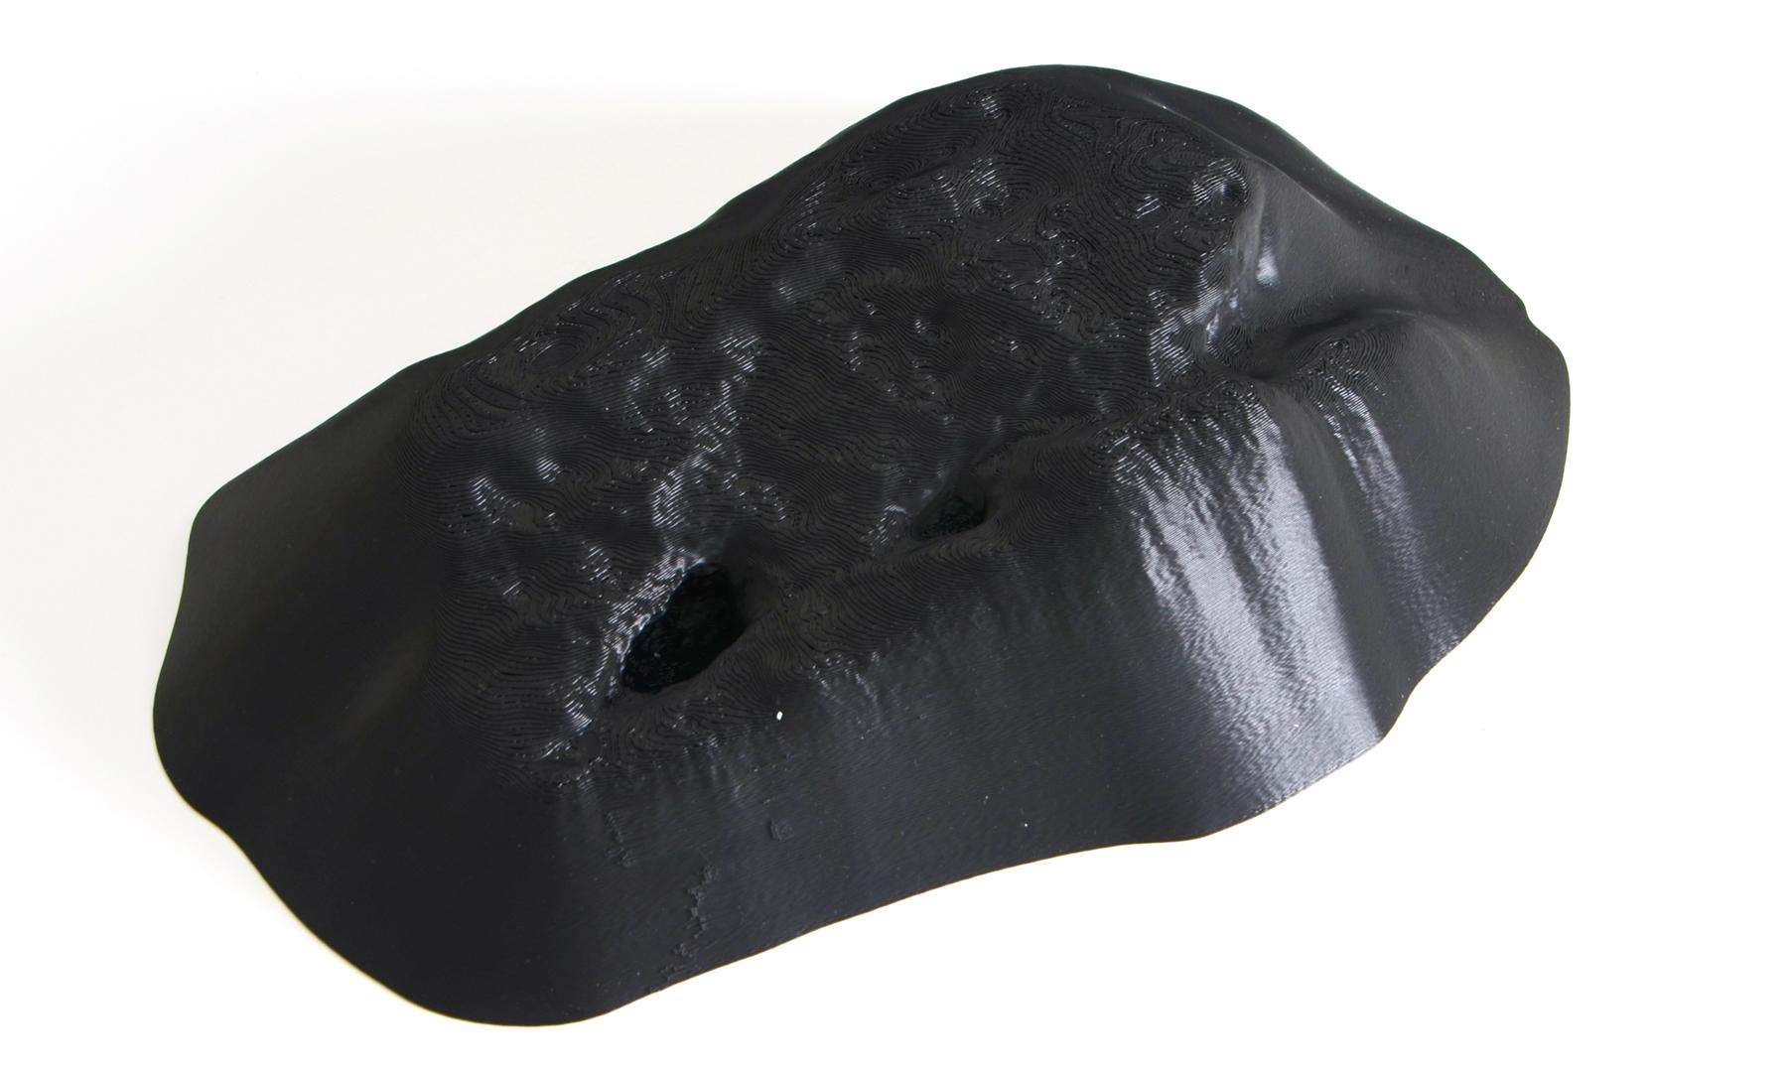
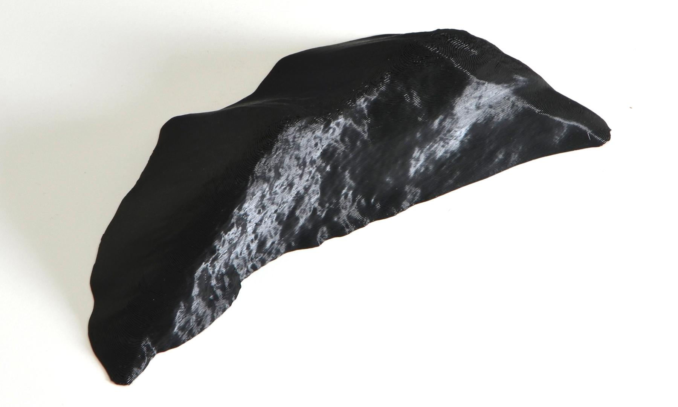
Fabrication: Temptation

Slide 29

Fabrication
3D print with adhered sand
CNC milled from high density foam

Slide 30
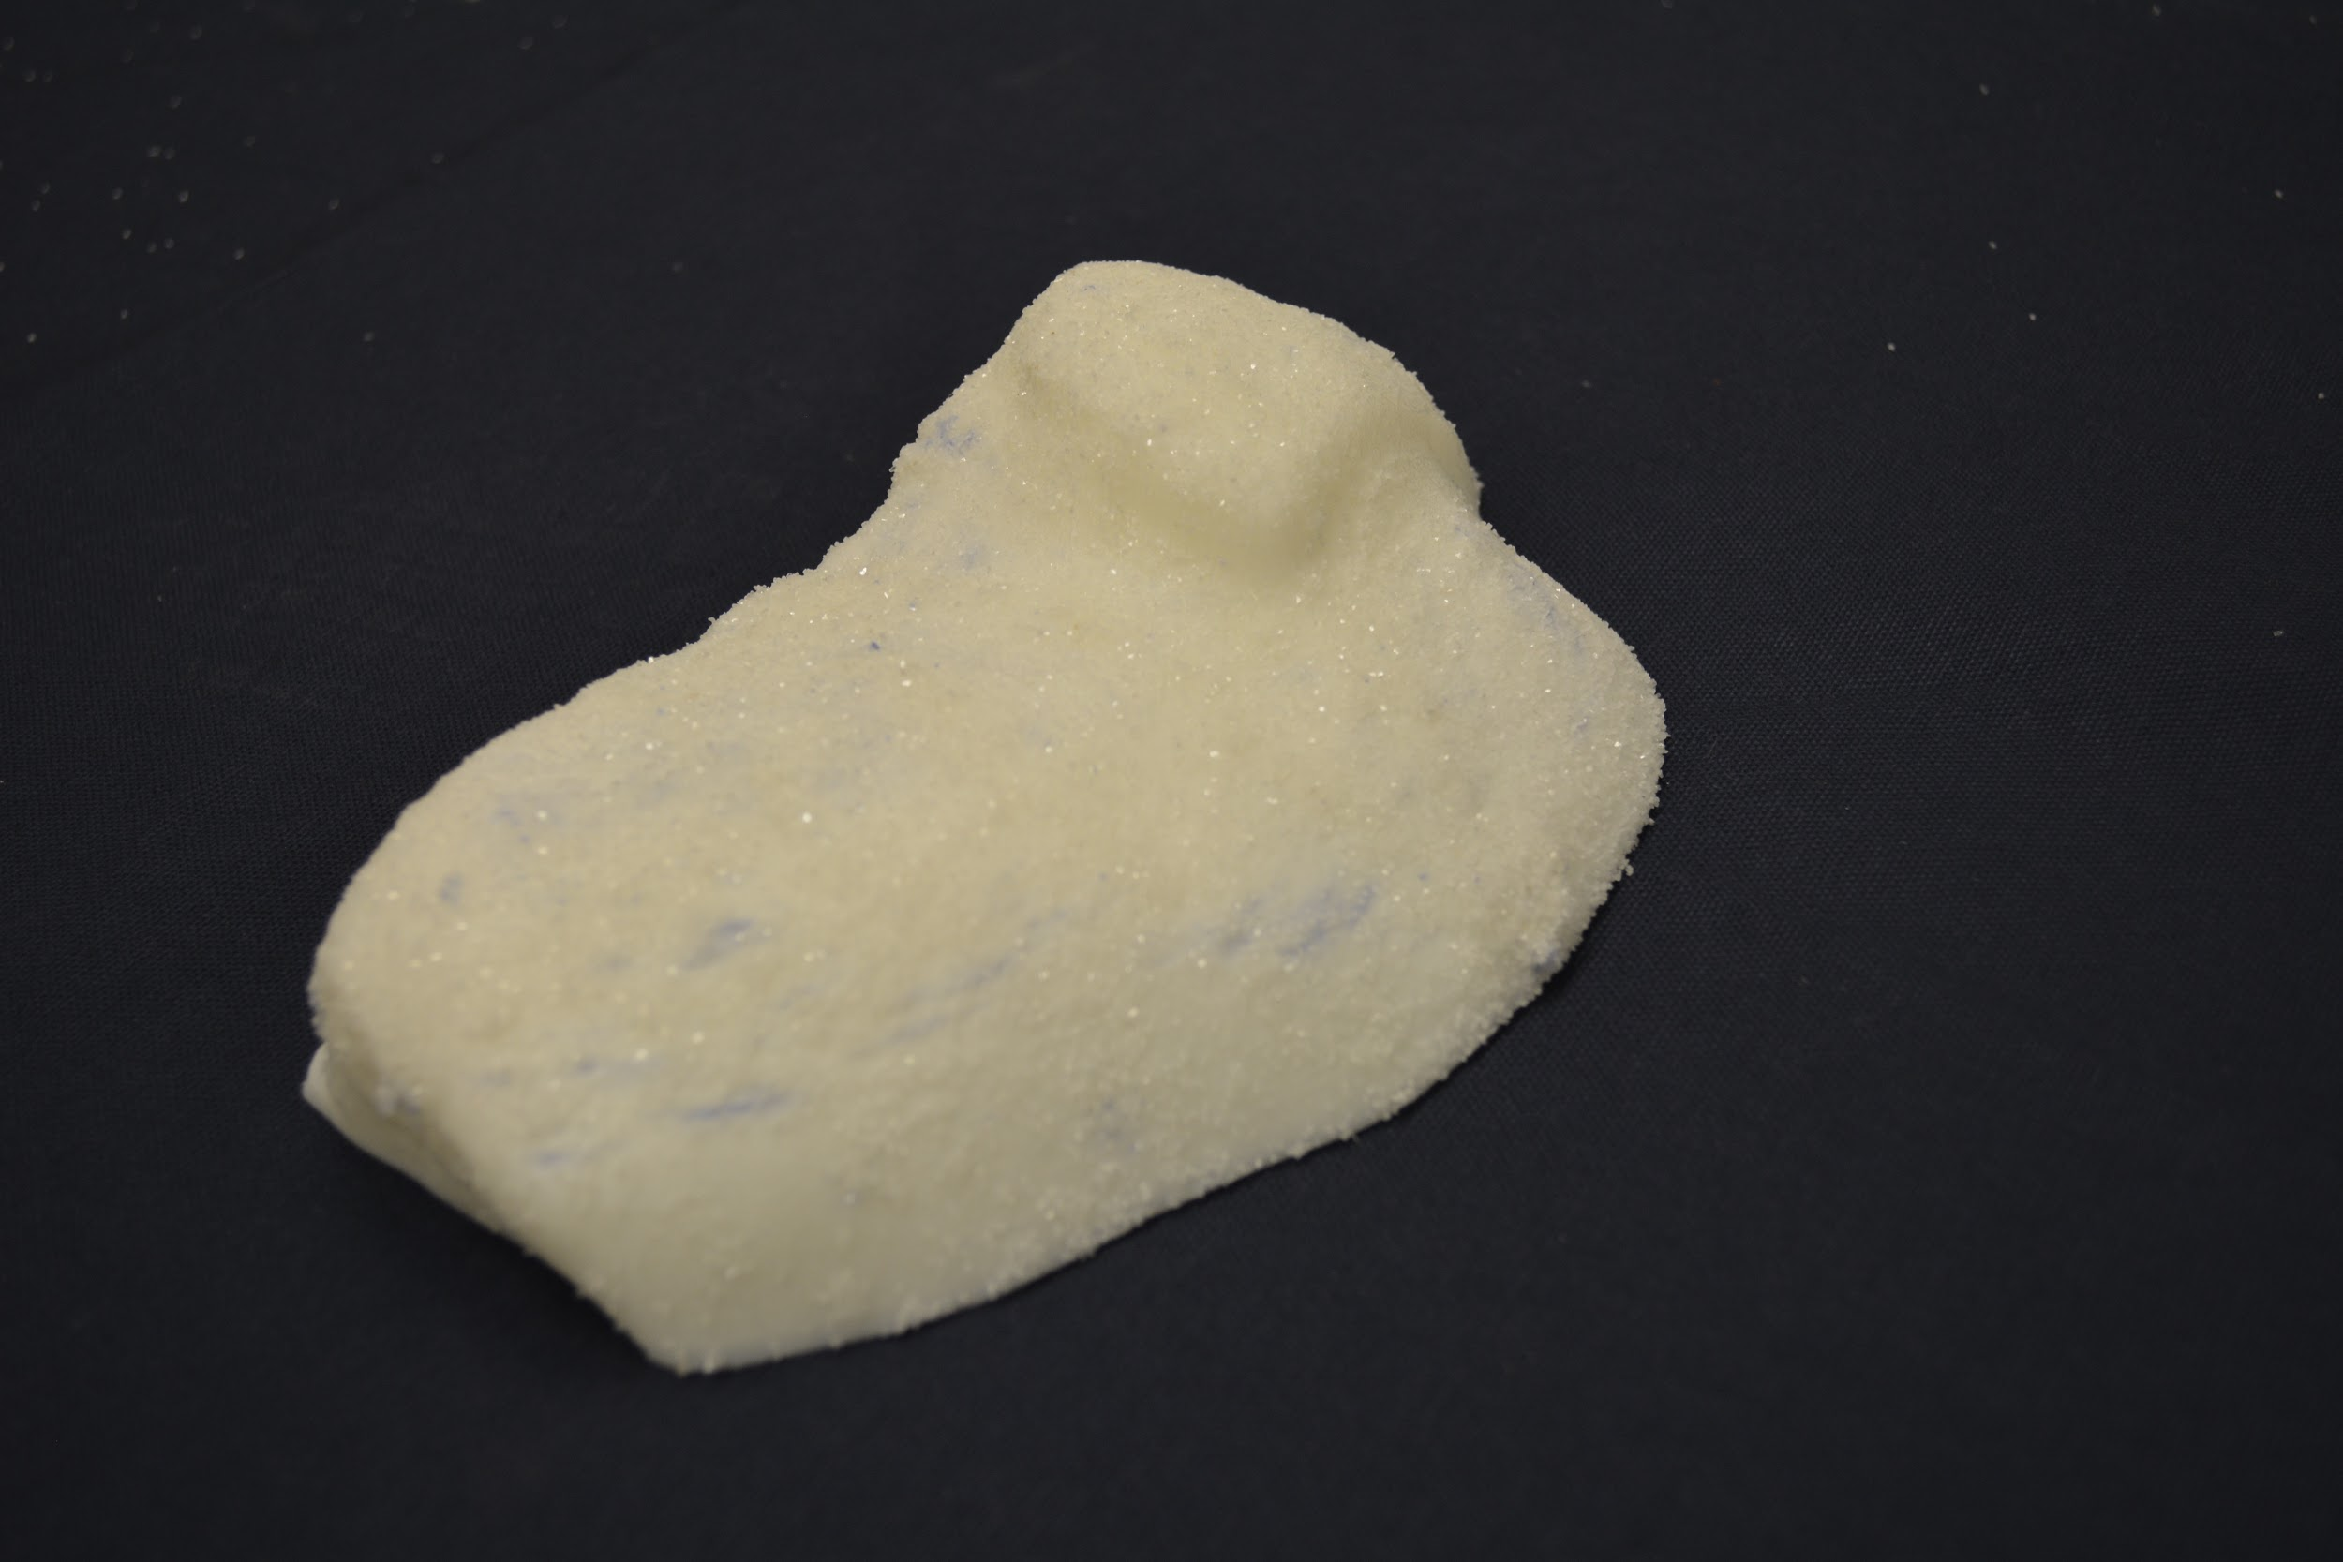
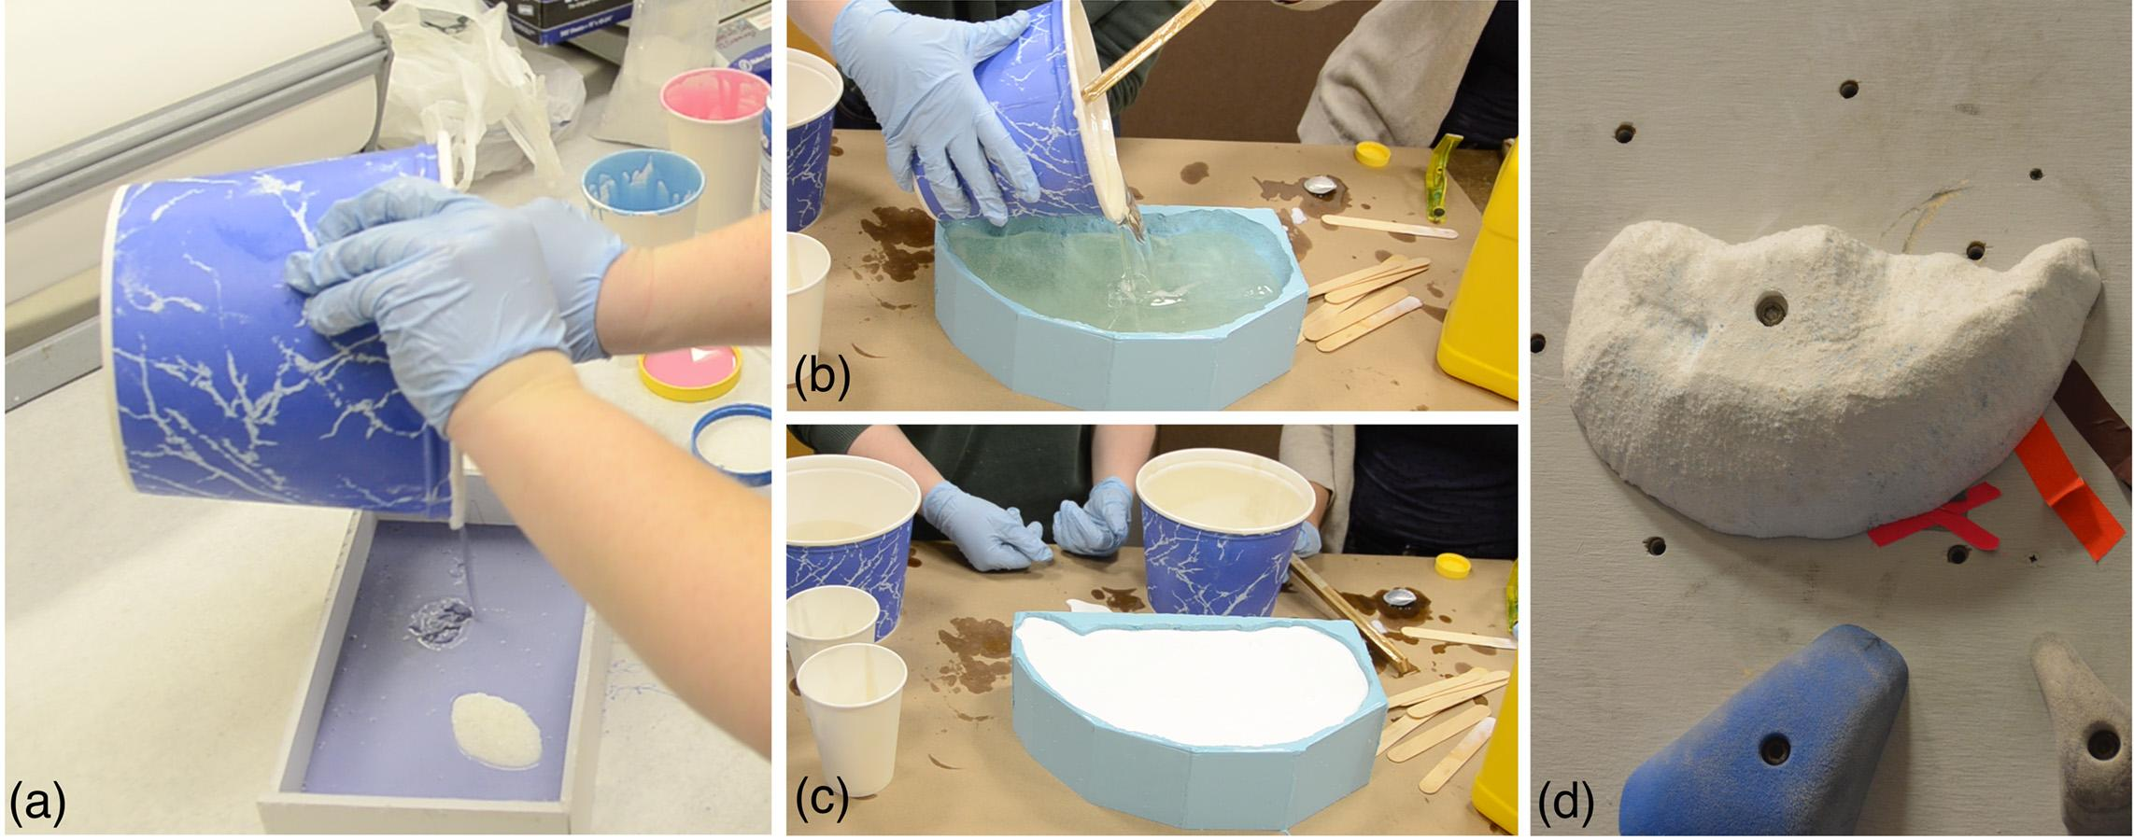
Fabrication
3D print with adhered sand
Molding Casting Mounting

Slide 31
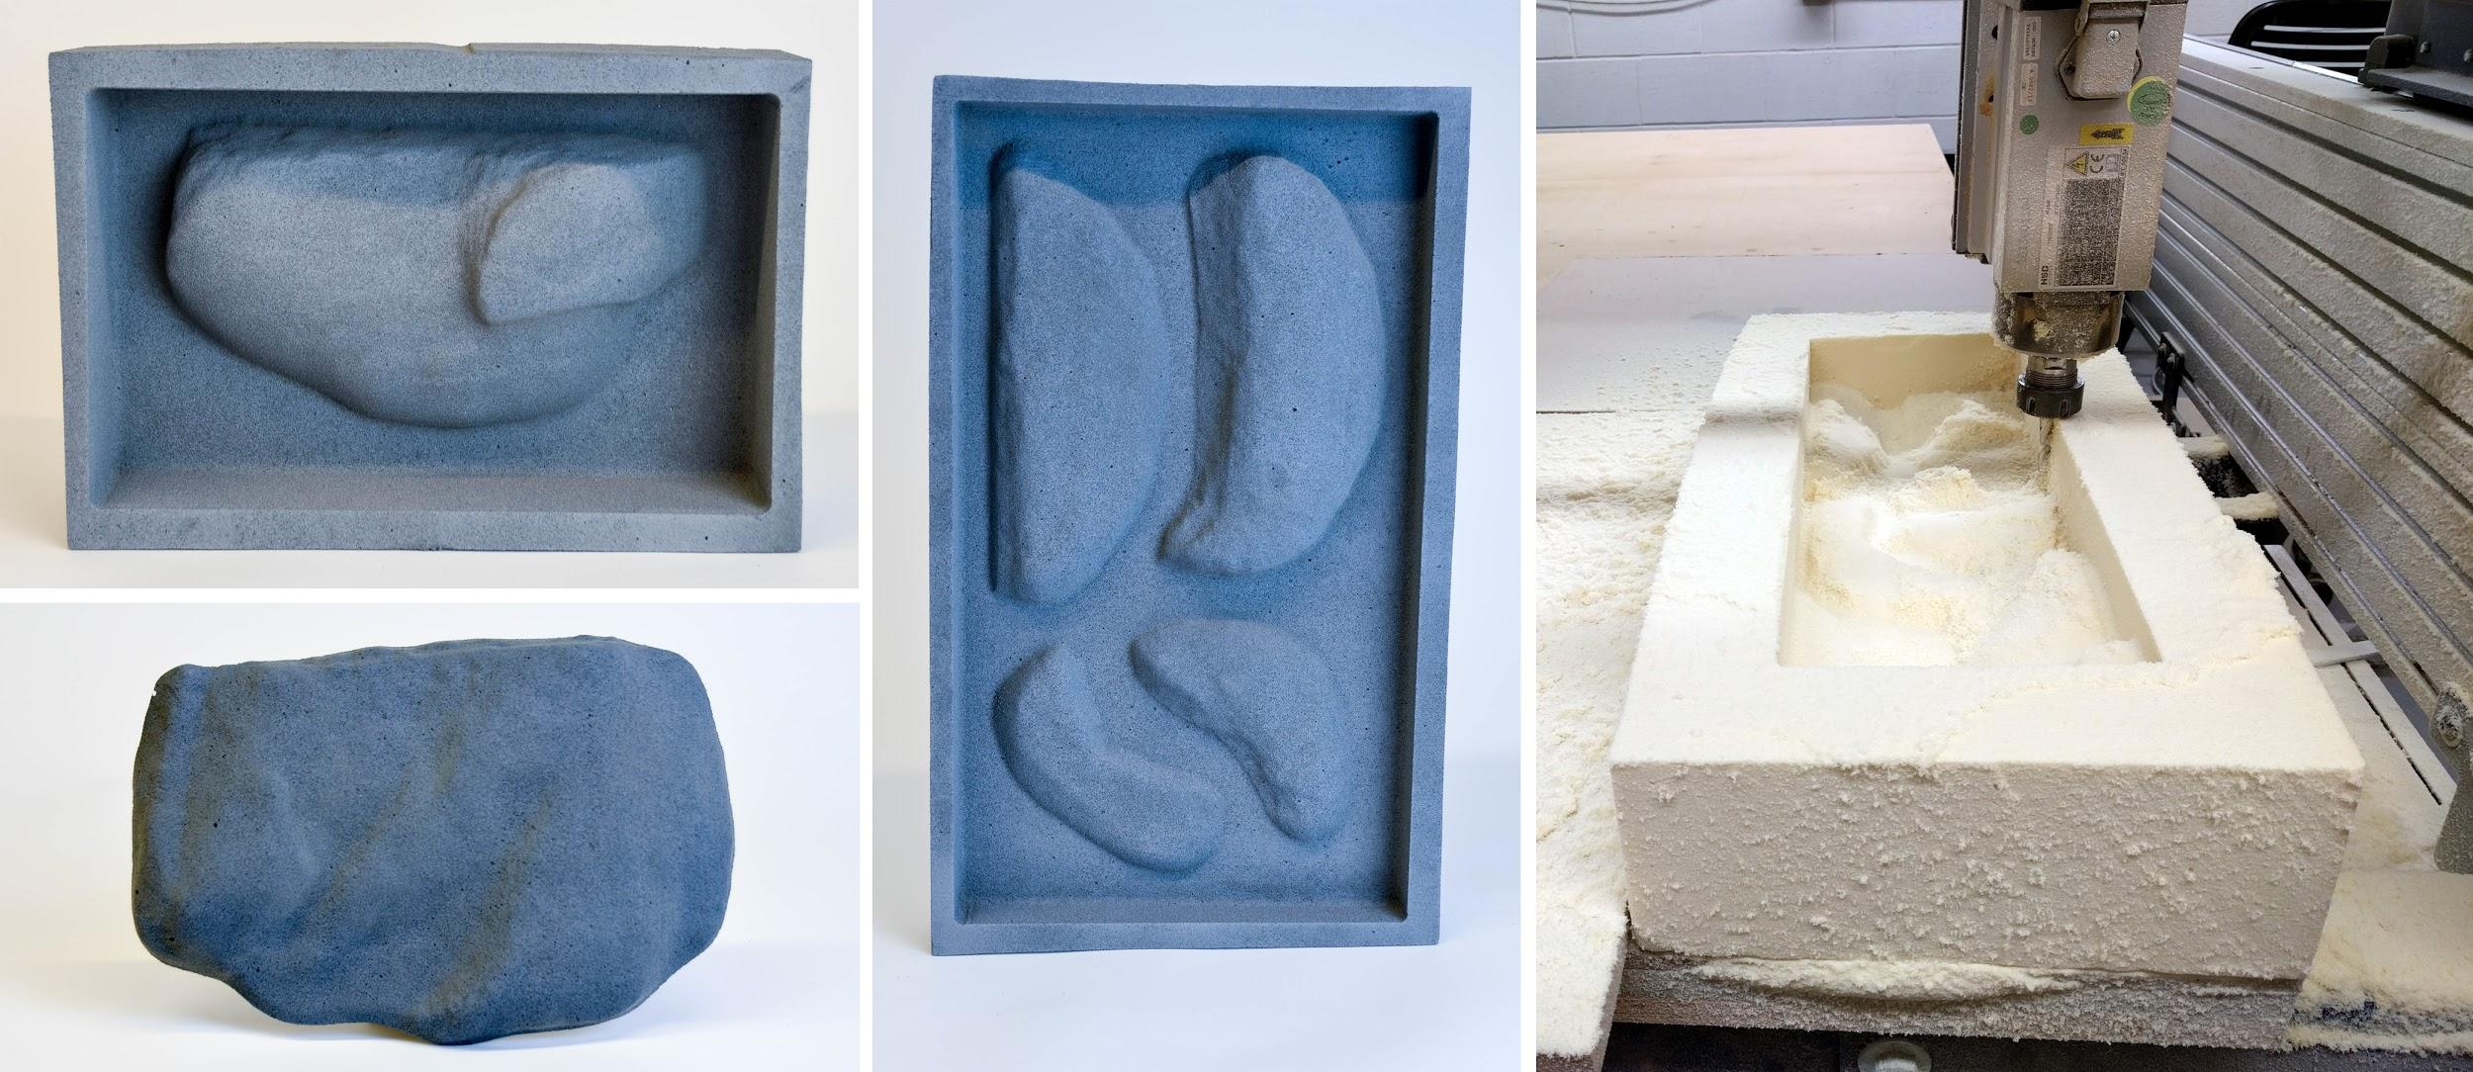
Fabrication
CNC milled from high density foam
3D print with adhered sand

Slide 32
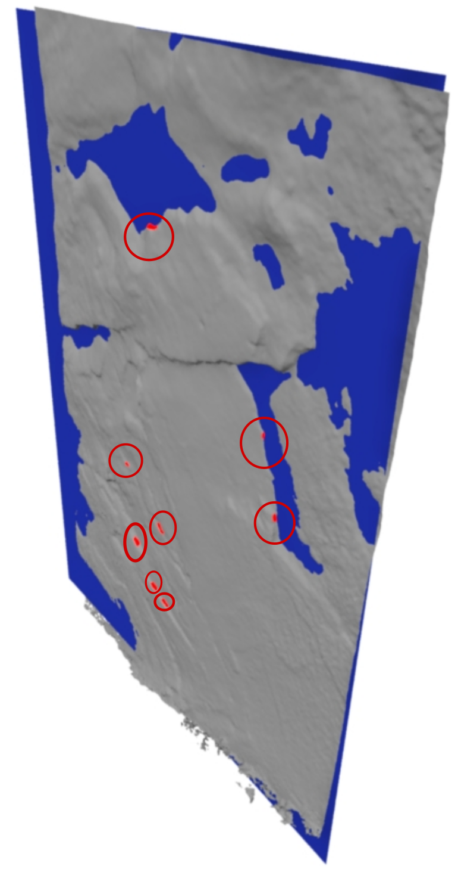
Hold Modeling
Fitting Plane
  Maintains relative depth
  Minimizes unnecessary print volume
Must ensure that no grasping region is clipped

