Slide 1

Information Security – Theory vs. Reality
0368-4474, Winter 2015-2016
Lecture 1:
Introduction,
Architectural side channels 1/2
Lecturer:
Eran Tromer

Slide 2
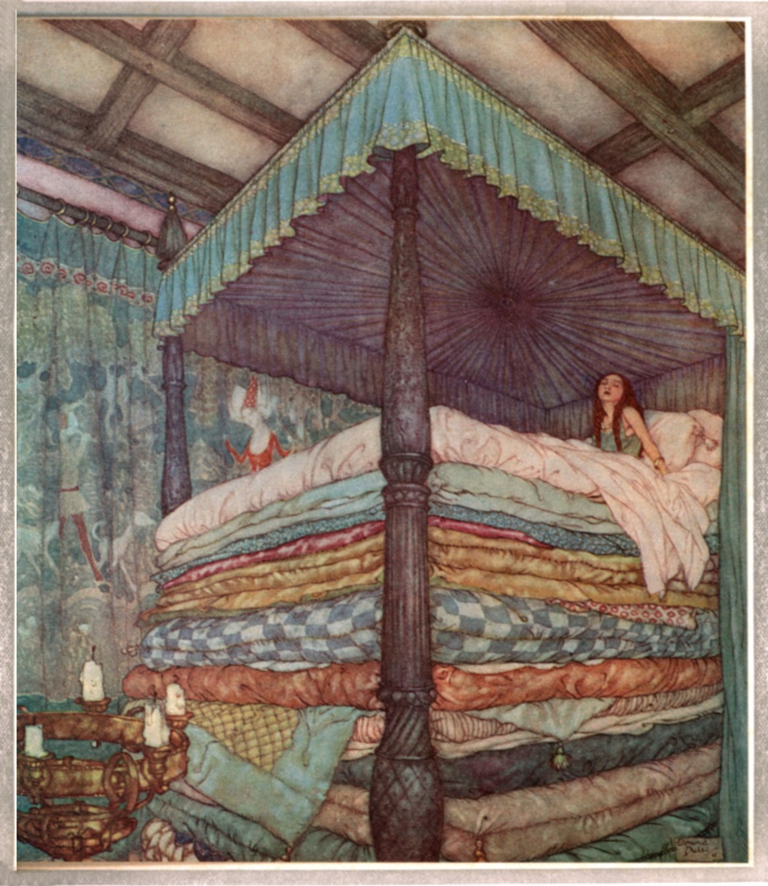

Course agenda

Slide 3
Course duties
  Questionnaire (on course website)
Material: everything covered in class (including whiteboard and discussions), and assigned reading as specified.
Exercises
  5 exercises, submitted in individually.
  30% of grade
  All mandatory
  No late submissions
Final project
Lecture summaries: up to 5% bonus

Slide 4
Resources
  Course website:
  http://cs.tau.ac.il/~tromer/istvr1516
  Recommended Facebook group: istvr1516
Mailing list (see website)
The course material is not covered by any single book. For background and discussion of physical attacks, see:
Ross Anderson, Security Engineering, 2nd ed.
Additional reading material during the semester.

Slide 5


Course agenda
Advanced topics in applied cryptography and information security, focusing on all the ways our convenient abstractions and careful designs fail in reality – and what to do about it.
Notes:
Hans Christian Andersen related a folk tale about a princess who was unable to sleep, because a single pea was uncomfortably poking her through 20 layers of mattresses. Let me relate a modern version of this tale.

Slide 6
Tentative topics
Attacks
Software side-channel attacks
Physical side-channel attacks
Fault attacks
Hardware security
Defense
Leakage-resilient cryptography
Fully-homomorphic encryption
Computationally-sound proofs
  with applications to Bitcoin
Multiparty computation
Obfuscation

Slide 7
Today:
Side-channel attacks

Slide 8
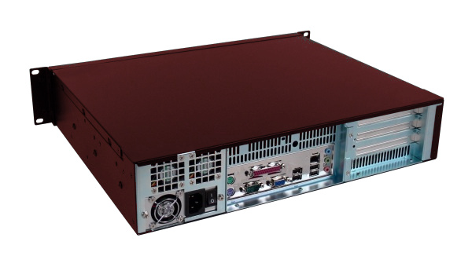
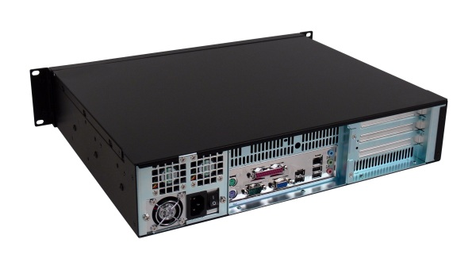
Types of undesired information flow
Inadvertent information channels between processes running on the same system:
Side channels
Covert channels
collaborate to circumvent mandatory access controls
Most generally:
Violate information flow control
attacker
victim
receiver
sender

Slide 9
Cryptographic algorithms vs. the real world
An example

Slide 10
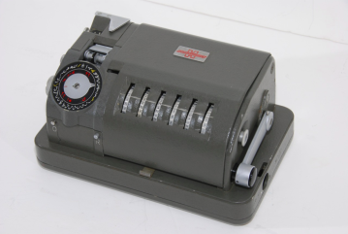
Cryptographic algorithms
Input:
(plaintext, key)
Output
(ciphertext)
Model:
Formal security definitions
(CPA, CCA1, CCA2, …)
Well-studied algorithms
(RSA, AES, DES, …)
Algorithmic attacks are believed infeasible.

Slide 11

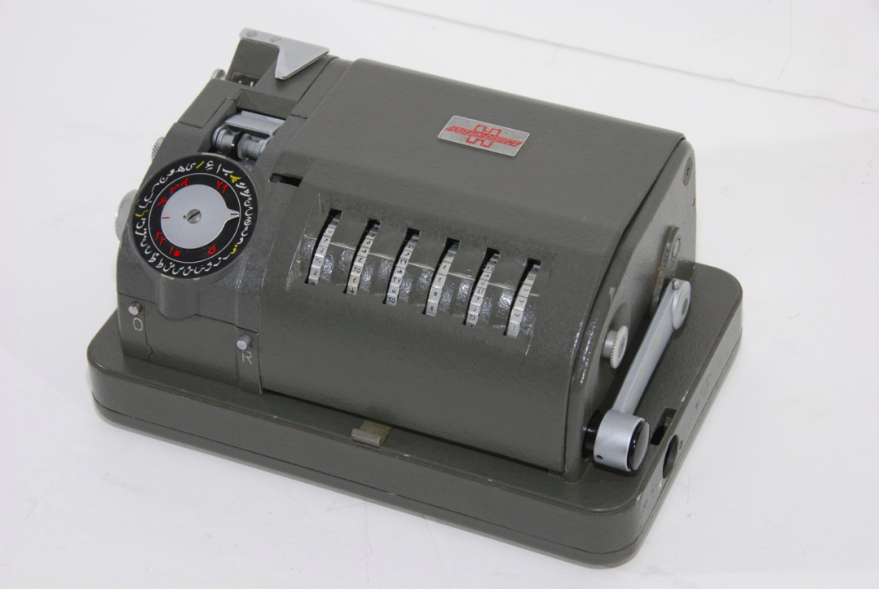
ENGULF [Peter Wright, Spycatcher, p. 84]
In 1956, a couple of Post Office engineers fixed a phone at the Egyptian embassy in London.

Slide 12
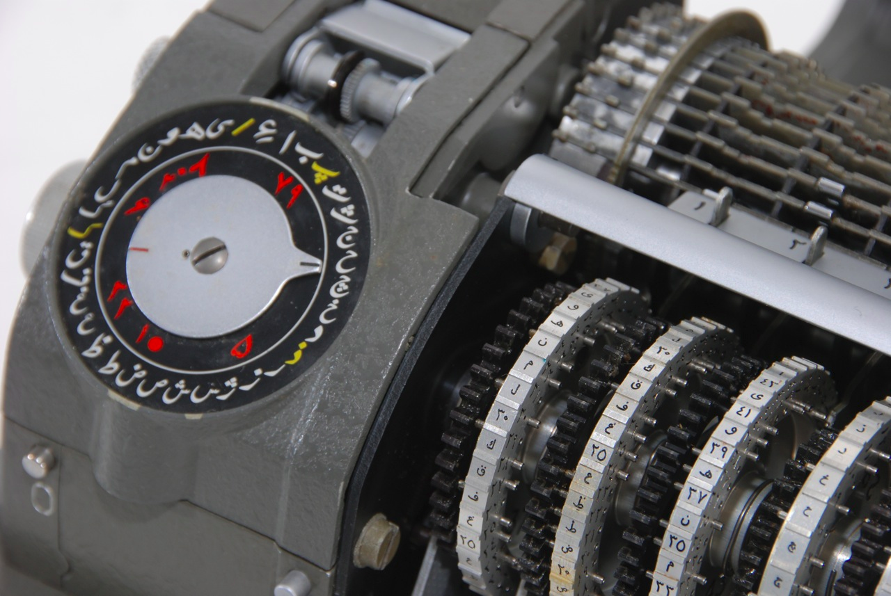
ENGULF (cont.)
“The combined MI5/GCHQ operation enabled us to read the Egyptian ciphers in the London Embassy throughout the Suez Crisis.”

Slide 13
Architectural side-channel attacks

Slide 14

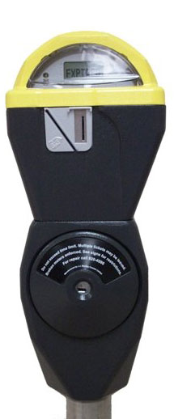

Cloud Computing (Infrastructure as a Service)
Instant virtual machines

Slide 15
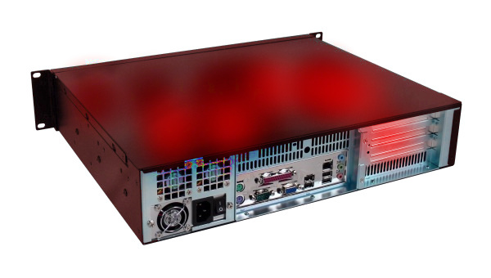
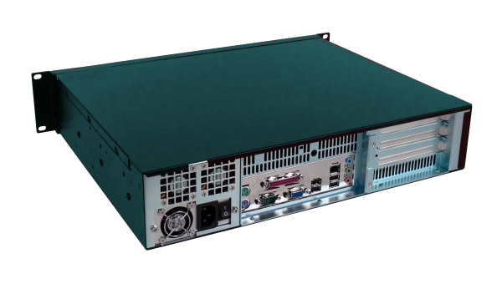
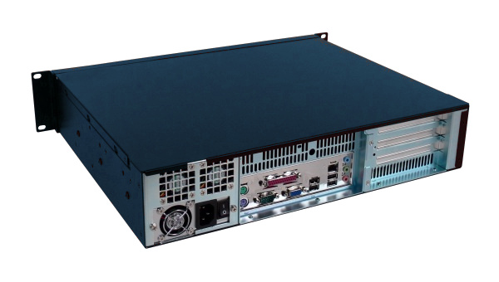
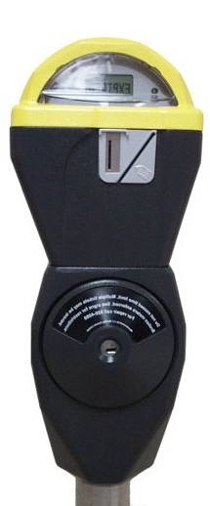
Public Clouds
(Amazon EC2, Microsoft Azure, Rackspace Mosso)
Instant virtual machines
... for anyone

Slide 16
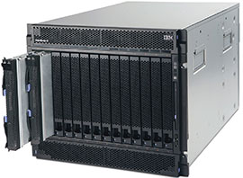
Virtualization
Instant virtual machines
... for anyone
…on the same hardware.

Slide 17
Virtualization
What if someone running on that hardware
is malicious?

Slide 18
A Tale of Virtualization and Side Channels

Slide 19
Virtualization: textbook description
Process
Process
Process
Process
Process
Process
OS
OS
Virtual machine manager
20 mattresses
Virtual memory
Hardware

Slide 20
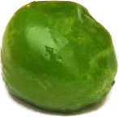
Cross-talk through architectural channels
Process
Process
Process
Process
Process
Process
OS
OS
Virtual machine manager
Virtual memory
Hardware

Slide 21
Cross-talk through architectural channels
Contention for shared hardware resources
Process
Process
Process
Process
Process
Process
OS
OS
Virtual machine manager
Virtual memory
Hardware

Slide 22
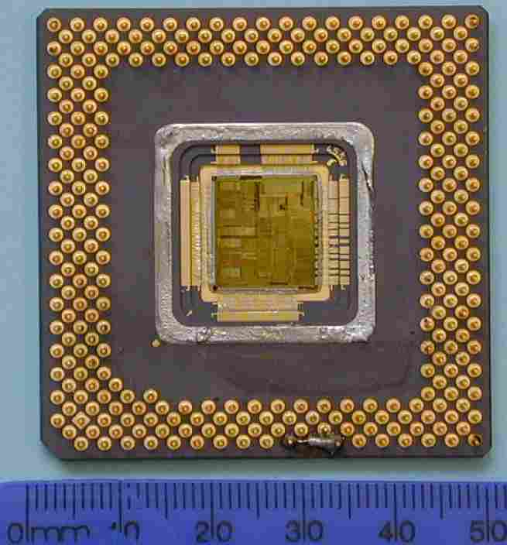
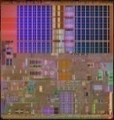
Cross-talk through architectural channels
Contention for shared hardware resources
Example: contention for CPU data cache
Attacker
Victim
OS
OS
Virtual machine manager
Virtual memory
Hardware
cache

Slide 23
Cross-talk through architectural channels
Contention for shared hardware resources
Example: contention for CPU data cache
Attacker
Victim
OS
OS
Virtual machine manager
Virtual memory
Hardware
cache
<1 ns latency

Slide 24
Cross-talk through architectural channels
Contention for shared hardware resources
Example: contention for CPU data cache
Attacker
Victim
OS
OS
Virtual machine manager
Virtual memory
Hardware
cache
<1 ns latency

Slide 25
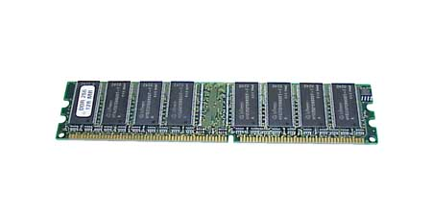
Cross-talk through architectural channels
Contention for shared hardware resources
Example: contention for CPU data cache
Attacker
Victim
OS
OS
Virtual machine manager
Virtual memory
Hardware
cache
DRAM
~100 ns latency
<1 ns latency

Slide 26
Cross-talk through architectural channels
Contention for shared hardware resources
Example: contention for CPU data cache leaks memory access patterns.
Attacker
Victim
OS
OS
Virtual machine manager
Virtual memory
Hardware
cache
~100 ns latency
<1 ns latency

Slide 27
Cross-talk through architectural channels
Contention for shared hardware resources
Example: contention for CPU data cache leaks memory access patterns.
This is sensitive information! Can be used to steal encryption keys in few milliseconds of measurements.
Attacker
Victim
OS
OS
Virtual machine manager
Virtual memory
Hardware
cache

Slide 28

The multicore/multithread world
CPU parallelism in is ubiquitous:
Multicore
Simultaneous multithreading
(“HyperThreading”)
SMP
This trend is fundamental:
CPU transistor count keeps growing exponentially, but clock rate and on-chip bandwidth aren’t.
Attacker
Victim
OS
OS
Virtual machine manager
Virtual memory
Hardware
Core
Core
Parallelism aggravates architectural side channels.
Core
Core
Inter-core and
inter-thread crosstalk

Slide 29
Cache attacks
CPU core contains small, fast memory cache shared by all applications.
Attacker
app
Victim
app
secret
key
Contention for this shared resources
mean Attacker can observe slow-down when Victim accesses its own memory.
From this, Attacker can deduce the memory access patterns of Victim.
cache
The cached data is subject to memory protection…
CPU
But the metadata leaks information about memory access patterns:
addresses and timing.
Slow DRAM main memory

Slide 30
Example: breaking AES encryption via address leakage
(NIST FIPS 197; used by WPA2, IPsec, SSH, SSL, disk encryption, …)
char p[16], k[16]; // plaintext and key
int32 Col[4]; // intermediate state
const int32 T0[256],T1[256],T2[256],T3[256]; // lookup tables
...
/* Round 1 */
Col[0]← T0[p[ 0] ⊕ k[ 0]] ⊕ T1[p[ 5] ⊕ k[ 5]] ⊕
T2[p[10] ⊕ k[10]] ⊕ T3[p[15] ⊕ k[15]];
Col[1]← T0[p[ 4] ⊕ k[ 4]] ⊕ T1[p[ 9] ⊕ k[ 9]] ⊕
T2[p[14] ⊕ k[14]] ⊕ T3[p[ 3] ⊕ k[ 3]];
Col[2]← T0[p[ 8] ⊕ k[ 8]] ⊕ T1[p[13] ⊕ k[13]] ⊕
T2[p[ 2] ⊕ k[ 2]] ⊕ T3[p[ 7] ⊕ k[ 7]];
Col[3]← T0[p[12] ⊕ k[12]] ⊕ T1[p[ 1] ⊕ k[ 1]] ⊕
T2[p[ 6] ⊕ k[ 6]] ⊕ T3[p[11] ⊕ k[11]];
Complications:
Multiple indices per
cache line
Uncertain messages
Noise
Requires further
cryptographic and
statistical analysis.
How to learn addresses?
lookup index = plaintext ⊕ key

Slide 31
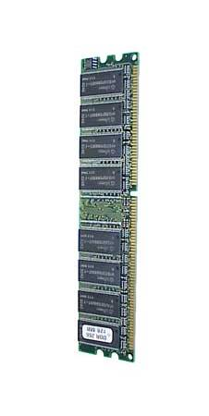
Associative memory cache
memory block
(64 bytes)
DRAM
cache set
(4 cache lines)
cache line
(64 bytes)
cache

Slide 32
Victim’s memory
S-box
table
DRAM
cache

Slide 33
Detecting victim’s memory accesses
Attacker
memory
S-box
table
DRAM
cache

Slide 34
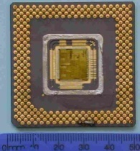


Measurement technique
Attacker can exploit cache-induced crosstalk as an input or as an output:
Effect of the cache on the victim
Effect of victim on the cache
Attacker
Victim
Victim
Attacker

Slide 35
Evict+Time: Measuring effect of cache on encryption
Attacker manipulates cache states and measures effect on victim’s running time.
1. Victim’s data fully cached
Attacker
memory
T0
2. Attacker evicts victim’s block
DRAM
3. Attacker times the victim’s next run. Slowdown?
cache

Slide 36
Prime+Probe: Measuring effect of encryption on cache
Attacker checks which of its own data was evicted by the victim.
Attacker
memory
1. Fill cache
with attacker’s data
S-box
table
DRAM
cache

Slide 37
Prime+Probe: Measuring effect of encryption on cache
Attacker checks which of its own data was evicted by the victim.
Attacker
memory
1. Fill cache
with attacker’s data
2. Trigger a single encryption
S-box
table
DRAM
cache

Slide 38
Prime+Probe: Measuring effect of encryption on cache
Attacker checks which of its own data was evicted by the victim.
Attacker
memory
1. Fill cache
with attacker’s data
2. Trigger a single encryption
S-box
table
3. Access attacker memory again and see which cache sets are slow
DRAM
cache

Slide 39
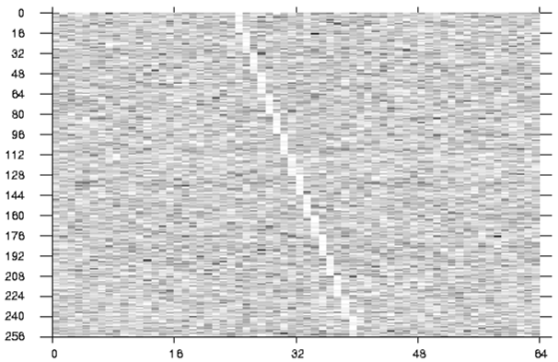
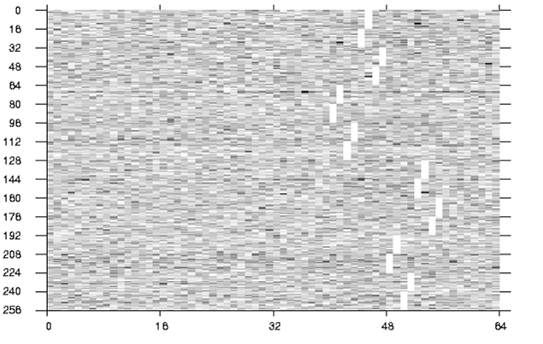
Experimental results [Osvik Shamir Tromer 05]
[Tromer Osvik Shamir 09]
Attack on OpenSLL AES encryption library call:
Full key extracted from 13ms of measurements (300 encryptions)
Attack on an AES encrypted filesystem (Linux dm-crypt):
Full key extracted from 65ms of measurements (800 I/O ops)
Secret key byte k[0]=0x00
Secret key byte k[5]=0x50
Measuring a “black box” OpenSSL encryption on Athlon 64, using 10,000 samples. Horizontal axis: evicted cache set. Vertical axis: p[0] (left), p[5] (right).Brightness: encryption time (normalized)

Slide 40
Extension: “Hyper Attacks”
Obtaining parallelism:
  HyperThreading (simultaneous multithreading)
  Multi-core, shared caches, cache coherence
  (Also: interrupts, scheduler)
Attack vector:
  Monitor cache statistics in real time
  Encryption process is not communicating with anyone
  (no I/O, no IPC).
  No special measurement equipment
  No knowledge of either plaintext of ciphertext

Slide 41
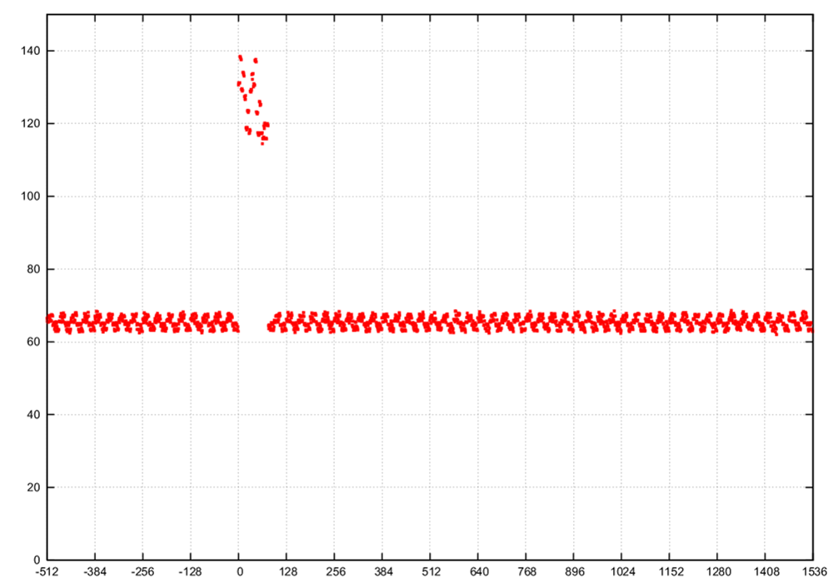
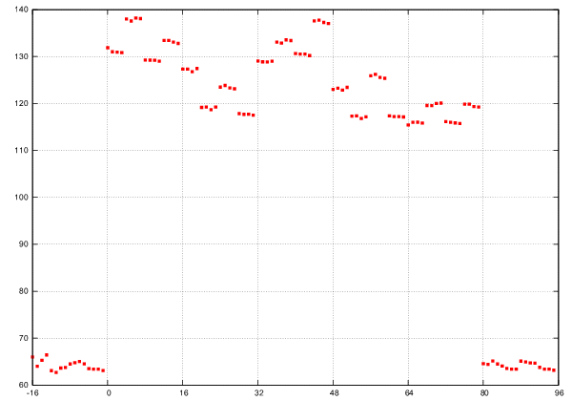
Experimental results
“Hyper Attack” attack on AES
(independent process doing batch encryption of text):
  Recovery of 45.7 key bits in one minute.

Slide 42
Implications?

Slide 43
Implications
Multiuser systems (e.g, Android)
Untrusted code, even if sandboxed
(e.g., ActiveX, Java applets, managed .NET, JavaScript, Google Native Client, Silverlight)
Digital right management
The trusted path is leaky
(even if verified by TPM attestation, etc.)
Remote network attacks
Virtual machines

Slide 44
Virtualization
US patent 6,922,774 (NSA)
Touted for its security benefits:
Isolation
Sandboxing
Management
Monitoring
Recovery
Forensics (replay)
All true.
Process
Process
Process
Process
Process
Process
Key
Untrusted
Code
OS services
OS services
OS kernel
OS kernel
Hypervisor
But many side-channel
attacks are
oblivious to virtualization.
(It’s the same
underlying hardware!)
This creates inherent new risks.
CPU
Memory
Devices

Slide 45
Architectural attacks in cloud computing: difficulties
How can the attacker reach a target VM?
How to exploit it? Practical difficulties:
  Core migration
  Extra layer of page-table indirection
  Coarse hypervisor scheduler
  Load fluctuations
  Choice of CPU
Is the “cloud” really vulnerable?

Slide 46
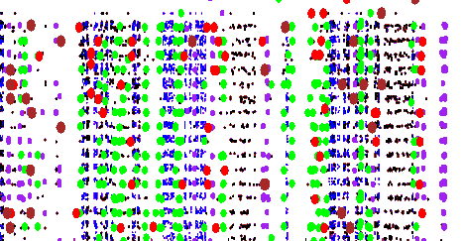
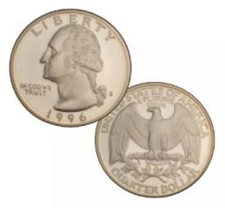
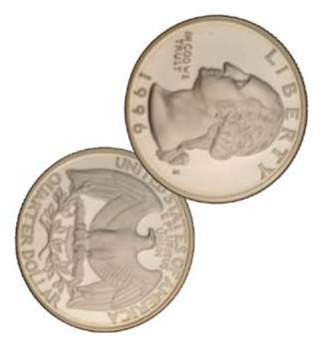


Demonstrated using Amazon EC2 as cast study:
Cloud cartography
Mapping the structure of the “cloud” and
locating a target on the map.
Placement vulnerabilities
An attacker can place his VM on the same physical
machine as a target VM (40% success for a few dollars).
Cross-VM exfiltration
Once VMs are co-resident, information and secret keys
can be exfiltrated across VM boundary.

Slide 47
Cloud cartography
Where in the world is the target VM, and how can I get there?
On EC2, VMs can be co-resident only if they have identical creation parameters:
  Region (US/Europe)
  Availability zone (data center)
  Instance type (machine pool)
The cloud-internal IP addresses
assigned to VMs are strongly
correlated with their creation
parameters.
Mapping out this correlation:

Slide 48


Cloud cartography (example)
zone 1
zone 3
zone 2
IP address (position) vs. zone (color)
IP address (position) vs. instance type (color)
Deduced:
Heuristic rules for mapping IP address to creation parameters.

Slide 49
Achieving co-residence
Overall strategy:
  Derive target’s creation parameters
  Create similar VMs until co-residence is detected.
Improvement:
  Target fresh (recently-created) instances, exploiting EC2’s sequential assignment strategy
  Conveniently, one can often trigger new creation of new VMs by the victim, by inducing load (e.g., RightScale).
Success in hitting a given (fresh) target:
~40% for a few dollars
Reliable across EC2 zones, accounts and times of day.

Slide 50
Detecting co-residence
EC2-specific:
  Internal IP address are close
Xen-specific:
  Obtain and compare Xen Dom0 address
Generic:
  Network latency
  Cross-VM architectural channels:
  send HTTP requests to target and observe correlation with cache utilization

Slide 51
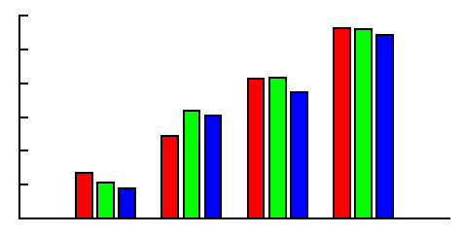
Exploiting co-residence: cross-VM attacks
Demonstrated:
[Ristenpart Tromer Shaham Savage ‘09]
[Zhang Juels Reiter Ristenpart ‘12]
  Measuring VMs load (average/transient)
  Estimating web server traffic
  Robust cross-VM covert channel
  Detecting keystroke timing in an SSH
  session across VMs
  (on a similarly-configured Xen box)
→ keystroke recovery [Song Wagner Tian 01]
  Stealing ElGamal secret keys [Zhang Juels Reiter Ristenpart 2012]
  Stealing RSA secret keys [Inci Gulmezoglu Irazoqui Eisenbarth Sunar 2015]
  Stealing AES secret keys [Irazoqui Inci Eisenbarth Sunar 2014]
measurement
0
50
100
200
http requests per minute

Slide 52
Architectural attacks (continued)

Slide 53
L3 Flush+Reload attack [Yarom Falkner 2014]
Target outermost cache, shared between all CPU cores (typically L3)
RSA key extraction from GnuPG 1.4.13
Target specific memory block (instead of cache set)
Exploits memory deduplication (content-based page sharing)
  Common code, libraries, data across VMs
  Supposedly safe (nominally, no new information flow)

Slide 54
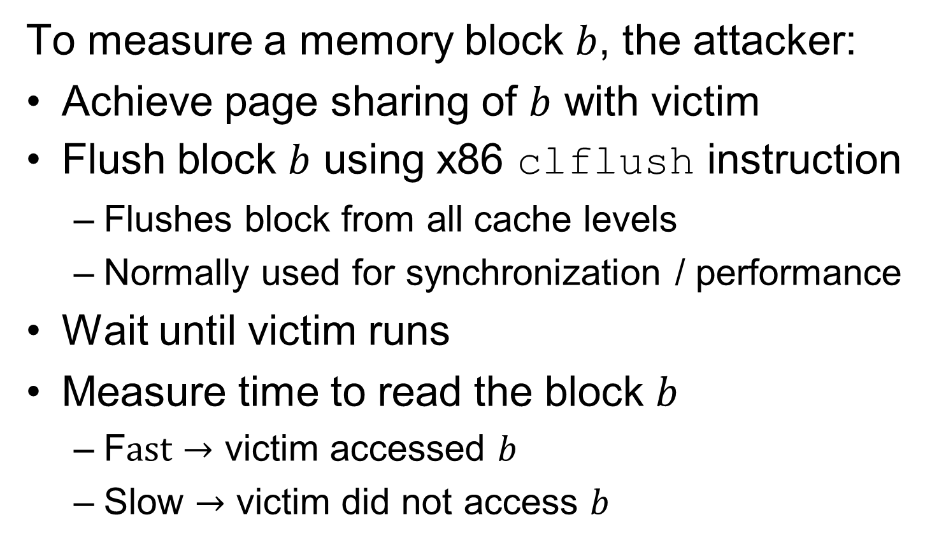
L3 flush+reload attack (cont.)

