Slide 1

Information Security – Theory vs. Reality
0368-4474, Winter 2015-2016
Lecture 11:
Fully homomorphic encryption
Lecturer:
Eran Tromer
Including presentation material by
Vinod Vaikuntanathan, MIT

Slide 2
Fully Homomorphic Encryption

Slide 3

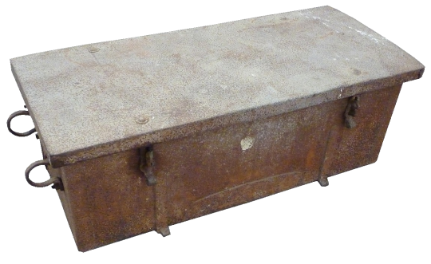



Confidentiality of static data: plain encryption
x₁

Slide 4
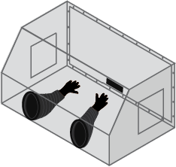
Confidentiality of data inside computation:
Fully Homomorphic Encryption
v=x+y;
w=f(v);
return w;

Slide 5
Fully Homomorphic Encryption
Goal: delegate computation on data without revealing it
A confidentiality goal

Slide 6


Example 1: Private search
Delegate processing of data
without revealing it
You: Encrypt the query,
send to Google
(Google does not know the key,
cannot “see” the query)
Google: Encrypted query →
Encrypted results
(You decrypt and recover the
search results)

Slide 7

Example 2: Private Cloud Computing
Delegate processing of data
without revealing it
Encrypt x
(Enc(x), P) → Enc(P(x))
(Input: x)
(Program: P)

Slide 8
Fully Homomorphic Encryption
Encrypted x, Program P → Encrypted P(x)
Definition: (KeyGen, Enc, Dec, Eval)
(as in regular public/private-key encryption)
Correctness of Eval: For every input x, program P
If c = Enc(PK, x) and c′ = Eval (PK, c, P),
then Dec (SK, c’) = P(x).
Compactness: Length of c′ independent of size of P
Security: semantic security / indistinguishability [GM82]

Slide 9





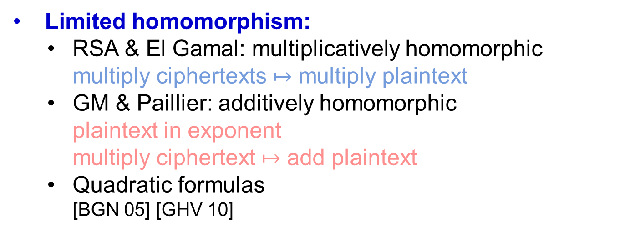
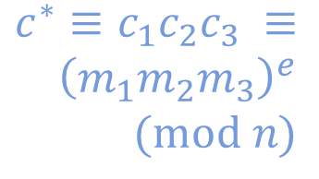
History of Fully Homomorphic Encryption
Since 1978
Eval: P, Enc(x) → Enc(P(x))
First Defined:
“Privacy homomorphism”
[Rivest Adleman Dertouzos 78]
motivation: searching encrypted data
Limited homomorphism:
  RSA & El Gamal: multiplicatively homomorphic
  multiply ciphertexts $↦$ multiply plaintext
  GM & Paillier: additively homomorphic
  plaintext in exponent
  multiply ciphertext $↦$ add plaintext
  Quadratic formulas
  [BGN 05] [GHV 10]
$$c^{∗}≡c_{1}c_{2}c_{3} ≡ \\ {\left(m_{1}m_{2}m_{3}\right)}^{e} \\ \text{ (}\text{mod} n)$$
$$×$$
$$c_{1}=m_{1}^{e}$$
$$c_{2}=m_{2}^{e}$$
$$c_{3}=m_{3}^{e}$$
Non-compact homomorphic encryption:
  Based on Yao garbled circuits
  [SYY 99] [MGH 08]: c* grows exp with degree/depth
  [IP 07] branching programs
Notes:
Here: Bring in the picture with the functions, all functions, and then ADD and MULT and QFs.

Slide 10
Fully Homomorphic Encryption
Since 1978
Eval: P, Enc(x) → Enc(P(x))
Big Breakthrough: [Gentry09]
First Construction of Fully Homomorphic Encryption
using algebraic number theory & “ideal lattices”
Full-semester course
Today: an alternative construction [DGHV 10]
using just integer addition and multiplication
easier to understand, implement and improve

Slide 11

Constructing fully-homomoprhic encryption assuming hardness of approximate GCD

Slide 12

A Roadmap
1. Secret-key “Somewhat” Homomorphic Encryption
(under the approximate GCD assumption)
(a simple transformation)
2. Public-key “Somewhat” Homomorphic Encryption
(under the approximate GCD assumption)
(borrows from Gentry’s techniques)
3. Public-key FULLY Homomorphic Encryption
(under approx GCD + sparse subset sum)

Slide 13
Secret-key Homomorphic Encryption
Secret key: a large n²-bit odd number p
(sec. param = n)
To Encrypt a bit b:
pick a random “large” multiple of p, say q·p
(q ~ n⁵ bits)
pick a random “small” even number 2·r
(r ~ n bits)
Ciphertext c = q·p+2·r+b
“noise”
To Decrypt a ciphertext c:
c (mod p) = 2·r+b (mod p) = 2·r+b
read off the least significant bit
Notes:
Noise term growing by how much? N^1/2 versus N/2
What is the sec parameter?
What is the efficiency?
Noise growing???
Random large!!!
Introduce the term near-multiple here.

Slide 14
Secret-key Homomorphic Encryption
How to Add and Multiply Encrypted Bits:
Add/Mult two near-multiples of p gives a near-multiple of p.
c₁ = q₁·p + (2·r₁ + b₁), c₂ = q₂·p + (2·r₂ + b₂)
c₁+c₂ = p·(q₁ + q₂) + 2·(r₁+r₂) + (b₁+b₂)
« p
LSB = b₁ XOR b₂
c₁c₂ = p·(c₂·q₁+c₁·q₂-q₁·q₂) + 2·(r₁r₂+r₁b₂+r₂b₁) + b₁b₂
« p
LSB = b₁ AND b₂

Slide 15

Problems
Ciphertext grows with each operation
Useless for many applications (cloud computing, searching encrypted e-mail)
Noise grows with each operation
Consider c = qp+2r+b ← Enc(b)
c (mod p) = r’ ≠ 2r+b
lsb(r’) ≠ b
2r+b
r’
(q-1)p
qp
(q+1)p
(q+2)p

Slide 16
Problems
Ciphertext grows with each operation
Useless for many applications (cloud computing, searching encrypted e-mail)
Noise grows with each operation
Can perform “limited” number of hom. operations
What we have: “Somewhat Homomorphic” Encryption

Slide 17
Public-key Homomorphic Encryption
Secret key: an n²-bit odd number p
Δ
Public key: [q₀p+2r₀,q₁p+2r₁,…,q_{t}p+2r_{t}] = (x₀,x₁,…,x_{t})
t+1 encryptions of 0
Wlog, assume that x₀ is the largest of them
To Decrypt a ciphertext c:
c (mod p) = 2·r+b (mod p) = 2·r+b
read off the least significant bit
Eval (as before)

Slide 18
Public-key Homomorphic Encryption
Secret key: an n²-bit odd number p
Δ
Public key: [q₀p+2r₀,q₁p+2r₁,…,q_{t}p+2r_{t}] = (x₀,x₁,…,x_{t})
To Encrypt a bit b: pick random subset S [1…t]
c = + b (mod x₀)
To Decrypt a ciphertext c:
c (mod p) = 2·r+b (mod p) = 2·r+b
read off the least significant bit
Eval (as before)

Slide 19
Public-key Homomorphic Encryption
Secret key: an n²-bit odd number p
Δ
Public key: [q₀p+2r₀,q₁p+2r₁,…,q_{t}p+2r_{t}] = (x₀,x₁,…,x_{t})
To Encrypt a bit b: pick random subset S [1…t]
c = + b (mod x₀)
c = p[ ] + 2[ ] + b (mod x₀)
c = p[ ] + 2[ ] + b – kx₀ (for a small k)
= p[ ] + 2[ ] + b
(mult. of p) + (“small” even noise) + b

Slide 20
Public-key Homomorphic Encryption
Ciphertext Size Reduction
Secret key: an n²-bit odd number p
Δ
Public key: [q₀p+2r₀,q₁p+2r₁,…,q_{t}p+2r_{t}] = (x₀,x₁,…,x_{t})
To Encrypt a bit b: pick random subset S [1…t]
c = + b (mod x₀)
To Decrypt a ciphertext c:
c (mod p) = 2·r+b (mod p) = 2·r+b
read off the least significant bit
Eval: Reduce mod x₀ after each operation
(*) additional tricks for mult

Slide 21
Public-key Homomorphic Encryption
Ciphertext Size Reduction
Secret key: an n²-bit odd number p
Δ
Public key: [q₀p+2r₀,q₁p+2r₁,…,q_{t}p+2r_{t}] = (x₀,x₁,…,x_{t})
To Encrypt a bit b: pick random subset S [1…t]
Resulting ciphertext < x₀
c = + b (mod x₀)
Underlying bit is the same (since x₀ has even noise)
To Decrypt a ciphertext c:
Noise does not increase by much^{(*)}
c (mod p) = 2·r+b (mod p) = 2·r+b
read off the least significant bit
Eval: Reduce mod x₀ after each operation
(*) additional tricks for mult

Slide 22
A Roadmap
Secret-key “Somewhat” Homomorphic Encryption
Public-key “Somewhat” Homomorphic Encryption
3. Public-key FULLY Homomorphic Encryption

Slide 23
How “Somewhat” Homomorphic is this?
Can evaluate (multi-variate) polynomials with m terms, and maximum degree d if d << n.
or
f(x₁, …, x_{t}) = x₁·x₂·x_{d} + … + x₂·x₅·x_{d-2}
m terms
Say, noise in Enc(x_{i}) < 2^{n}
Final Noise ~ (2^{n})^{d}+…+(2^{n})^{d} = m•(2^{n})^{d}
Notes:
What happens to the noise? Does not increase by too much.

Slide 24
Bootstrapping: from “somewhat HE” to “fully HE”
Decrypt-then-NAND circuit
NAND
Dec
Dec
c₁
sk
c₂
sk

Slide 25
Bootstrapping: from “somewhat HE” to “fully HE”
Theorem [Gentry’09]: Convert “bootstrappable” → FHE.
FHE = Can eval all circuits
Decrypt-then-NAND circuit
“Somewhat” HE
“Bootstrappable”
NAND
Dec
Dec
c₁
sk
c₂
sk

Slide 26
Is our Scheme “Bootstrappable”?
What functions can the scheme evaluate?
(polynomials of degree < n)
(?)
Complexity of the Decrypt-then-NAND circuit
(degree ~ n^{1.73} polynomial)
Can be made bootstrappable by “preprocessing” some of the decryption outside the decryption circuit (Following [Gentry 09])
Caveat: Assume Hardness of “Sparse Subset Sum”

Slide 27
Security
(of the “somewhat” homomorphic scheme)

Slide 28

The Approximate GCD Assumption
Parameters of the Problem: Three numbers P,Q and R
p?
(q₁p+r₁,…, q_{t}p+r_{t})
q₁p+r₁
p
q₁ ← [0…Q]
r₁ ← [-R…R]
Assumption: no PPT adversary can guess the number p
odd p ← [0…P]
Notes:
TODO!!

Slide 29

(q₁p+r₁,…, q_{t}p+r_{t})
p?
p
Assumption: no PPT adversary can guess the number p
=
(proof of security)
Semantic Security [GM’82]: no PPT adversary can guess the bit b
PK =(q₀p+2r₀,{q_{i}p+2r_{i}})
Enc(b) =(qp+2r+b)
Notes:
TODO!!

Slide 30
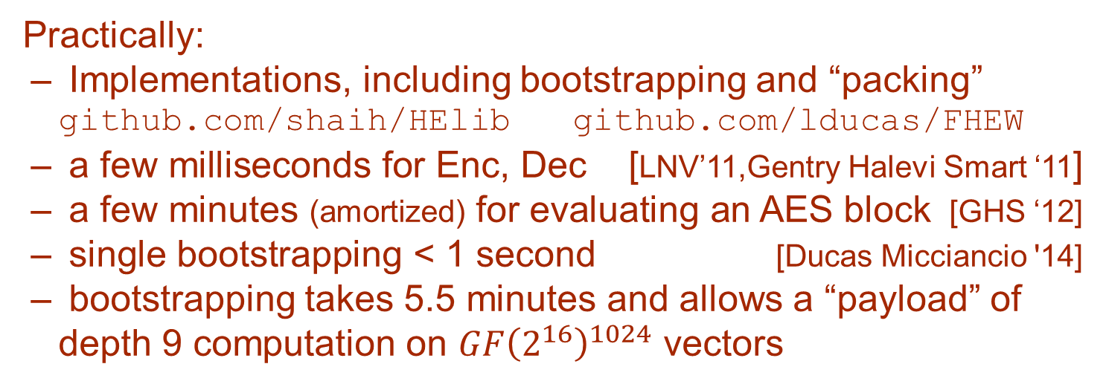
Progress in FHE
“Galactic” → “Efficient”
Asymptotically: nearly linear-time* algorithms
Practically:
  Implementations, including bootstrapping and “packing” github.com/shaih/HElib github.com/lducas/FHEW
  a few milliseconds for Enc, Dec [LNV’11,Gentry Halevi Smart ‘11]
  a few minutes (amortized) for evaluating an AES block [GHS ‘12]
  single bootstrapping < 1 second [Ducas Micciancio '14]
  bootstrapping takes 5.5 minutes and allows a “payload” of depth 9 computation on $GF{\left(2^{16}\right)}^{1024}$ vectors
Strange assumptions → Mild assumptions
Best Known [BGV11]: (leveled) FHE from worst-case hardness of n^{O(log n)}-approx short vectors on lattices
*linear-time in the security parameter

Slide 31

Multi-key FHE
sk₁, pk₁
x₁
c₁ = Enc(pk₁,x₁)
Function
f
sk₂, pk₂
c₂ = Enc(pk₂,x₂)
x₂

Slide 32
Multi-key FHE
sk₁, pk₁
x₁
Function
f
y = Eval(f,c₁,c₂)
Dec
sk₂, pk₂
x₂
Correctness:
Dec(sk₁,sk₂ y)=f(x₁,x₂)

Slide 33
Fully Homomorphic Encryption
Whiteboard discussion:
Properties
Performance
Contrast with obfuscation
Usefulness

Slide 34
Protecting memory using Oblivious RAM

Slide 35
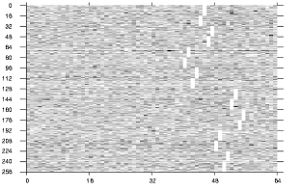
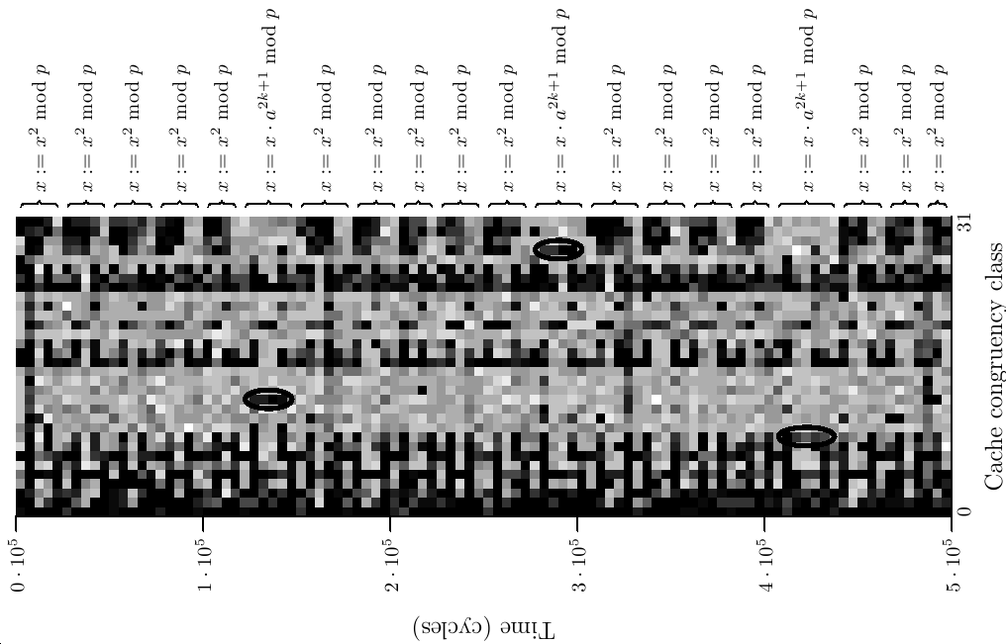
Motivation: memory/storage attacks
Physical attacks
  Memory/storage is on a physical separate device (DRAM chip, SD card, hard disk, …)
  Communication between CPU and device is easy to tap
  Memory/storage device may be under attack or stolen
    Aggravated by data remanence problem
Software side channels
  Leakage of accesses memory addresses across software confinement boundaries (via data cache, instruction cache, page table, …)
Network attacks
  External storage (file server, Network Attached Storage, cloud service, …)
  Remote server/appliance/provider may be compromised

Slide 36
Protecting against memory attack
Computation model:
  Random access memory
  Small processor (logarithmic in memory size)
Leakage/tampering model:
  All memory accesses (both data and address) leak or are corrupted arbitrary (relaxation: by polytime adversary)
  Processor assumed secure
Goal: a compiler that converts any program into one that resists memory attacks
  Functionality: input/output precisely preserved
  Security: privacy against leakage [MR04] with suitable (restricted) circuit classes and admissible functions

Slide 37
Protecting memory content from leakage
Encrypt the whole memory as a single message
Encrypt every block separately
  encrypt block data using AES
  encrypt block number + data using AES
  encrypt block using semantically-secure (probabilistic encryption
Keep the decryption key inside the secure processor
inefficient
Insecure
Insecure
OK

Slide 38
Protecting memory content from corruption
Sign every block, keep the signing key inside the secure processor
Hash every block, keep digests inside the secure processor
Using Merkle trees
  Maintain a Merkle hash tree over the memory
  Merkle nodes stored in the unstrusted memory
  Merkle root stored in secure processor
  At every read, processor verifies Merkle path
  At every write, update Merkle path
Insecure
inefficient
OK

Slide 39
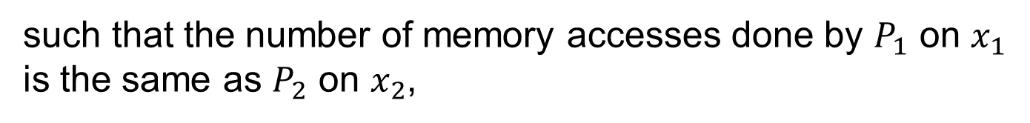
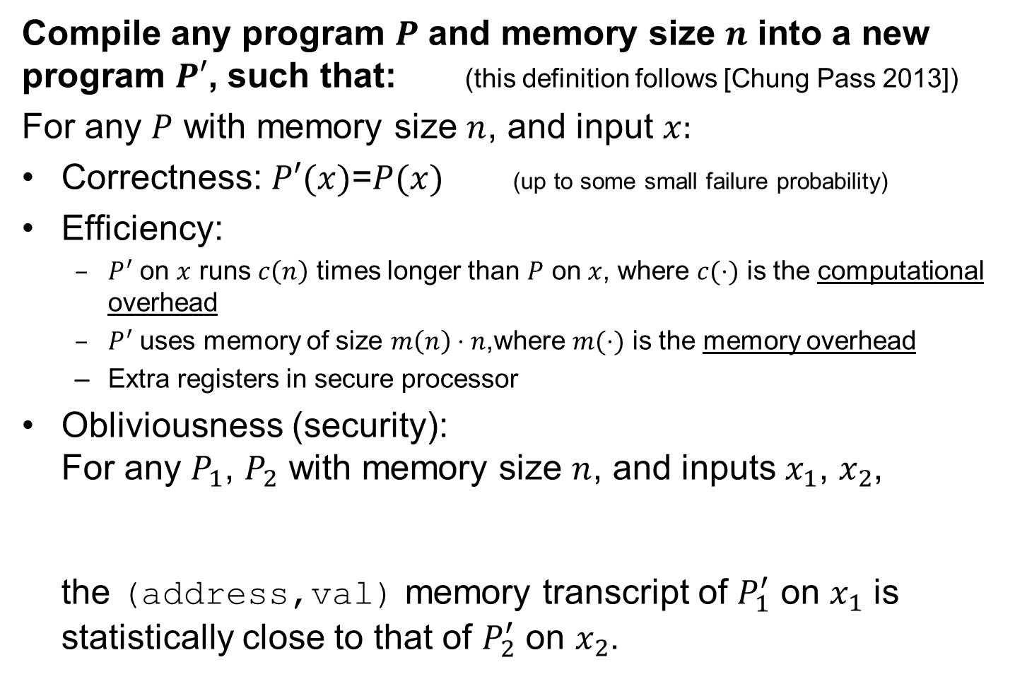
Oblivious RAM [Goldreich Ostrovsky ‘96]…
Protecting against memory access leakage
Compile any program $P$ and memory size $n$ into a new program $P′$, such that: (this definition follows [Chung Pass 2013])
For any $P$ with memory size $n$, and input $x:$
Correctness: $P′(x)$=$P(x)$ (up to some small failure probability)
Efficiency:
  $P^{′}$ on $x$ runs $c\left(n\right)$ times longer than $P$ on $x$, where $c(⋅)$ is the computational overhead
  $P^{′}$ uses memory of size $m\left(n\right)⋅n$,where $m(⋅)$ is the memory overhead
  Extra registers in secure processor
Obliviousness (security):
For any $P_{1}$, $P_{2}$ with memory size $n$, and inputs $x_{1}$, $x_{2}$,
the (address,val) memory transcript of $P_{1}^{′}$ on $x_{1}$ is statistically close to that of $P_{2}^{′}$ on $x_{2}$.
such that the number of memory accesses done by $P_{1}$ on $x_{1}$ is the same as $P_{2}$ on $x_{2}$,

Slide 40
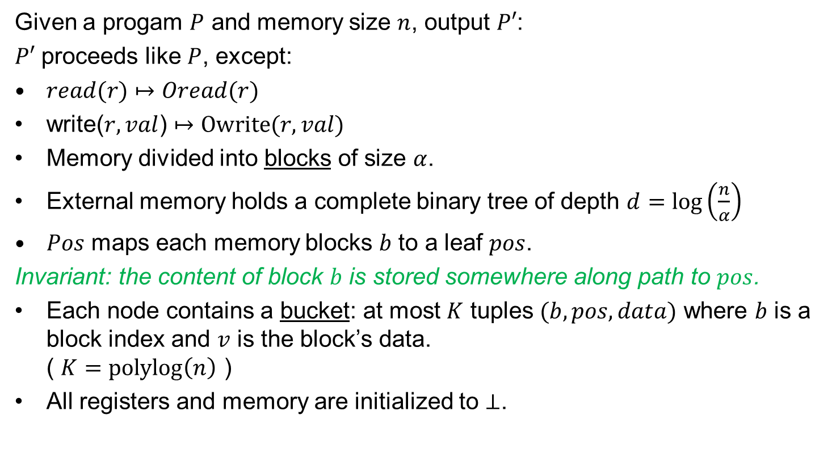
“Simple ORAM” construction [Chung Pass ‘13]
Given a progam $P$ and memory size $n$, output $P′$:
$P′$ proceeds like $P$, except:
$read(r)$ $↦$ $Oread(r)$
write($r,val$) $↦$ $Owrite(r,val)$
Memory divided into blocks of size $α$.
External memory holds a complete binary tree of depth $d=log\left(\frac{n}{α}\right)$
$Pos$ maps each memory blocks $b$ to a leaf $pos$.
Invariant: the content of block $b$ is stored somewhere along path to $pos$.
Each node contains a bucket: at most $K$ tuples $(b,pos,data)$ where $b$ is a block index and $v$ is the block’s data.
( $K=\text{polylog}\left(n\right)$ )
All registers and memory are initialized to $⊥$.
Notes:
, labeled by path from root (e.g., 011 = left,right,right).

Slide 41
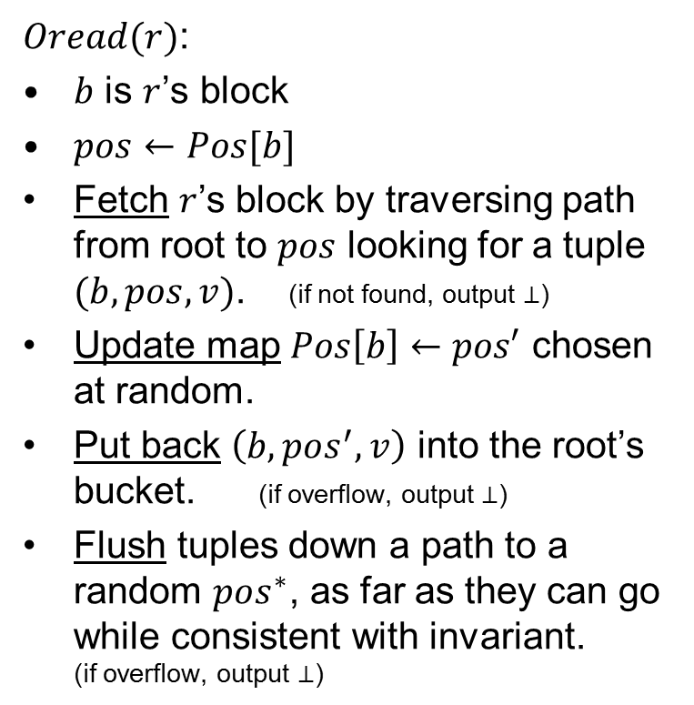

Simple ORAM” construction: reading
$Oread(r)$:
$b$ is $r$’s block
$pos←Pos[b]$
Fetch $r$’s block by traversing path from root to $pos$ looking for a tuple $(b,pos,v)$. (if not found, output $⊥$)
Update map $Pos\left[b\right]←pos′$ chosen at random.
Put back $\left(b,pos^{′},v\right)$ into the root’s bucket. (if overflow, output $⊥$)
Flush tuples down a path to a random $pos^{∗}$, as far as they can go while consistent with invariant.
(if overflow, output $⊥$)
Obliviousness: each $Oread$ operation traverses the tree along two paths that are chosen at random and independently of the history so far (doing a single read and single write at every node).

Slide 42
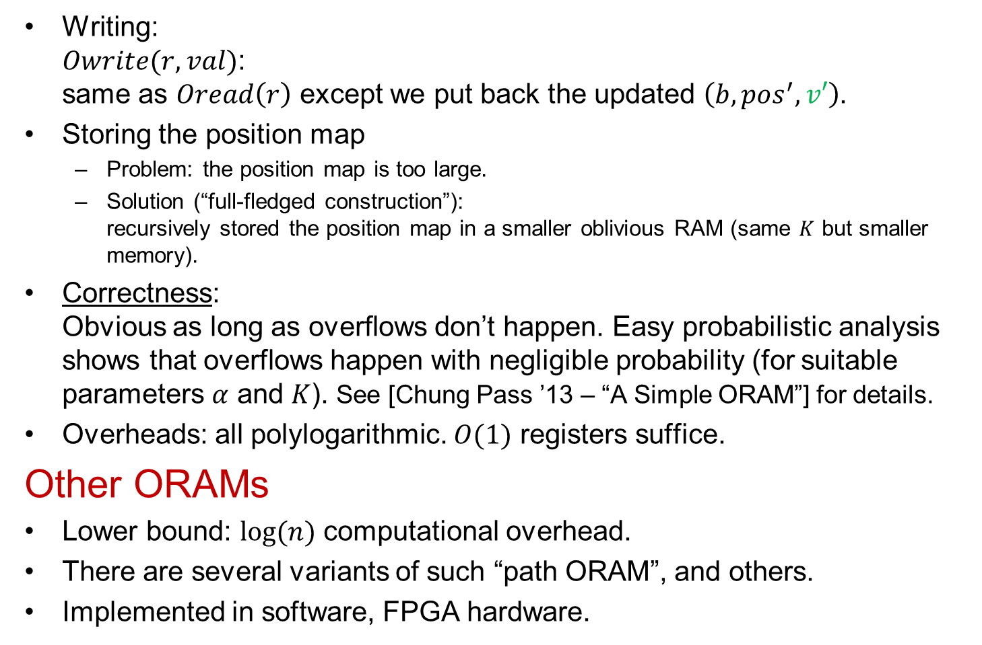
Simple “ORAM” construction: further details
Writing:
$Owrite(r,val)$:
same as $Oread\left(r\right)$ except we put back the updated $\left(b,pos^{′},v′\right)$.
Storing the position map
  Problem: the position map is too large.
  Solution (“full-fledged construction”):
  recursively stored the position map in a smaller oblivious RAM (same $K$ but smaller memory).
Correctness:
Obvious as long as overflows don’t happen. Easy probabilistic analysis shows that overflows happen with negligible probability (for suitable parameters $α$ and $K$). See [Chung Pass ’13 – “A Simple ORAM”] for details.
Overheads: all polylogarithmic. $O(1)$ registers suffice.
Other ORAMs
Lower bound: $log⁡(n)$ computational overhead.
There are several variants of such “path ORAM”, and others.
Implemented in software, FPGA hardware.

