Slide 1

Information Security – Theory vs. Reality
0368-4474, Winter 2015-2016
Lecture 2:
Architectural side-channels (2/2)
Lecturer:
Eran Tromer

Slide 2
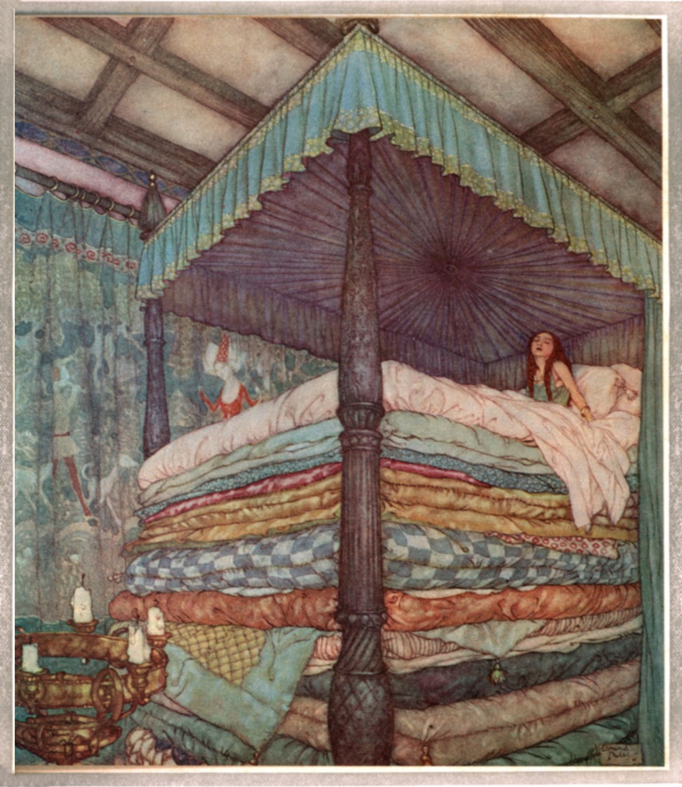

Course agenda

Slide 3
Architectural side-channel attacks (cont.)

Slide 4
L3 Flush+Reload attack [Yarom Falkner 2014]
Target outermost cache, shared between all CPU cores (typically L3)
RSA key extraction from GnuPG 1.4.13
Target specific memory block (instead of cache set)
Exploits memory deduplication (content-based page sharing)
  Common code, libraries, data across VMs
  Supposedly safe (nominally, no new information flow)

Slide 5
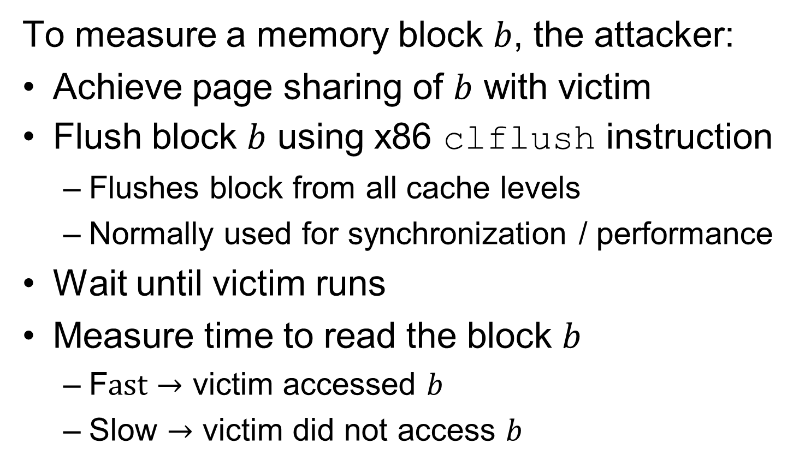
L3 flush+reload attack (cont.)

Slide 6
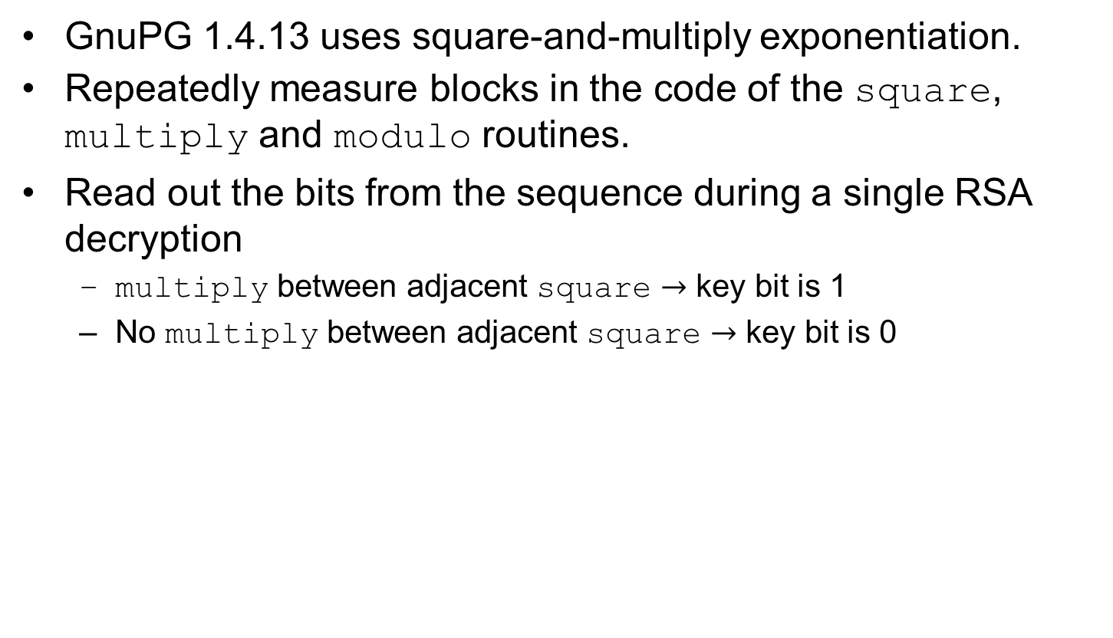
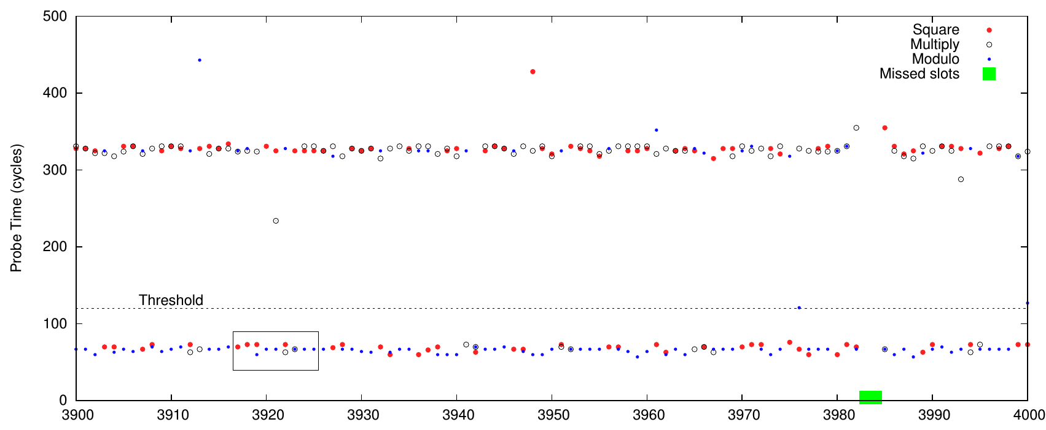
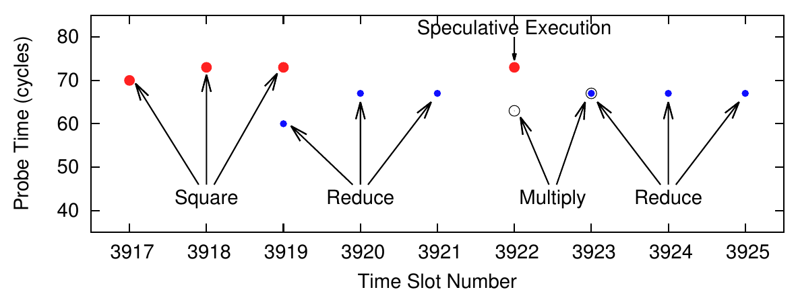
L3 flush+reload attack on GnuPG’s RSA
[Yarom Falkner 2014]

Slide 7
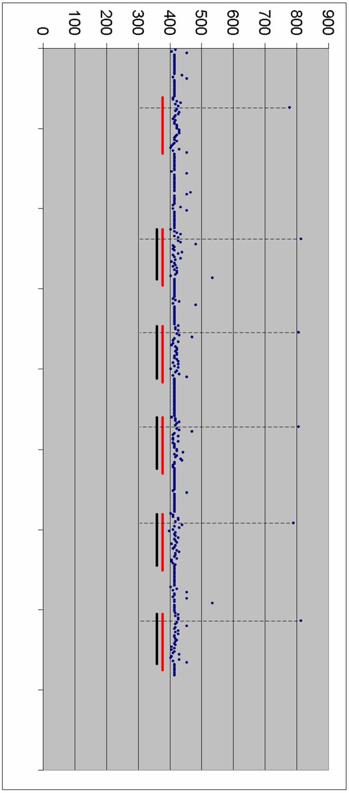
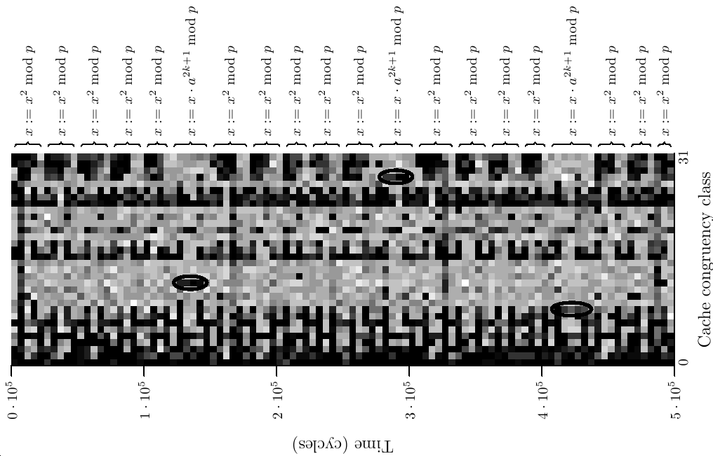
Other attacks on RSA
Attacker’s MUL time
Cache attack using HyperThreading [Percival 05]
ALU multiplier attack
[Aciicmez Seifert 2007]
cache set
time
time
MUL
SQR
SQR
SQR
SQR
Victim’s
operation
On whiteboard:
m-ary exponentiation

Slide 8
Other architectural attacks
(Whiteboard discussion)
Covert channels [Hu ’91, ‘92]
Hardware-assisted
– Power trace [Page ’02]
Timing attacks via internal collisions
[Tsunoo Tsujihara Minematsu Miyuachi ’02]
[Tsunoo Saito Suzaki Shigeri Miyauchi ’03]
Model-less timing attacks [Bernstein ’04]
RSA [Percival ’05]
Exploiting the scheduler [Neve Seifrert ’07]
  Improve temporal resolution by causing victim to get tiny time slice
Instruction cache Aciicmez ’07]
  Exploits difference between code paths
  Attacks are analogous to data cache attack
Branch prediction [Aciicmez Schindler Koc ’06–’07]
  Exploits difference in choice of code path
  BP state is a shared resource
ALU resources [Aciicmez Seifert ’07]
  Exploits contention for the multiplication units
Many followups

Slide 9
Mitigation
(classroom discussion)

