Slide 1
Information Security – Theory vs. Reality 0368-4474, Winter 2015-2016 Lecture 6: Physical Side Channel Attacks on PCs
Guest lecturer: Lev Pachmanov

Slide 2
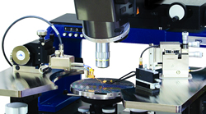
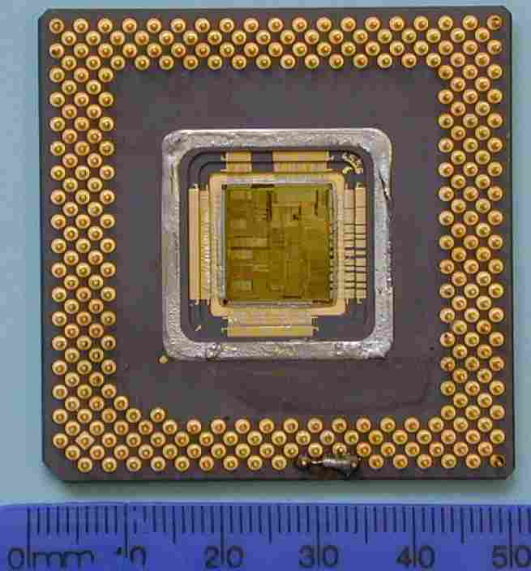
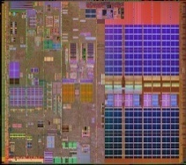
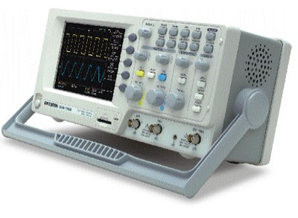
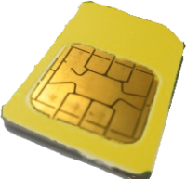
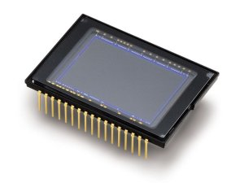
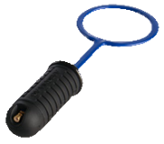
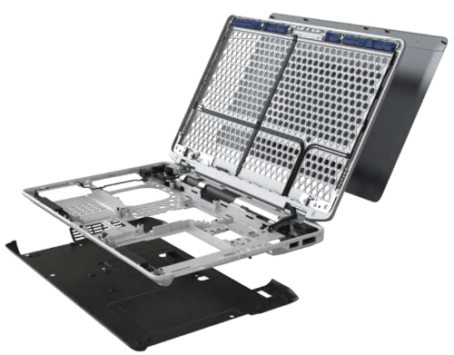
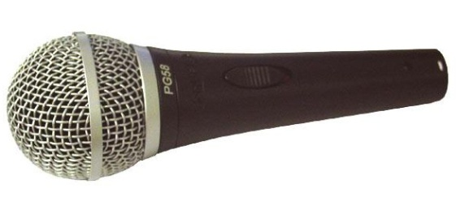
Side channel attacks
probing
CPU architecture
optical
power
electromagnetic
acoustic
chassis potential

Slide 3
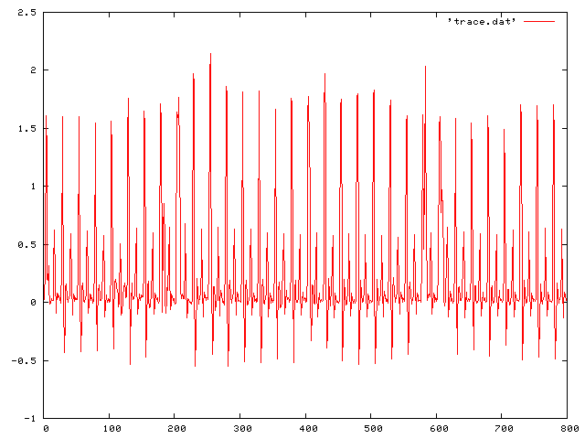
Traditional side channel attacks methodology
for i=1…2048
sqr(…)
if key[i]=1
mul(…)
Grab/borrow/steal device
Find key-dependent instruction
Record emanations using high-bandwidth equipment (> clock rate , PC: >2GHz)
Obtain traces
Signal and cryptanalytic analysis
Recover key
Hard for PCs

Slide 4
Traditional side channel attacks methodology
Grab/borrow/steal device
Find key-dependent instruction
Record emanations using high-bandwidth equipment (> clock rate , PC: >2GHz)
Obtain traces
Signal and cryptanalytic analysis
Recover key
Hard for PCs

Slide 5
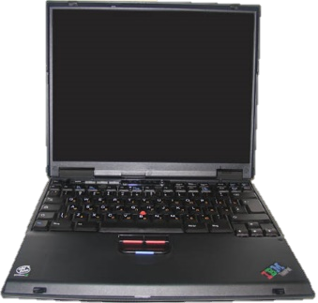
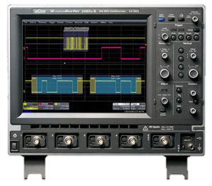
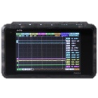
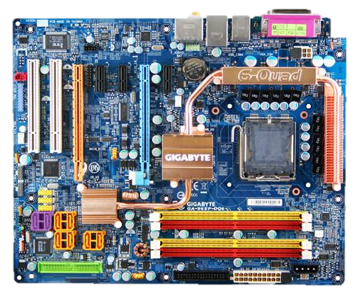
Traditional side channel attacks methodology
Not handed out
vs.
Grab/borrow/steal device
Find key-dependent instruction
Record emanations using high-bandwidth equipment (> clock rate , PC: >2GHz)
Obtain traces
Signal and cryptanalytic analysis
Recover key
Measuring a 2GHz PC requires expansive and bulky equipment (compared to a 100
MHz smart card)
vs.
Complex electronics running complicated software (in parallel)
Hard for PCs
vs.
1,000$
100,000$

Slide 6
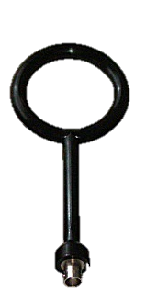
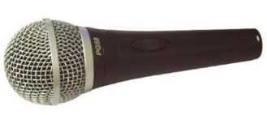
Our results
Channels for attacking PCs
Ground potential (chassis and others)
Power
Electromagnetic
Acoustic
Exploited via low-bandwidth cryptanalytic attacks
Adaptive attack (50 kHz bandwidth) [Genkin Shamir Tromer ‘14]
Non-adaptive attacks (1.5 MHz bandwidth) [Genkin Pipman Tromer ‘14] [Genkin Pachmanov Pipman Tromer ‘15]
Common cryptographic software
GnuPG 1.4.13-1.4.16 (CVE 2013-4576, 2014-3591, 2014-5270)
RSA and ElGamal, various implementations
Worked with GnuPG developers to mitigate the attacks
Applicable to various laptop models

Slide 7
Chassis-potential channel

Slide 8
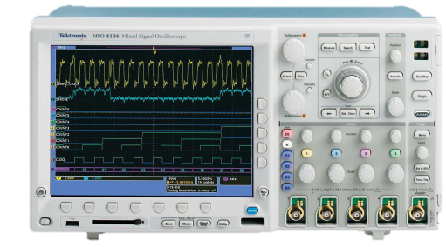
Ground-potential analysis
Attenuating EMI emanations “Unwanted currents or electromagnetic fields? Dump them to the circuit ground!” (Bypass capacitors, RF shields, …)
Device is grounded, but its “ground” potential fluctuates relative to the mains earth ground.
Computation
affects currents and EM fields
dumped to device ground
connected to conductive chassis
Key = 101011…

Slide 9
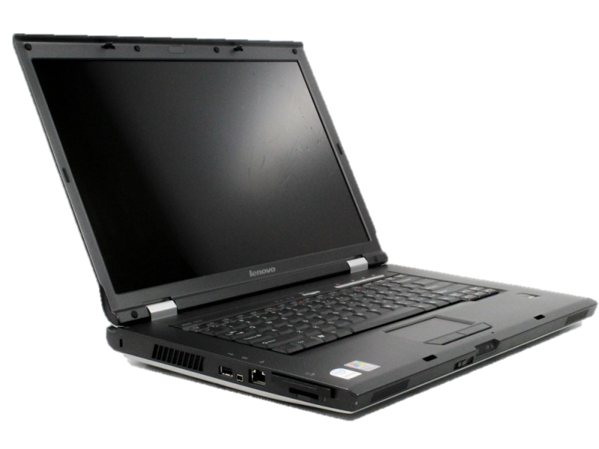
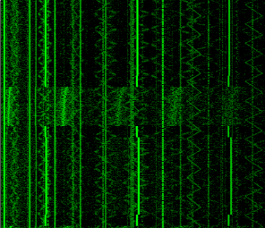
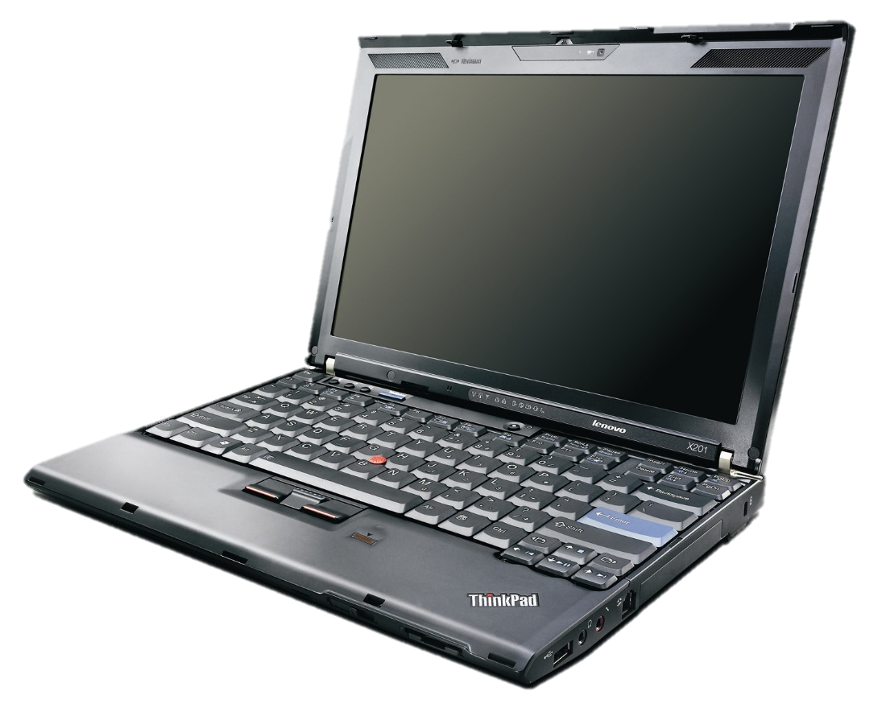
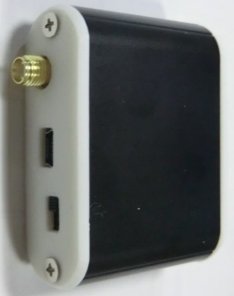
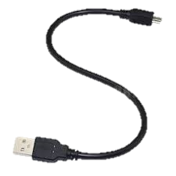
Connecting to the chassis

Slide 10
Demo: distinguishing instructions
Key = 101011…

Slide 11
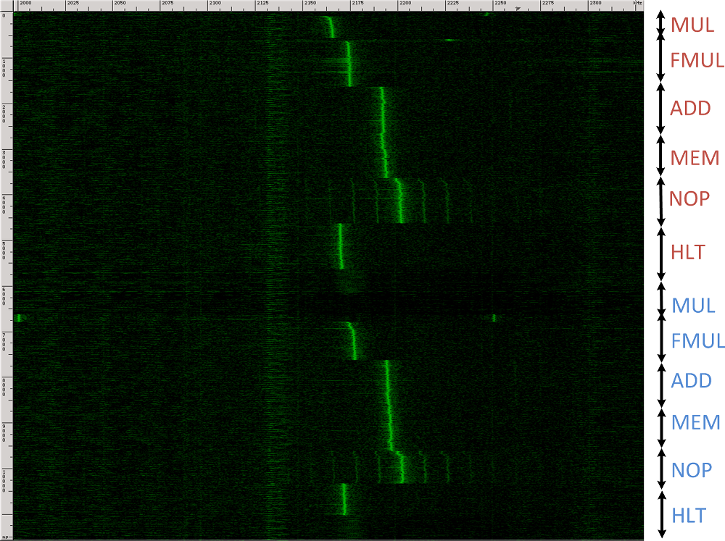
Distinguishing various CPU operations
frequency (2-2.3 MHz)
time (10 sec)

Slide 12
Low-bandwidth leakage of RSA

Slide 13
Definitions (RSA)
Key setup
sk: random primes $p,q$, private exponent $d$
pk: $n=pq$, public exponent $e$
Decryption
$$m=c^{d} mod n$$
A quicker way used by most implementations
$$m_{p}=c^{d_{p}} mod p$$
$$m_{q}=c^{d_{q}} mod q$$
Obtain $m$ using Chinese Remainder Theorem
Encryption
$$c=m^{e} mod n$$

Slide 14
GnuPG RSA key distinguishability
frequency (1.9-2.4 MHz)
time (0.8 sec)
mod $p$
mod $q$
Can distinguish between:
Decryptions and other operations
Two exponentiations (mod $p$, mod $q$)
Different keys
Different primes

Slide 15
Key extraction

Slide 16
GnuPG modular exponentiation
modular_exponentiation(c,d,p){
m=1
for i=n to 1 do
m = m² mod p
t = m*c mod p //always mult
if d[i]==1 then
m=t
return m
}
$$m=c^{d_{n}⋯d_{i+1}} mod p$$
$$m=c^{d_{n}⋯d_{i+1}0} mod p$$
$$t=c^{d_{n}⋯d_{i+1}1} mod p$$
$$m=c^{d_{n}⋯d_{i}} mod p$$
Q: Why always compute $t←m⋅c$ then conditionally copy?
A: This is a side channel countermeasure meant to protect $d$
no key dependent operation to measure

Slide 17
GnuPG modular exponentiation
modular_exponentiation(c,d,p){
m=1
for i=n to 1 do
m = m² mod p
t = m*c mod p //always mult
if d[i]==1 then
m=t
return m
}
$m$ depends on both $d[i]$and$c$
$m$ is squard in next iteration of the main loop
2GHz CPU speed vs. 1.5MHz measurements
can only see drastic changes inside squaring operation
craft $c$ to affect the squaring in the next loop iteration, based on $d[i]$
measure changes inside squaring operation and obtain $d[i]$
Idea: leakage self-amplification
abuse algorithm’s own code to amplify its own leakage!
Craft suitable cipher-text to affect the inner-most loop
Small differences in repeated inner-most loops cause a big overall difference in code behavior
Notes:
לחבר את זה לCPA – גם פה מנצלים בעיה במימוש

Slide 18
Non-adaptive key extraction (similar to [Yen, Lien, Moon and Ha 05])
modular_exponentiation(c,d,p){
m=1
for i=n to 1 do
m = m² mod p
t = m*c mod p //always mult
if d[i]==1 then
m=t
return m
}
$$c≡−1 (mod p)$$
$$m≡1 (mod p)$$
$$m≡±1$$
$$±1$$
karatsuba_sqr( m ){
…
basic_sqr( x )
…
}
$$t≡−1 (mod p)$$
Many zeros or
random looking,
based on $d[i]$
0/$
If $d\left[i\right]==1$ then $m≡−1 (mod p)$
so bits of $m$ are “random”.
If $d\left[i\right]==0$ then $m≡1 (mod p)$ so bits of $m$ have many zeros.
$$m≡−1$$
basic_sqr( x ){
…
}
$$m≡1$$
if( x[j]==0)
y = 0 else y = x[j]*x
repeated 189 times per bit of $d$
~0.2ms of measurement per bit of $d$
x27
x7

Slide 19
A chosen ciphertext attack
Non-adaptive ciphertext choice $c≡−1 mod p$ (similar to [YLMH05]):
RSA: $c=N−1$
ElGamal: $c=p−1$
Overall attack performance:
Algorithm | Attack type | # ciphertexts | Time | BW | Cipher | Ref
Sqr-and- always-mlt | Non-adaptive chosen ciphertext | 1 | 3 sec | 2 MHz | ElGamal, RSA | [GPT14]

Slide 20
A chosen ciphertext attack
Non-adaptive ciphertext choice $c≡−1 mod p$ (similar to [YLMH05]):
RSA: $c=N−1$
ElGamal: $c=p−1$
Overall attack performance:
Algorithm | Attack type | # ciphertexts | Time | BW | Cipher | Ref
Sqr-and- always-mlt | Non-adaptive chosen ciphertext | 1 | 3 sec | 2 MHz | ElGamal, RSA | [GPT14]
Sliding / fixed window | Non-adaptive chosen ciphertext | $2^{w−1}$ (usually 8 or 16) | 30 sec | 2 MHz | ElGamal, RSA | [GPPT15]

Slide 21
A chosen ciphertext attack
Non-adaptive ciphertext choice $c≡−1 mod p$ (similar to [YLMH05]):
RSA: $c=N−1$
ElGamal: $c=p−1$
Overall attack performance:
Algorithm | Attack type | # ciphertexts | Time | BW | Cipher | Ref
Sqr-and- always-mlt | Non-adaptive chosen ciphertext | 1 | 3 sec | 2 MHz | ElGamal, RSA | [GPT14]
Sliding / fixed window | Non-adaptive chosen ciphertext | $2^{w−1}$ (usually 8 or 16) | 30 sec | 2 MHz | ElGamal, RSA | [GPPT15]
Sqr-and- always-mlt | Adaptive chosen ciphertext | $$\frac{Key size}{4}$$ | 1 hour | 50 kHz | RSA | [GST14]

Slide 22
A chosen ciphertext attack
Non-adaptive ciphertext choice $c≡−1 mod p$ (similar to [YLMH05]):
RSA: $c=N−1$
ElGamal: $c=p−1$
Overall attack performance:
Algorithm | Attack type | # ciphertexts | Time | BW | Cipher | Ref
Sqr-and- always-mlt | Non-adaptive chosen ciphertext | 1 | 3 sec | 2 MHz | ElGamal, RSA | [GPT14]
Sliding / fixed window | Non-adaptive chosen ciphertext | $2^{w−1}$ (usually 8 or 16) | 30 sec | 2 MHz | ElGamal, RSA | [GPPT15]
Sqr-and- always-mlt | Adaptive chosen ciphertext | $$\frac{Key size}{4}$$ | 1 hour | 50 kHz | RSA | [GST14]
Ciphertext injection
Send chosen ciphertexts via email (PGP/MIME). Decrypted by email client (e.g., Enigmail) automatically.

Slide 23
Empirical results: ground-potential attacks

Slide 24
Demo: RSA key extraction from chassis potential

Slide 25
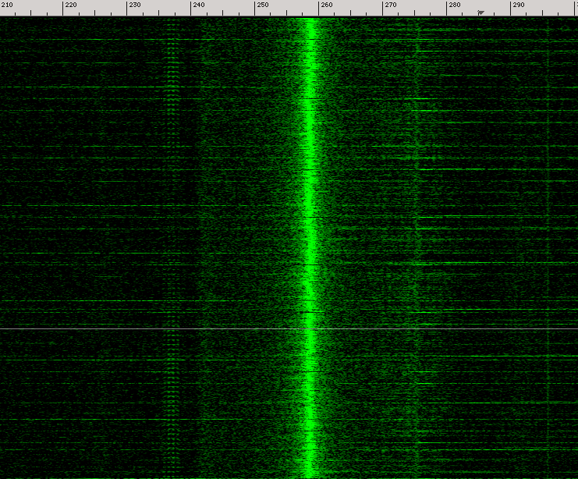
Reading the secret key (non-adaptive attack)
carrier
FM-modulated key
Key = 101011…
due to squaring of a random-looking /
mostly zero limb value of $m$

Slide 26
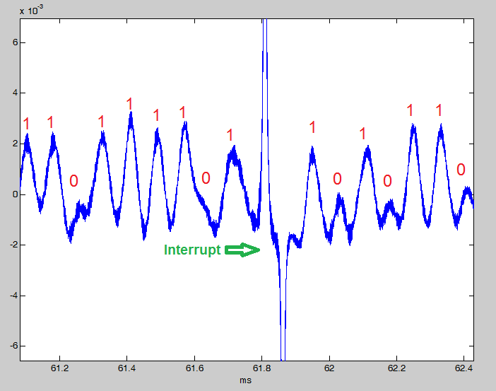
Reading the secret key (non-adaptive attack)
Acquire trace
Filter around carrier (1.7 MHz)
FM demodulation
Read out bits (“simple ground analysis”)
interrupt

Slide 27
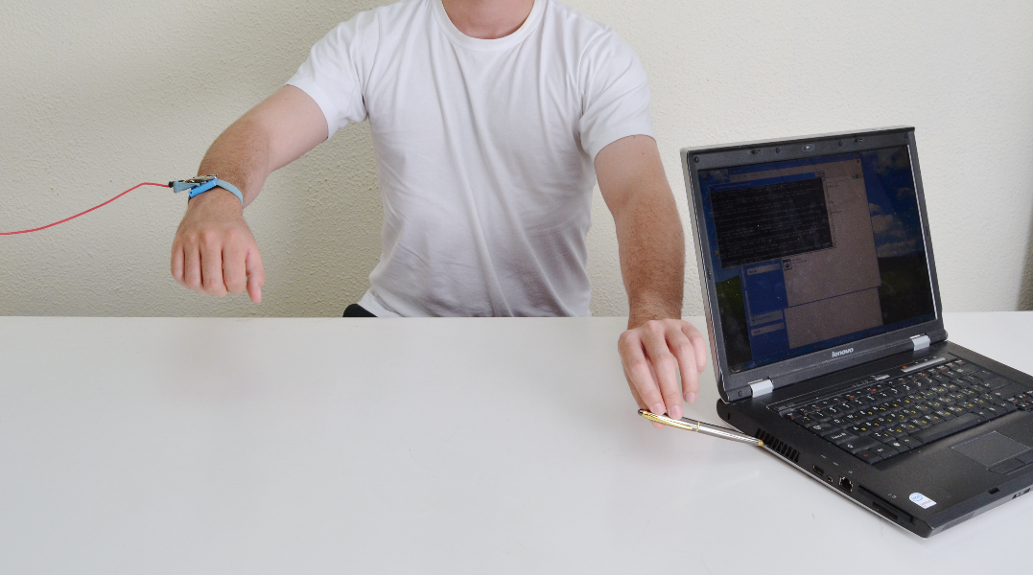
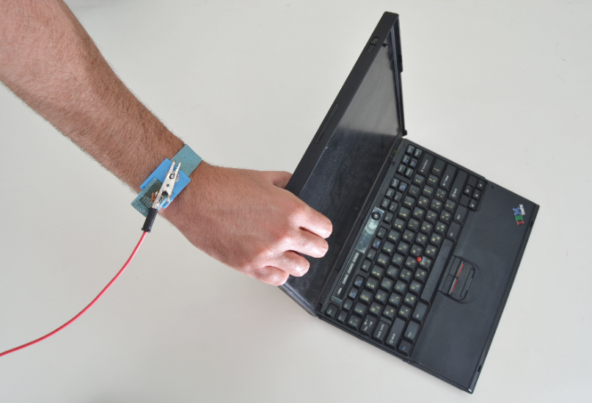
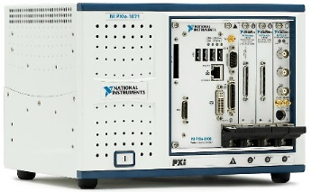
RSA and ElGamal key extraction in a few seconds using human touch (non-adaptive attack)
Key = 101011…

Slide 28
Ground-potential analysis
Attenuating EMI emanations “Unwanted currents or electromagnetic fields? Dump them to the circuit ground!” (Bypass capacitors, RF shields, …)
Device is grounded, but its “ground” potential fluctuates relative to the mains earth ground.
Computation
affects currents and EM fields
dumped to device ground
connected to conductive chassis

Slide 29
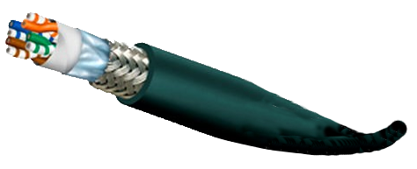
Ground-potential analysis
Attenuating EMI emanations “Unwanted currents or electromagnetic fields? Dump them to the circuit ground!” (Bypass capacitors, RF shields, …)
Device is grounded, but its “ground” potential fluctuates relative to the mains earth ground.
Computation
affects currents and EM fields
dumped to device ground
connected to conductive chassis
connected to shielded cables
Even when no data, or port is turned off.
Key = 101011…

Slide 30
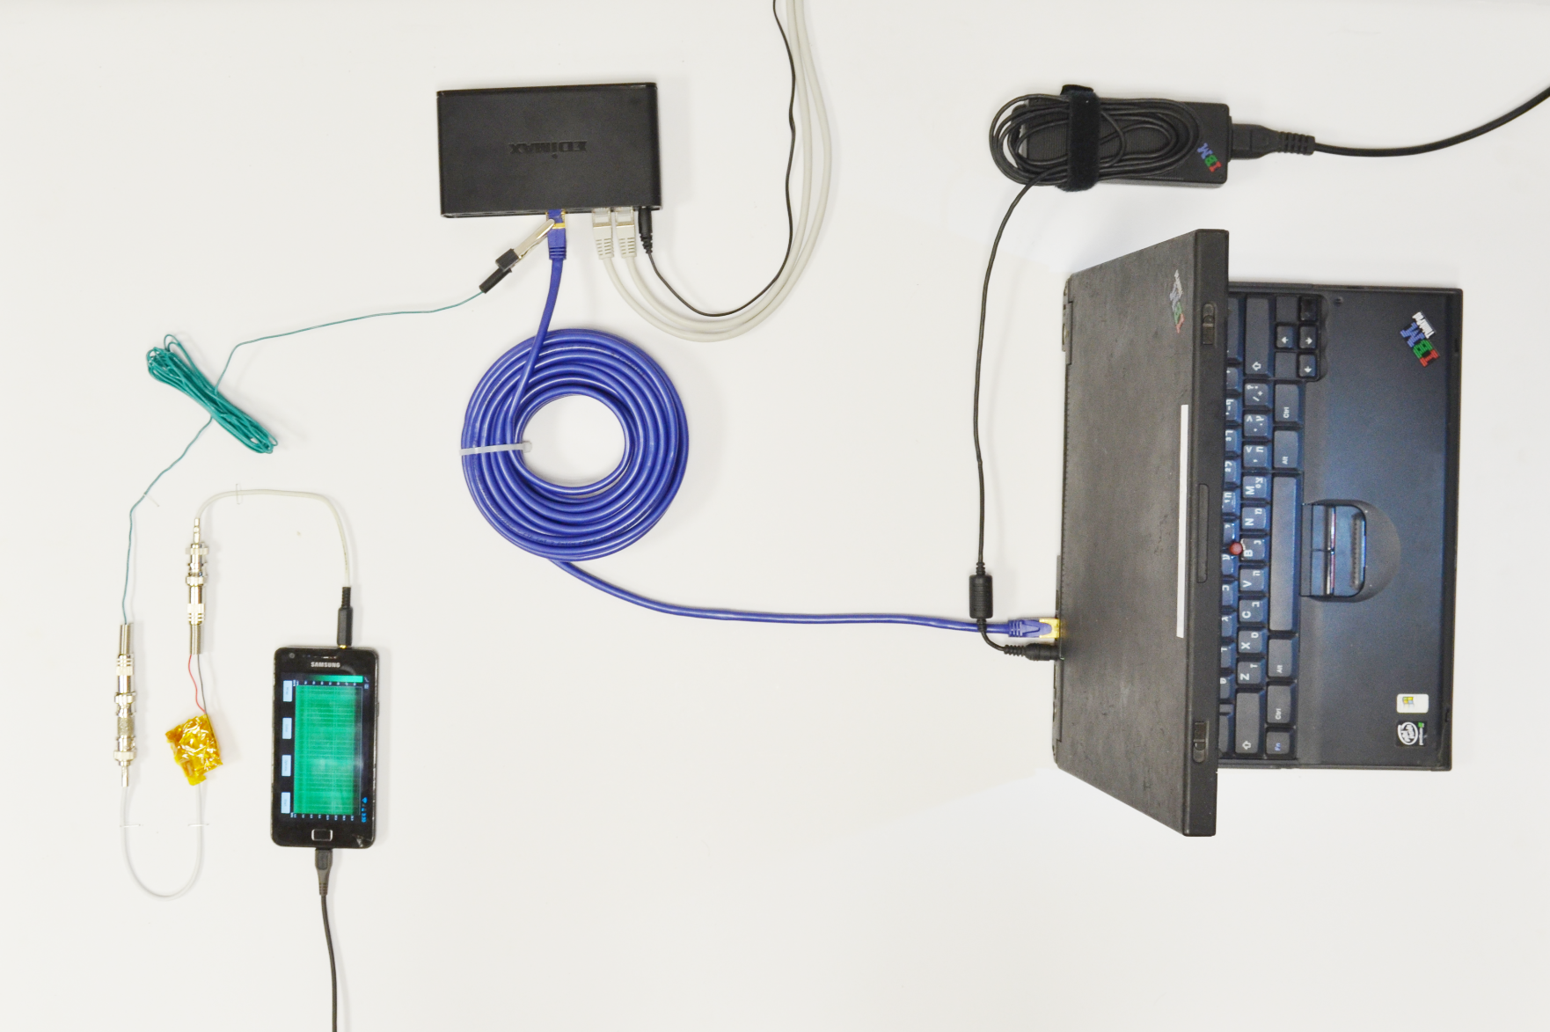
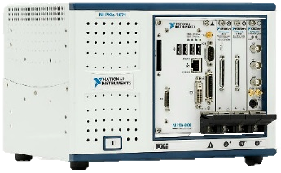
RSA and ElGamal key extraction in a few seconds using the far end of 10 meter network cable
works even if a firewall is present, or port is turned off
key= 101011…

Slide 31
Empirical results: electromagnetic attacks

Slide 32
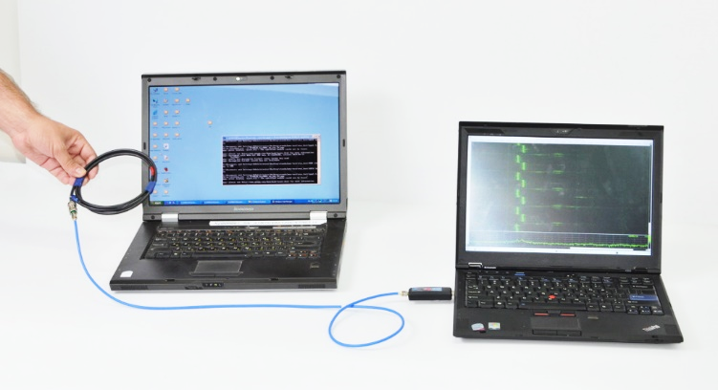
Electromagnetic key extraction
Currents inside the target create electromagnetic waves.
Can be detected using an electromagnetic probe (e.g., a loop of cable).
target
attacker

Slide 33
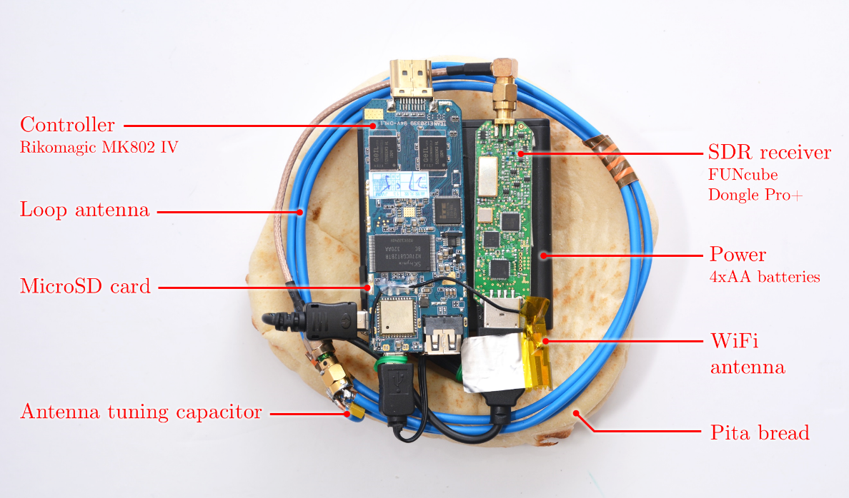
Portable Instrument for Trace Acquisition
Cost to build: ~300$

Slide 34
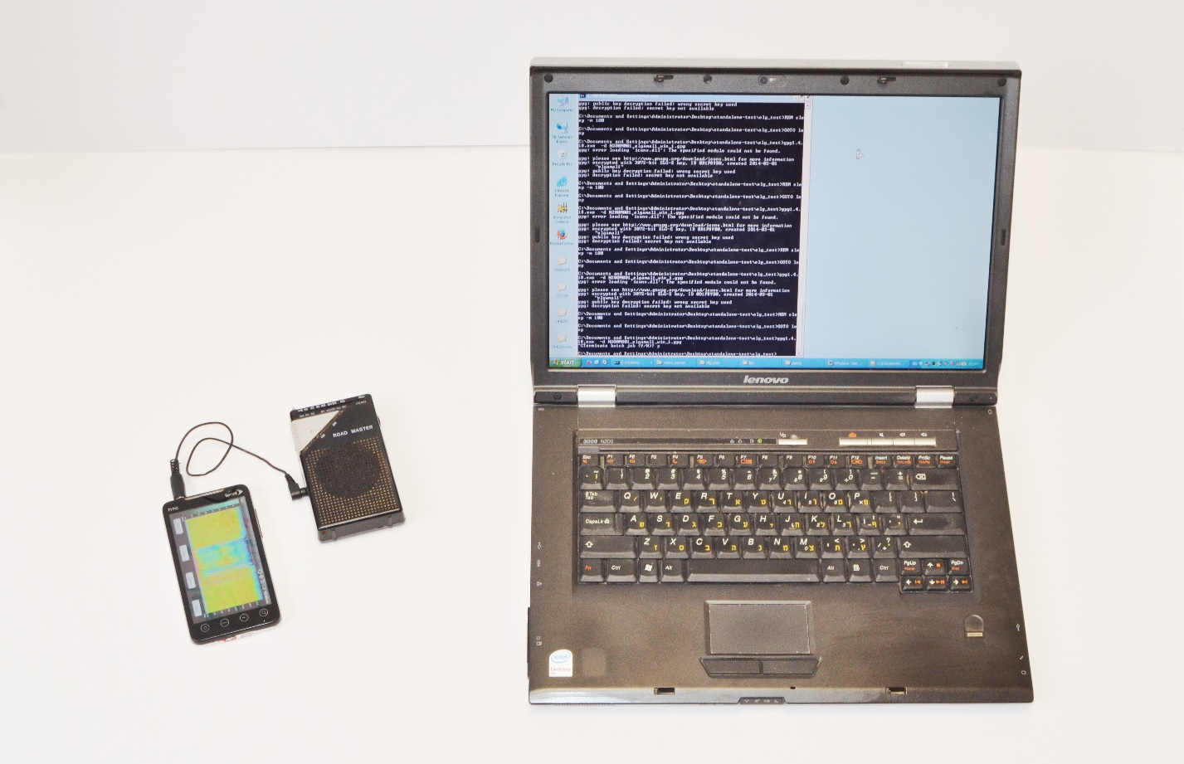
Key extraction via commodity radio receiver

Slide 35
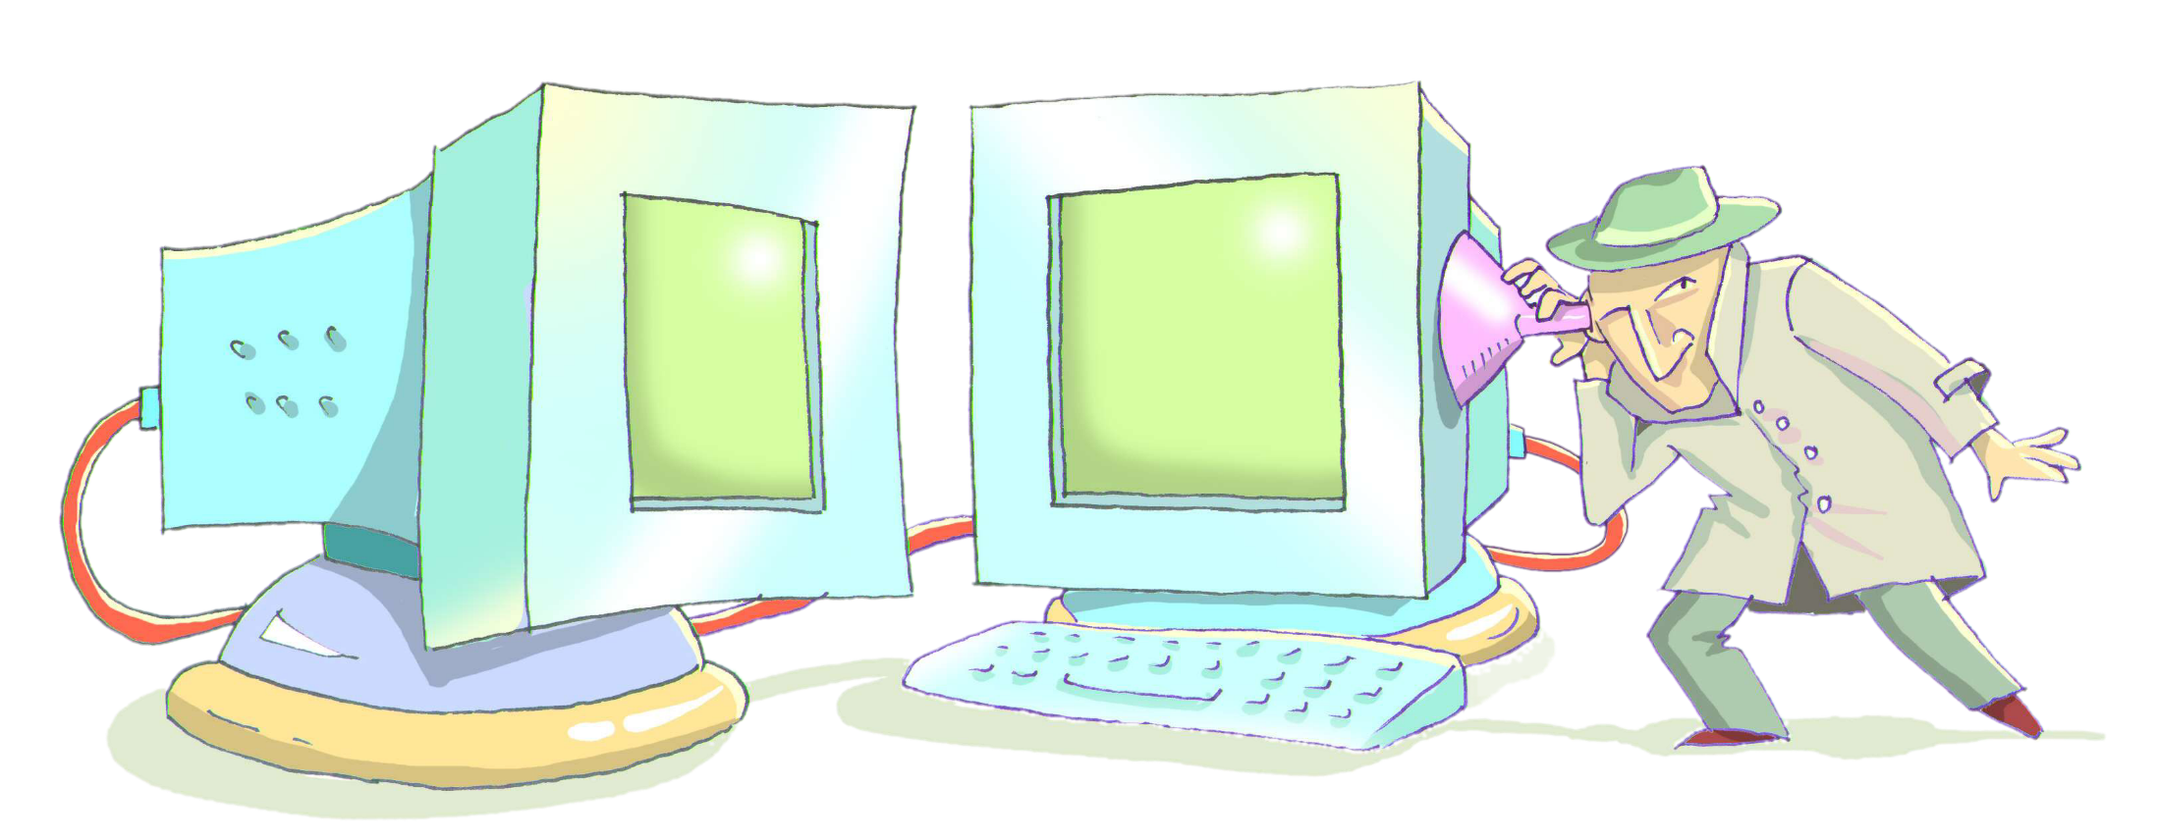
Acoustic cryptanalysis

Slide 36
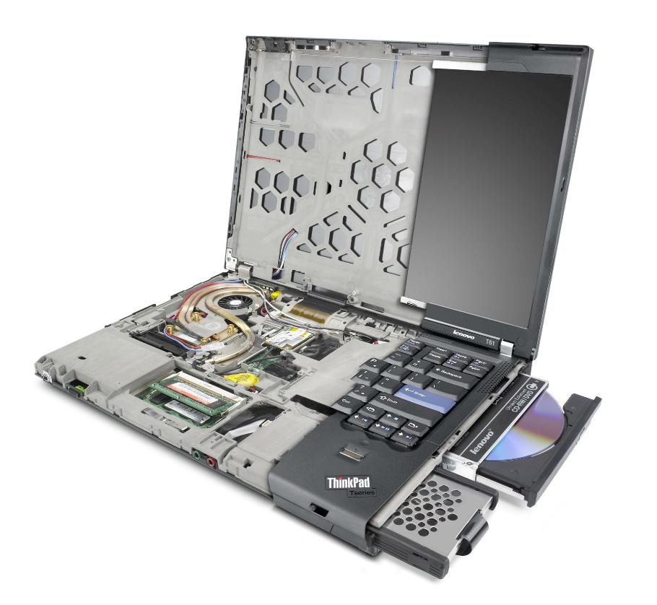
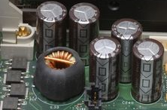
Acoustic emanations from PCs
Noisy electrical components in the voltage regulator
Commonly known as “coil-whine’’ but also originates from capacitors
Bzzzzzz

Slide 37
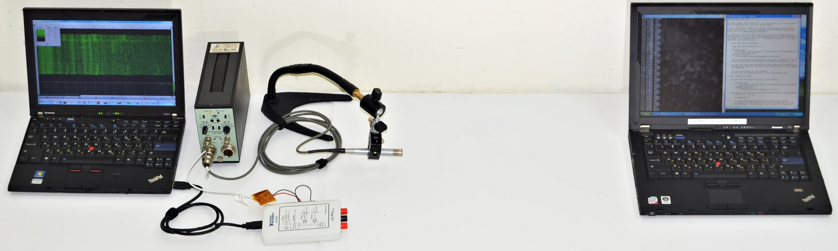
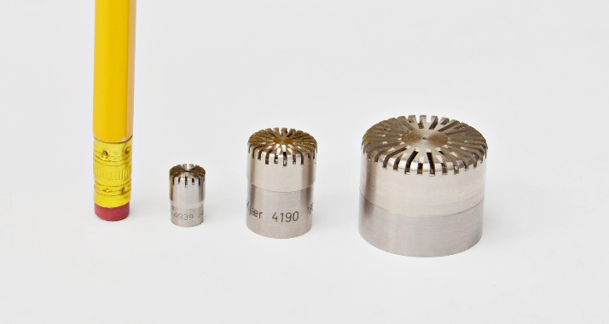
Experimental setup (example)
attacker
target
amplifier
microphone
digitizer

Slide 38
Adaptive key extraction
Severe attenuation of high frequency signals.
Effective bandwidth of 50 kHZ
Cannot observe a single squaring
Make the entire decryption depend on a single attacked bit
Extreme version of self-amplification
Extract the prime $q$ bit-by-bit (adaptive chosen ciphertext)
Total #measurements: 2048 decryptions for RSA-4096 (~1 hour)

Slide 39
An adaptive chosen-ciphertext attack
1111...1
Bit-distinguisher oracle
$$q=11??????…$$
$$c= ... . .. 111…1$$
$$q=11011010…$$
$c=11011111$…
$$q=110?????…$$
$$q=1???????…$$
$c=10111111$…
1
$$\left.\begin{matrix}0 & if c>q \\ 1 & if c≤q\end{matrix}\right\}$$
0
1000…0

Slide 40
An adaptive chosen-ciphertext attack
Bit distinguisher oracle
Total #measurements:
$$\frac{Key size}{2⋅2}⋅2$$
Overall: 2048 decryptions for RSA-4096 (~1 hour)
$$c= ... . .. 111…1$$
Error
correction
Just q
Coppersmith lattice reduction: half the bits suffice
$$\left.\begin{matrix}0 & if c>q \\ 1 & if c≤q\end{matrix}\right\}$$

Slide 41
GnuPG RSA decryption - $m_{q}=c^{d_{q}} mod q$
modular_exponentiation(c,d,q){
…
karatsuba_mult(m,c)
…
}
Grand total:
272384 times
~0.5 sec of measurements
karatsuba_mult(m,c){
…
basic_mult(x,y)
…
}
basic_mult(x,y){
…
}
x2048
x19
if (y[j]==0)
return 0 else return y[j]*x
x7
craft c such that
$$q_{i}=1→y[j]=0$$
$$q_{i}=0→y\left[j\right]≠0$$
(for most $j$’s)

Slide 42
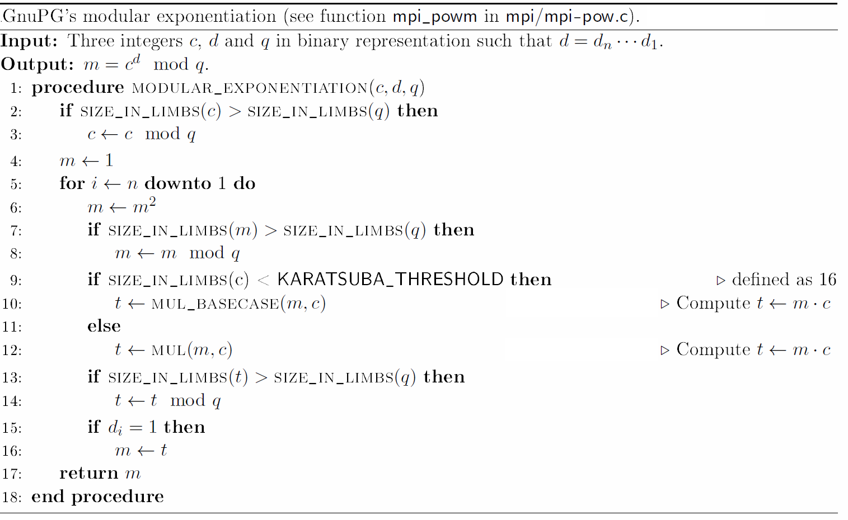
Extracting $q_{i}$ (simplified)
$$c^{i}= q_{2048}⋯q_{i+1}01⋯1$$
If $q_{i}=1$ then $c^{i}<q$,
thus $c=c^{i}$.
That is, $c$ has special structure.
If $q_{i}=0$ then $2q>c^{i}>q$, thus $c=c^{i}−q$.
That is, $c$ is random looking.
and we now multiply by $c$ causing the bit-dependent leakage.

Slide 43
Extracting $q_{i}$
$$c^{i}= q_{2048}⋯q_{i+1}01⋯1+n$$
If $q_{i}=1$ then $c^{i}−n<q$, thus $c=c^{i}−n$.
That is, $c$ has special structure.
If $q_{i}=0$ then
$2q>c^{i}−n>q$, thus $c=c^{i}−q−n$.
That is, $c$ is random looking.
and we now multiply by $c$ causing the bit-dependent leakage.

Slide 44
Extracting $q_{i}$ (problem)
Multiplication is repeated 2048 times (0.5 sec of data)
Single multiplication is way too fast for us to measure

Slide 45
Empirical results: acoustic attacks

Slide 46
Distinguishing a key bit by a spectral signature
frequency
frequency
time
time
mod p
mod p
mod q
mod q

Slide 47
Demo: key extraction

Slide 48
Acoustic: results
RSA 4096-bit key extraction from 1 meter away using a microphone

Slide 49
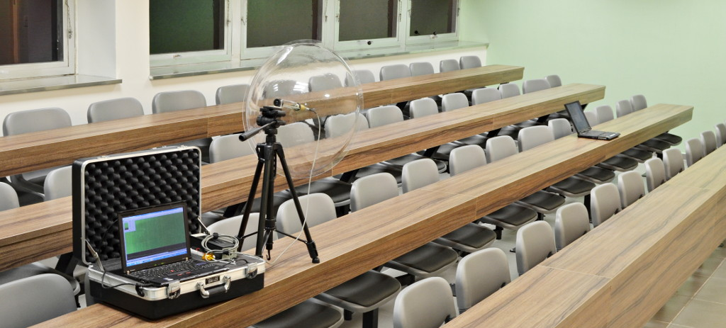
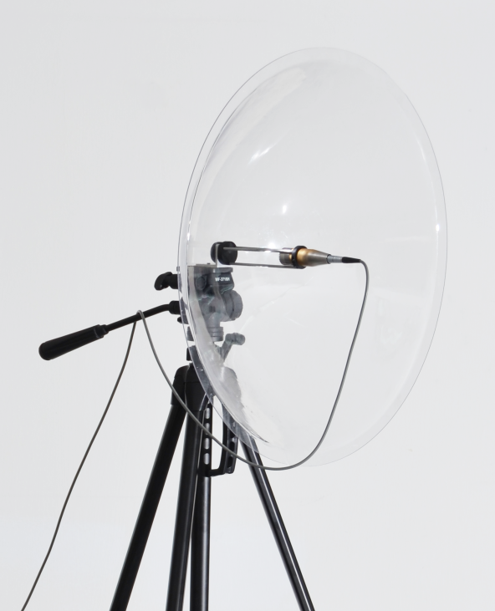
Acoustic: results
RSA 4096-bit key extraction from
10 meters away using a parabolic microphone

Slide 50
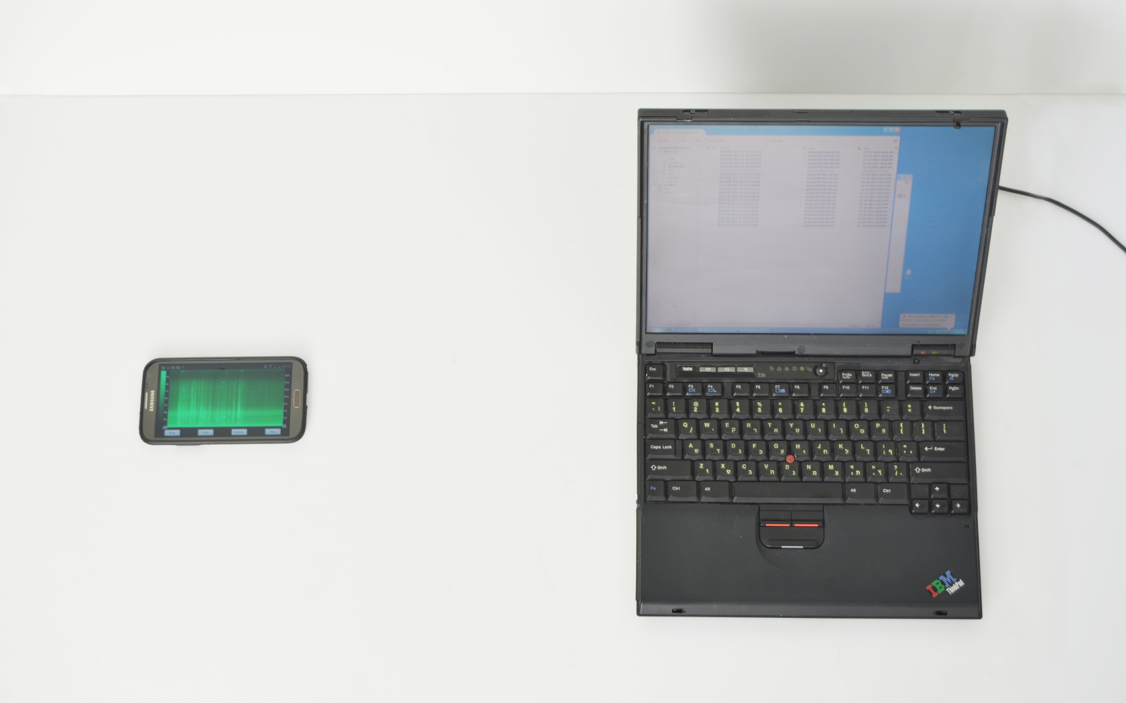
Acoustic: results
RSA 4096-bit key extraction from 30cm away using a smartphone

Slide 51
Countermeasures

Slide 52
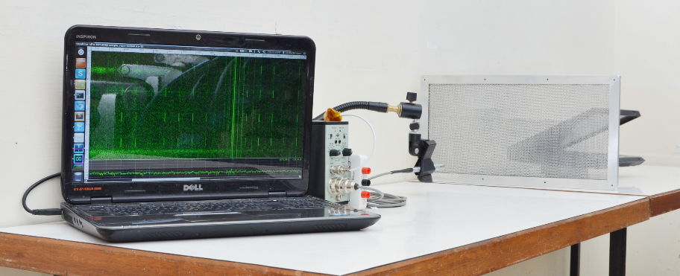
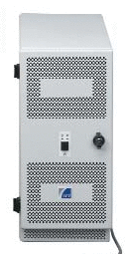
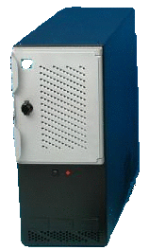
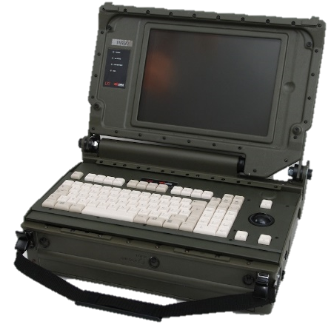
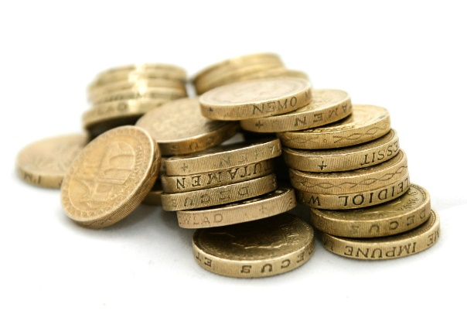
Countermeasures
Common suggestions
Shielding
EM (Faraday cages), ground difficult and expensive
Acoustic? Vents!
Add analog noise (expensive, correlations remain)
Parallel software load (inadequate, may help attacker)
Attacks rely on decryption of chosen ciphertexts.
Solution: ciphertext randomization use equivalent but random-looking ciphertexts
Negligible slowdown for RSA
x2 slowdown for ElGamal

Slide 53
Effective countermeasure: ciphertext randomization (added in GnuPG 1.4.16)
Given a ciphertext $c$:
Generate a random number $r$ and compute $r^{e}$
Decrypt $r^{e}⋅c$ and obtain $m′$
Output $m^{′}⋅r^{−1}$
Works since $ed=1 mod φ(n)$ thus:
$${\left(r^{e}⋅c\right)}^{d}⋅r^{−1} mod n=r^{ed}⋅r^{−1}⋅c^{d} mod n \\ =r⋅r^{−1}⋅c^{d} mod n \\ =c^{d} mod n \\ =m$$

Slide 54
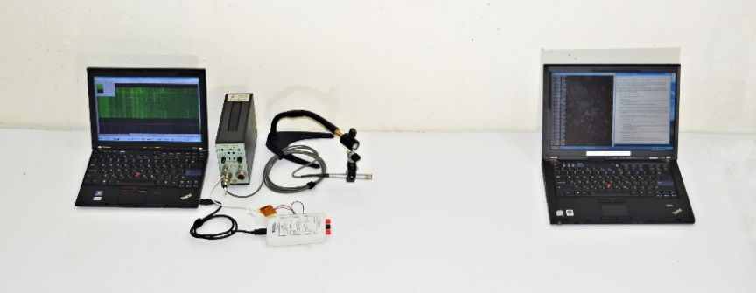
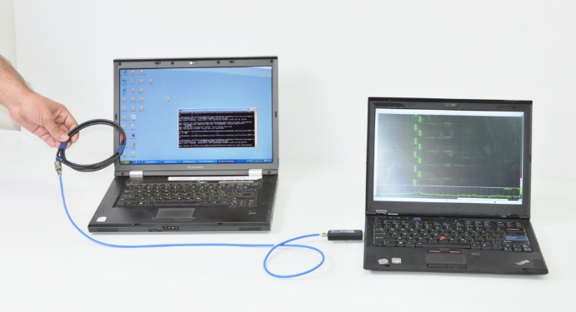
tau.ac.il/~tromer/acoustic CRYPTO’14 CVE 2013-4576
tau.ac.il/~tromer/handsoff CHES’14 CVE-2014-5270
tau.ac.il/~tromer/radioexp CHES’15 CVE-2014-3591

