Slide 1

Information Security – Theory vs. Reality
0368-4474, Winter 2015-2016
Lecture 7:
Fault attacks,
Hardware security (1/2)
Lecturer:
Eran Tromer

Slide 2
Fault attacks

Slide 3
Fault attacks on chips: non-nominal channels
Temperature
Mechanical stress
Clock
  Overlocking, unstable, spikes
Supply voltage / ground
  Too low, too high, unstable, spikes
Electromagnetic
  Strong electric/magnetic fields
  Optical
Chemical
Inject signals into non-inpu
  On non-input pins
  Using probes within circuit

Slide 4
Fault attacks: abusing nominal channels
Exploits using malformed inputs
  Buffer overflow, SQL injection, …
Imperfect behavior and “unlikely” error conditions
  Rowhammer on DRAM
Corrupt communication on interfaces with peripherals and network

Slide 5
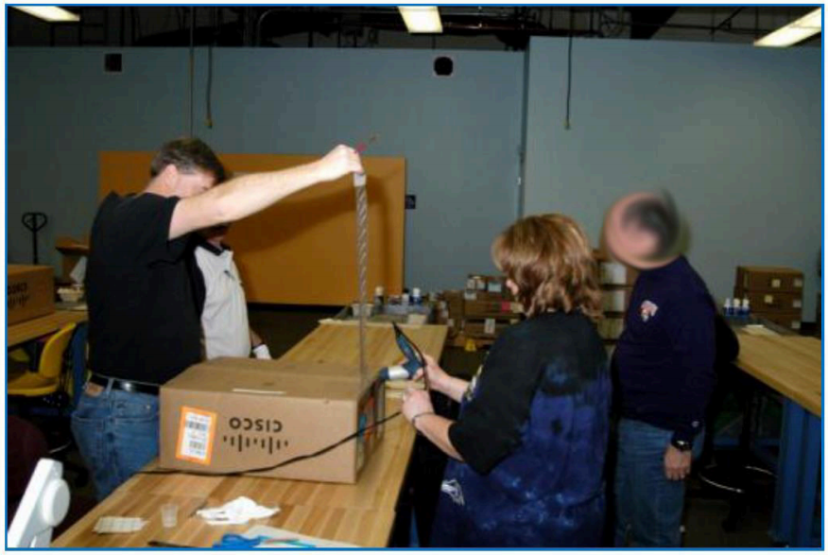
Fault attacks: trojan horses in the “IT supply chain”
Hardware design
Hardware manufacturing
Software design
Software manufacturing
Standards
  NSA’s Dual_EC_DRBG
Distribution
Transportation

Slide 6
Differential Fault Analysis of Arbitrary Decryption
Whiteboard discussion.
[Biham, Shamir, Differential Fault Analysis of Secret Key Cryptosystems, CRYPTO 1997 (section 3)]

Slide 7
Fault Analysis of RSA-CRT signatures
Whiteboard discussion:
Using faulty+correct signature
Using faulty signature and known message
[DeMillo, Lipton, On the importance of eliminating errors in cryptographic protocols, Journal of Cryptology, 2001 (Section 2.2)]

Slide 8
Hardware security
(survey and additional vectors)
Including presentation material by
Sergei Skorobogatov, University of Cambridge

Slide 9
Outline
Introduction
Attack awareness
Tamper protection levels
Attack methods
  Non-invasive
  Invasive
  Semi-invasive
Protection against attacks
Conclusions

Slide 10
Physical security
Protection of systems and devices against physical attacks
  protecting secrets from being stolen
  preventing unauthorised access
  protecting intellectual property from piracy
  preventing fraud
Examples
  locks and sensors to prevent physical access
  smartcards to hold valuable data and secret keys
  electronic keys, access cards and hardware dongles
  electronic meters, SIM cards, PayTV smartcards
  crypto-processors and crypto-modules for encryption
  mobile phones, game consoles and many other devices
  product identification for printer ink, perfume etc.

Slide 11
Why do we need hardware security?
Theft of service
  attacks on service providers (satellite TV, electronic meters, access cards, software protection dongles)‏
Access to information
  information recovery and extraction
  gaining trade secrets (IP piracy)‏
  ID theft
Cloning and overbuilding
  copying for making profit without investment in development
  low-cost mass production by subcontractors
Denial of service
  dishonest competition
  electronic warfare

Slide 12
Who need secure chips?
There is growing demand for secure chips
  car industry, service providers, manufacturers of various devices
  banking industry and military applications
Technical progress pushed secure semiconductor chips towards ubiquity
  consumer electronics (authentication, copy protection)‏
  aftermarket control (spare parts, accessories)‏
  access control (RF tags, cards, tokens and protection dongles)‏
  service control (mobile phones, satellite TV, license dongles)‏
  intellectual property (IP) protection (software, algorithms, design)‏
Challenges
  How to design secure system? (hardware security engineering)‏
  How to evaluate protection? (estimate cost of breaking)‏
  How to find the best solution? (minimum time and money)‏

Slide 13
How to design a secure system?
What is the reason to attack your system?
  attack scenarios and motivations: theft, access, cloning or DoS
Who is likely to attacks your system?
  classes of attackers: outsiders, insiders or funded organisations
What tools would they use for the attacks?
  attack categories: side-channel, fault, probing, reverse engineering
  attack methods: non-invasive, invasive, semi-invasive
How to protect against these attacks?
  estimate the threat: understand motivation, cost and probability
  develop adequate protection by locating weak points
  perform security evaluation
  choose secure components for your system (blocks and chips)‏

Slide 14
Choosing secure components
What has changed in the past?
  too many designs and devices on the market
  vast majority of devices are claimed to be secure
  security started to be used for marketing purposes
  virtually impossible to test everything
What are the problems?
  certification does not provide guarantee against attacks
  manufacturers do not carry any obligations or legal responsibility
  no such thing as security benchmark
  no ways of comparing devices from different manufacturers
  no chip manufacturer will tell you the truth about security
Need for security educated system engineers

Slide 15
Attack categories
Side-channel attacks
  techniques that allows the attacker to monitor the analog characteristics of supply and interface connections and any electromagnetic radiation
Software attacks
  use the normal communication interface and exploit security vulnerabilities found in the protocols, cryptographic algorithms, or their implementation
Fault generation
  use abnormal environmental conditions to generate malfunctions in the system that provide additional access
Microprobing
  can be used to access the chip surface directly, so we can observe, manipulate, and interfere with the device
Reverse engineering
  used to understand the inner structure of the device and learn or emulate its functionality; requires the use of the same technology available to semiconductor manufacturers and gives similar capabilities to the attacker

Slide 16
Attack methods
Non-invasive attacks (low-cost)‏
  observe or manipulate with the device without physical harm to it
  require only moderately sophisticated equipment and knowledge to implement
Invasive attacks (expensive)‏
  almost unlimited capabilities to extract information from chips and understand their functionality
  normally require expensive equipment, knowledgeable attackers and time
Semi-invasive attacks (affordable)‏
  semiconductor chip is depackaged but the internal structure of it remains intact
  fill the gap between non-invasive and invasive types, being both inexpensive and easily repeatable

Slide 17
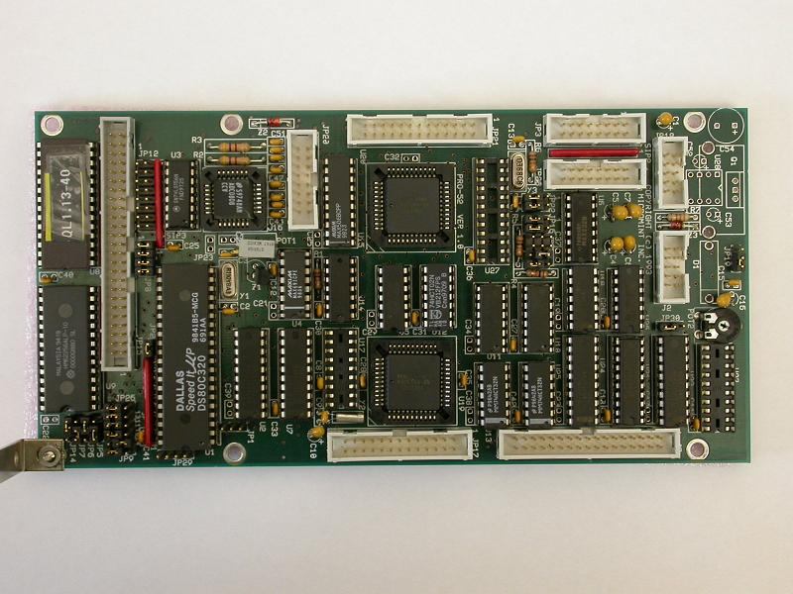
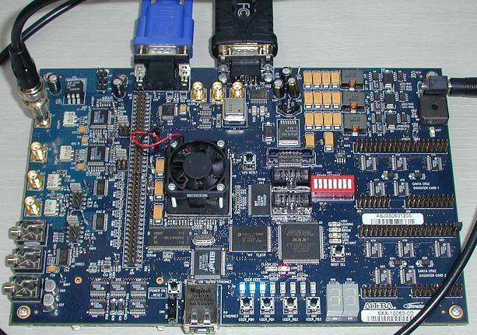
Tamper protection levels
D.G.Abraham et al. (IBM), 1991
Level ZERO (no special protection)‏
  microcontroller or FPGA with external ROM
  no special security features are used. All parts have free access and can be easily investigated
  very low cost, attack time: minutes to hours

Slide 18
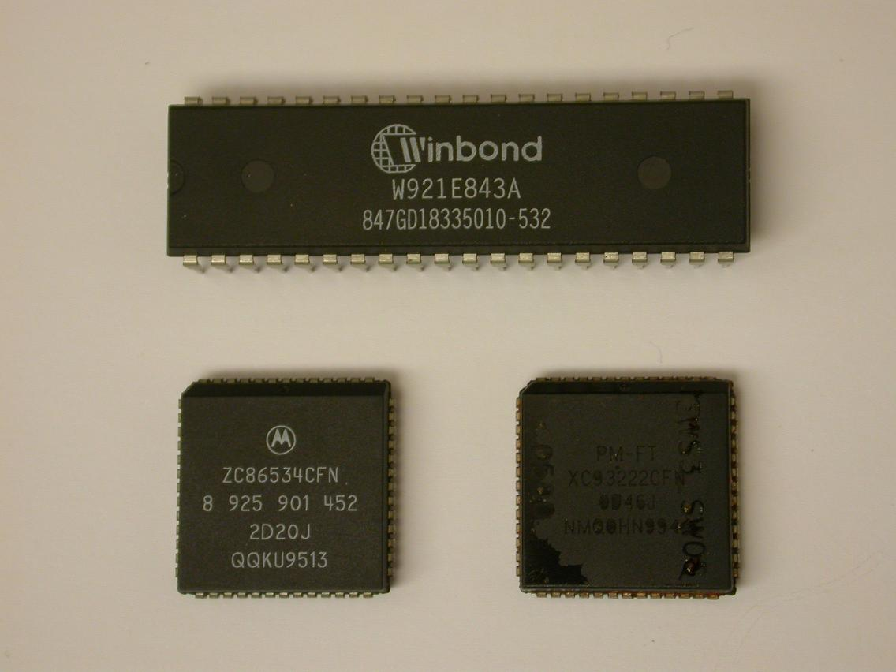
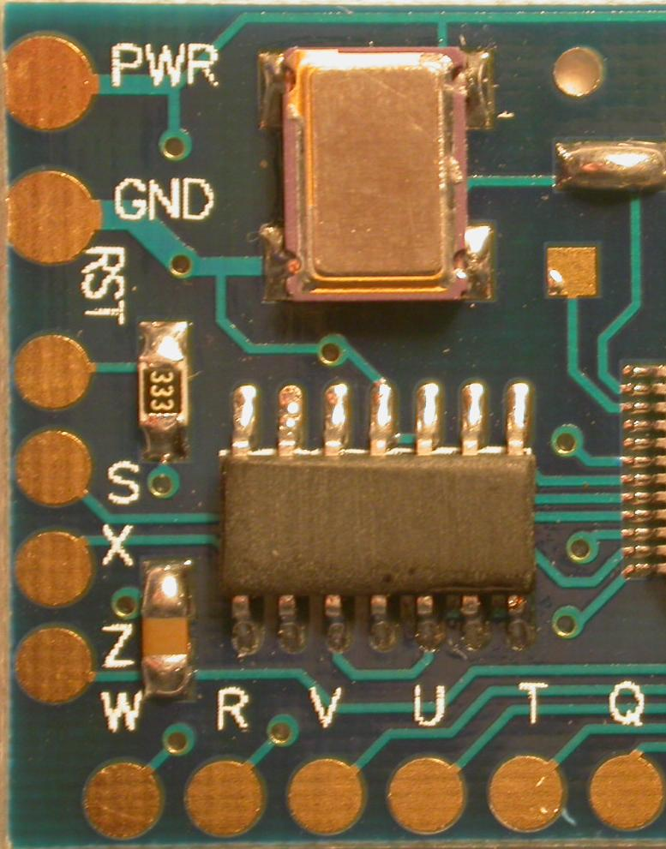
Tamper protection levels
Level LOW
  microcontrollers with proprietary access algorithm, remarked ICs
  some security features are used but they can be relatively easy defeated with minimum tools required
  low cost, attack time: hours to days

Slide 19
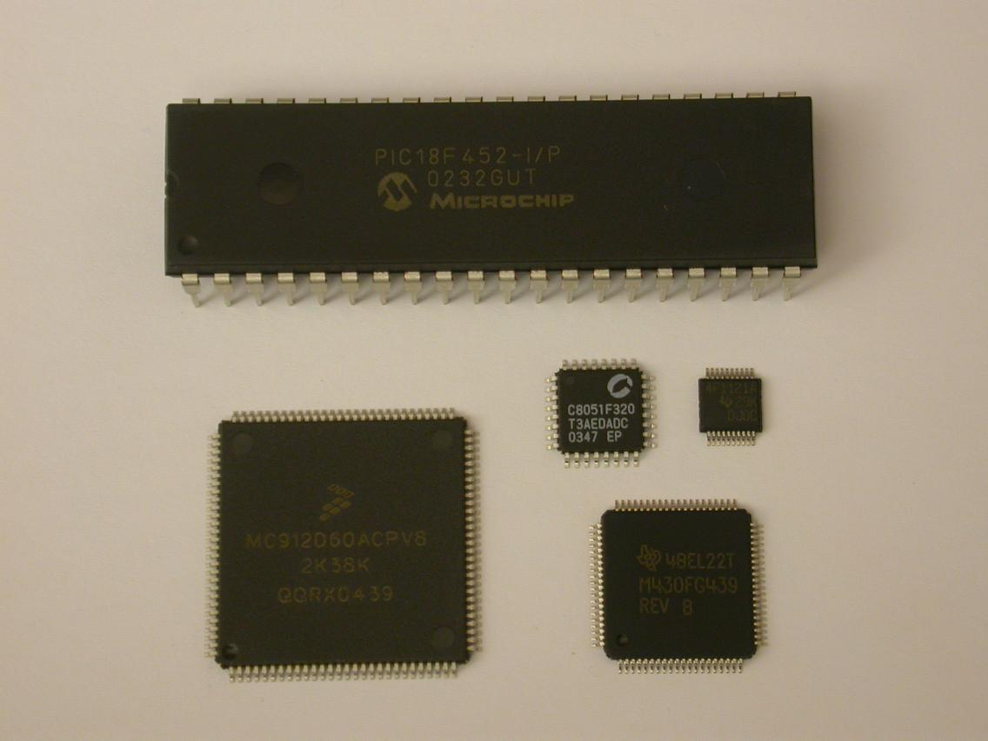
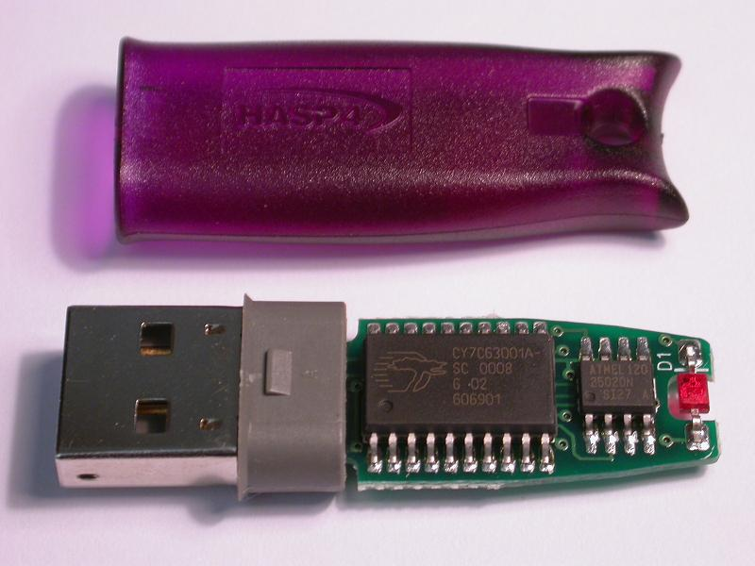
Tamper protection levels
Level MODL
  microcontrollers with security protection, low-cost hardware dongles
  protection against many low-cost attacks; relatively inexpensive tools are required for attack, but some knowledge is necessary
  moderate cost, attack time: days to weeks

Slide 20
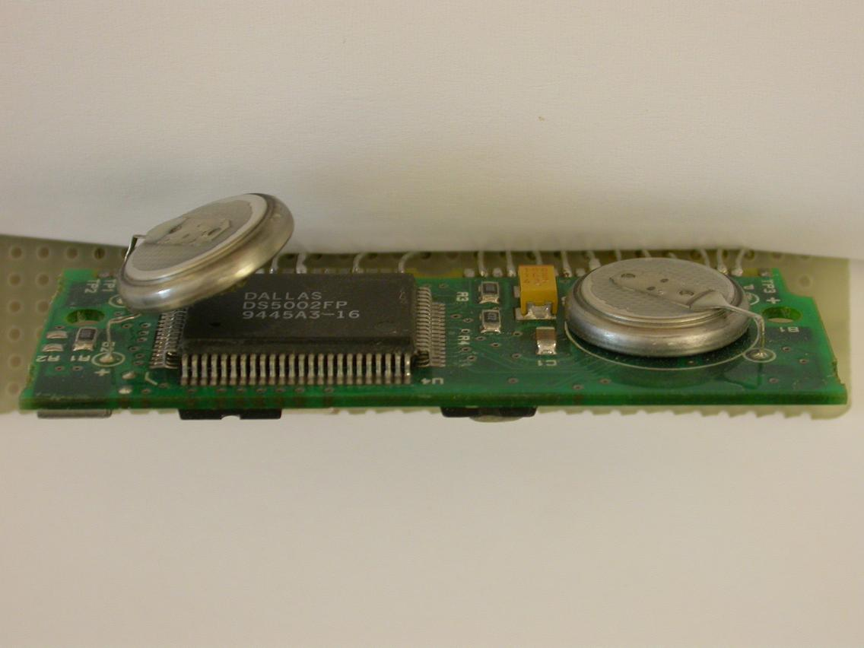
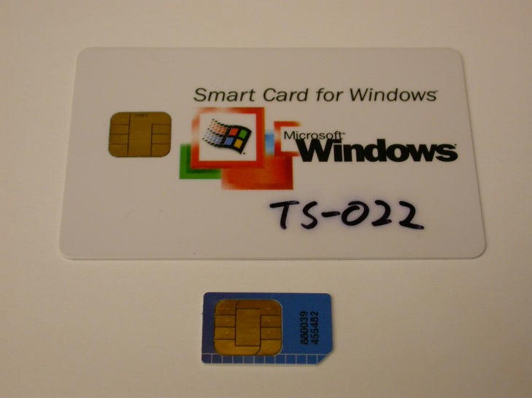
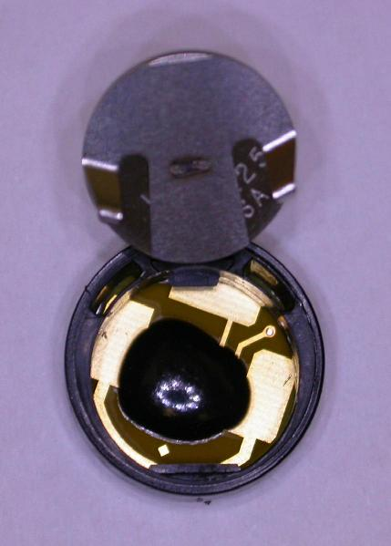
Tamper protection levels
Level MOD
  smartcards, high-security microcontrollers, ASICs, CPLDs, hardware dongles, i-Buttons, secure memory chips
  special tools and equipment are required for successful attack as well as some special skills and knowledge
  high cost, attack time: weeks to months

Slide 21
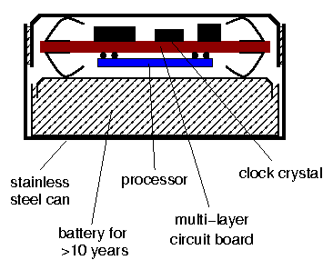
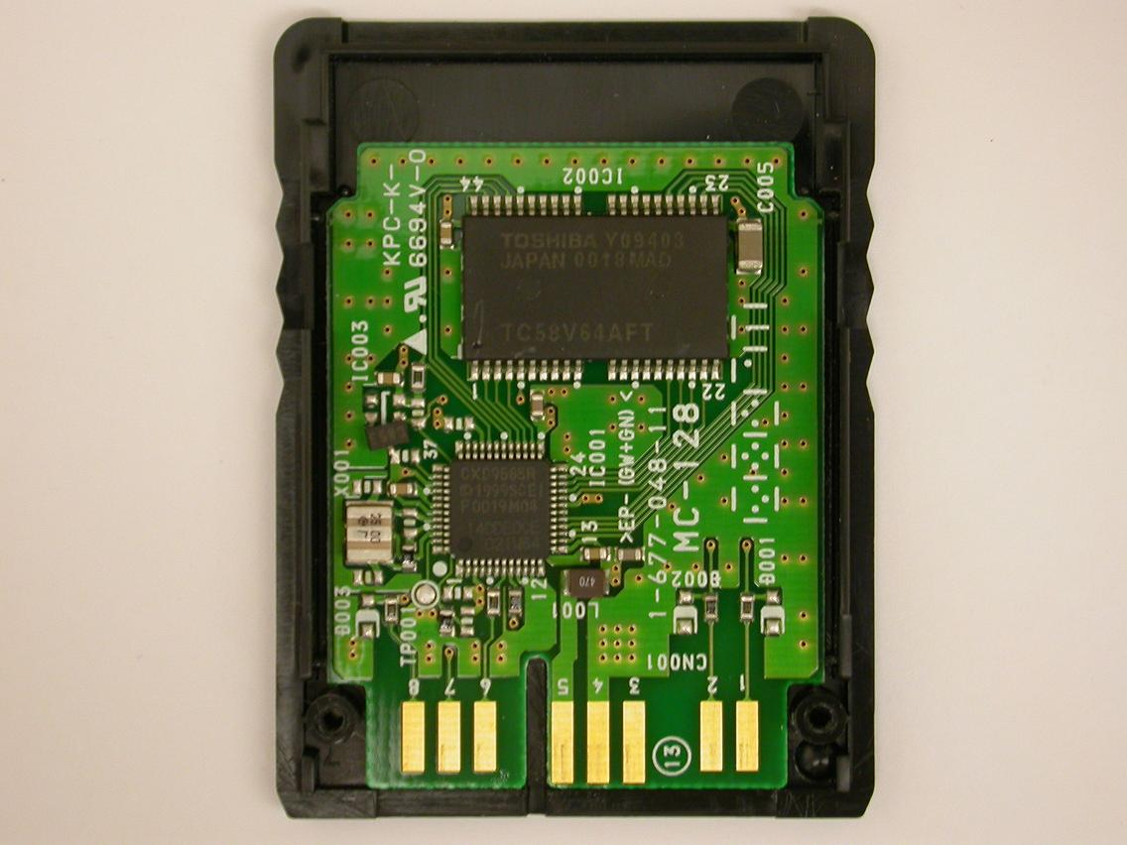
Tamper protection levels
Level MODH
  secure i-Buttons, secure FPGAs, high-end smartcards, ASICs, custom secure ICs
  special attention is paid to design of the security protection; equipment is available but is expensive to buy and operate
  very high cost, attack time: months to years
Picture courtesy of Dr Markus Kuhn

Slide 22
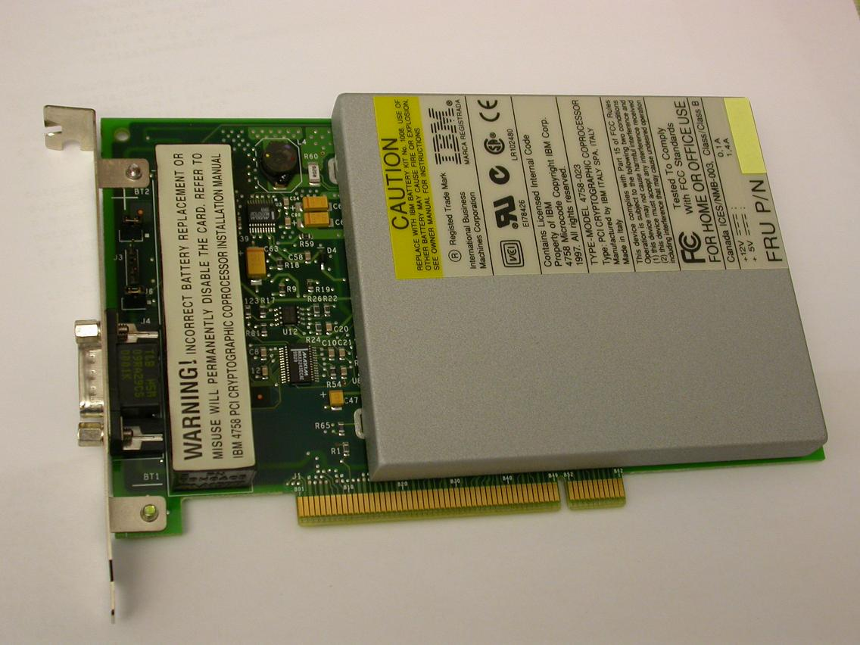
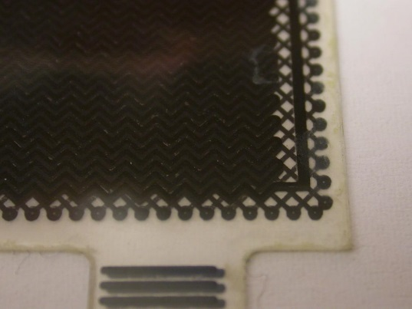
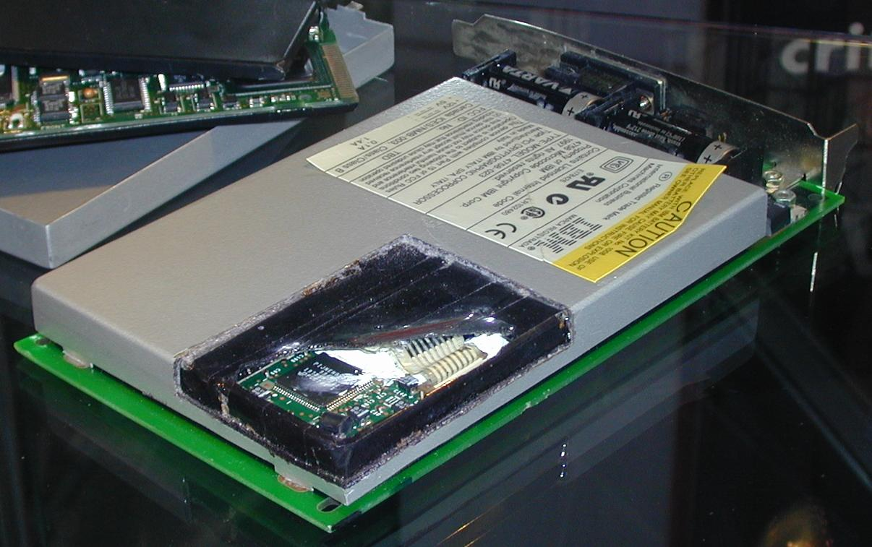
Tamper protection levels
Level HIGH
  Primary example: Hardware Security Modules (HSMs)
  military, banks, ATM, certificate authorities
  all known attacks are defeated. Some research by a team of specialists is necessary to find a new attack
  extremely high cost, attack time: years
Picture courtesy of Dr Markus Kuhn

Slide 23
Tamper protection levels
Division into levels from ZERO to HIGH is relative
  some products designed to be very secure might have flaws
  some products not designed to be secure might still end up being very difficult to attack
  technological progress opens doors to less expensive attacks, thus reducing the protection level of some products
Proper security evaluation must be carried out to estimate whether products comply with all the requirements
  design overview for any possible security flaws
  test products against known attacks

Slide 24
Non-invasive attacks

Slide 25
Non-invasive attacks
Non-penetrative to the attacked device
  normally do not leave tamper evidence of the attack
Tools
  digital multimeter
  IC soldering/desoldering station
  universal programmer and IC tester
  oscilloscope, logic analyser, signal generator
  programmable power supplies
  PC with data acquisition board, FPGA board, prototyping boards
Types of non-invasive attacks: passive and active
  side-channel attacks: timing, power, electromagnetic, acoustic, thermal, …
  data remanence
  fault injection: glitching, bumping
  brute forcing

Slide 26
Non-invasive attacks: side-channel
(discussed previously)

Slide 27
Non-invasive attacks: side-channel
Timing attacks aimed at different computation time
  incorrect password verification: termination on incorrect byte, different computation length for incorrect bytes
  incorrect implementation of encryption algorithms: performance optimisation, cache memory usage, non-fixed time operations
Power analysis: measuring power consumption in time
  very simple set of equipment – a PC with an oscilloscope and a small resistor in power supply line; very effective against many cryptographic algorithms and password verification schemes
  some knowledge in electrical engineering and digital signal processing is required
  two basic methods: simple (SPA) and differential (DPA)‏
Electro-magnetic analysis (EMA): measuring emission
  similar to power analysis, but instead of resistor, a small magnetic coil is used allowing precise positioning over the chip

Slide 28
Non-invasive attacks: power analysis
Simple power analysis (SPA): difference in instruction flow
  8-byte password check in Freescale MC908AZ60A microcontroller
  1 byte at a time, 1 of 256 attempts leads to distinctive power trace
  full password recovery in 2048 attempts (less than 10 minutes)‏
loop: CBEQX #$FE, ptr3 ;check for end
JSR sub_recv ;receive byte
CBEQ X+, ptr2 ;compare byte
CLR adr_50 ;clear status
ptr1: BRA loop ;loop
ptr2: BRA ptr1 ;time alignment
ptr3: LDX #$FF ;set address
LDA adr_50 ;check status
BEQ cont ;skip flash enable
STX , X ;flash enable
cont: … … …

Slide 29
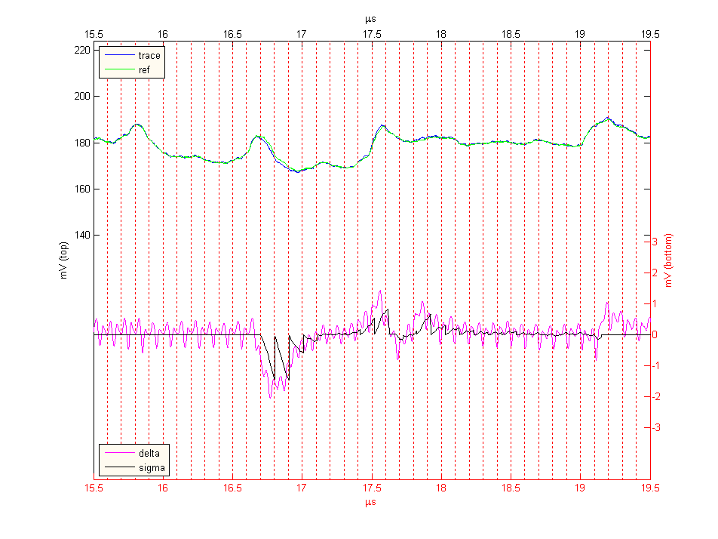
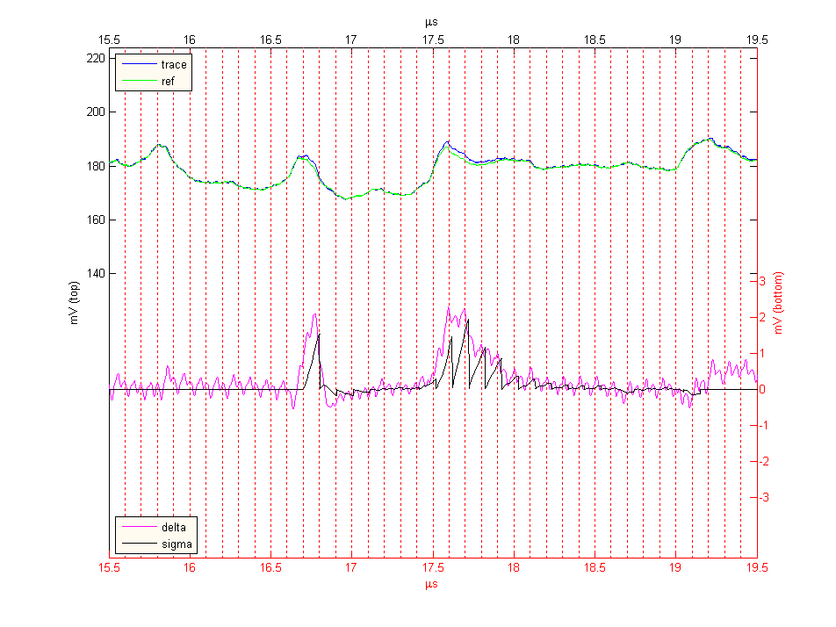
Non-invasive attacks: power analysis
Differential power analysis (DPA): correlation with secret
  AES decryption in asynchronous ASIC (130 nm, 1.5V), 128-bit key
  first round of decryption starts with XORing the input data with round key, the difference is only in the input data and the result
  full key recovery in 256 attempts with each attempt requiring average of 4096 traces (~2 minutes per attempt, total 8 hours)‏

Slide 30
Non-invasive attacks: fault injection
Glitch attacks
  clock glitches
  power supply glitches
  data corruption
Security fuse verification in the Mask ROM bootloader of the Motorola MC68HC05B6 microcontroller
  double frequency clock glitch causes incorrect instruction fetch
  low-voltage power glitch results in corrupted EEPROM data read
LDA #01h ;load content of EEPROM byte
AND $0100 ;check a flag bit
loop: BEQ loop ;endless loop if the bit is zero
BRCLR 4, $0003, cont ;test mode of operation
JMP $0000 ;direct jump to the preset address
cont: … … …

Slide 31
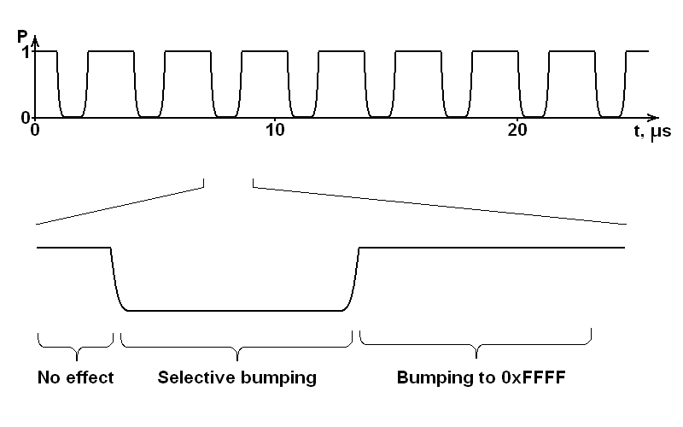
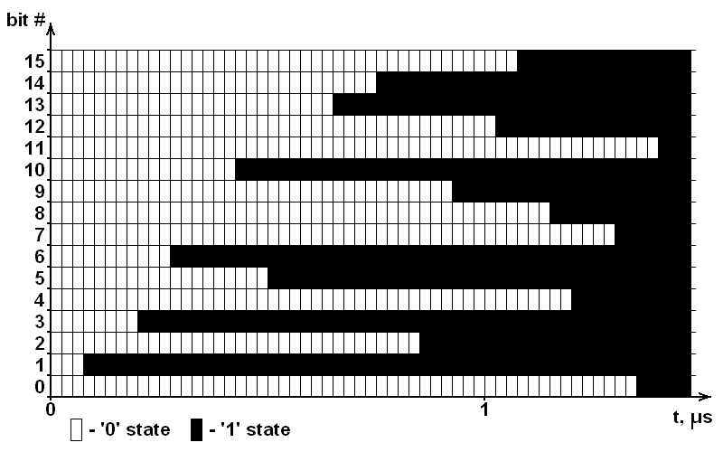
Non-invasive attacks: fault injection
Bumping and selective bumping attacks
  aimed at internal integrity check procedure on a chip (verification and authentication using encryption or hash functions)‏
  aimed at blocks of data down to bus width or at individual bits within the bus
Power supply glitching attack on secure microcontroller
  exhaustive search: 2¹²⁷ attempts per 128-bit AES key → >trillion years
  bumping: 2¹⁵ attempts per 16-bit word, 100ms cycle, 8 hours for AES key
  selective bumping: 2⁷ attempts per 16-bit word, 2 minutes for AES key

Slide 32
Non-invasive attacks: brute forcing
Brute force attacks
  searching for keys and passwords, exploiting inefficient selection of keys and passwords
  recovering design from CPLDs, FPGAs and ASICs
  eavesdropping on communication to find hidden functions
  applying random signals and commands to find hidden functionality
Modern chips deter most brute force attacks
  longer keys make searching infeasible
  moving from 8-bit base to 32-bit base means longer search
  CPLDs, FPGAs and ASICs became too complex to analyse
  too large search field for finding hidden functionality

Slide 33
Non-invasive attacks: data remanence
  (discussed in previous lecture)

Slide 34
Invasive attacks

Slide 35
Invasive attacks
Penetrative attacks
  leave tamper evidence of the attack or even destroy the device
Tools
  IC soldering/desoldering station
  simple chemical lab
  high-resolution optical microscope
  wire bonding machine, laser cutting system, microprobing station
  oscilloscope, logic analyser, signal generator
  scanning electron microscope and focused ion beam workstation
Types of invasive attacks: passive and active
  decapsulation, optical imaging, reverse engineering
  microprobing and internal fault injection
  chip modification

Slide 36
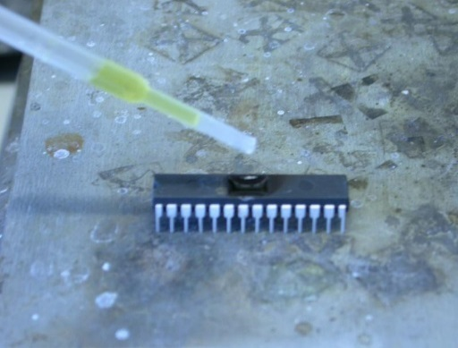
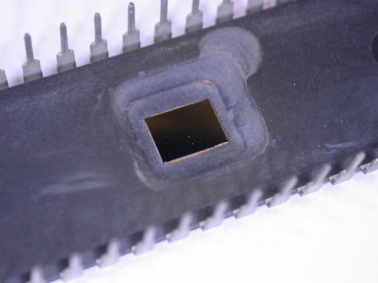
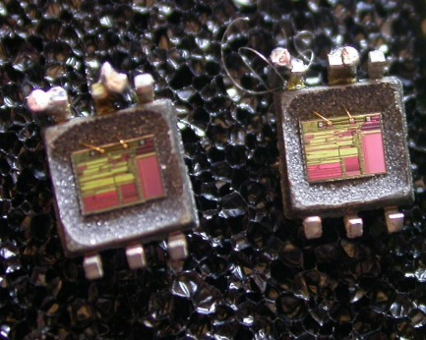
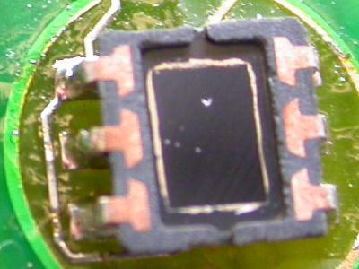
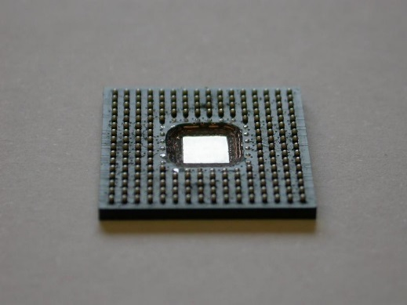
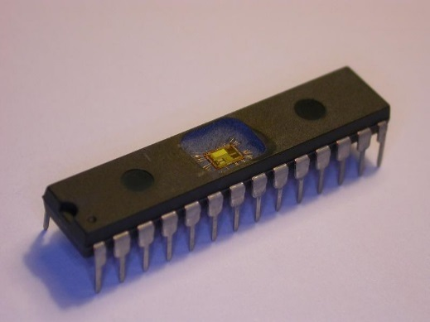
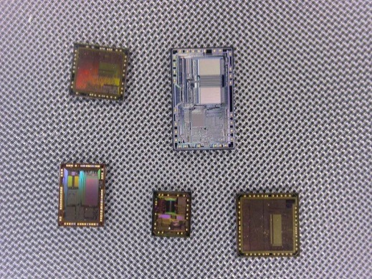
Invasive attacks: sample preparation
Decapsulation
  manual with fuming nitric acid (HNO₃) and acetone at 60ºC
  automatic using mixture of HNO₃ and H₂SO₄
  full or partial
  from front side and from rear side
Challenging process for small and BGA packages

Slide 37
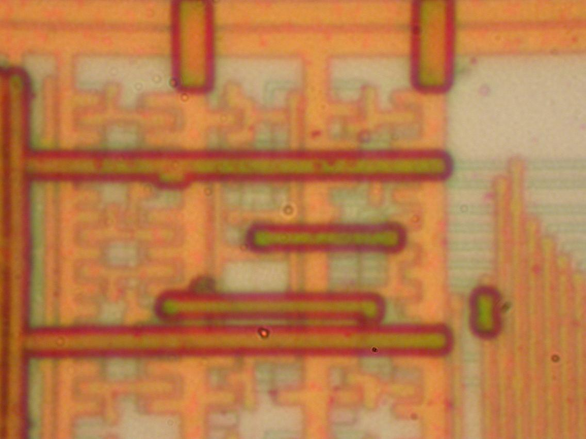
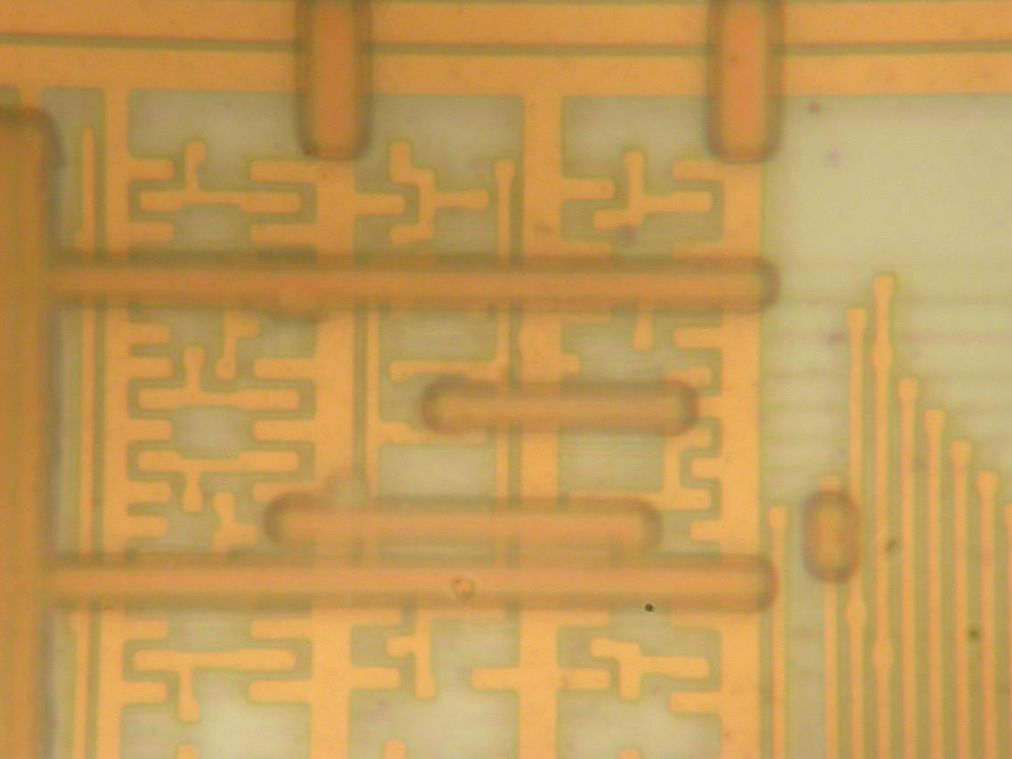
Invasive attacks: imaging
Optical imaging
  resolution is limited by optics and wavelength of a light: R = 0.61 λ / NA = 0.61 λ / n sin(μ)‏
    reduce wavelength of the light using UV sources
    increasing the angular aperture, e.g. dry objectives have NA = 0.95
    increase refraction index of the media using immersion oil (n = 1.5)‏
Bausch&Lomb MicroZoom, 50×2×, NA = 0.45
Leitz Ergolux AMC, 100×, NA = 0.9

Slide 38
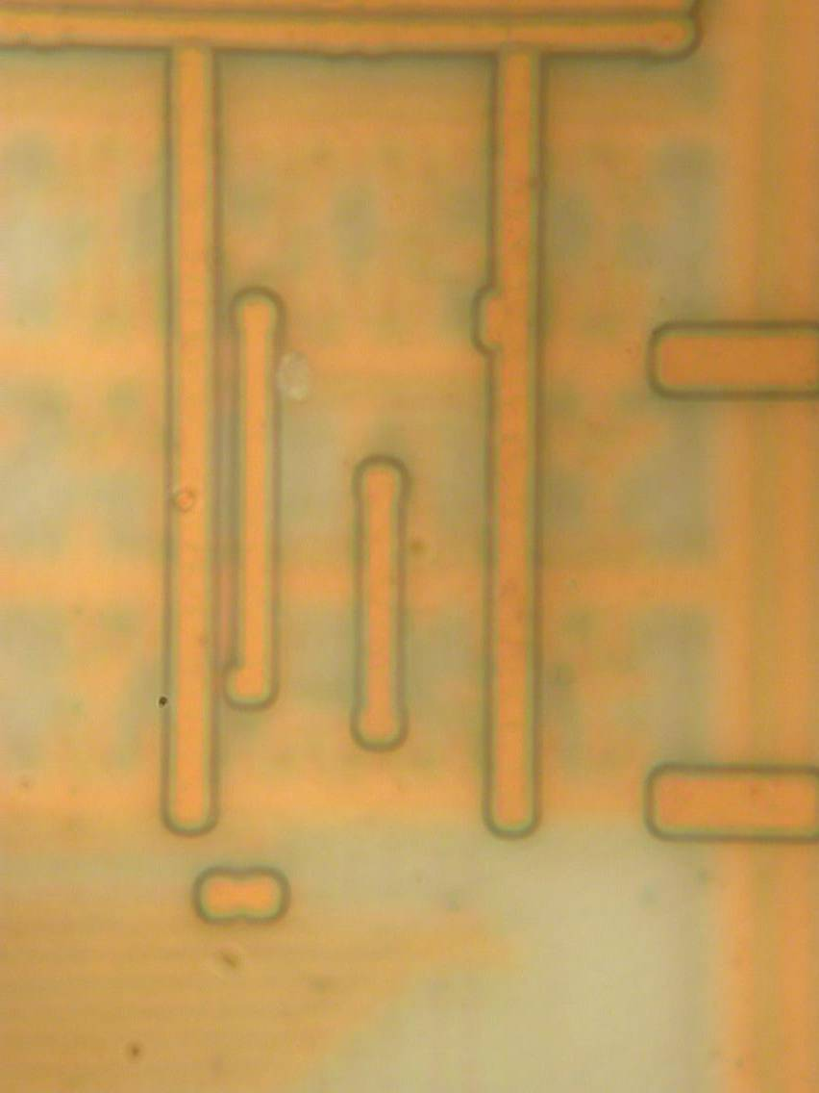
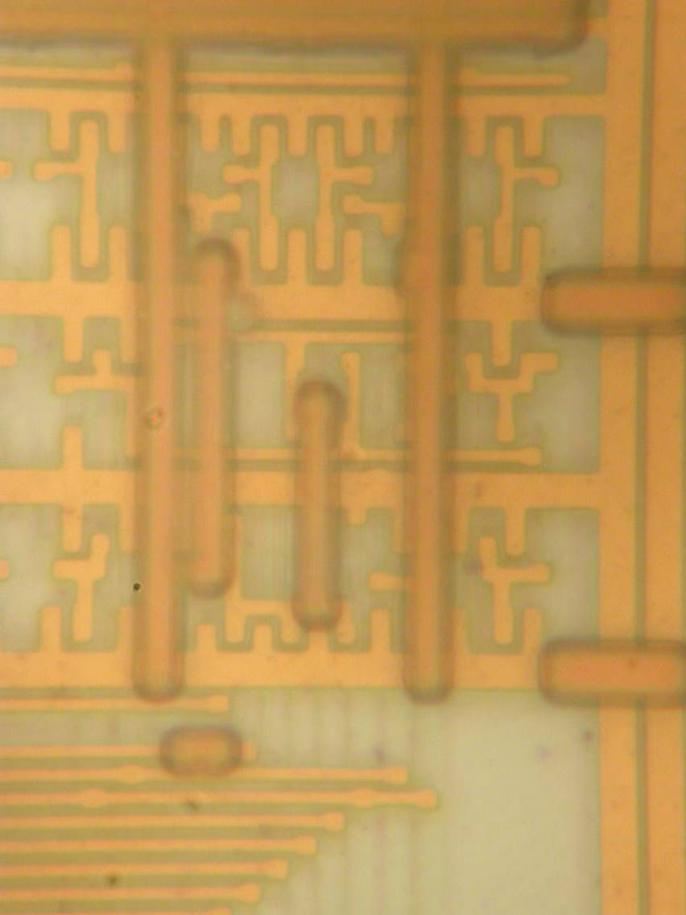
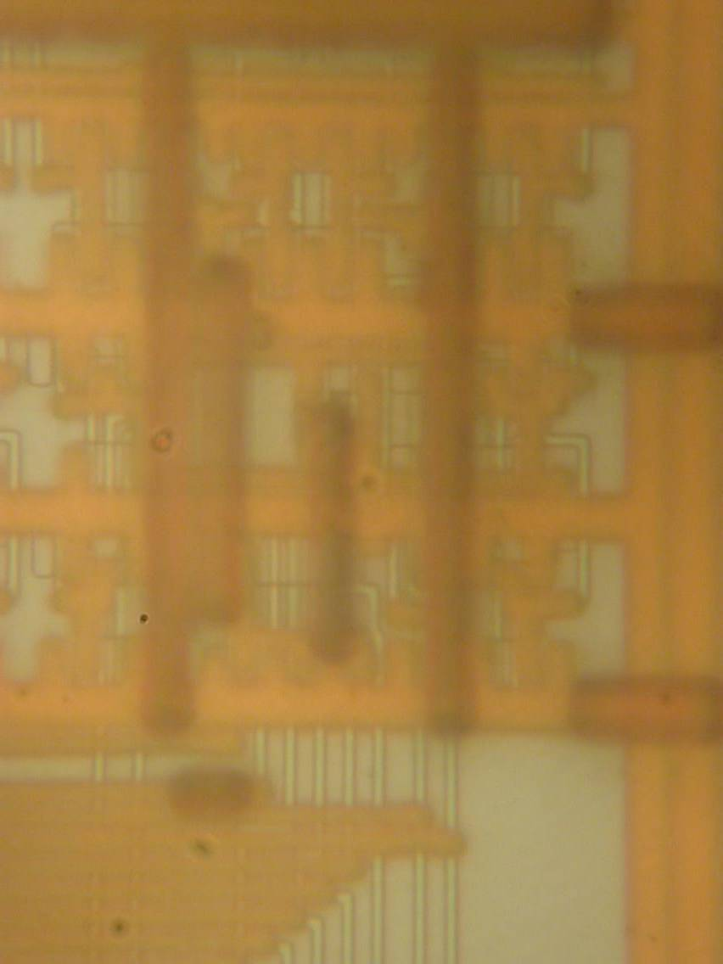
Invasive attacks: imaging
Optical imaging
  image quality depends on microscope optics
    depth of focus helps in separating the layers
    geometric distortions pose problem for later post-processing

Slide 39
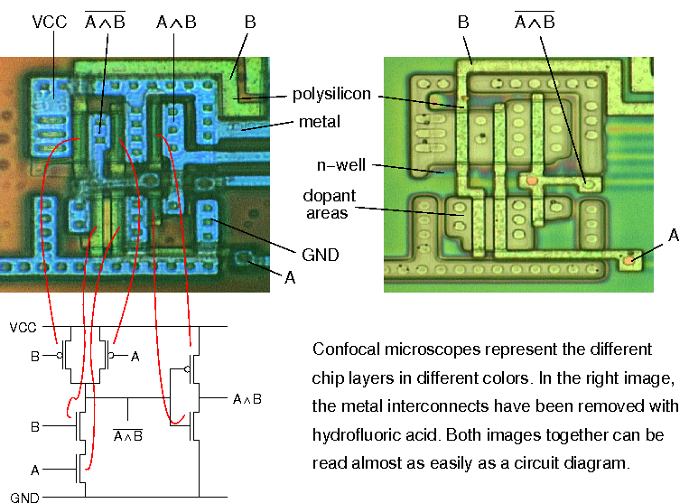
Invasive attacks: reverse engineering
Reverse engineering – understanding the structure of a semiconductor device and its functions
  optical, using a confocal microscope (for > 0.5 μm chips)‏
  deprocessing is necessary for chips with smaller technology
Picture courtesy of Dr Markus Kuhn

Slide 40
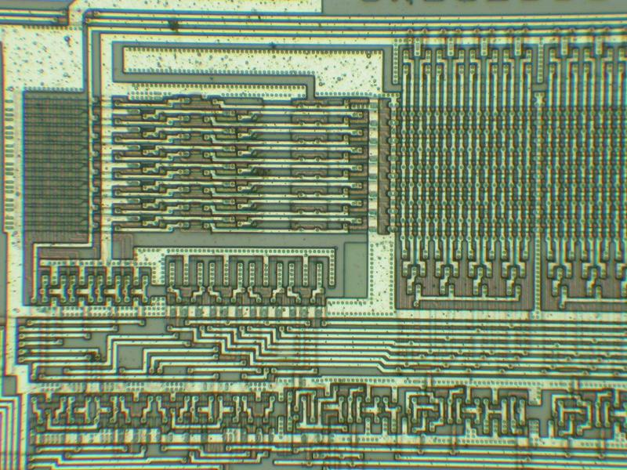
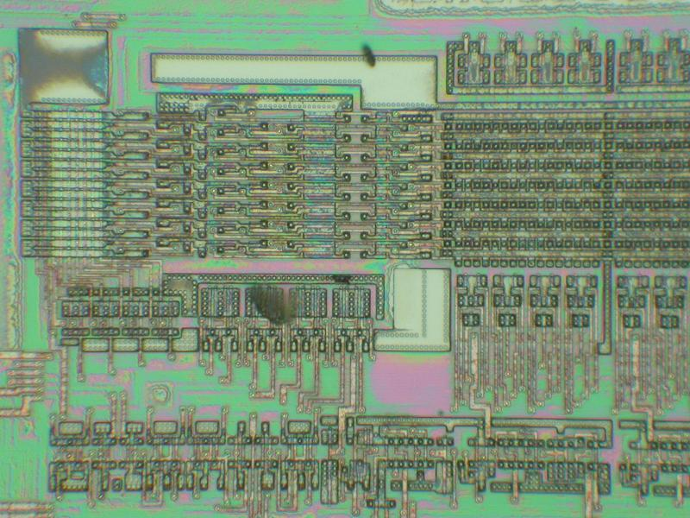
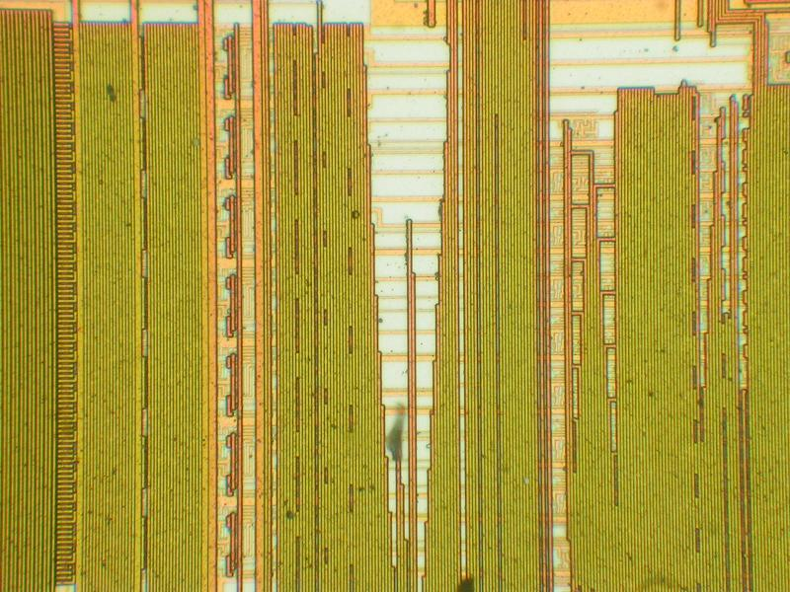
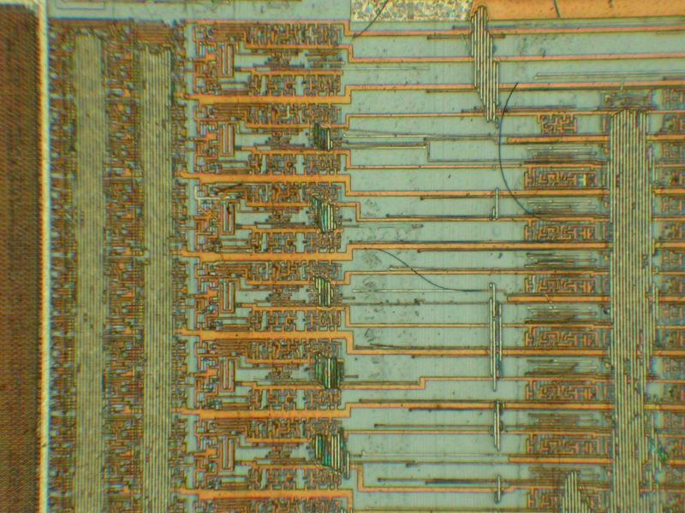
Invasive attacks: reverse engineering
Removing top metal layer using wet chemical etching
  good uniformity over the surface, but works reliably only for chips fabricated with 0.8 μm or larger process (without polished layers)‏
Motorola MC68HC705C9A microcontroller
1.0 μm
Microchip PIC16F76 microcontroller
0.5 μm

Slide 41
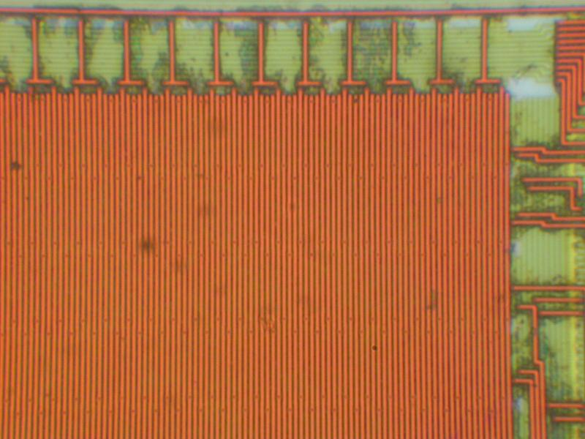
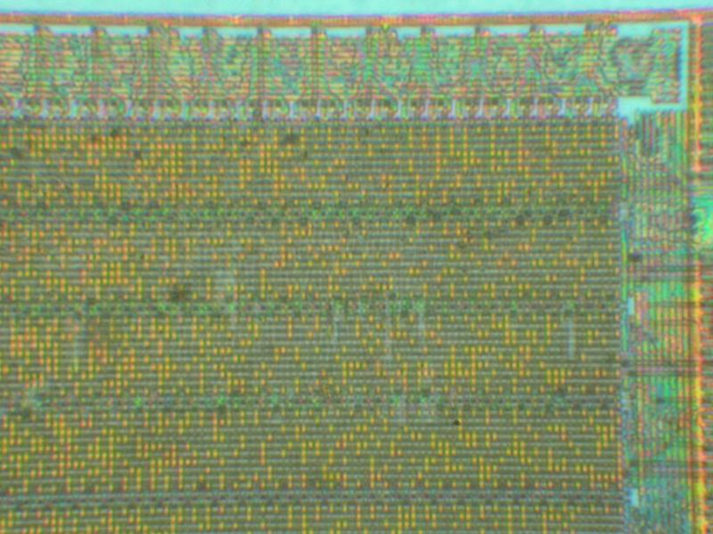
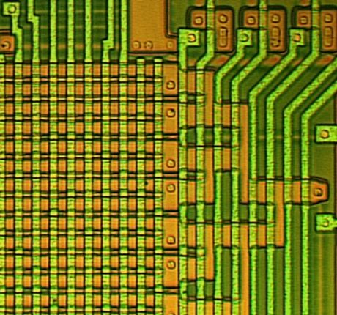
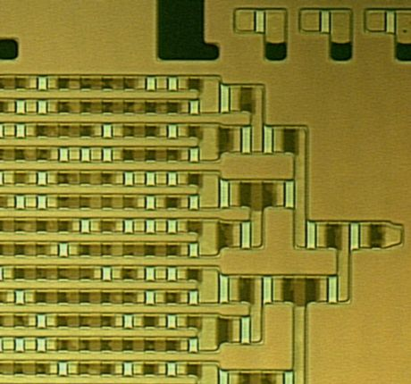
Invasive attacks: reverse engineering
Memory extraction from Mask ROMs
  removing top metal layers for direct optical observation of data in NOR ROMs (bits programmed by presence of transistors)‏
  not suitable for VTROM (ion implanted) used in smartcards – selective (dash) etchants are required to expose the ROM bits
NEC μPD78F9116 microcontroller
0.35 μm
Motorola MC68HC05SC27 smartcard
1.0 μm
Picture courtesy of Dr Markus Kuhn

