Slide 1

Information Security – Theory vs. Reality
0368-4474, Winter 2015-2016
Lecture 8:
Hardware security (2/2),
Leakage/tamper resilience (1/2)
Lecturer:
Eran Tromer

Slide 2
Hardware security
Invasive attacks
(continued)
Including presentation material by
Sergei Skorobogatov, University of Cambridge

Slide 3
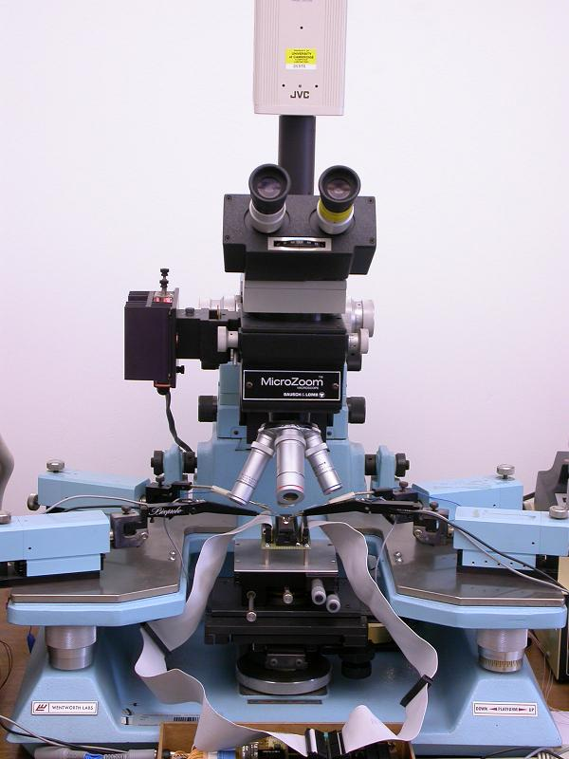
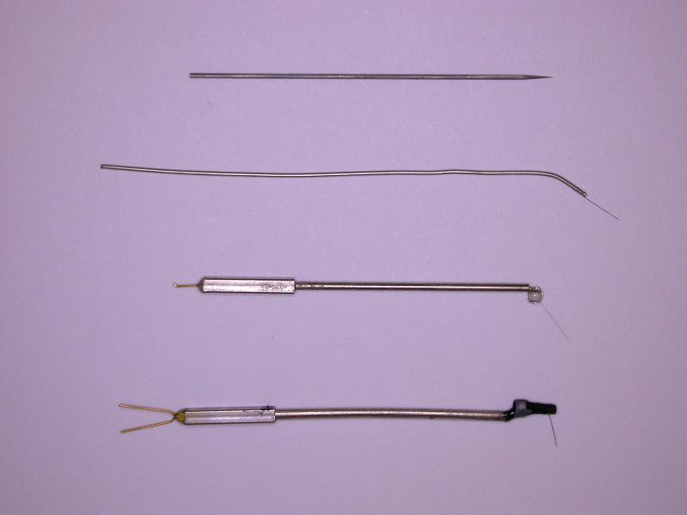
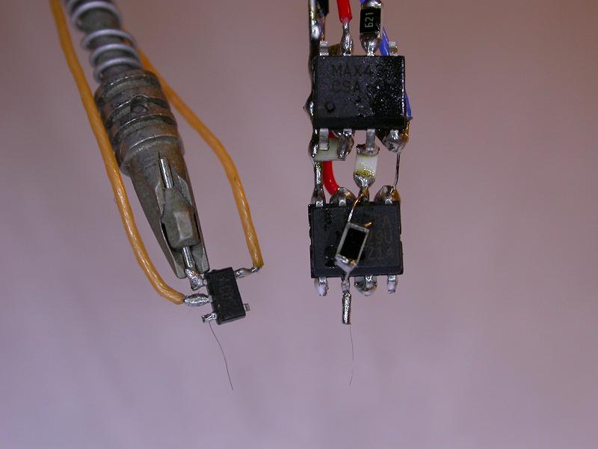
Invasive attacks: microprobing
Microprobing with fine electrodes
  eavesdropping on signals inside a chip
  injection of test signals and observing the reaction
  can be used for extraction of secret keys and memory contents
  limited use for 0.35µm and smaller chips

Slide 4
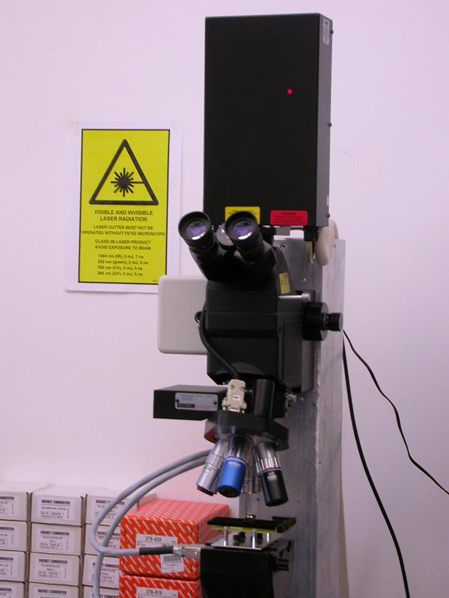
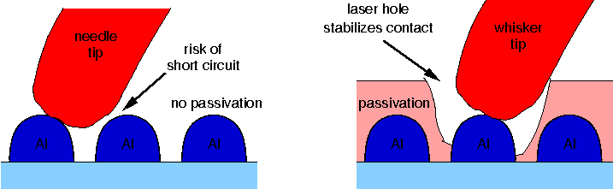
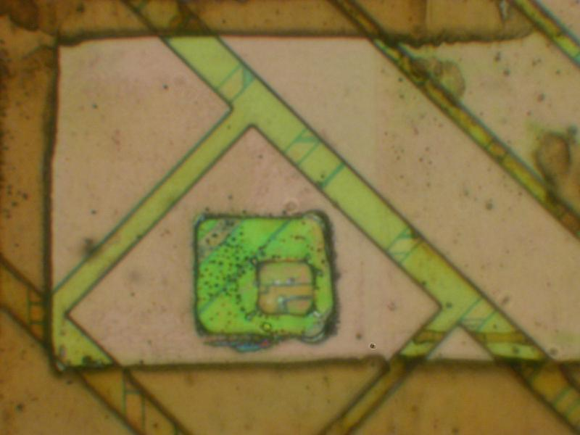
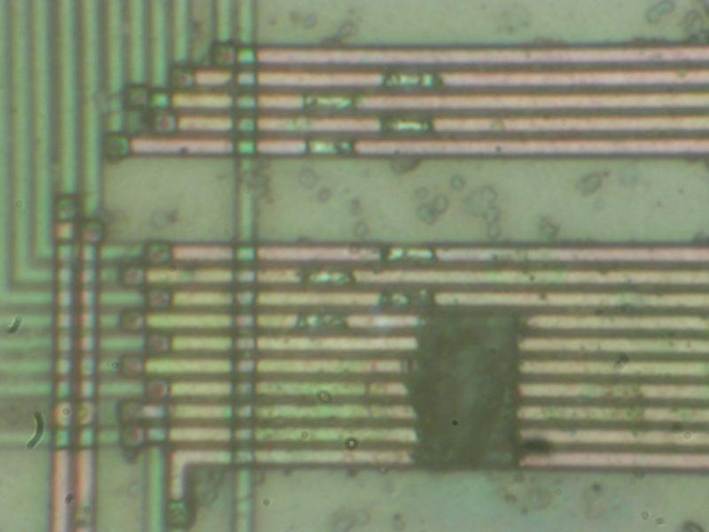
Invasive attacks: microprobing
Laser cutting systems
  removing polymer layer from a chip surface
  local removing of a passivation layer for microprobing attacks
  cutting metal wires inside a chip
  maximum can access the second metal layer
Picture courtesy of Dr Markus Kuhn

Slide 5
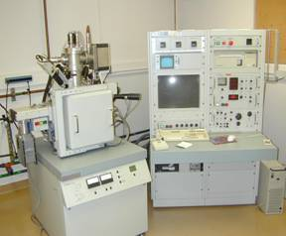
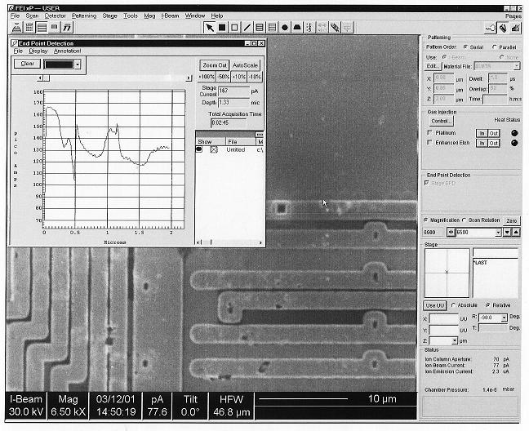
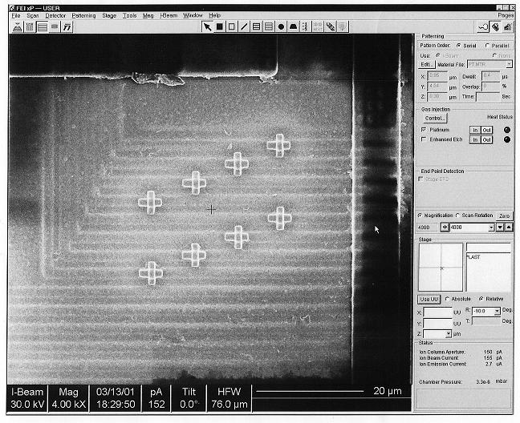
Invasive attacks: chip modification
Focused Ion Beam (FIB) workstation
  chip-level surgery with 10 nm precision
  etching with high aspect ratio
  platinum and SiO₂ deposition
Picture courtesy of Semiresearch Ltd

Slide 6
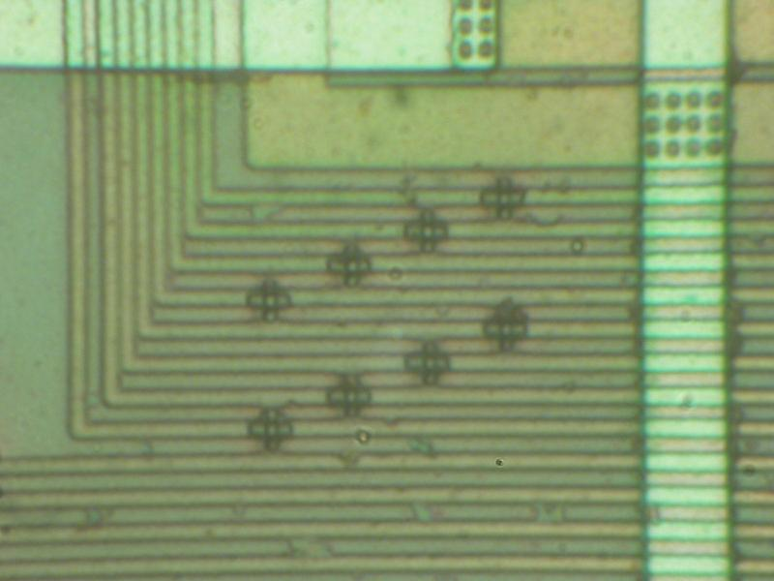
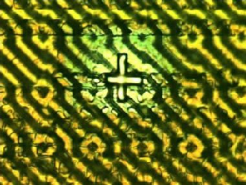
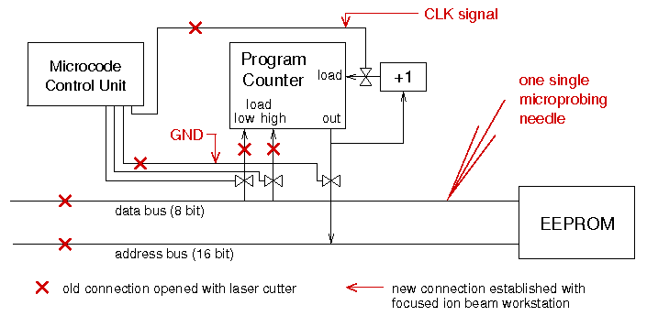
Invasive attacks: chip modification
Focused Ion Beam workstation
  creating probing points inside smartcard chips, read the memory
  modern FIBs allow backside access, but requires special chip preparation techniques to reduce the thickness of silicon
Picture: Oliver Kömmerling
Picture courtesy of Dr Markus Kuhn

Slide 7
Semi-invasive attacks
Fill the gap between non-invasive and invasive attacks
  less damaging to target device (decapsulation without penetration)‏
  less expensive and easier to setup and repeat than invasive attacks
Tools
  IC soldering/desoldering station
  simple chemical lab
  high-resolution optical microscope
  UV light sources, lasers
  oscilloscope, logic analyser, signal generator
  PC with data acquisition board, FPGA board, prototyping boards
  special microscopes (laser scanning, infrared etc.)‏
Types of semi-invasive attacks: passive and active
  imaging: optical and laser techniques
  fault injection: UV attack, photon injection, local heating, masking
  side-channel attacks: optical emission analysis, induced leakage

Slide 8
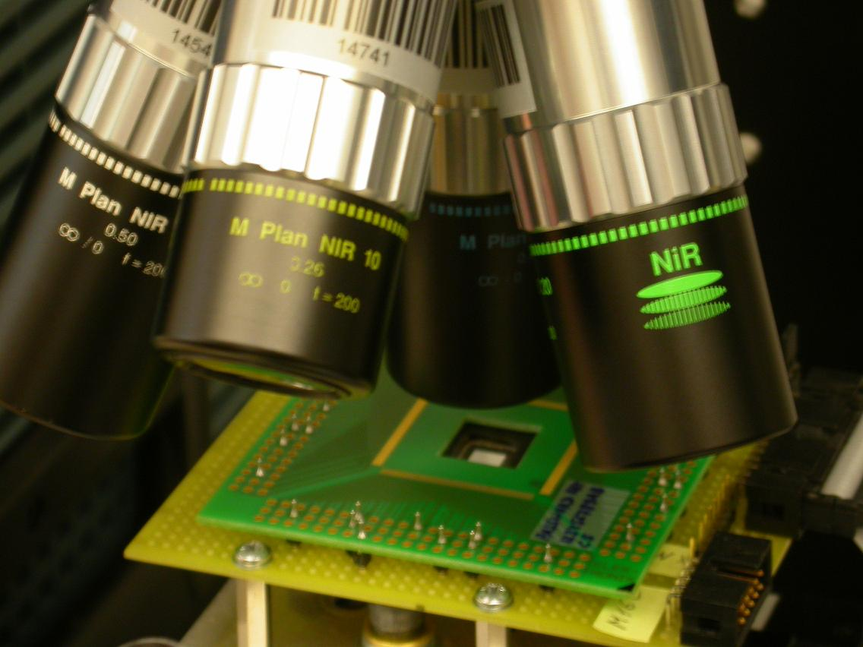
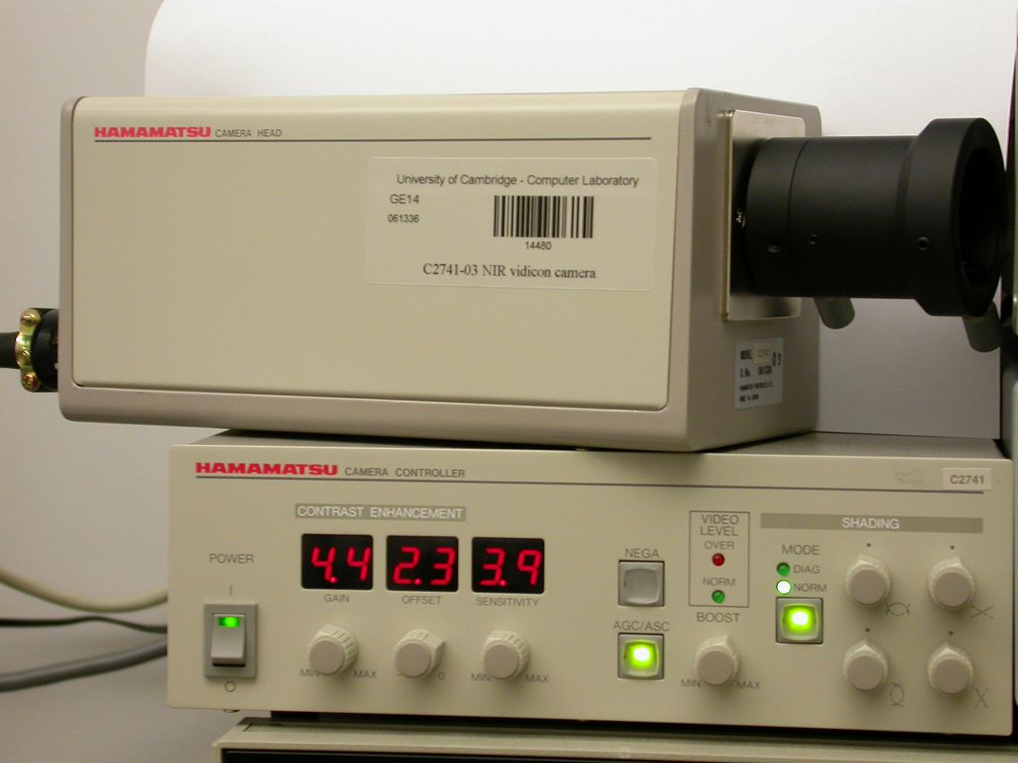
Semi-invasive attacks: imaging
Backside infrared imaging
  microscopes with IR optics give better quality of image
  IR-enhanced CCD cameras or special cameras must be used
  resolution is limited to ~0.6μm by the wavelength of used light
  view is not obstructed by multiple metal layers

Slide 9
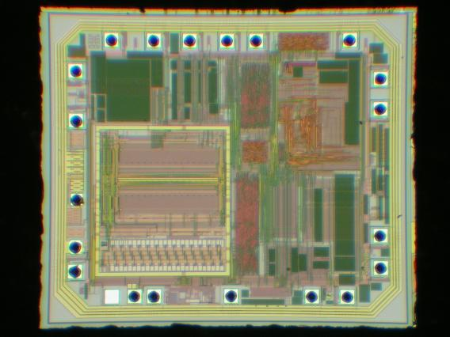
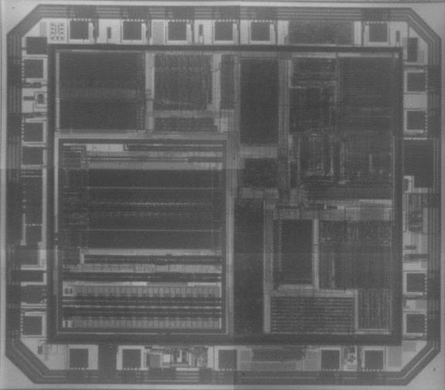
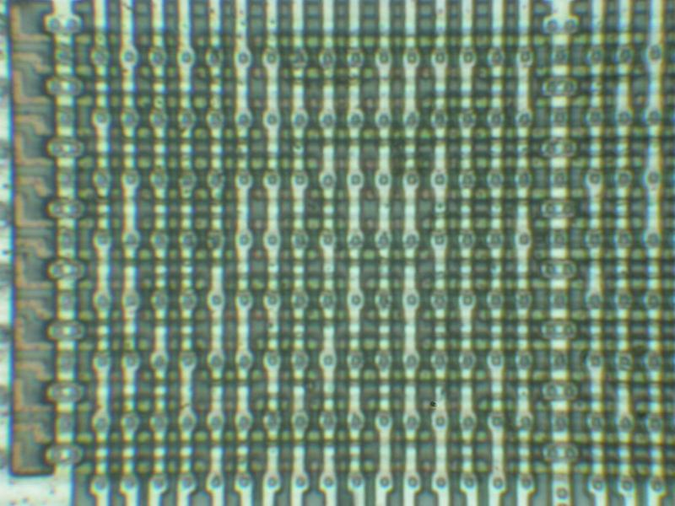
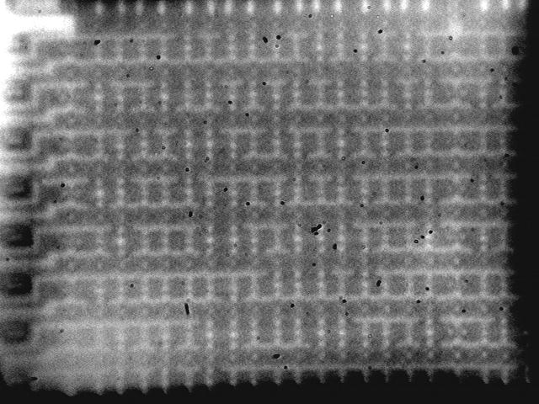
Semi-invasive attacks: imaging
Backside infrared imaging
  Mask ROM extraction without chemical etching
Main option for 0.35µm and smaller chips
  multiple metal wires do not block the optical path
Texas Instruments MSP430F112 microcontroller
0.35 μm
Motorola MC68HC705P6A microcontroller
1.2 μm

Slide 10
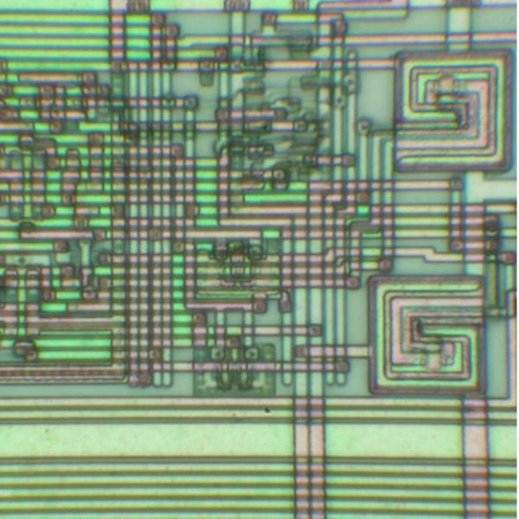
Semi-invasive attacks: imaging
Advanced imaging techniques – active photon probing (Optical Beam Induced Current (OBIC))‏
  photons with energy exceeding semiconductor band gap ionize IC’s regions, which results in a photocurrent flow producing the image
  used for localisation of active areas
  also works from the rear side of a chip (using infrared lasers)‏
Microchip PIC16F84A microcontroller

Slide 11
Semi-invasive attacks: imaging
Advanced imaging techniques – active photon probing (light-induced voltage alteration (LIVA) technique)‏
  photon-induced photocurrent is dependable on the state of a transistor
  reading logic state of CMOS transistors inside a powered-up chip
  works from the rear side of a chip (using infrared lasers)‏
Requires backside approach for 0.35µm and smaller chips
  multiple metal wires do not block the optical path
  resolution is limited to ~0.6μm (still enough for memory cells)‏
Microchip PIC16F84 microcontroller

Slide 12
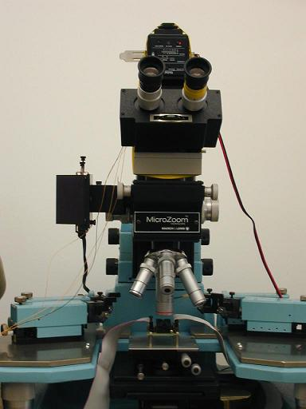
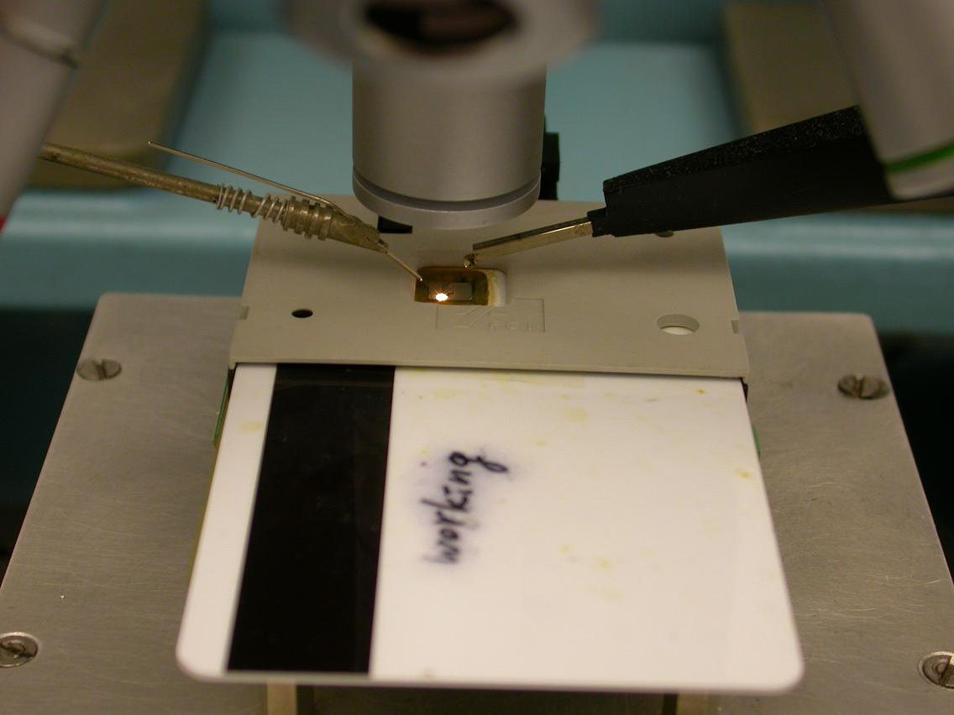
Semi-invasive attacks: fault injection
Optical fault injection attacks
  optical fault injection was observed in experiments with microprobing attacks in early 2001, introduced as a new method in 2002
  lead to new powerful attack techniques and forced chip manufacturers to rethink their design and bring better protection
  original setup involved optical microscope with a photoflash and Microchip PIC16F84 microcontroller programmed to monitor its SRAM

Slide 13
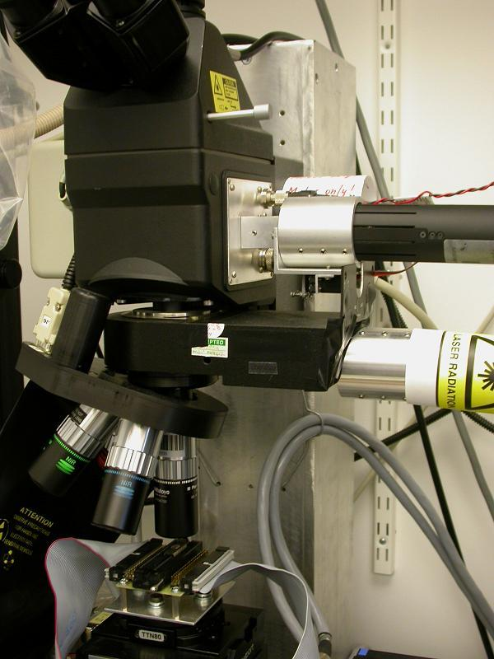
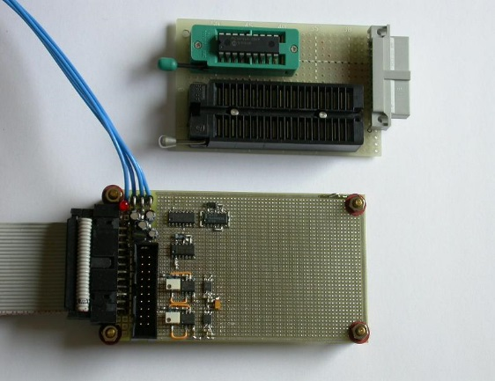
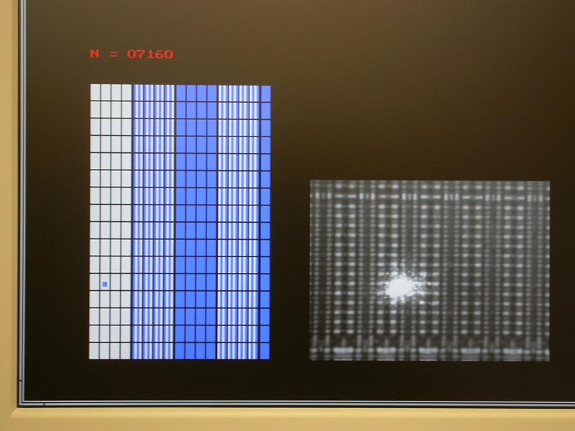
Semi-invasive attacks: fault injection
Localised heating using (continuous-wave) lasers
  test board with PIC16F628 and PC software for analysis
  permanent change of a single memory cell on a 0.9µm chip
Limited influence on modern chips (<0.5µm) – influence on adjacent cells

Slide 14
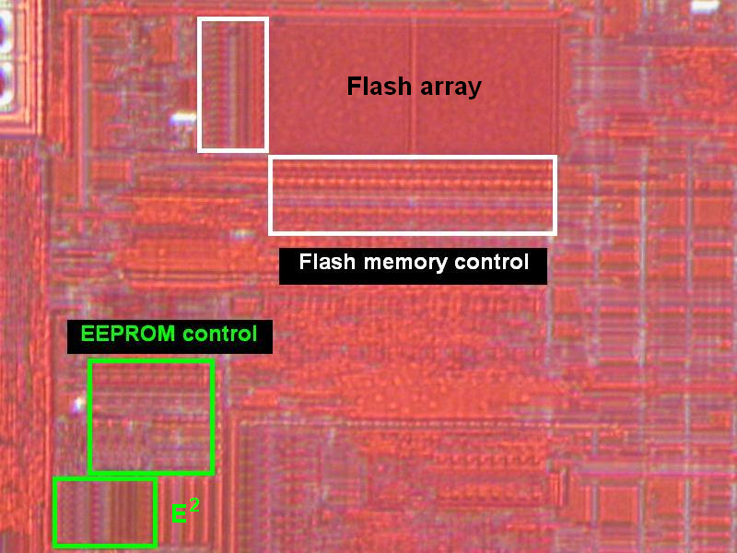
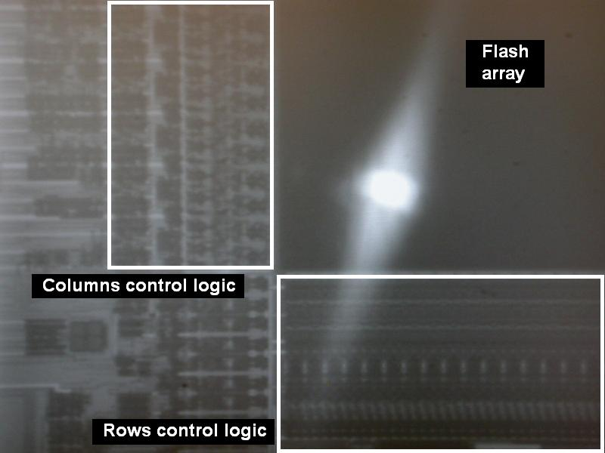
Semi-invasive attacks: fault injection
Memory masking attacks
  temporarily disable write and erase operations in embedded memory (Flash/EEPROM) and write into volatile memory (SRAM)‏
  use cw red lasers for front-side and infrared lasers for backside attacks

Slide 15
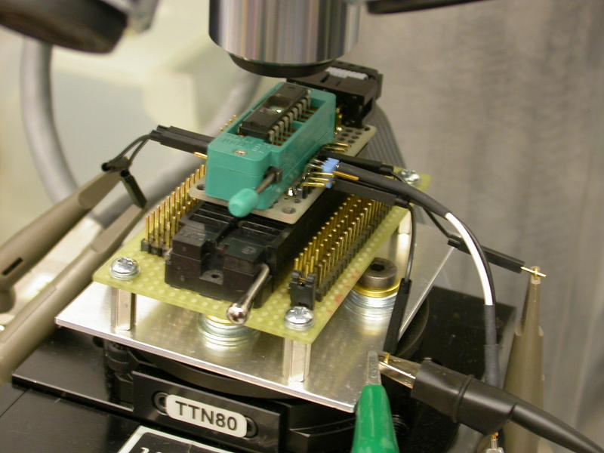
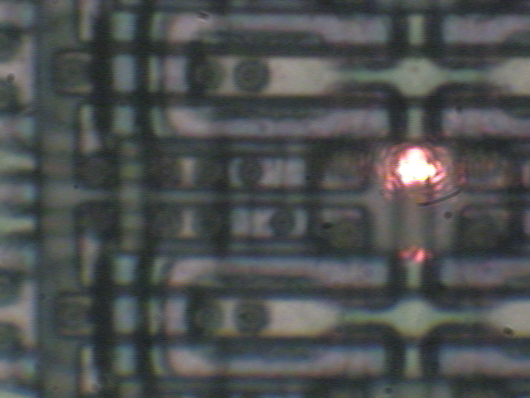
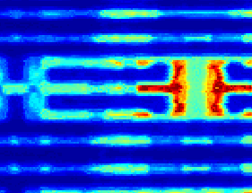
Semi-invasive attacks: side-channel
Optically enhanced position-locked power analysis
  Microchip PIC16F84 microcontroller with test program at 4 MHz
  classic power analysis setup (10 Ω resistor in GND, digital storage oscilloscope) plus laser microscope scanning setup
  test pattern
    run the code inside the microcontroller and store the power trace
    point the laser at a particular transistor and store the power trace
    compare two traces

Slide 16
Semi-invasive attacks: side-channel
Optically enhanced position-locked power analysis
  results for memory read operations: non-destructive analysis of active memory locations (‘0’ and ‘1’)‏
  results for memory write operations: non-destructive analysis of active memory locations (‘0→0’, ‘0→1’, ‘1→0’ and ‘1→1’)‏
Only backside approach for 0.35µm and smaller chips
  single-cell access is limited to 0.5µm laser spot

Slide 17
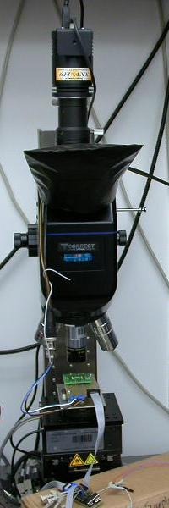
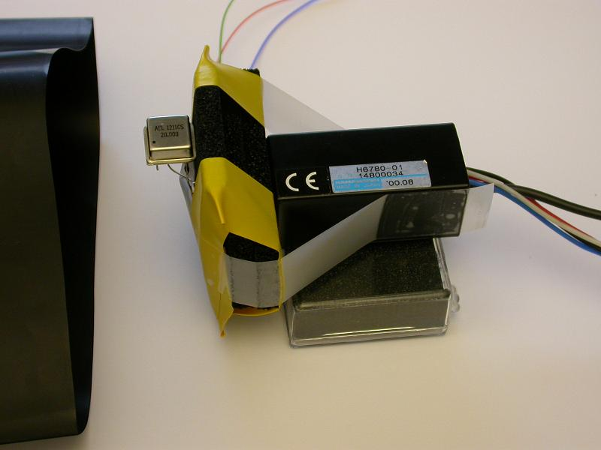
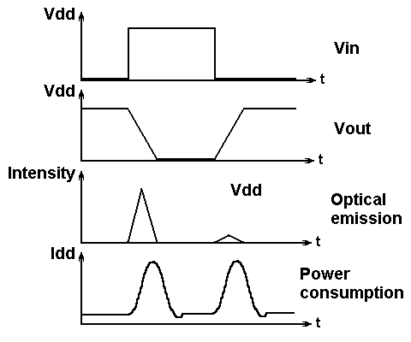
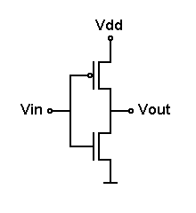
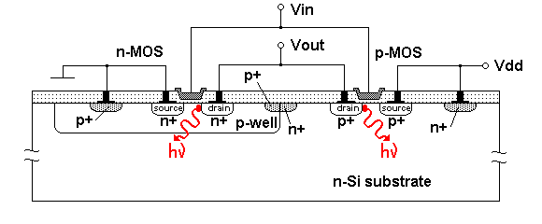
Semi-invasive attacks: side-channel
Optical emission analysis
  transistors emit photons when they switch
  10⁻² to 10⁻⁴ photons per switch with peak in NIR region (900–1200 nm)‏
  optical emission can be detected with photomultipliers and CCD cameras
  comes from area close to the drain and primarily from the NMOS transistor

Slide 18
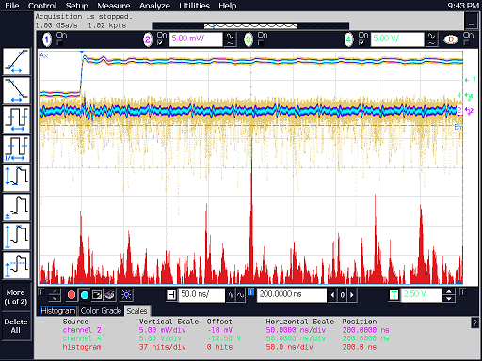
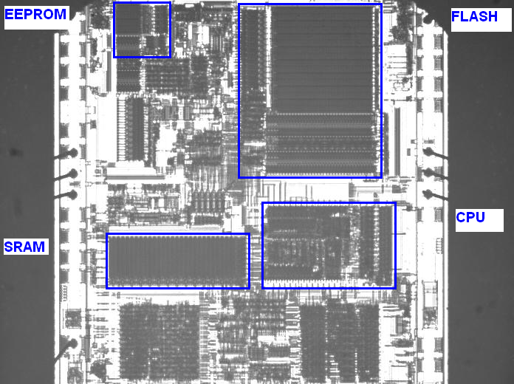
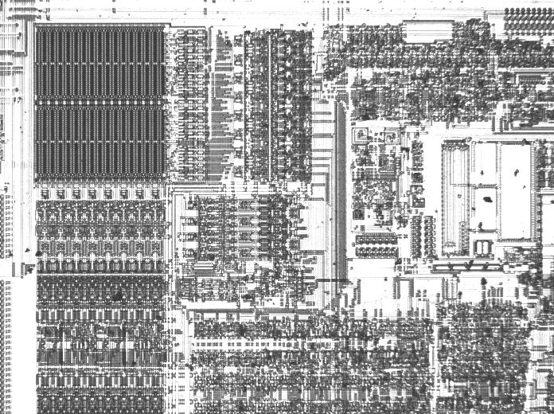
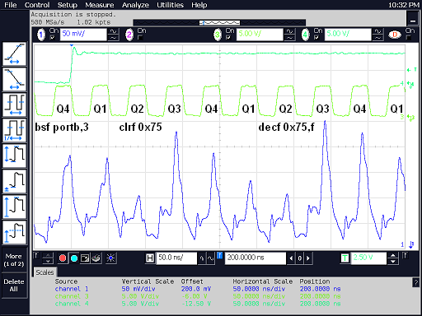
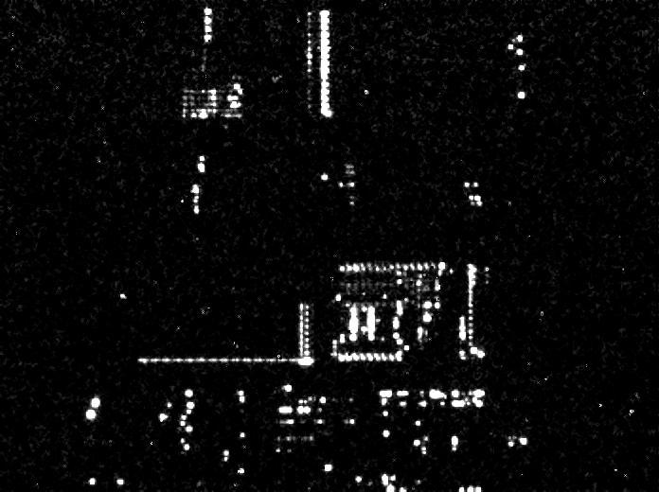
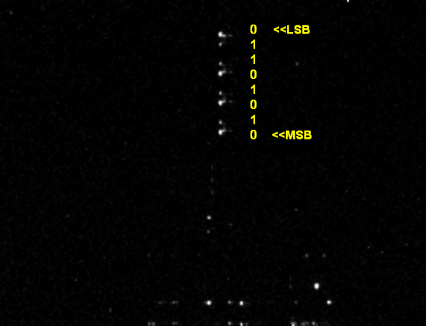
Semi-invasive attacks: side-channel
Optical emission analysis
  Microchip PIC16F628 microcontroller with test code at 20 Mhz; PMT vs SPA and CCD camera images in just 10 minutes
Only backside approach for 0.35µm and smaller chips
  successfully tested on chips down to 130nm (higher Vcc, >1 hour)‏

Slide 19
Hardware tamper protection

Slide 20
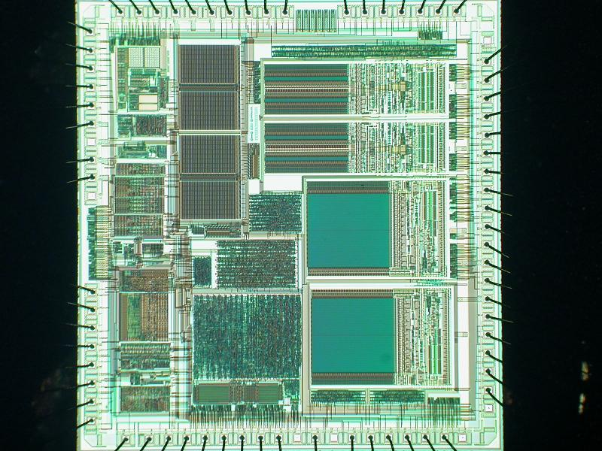
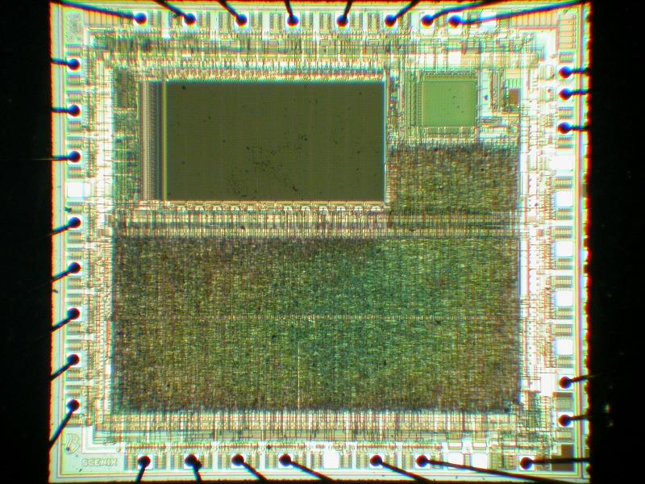
Tamper protection
Old devices
  security fuse is placed separately from the memory array (easy to locate and defeat)‏
  security fuse is embedded into the program memory (hard to locate and defeat), similar approach is used in many smartcards in the form of password protection and encryption keys
  moving away from building blocks which are easily identifiable and have easily traceable data paths
Motorola MC68HC908AZ60A microcontroller
Scenix SX28 microcontroller

Slide 21
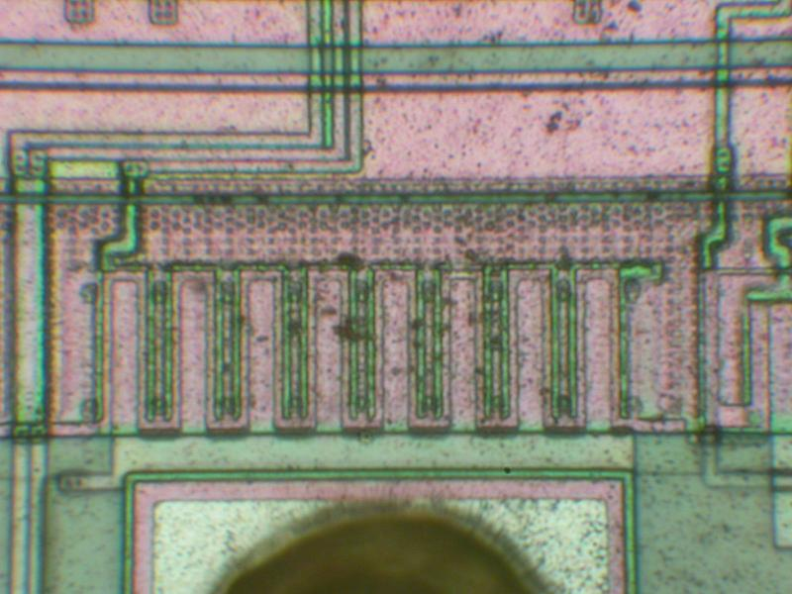
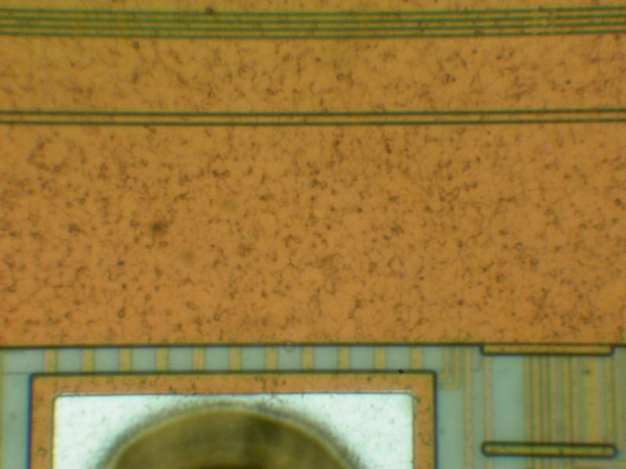
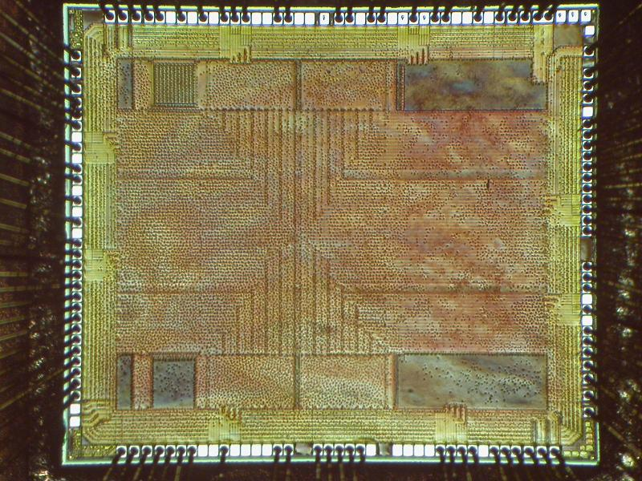
Tamper protection
Help came from chip fabrication technology
  planarisation as a part of modern chip fabrication process (0.5 μm or smaller feature size)‏
  glue logic design makes reverse engineering much harder
  multiple metal layers block any direct access
  small size of transistors makes attacks less feasible
  chips operate at higher frequency and consume less power
  smaller and BGA packages scare off many attackers
0.9µm microcontroller
0.5µm microcontroller
0.13µm FPGA

Slide 22

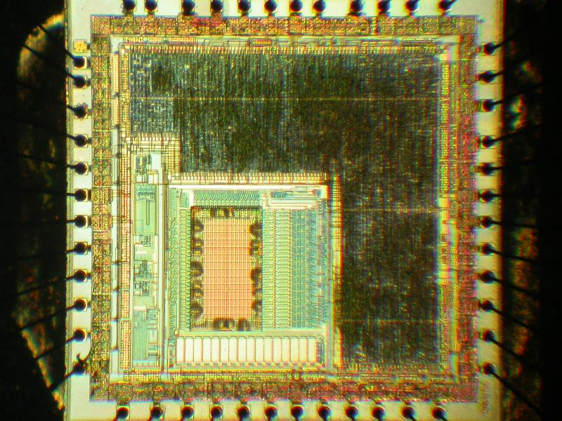
Tamper protection
Additional protections
  top metal layers with sensors
  voltage, frequency and temperature sensors
  memory access protection, crypto-coprocessors
  internal clocks, power supply pumps
  asynchronous logic design, symmetric design, dual-rail logic
  ASICs‏, secure FPGAs and custom-designed ICs
  software countermeasures
STMicroelectronics ST16 smartcard
Fujitsu secure microcontroller

Slide 23
Tamper protection: what goes wrong
Security advertising without proof
  no means of comparing security, lack of independent analysis
  no guarantee and no responsibility from chip manufacturers
  wide use of magic words: protection, encryption, authentication, unique, highly secure, strong defence, cannot be, unbreakable, impossible, uncompromising, buried under x metal layers
Constant economics pressure on cost reduction
  less investment, hence, cheaper solutions and outsourcing
  security via obscurity approach
Quicker turnaround
  less testing, hence, more bugs
What about back-doors?
  access to the on-chip data for factory testing purposes
  how reliably was this feature disabled?
  how difficult is to attack the access port?
  are there any trojans deliberately inserted by subcontractors?

Slide 24
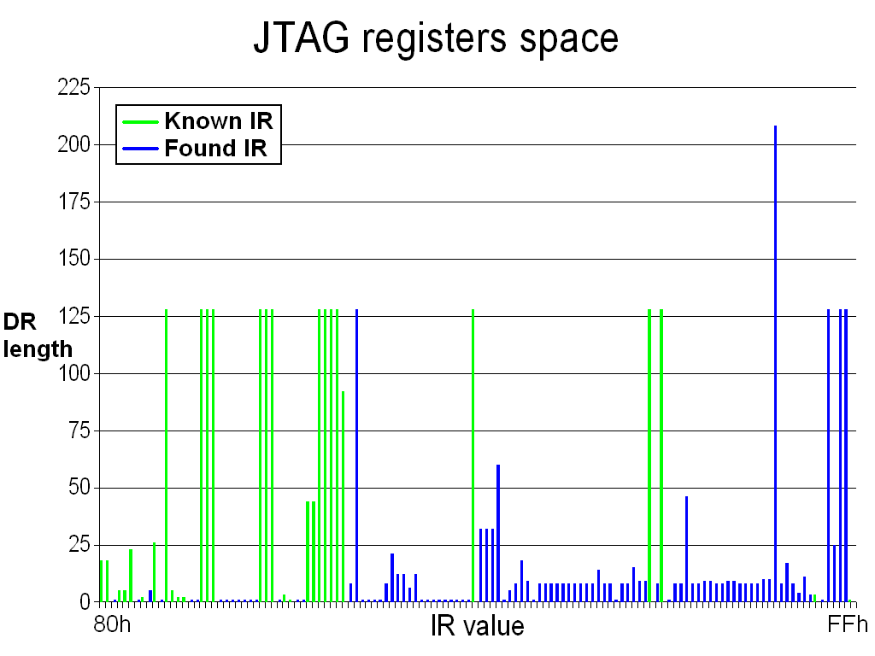
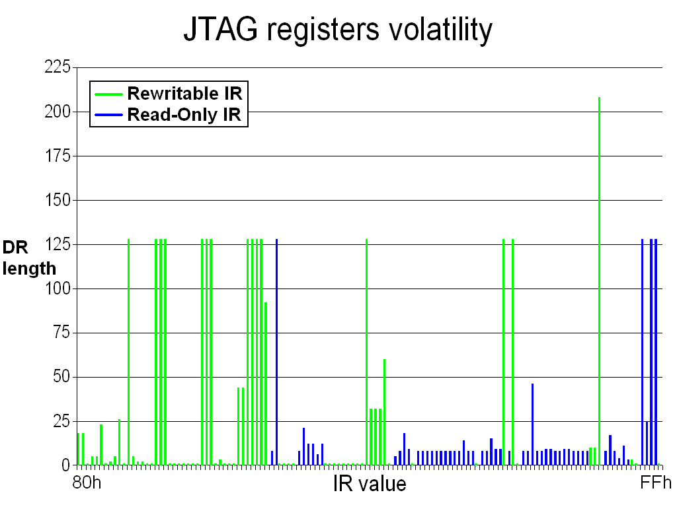
Actel/Microsemi ProASIC3 Flash FPGA
Scanning JTAG for command space
  find depth of DR registers associated with each command
  test if those DR registers can be amended
Analysing STAPL programming file from design software
  hints on unused spaces

Slide 25
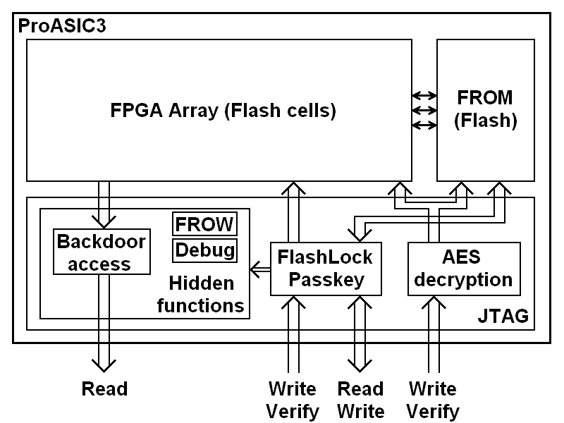
Simplified ProASIC3 security
AES encryption engine can only send data in one direction
Passkey only unlocks FROM readback
Hidden JTAG functions include different areas
  factory settings, debug features and control registers
  no references were found in their tools or documentation that readback of the design was a possibility

Slide 26
Defence technologies : how it fails
Microchip PIC microcontroller: security fuse bug
  security fuse can be reset without erasing the code/data memory
    solution: fixed in newer devices
Hitachi smartcard: information leakage on a products CD
  full datasheet on a smartcard was placed by mistake on the CD
Actel secure FPGA: programming software bug
  devices were always programmed with a 00..00 passkey
    solution: software update
Xilinx secure CPLD: programming software bug
  security fuse incorrectly programmed resulting in no protection
    solution: software update
Dallas SHA-1 secure memory: factory initialisation bug
  some security features were not activated resulting in no protection
    solution: recall of the batch
Other possible ways of security failures
  insiders, datasheets of similar products, development tools, patents
    solution: test real devices and control the output

Slide 27
Conclusions
There is no such a thing as absolute protection
  given enough time and resources any protection can be broken
Technical progress helps a lot, but has certain limits
  do not overestimate capabilities of the silicon circuits
  do not underestimate capabilities of the attackers
Defence should be adequate to anticipated attacks
  security hardware engineers must be familiar with attack technologies to develop adequate protection
  choosing the correct protection saves money in development and manufacturing
Attack technologies are constantly improving, so should the defence technologies
Many vulnerabilities were found in various secure chips and more are to be found posing more challenges to hardware security engineers

Slide 28
References
Slides
  http://www.cl.cam.ac.uk/~sps32/PartII_040213.pdf
Literature:
  Ross Anderson’s book “Security Engineering”
  “Physical Attacks and Tamper Resistance” in Introduction to Hardware Security and Trust, Eds: Mohammad Tehranipoor and Cliff Wang, Springer, September 2011
  http://www.cl.cam.ac.uk/techreports/UCAM-CL-TR-630.pdf
  http://www.cl.cam.ac.uk/~sps32/#Publications
  http://www.cl.cam.ac.uk/~sps32/sec_news.html

Slide 29
Leakage and Tamper Resilience
(1/2)

Slide 30










Circuit transformers
s_{i}
$$X_{i}$$
$$Y_{i}$$
$$X_{i}$$
$$Y_{i}$$
$$C$$
$$C′$$
Any boolean circuit
Transformed circuit
Circuit transformation

Slide 31



Circuit transformers
$$si$$
$$X_{i}$$
$$Y_{i}$$
$$X_{i}$$
$$Y_{i}$$
$$C$$
$$C′$$
Transformer $T=(T_{C},T_{s})$
$C\underset{→}{T_{C}}C′$, $s_{0}\underset{→}{T_{s}}s_{0}^{′}$
$T$ may be randomized
$C′$ may be randomized or (better yet) deterministic
Functionally equivalent in input-output behavior:
$C\left[S_{0}\right]≈C^{′}[s_{0}^{′}]$
(There is a security parameter everywhere; we keep it implicit.)

Slide 32



Security [Ishai Sahai Wagner ’03]
$$s_{i}$$
$$s_{i}^{′}$$
$$X_{i}$$
$$Y_{i}$$
$$X_{i}$$
$$Y_{i}$$
$$C$$
$$C′$$
black
box
Adversary chooses a leakage/tampering function, from a given set of admissible leakage/tampering functions, to be applied to the wires.
admissible leakage/
tampering
indistinguishable
simulator
adversary

Slide 33



Security definition
CIRCUIT
CIRCUIT
C’
C
INPUT
OUTPUT
INPUT
OUTPUT
T
s₀
s₀’
MEMORY
MEMORY
Transformer $T$ protects privacy (of the initial state)
against a given class of admissible leakage/tampering:
∀circuit C
∃efficient Sim
∀admissible Adv
∀initial state s₀ :
Sim^{Adv,C[s0]} ≈ output of Adv attacking C’[s₀’]
(Even in case of tampering, only privacy is required)

Slide 34


Protecting against sum-of-wires leakage
  $T_{s}$ implements circuit using Dual-Rail Logic: $0↦\left(0,1\right), 1↦(1,0)$
figure from [Waddle the Wagner 2005 – Fault Attacks on Dual-Rail Encoded Systems]
  Also: NOT, INPUT, OUTPUT.
  $T_{s}$ represents $s_{0}$ using dual-rail logic.

Slide 35
Protecting against sum-of-wires leakage
(cont.)
  Security proof sketch: simulator runs adversary and, when asked for leakage value, answers with the constant (thus known) Hamming weight.
  Also handles weighted sum
  (e.g., different capacitance for long vs. short wires), as long as pairs are balanced.
Practical complications:
  Capacitance imbalance
  Timing imbalance
  Glitches
  Cell internals

