Slide 1

Information Security – Theory vs. Reality
0368-4474, Winter 2015-2016
Lecture 9:
Leakage resilience (continued)
Lecturer:
Eran Tromer

Slide 2
Leakage resilience
(continued)

Slide 3
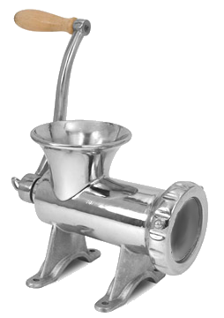
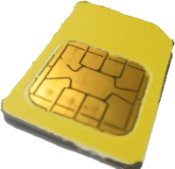









Security [Ishai Sahai Wagner ’03]
$$s_{i}$$
$$s_{i}^{′}$$
$$X_{i}$$
$$Y_{i}$$
$$X_{i}$$
$$Y_{i}$$
$$C$$
$$C′$$
black
box
Adversary chooses a leakage/tampering function, from a given set of admissible leakage/tampering functions, to be applied to the wires.
admissible leakage/
tampering
indistinguishable
simulator
adversary

Slide 4
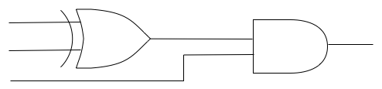

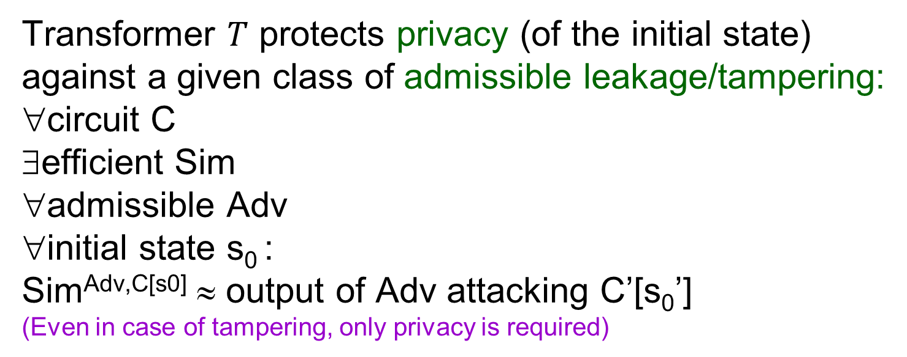
Security definition
CIRCUIT
CIRCUIT
C’
C
INPUT
OUTPUT
INPUT
OUTPUT
T
s₀
s₀’
MEMORY
MEMORY
Transformer $T$ protects privacy (of the initial state)
against a given class of admissible leakage/tampering:
∀circuit C
∃efficient Sim
∀admissible Adv
∀initial state s₀ :
Sim^{Adv,C[s0]} ≈ output of Adv attacking C’[s₀’]
(Even in case of tampering, only privacy is required)

Slide 5
Resilient-schemes 1/3
(whiteboard discussion)
Sum-of-wires leakage
  Dual-Rail Logic
Sum-of-wire-transitions leakage
  Dual-Rail Precharge Logic

Slide 6
Resilient-schemes 2/3
(whiteboard discussion)
Single-wire leakage
  Bit masking or secret sharing
Multiple-wire leakage
  Secret sharing
Leakage of “data-dependent” values from “bulk” computation
  RSA blinding

Slide 7
t-wire leakage [ISW03]
Secrets additively secret-shared into m=2t+1 shares
Given shares of
a=a₁⊕ … ⊕a_{m} and
b=b₁⊕… ⊕b_{m} :
  Compute shares of NOT(a) : apply NOT to a₁
  Compute shares c_{i} of a AND b :
    Let z_{i,j} , i<j, be random independent bits
    Let z_{j,i}=(z_{i,j}⊕a_{i}b_{j}) ⊕ a_{j}b_{i} (i<j)
    Let c_{i}=a_{i}b_{i} ⊕ ⊕_{j≠i} z_{i,j}
Re-randomize s’ at every iteration (hence m=2t+1).
Security proof sketch: simulator runs adversary and, when asked for leakage value: if answer implied by inputs / inputs / previous answer, answers thus. Otherwise answers randomly. This has the correct distribution.
s₀’
Notes:
Randomness gates can be eliminated by a random-number generator

Slide 8
Other leakage?
s_{i}
x
Y
X
Y
C
C’
black-box
admissible leakage
indistinguishable

Slide 9
Our goal
Allow stronger leakage.

Slide 10

Leakage classes
Locality assumptions
  Single wire, t wires
  Separate sub-circuits
  Leak-free processor:
  Oblivious RAM [Goldreich Ostrovsky 95]
  Leak-free memory (“only computation leaks information” [Micali Reyzin 04]: leakage is only from CPU state and memory accessed at that program step)
Quantitatively bounded
  Total #bits leaked
  Total #bits leaked per “computational step”
  Noisy leakage from every wire
“Simple leakage”
  Sums and Hamming weights
  Low-complexity global functions
“Too-complicated leakage” (hard to invert)
Some of these are for specific functionality (mainly crypto)
Open problem: realistic models allowing secure and efficient constructions.

Slide 11
Trusted Computing Architecture
(warmup discussion, see next week’s slides)

